Slide 1
My First FPGA for Altera DE2-115 Board
Digital Circuit Lab
TA: Po-Chen Wu

Slide 2
Outline
Complete Your Verilog Design
Assign The Device
Add a PLL Megafunction
Assign the Pins
Create a Default TimeQuest SDC File
Compile and Verify Your Design
Configuring the Cyclone IV E FPGA

Slide 3
Complete Your Verilog Design

Slide 4
exp1_traffic.v (1/5)
It is a 10 seconds
countdown system.
module name = file name
module exp1_traffic (
clk,
rst_n,
pause,
HEX0
);
//==== parameter definition ===============================
// for finite state machine
parameter S_NORMAL = 1'd0;
parameter S_PAUSE = 1'd1;
// for countdown
parameter C_PERIOD = 4'd9;
//==== in/out declaration ==================================
//-------- input ---------------------------
input clk;
input rst_n; // reset signal (button)
input pause; // pause signal (switch)
//-------- output --------------------------------------
output [6:0] HEX0;
The countdown system can be paused by turning on the switch.

Slide 5
exp1_traffic.v (2/5)
//==== reg/wire declaration ================================
//-------- output --------------------------------------
reg [6:0] HEX0;
//-------- wires ---------------------------------------
wire clk_16; // 16MHz clock signal
wire [23:0] next_clks;
reg next_state;
reg [3:0] next_countdown;
reg [6:0] next_HEX0;
//-------- flip-flops ----------------------------------
reg [23:0] clks;
reg state;
reg [3:0] countdown;
//==== combinational part ==================================
// clock signal
clksrc clksrc1 (clk, clk_16);
assign next_clks = (state==S_PAUSE)? clks: clks+24'd1;
Output should be register.
(Critical path issue)
PLL
(input: clk, 50MHz)
(output: clk_16, 16MHz)

Slide 6
exp1_traffic.v (3/5)
// finite state machine (state)
always@(*) begin
case(state)
S_NORMAL: begin
if(pause==1) next_state = S_PAUSE;
else next_state = S_NORMAL;
end
S_PAUSE: begin
if(pause==1) next_state = S_PAUSE;
else next_state = S_NORMAL;
end
endcase
end
// countdown
always@(*) begin
if(clks[23]==1'b1 && next_clks[23]==1'b0)
next_countdown = (countdown==0)? C_PERIOD: countdown-4'd1;
else
next_countdown = countdown;
end
Cover every possible branch of every if or case to avoid latches.
Be careful!!
1Hz
Cover every possible branch.
Notes:
有時候switch直接當作判斷condition的input時(ex: if(pause==1) … )會有問題
(它的值不一定是real 1 or 0而是Z or 0的感覺)
最保險的方法是用一個register擋住switch input，而在判斷式內就用register比較

Slide 7
exp1_traffic.v (4/5)
// 7-segment Displays
always@(*) begin
case(countdown)
7'd0: next_HEX0 = 7'b1000000;
7'd1: next_HEX0 = 7'b1111001;
7'd2: next_HEX0 = 7'b0100100;
7'd3: next_HEX0 = 7'b0110000;
7'd4: next_HEX0 = 7'b0011001;
7'd5: next_HEX0 = 7'b0010010;
7'd6: next_HEX0 = 7'b0000010;
7'd7: next_HEX0 = 7'b1111000;
7'd8: next_HEX0 = 7'b0000000;
7'd9: next_HEX0 = 7'b0010000;
default: next_HEX0 = 7'b1111111;
endcase
end
Cover every possible branch.

Slide 8
exp1_traffic.v (5/5)
//==== sequential part =====================================
always@( posedge clk_16 or negedge rst_n ) begin
if( rst_n==0 ) begin
clks <= 24'd0;
state <= S_NORMAL;
countdown <= C_PERIOD;
HEX0 <= 7'h7f;
end
else begin
clks <= next_clks;
state <= next_state;
countdown <= next_countdown;
HEX0 <= next_HEX0;
end
end
endmodule

Slide 9
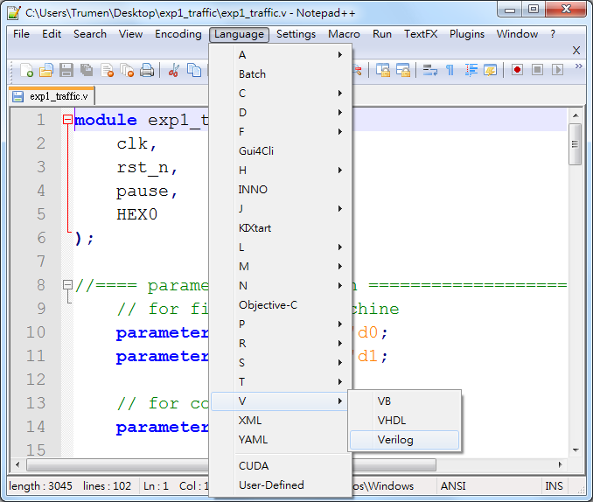
Notepad++ (1/5)
1
2
3
Highlight

Slide 10
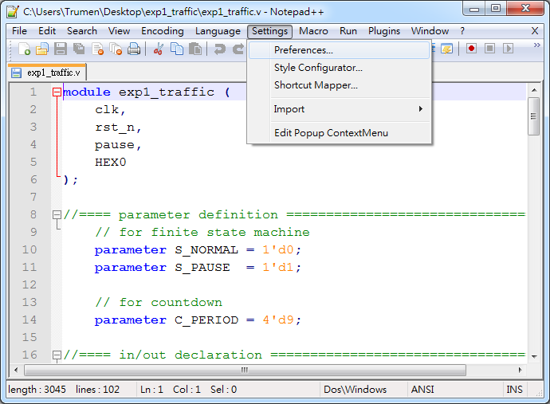
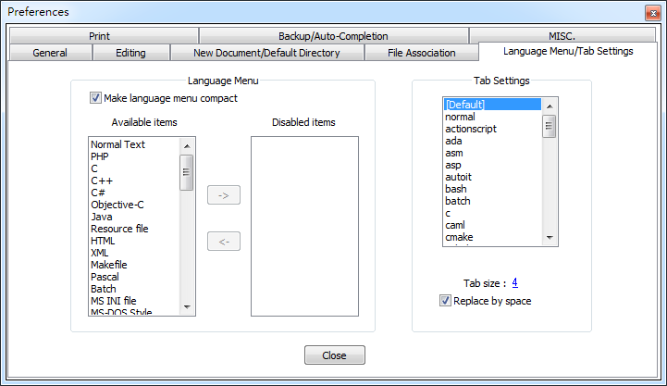
Notepad++ (2/5)
1
2
3
4
5

Slide 11
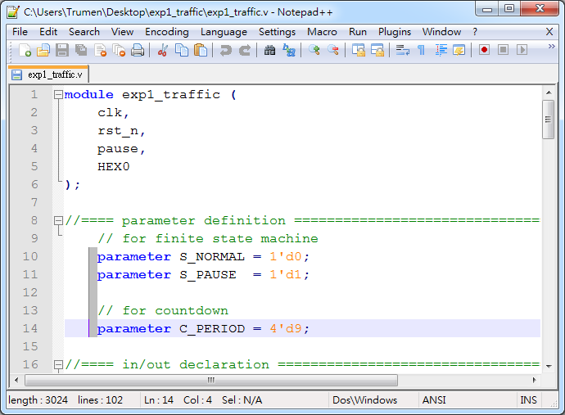
Notepad++ (3/5)
Column Mode Editing
1. Alt + Mouse dragging
2. Alt + Shift + Arrow keys

Slide 12
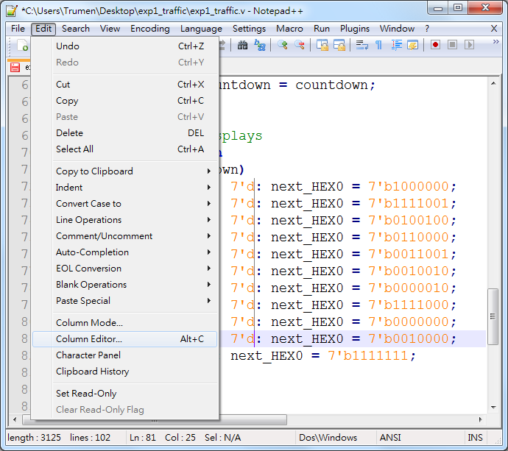
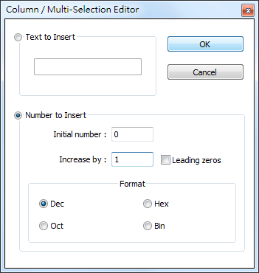
Notepad++ (4/5)
1
4
3
2

Slide 13
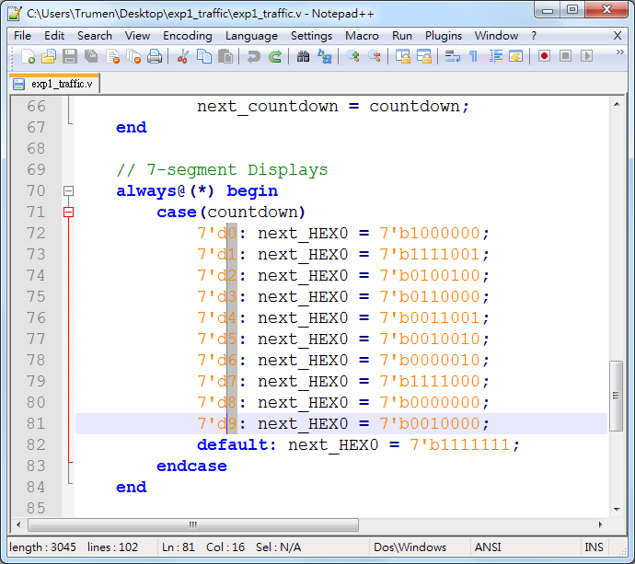
Notepad++ (5/5)

Slide 14
Assign The Device

Slide 15
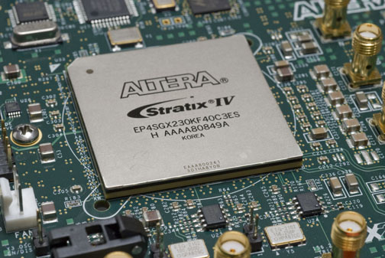
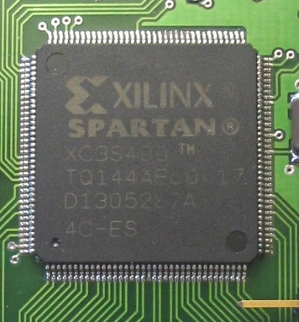
Introduction to FPGA (1/3)
A field-programmable gate array (FPGA) is an integrated circuit designed to be configured by a designer after manufacturing.
  An electronic device is said to be field-programmable if it can be modified "in the field".

Slide 16
Introduction to FPGA (2/3)
FPGAs contain programmable logic components called "logic blocks", and a hierarchy of reconfigurable interconnects that allow the blocks to be "wired together".
FPGAs can be used to implement any logical function that an ASIC could perform.

Slide 17


Introduction to FPGA (3/3)
Xilinx and Altera are the current FPGA market leaders and long-time industry rivals.
  Both Xilinx and Altera provide free Windows and Linux design software (ISE and Quartus)

Slide 18
Altera's Main FPGA Products
Stratix series FPGAs are the largest, highest bandwidth devices, with up to 1.1 million logic elements.
Cyclone series FPGAs and are the company's lowest cost, lowest power FPGAs.
Arria series FPGAs are between the two device families above.

Slide 19

Altera® Development Kits
http://www.altera.com/products/devkits/kit-dev_platforms.jsp
Development kits include software, reference designs, cables, and programming hardware (development board).

Slide 20
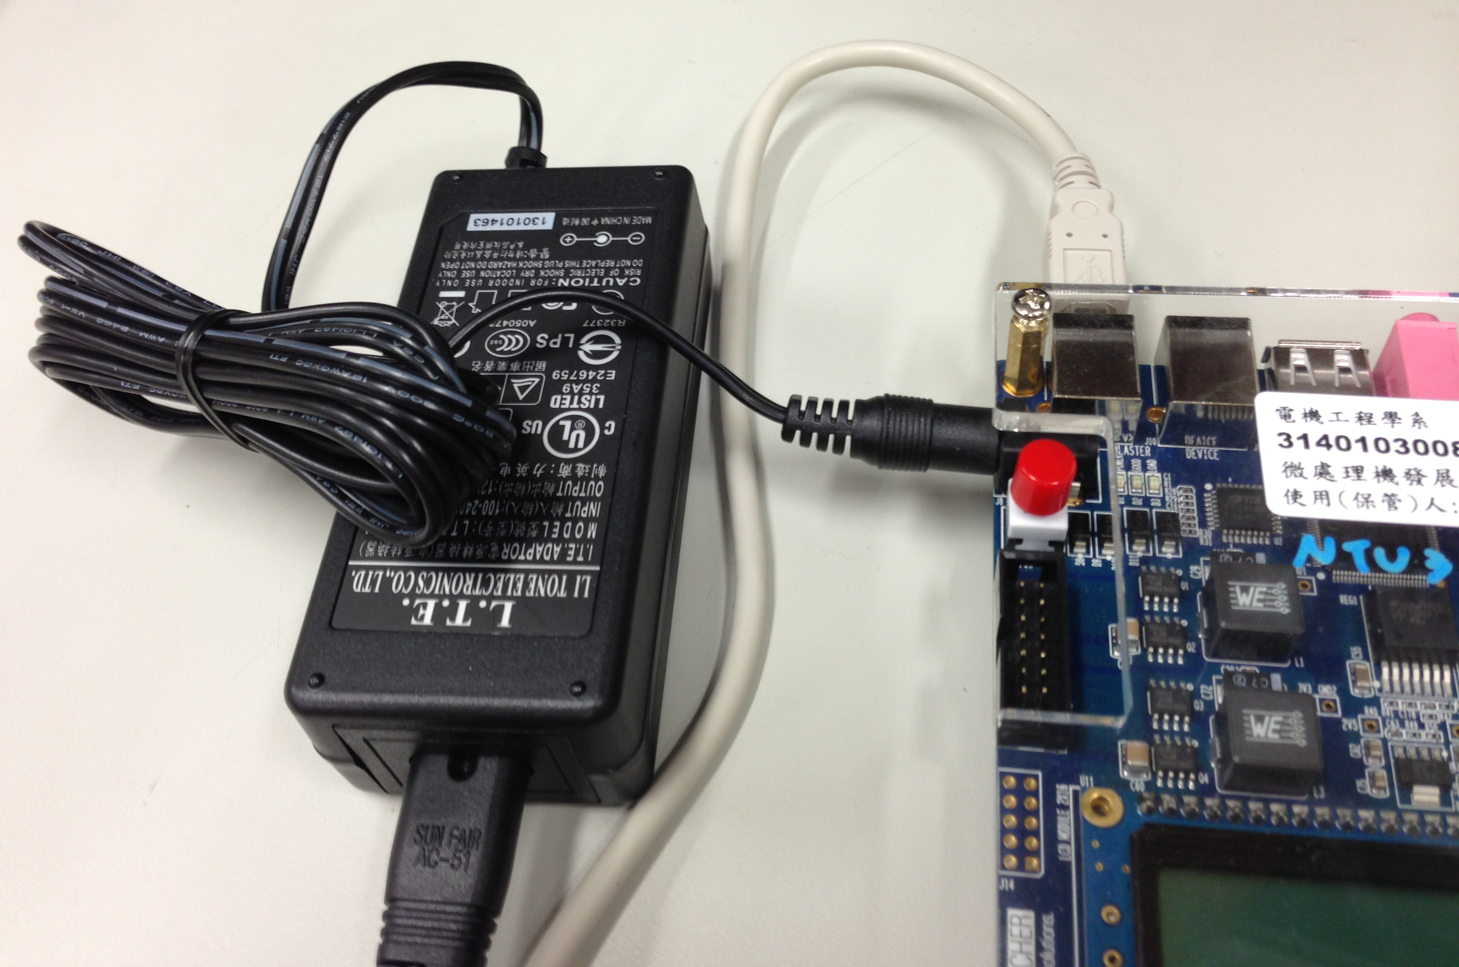
Installed The USB-Blaster driver (1/2)
Plug in the 12-volt adapter to provide power to the board.
Use the USB cable to connect the leftmost USB connector (the one closest to the power switch) on the DE2-115 board to a USB port on a computer that runs the Quartus II software.
Turn on the power switch on the DE2-115 board.
USB cable
12-volt adapter
power

Slide 21
Installed The USB-Blaster driver (2/2)
The computer will recognize the new hardware connected to its USB port.
  But it will be unable to proceed if it does not have the required driver already installed.
  The DE2-115 board is programmed by using Altera USB-Blaster mechanism. If the USB-Blaster driver is not already installed, the New Hardware Wizard will appear.
    Next →Next →… →OK!
Notes:
http://www.altera.com/download/drivers/usb-blaster/dri-usb-blaster-vista.html

Slide 22
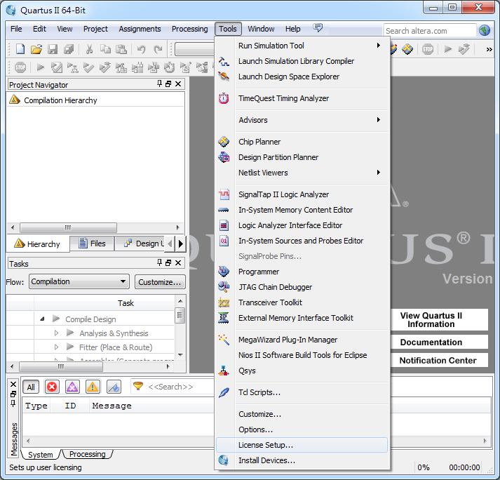
Setup Licensing (1/2)
1
2

Slide 23
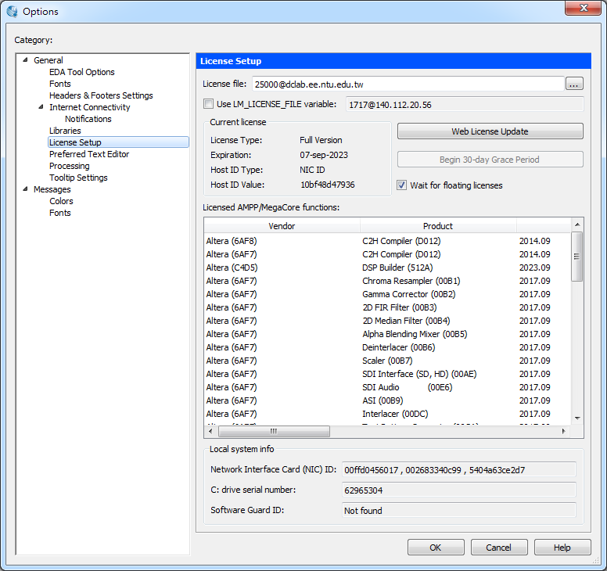
Setup Licensing (2/2)
Only for IP 140.112.*.*
1
Make sure these items appear, and now you can compile your design.
2
Notes:
若有兩個以上的license，則用分號’;’隔開
例如: 25000@dclab.ee.ntu.edu.tw;D:/test.dat

Slide 24
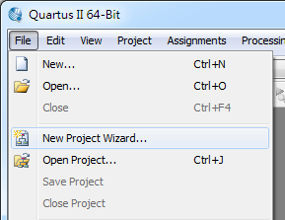
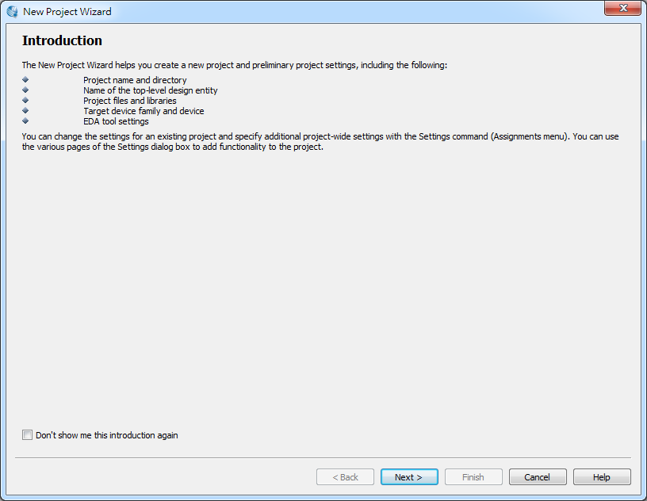
Create a New Project
1
2
3

Slide 25
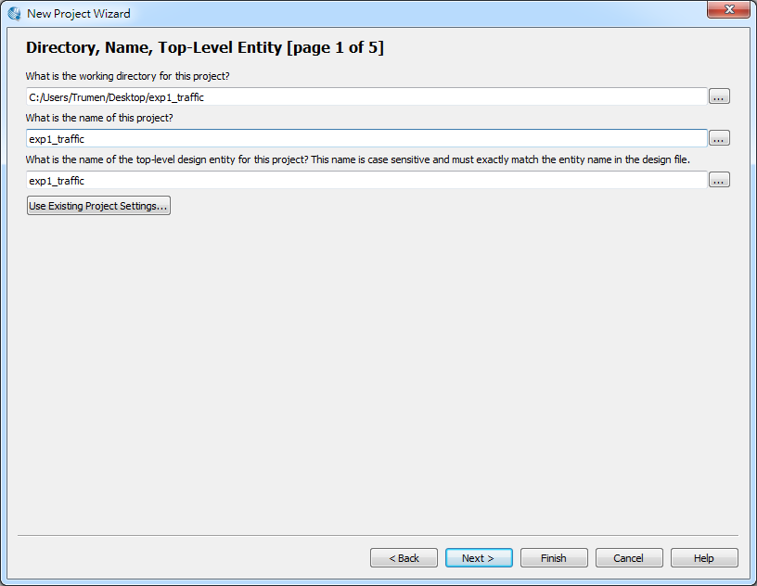
1
2
same as (top-level) file name
3

Slide 26
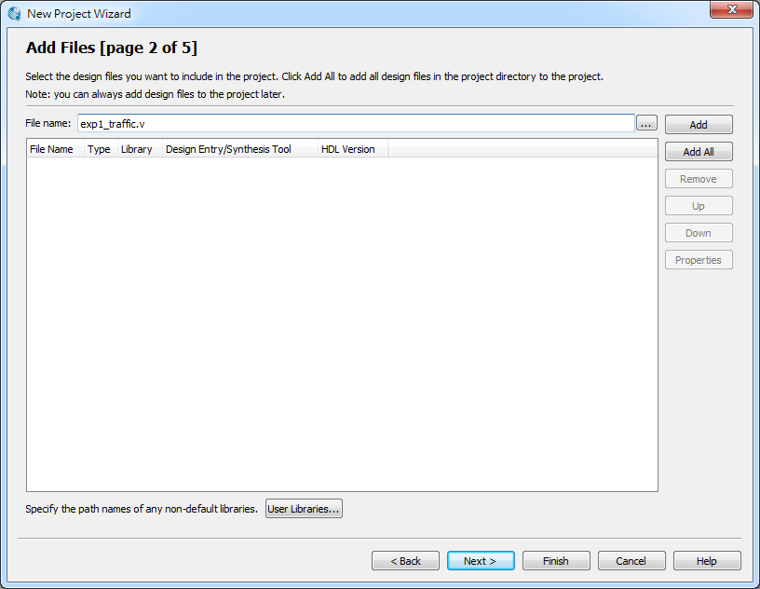
1
2
3

Slide 27
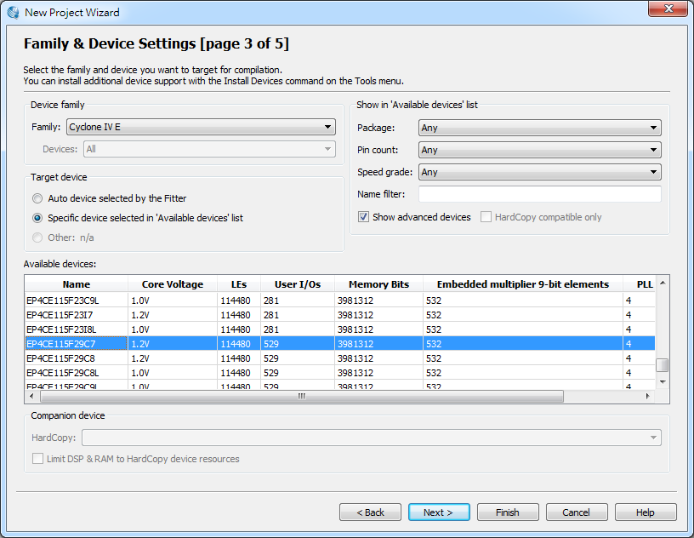
1
for DE2-115
2
3

Slide 28
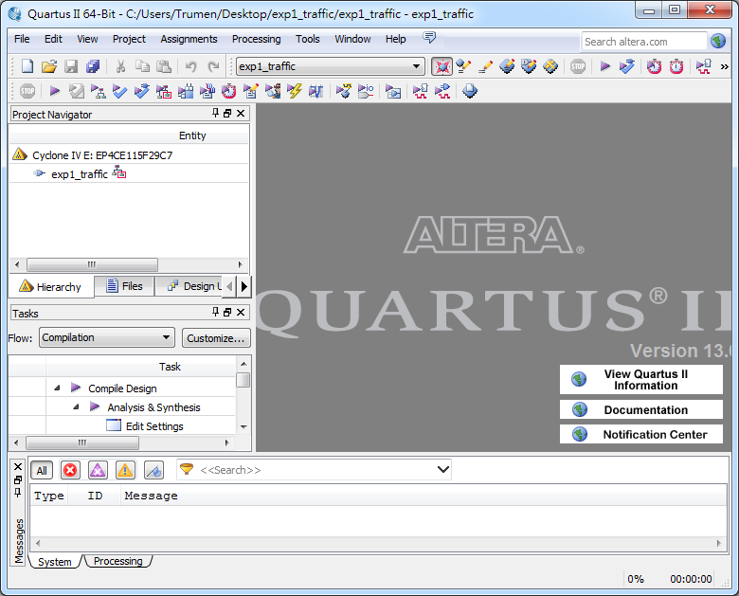

Slide 29
Add a PLL Megafunction

Slide 30
Using Quartus Add a PLL Megafunction
A PLL uses the on-board oscillator (50 MHz for DE2-115 Board) to create a constant clock frequency as the input to the counter.
To create the clock source, you will add a pre-built library of parameterized modules (LPM) megafunction named ALTPLL.

Slide 31
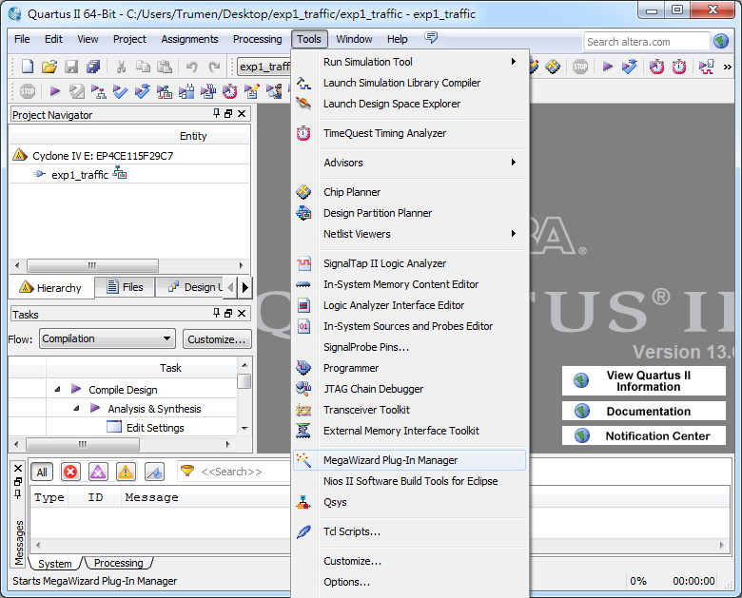
1
2

Slide 32
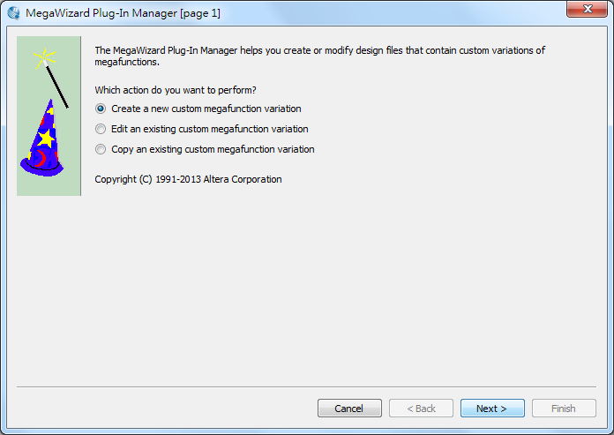
1

Slide 33
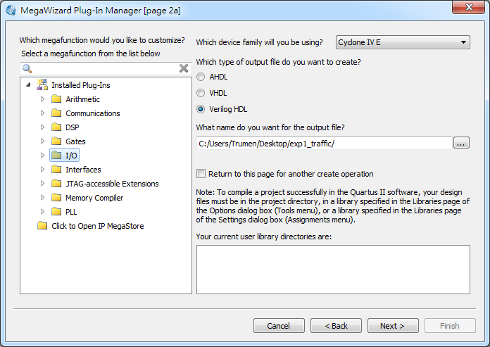
1

Slide 34
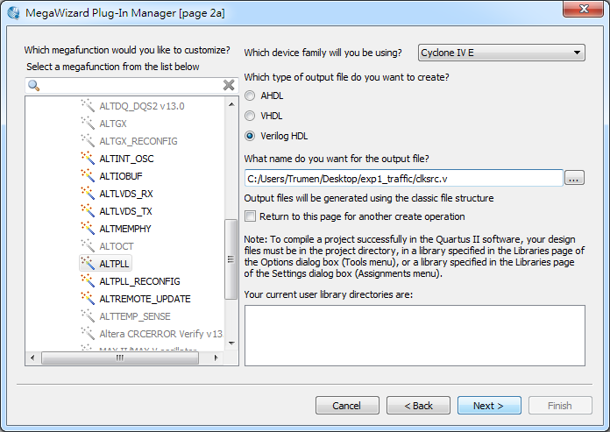
2
1
3

Slide 35
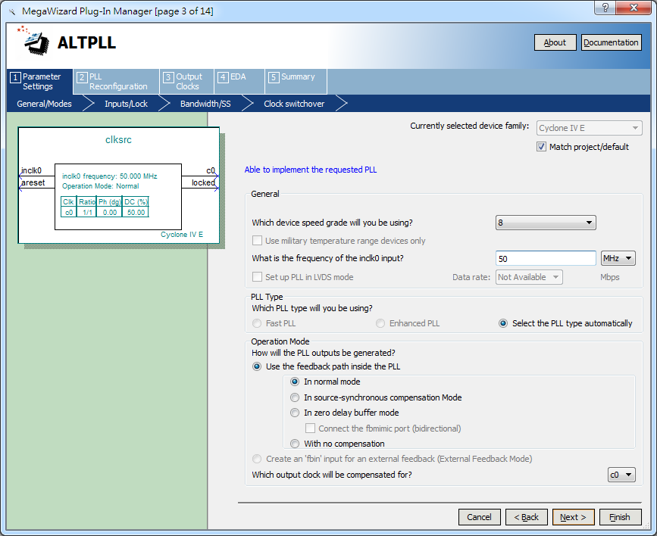
for DE2-115
1
2
3

Slide 36
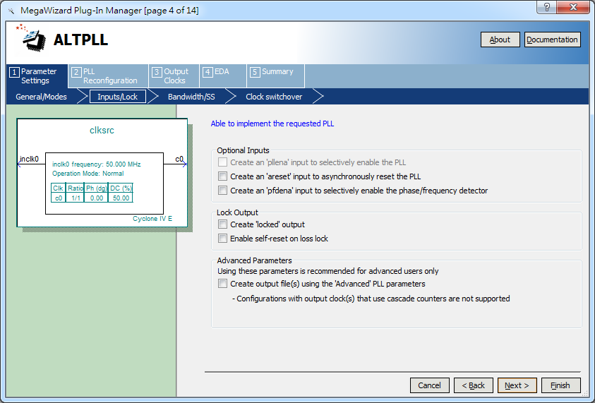
Uncheck all the options
1

Slide 37
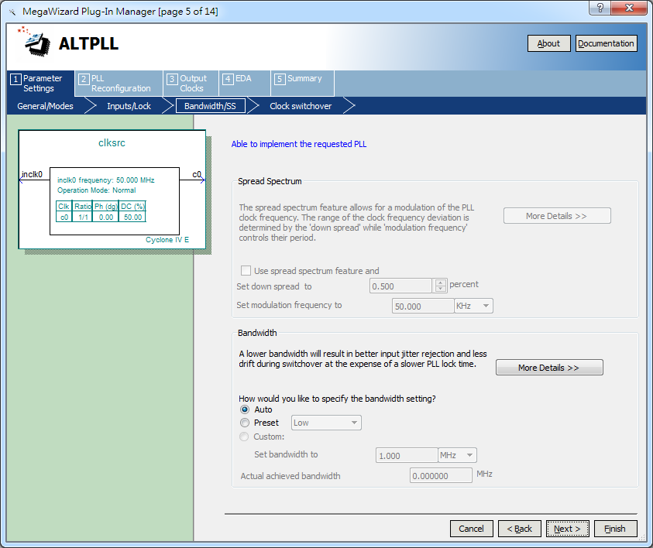
1

Slide 38
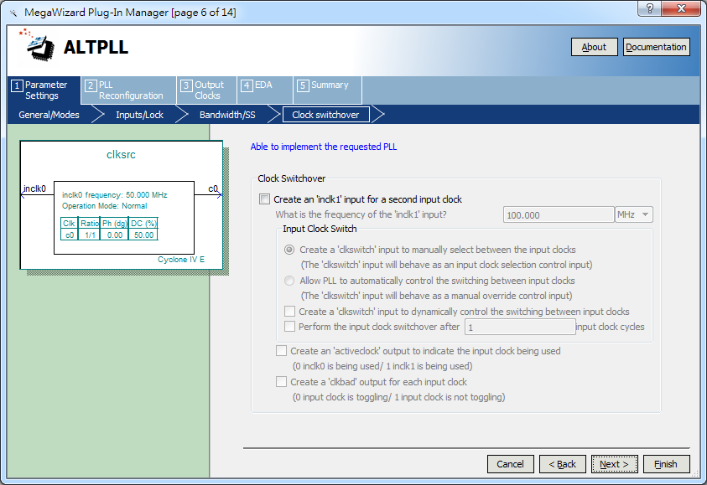
1

Slide 39
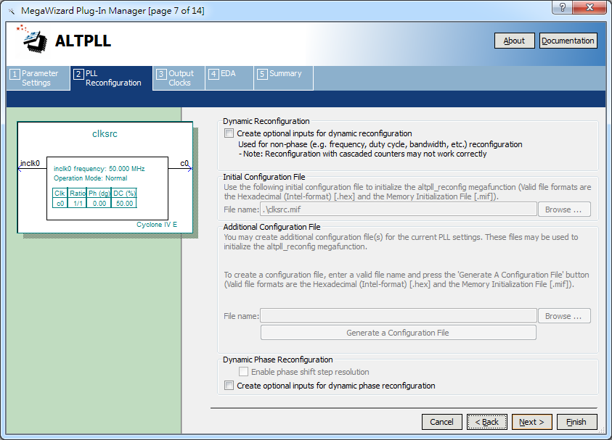
1

Slide 40
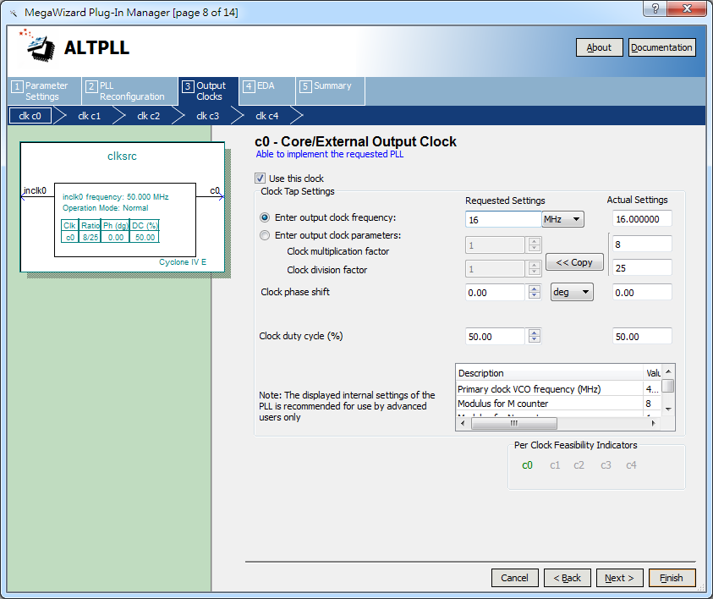
1
2

Slide 41
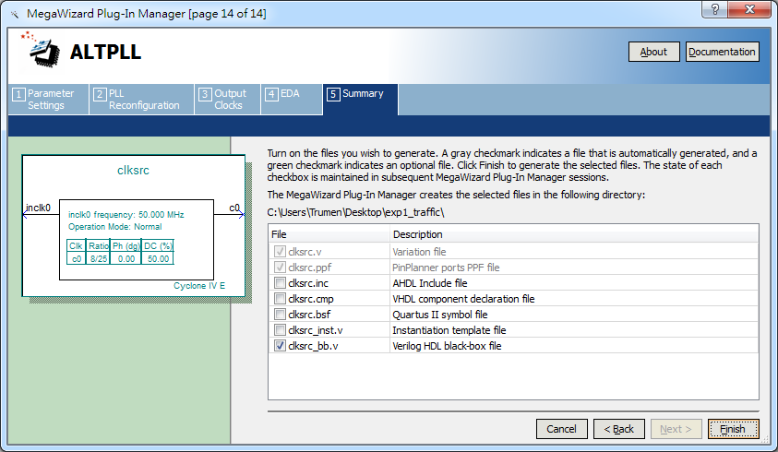
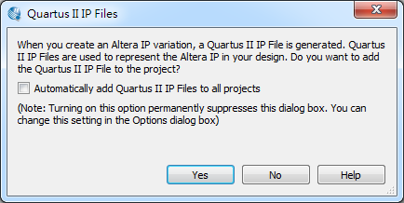
1
2

Slide 42
Assign the Pins

Slide 43
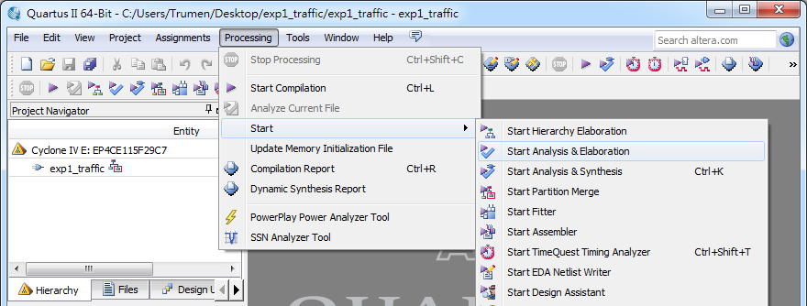
Assign the Pins
Before making pin assignments…
1
2
3

Slide 44
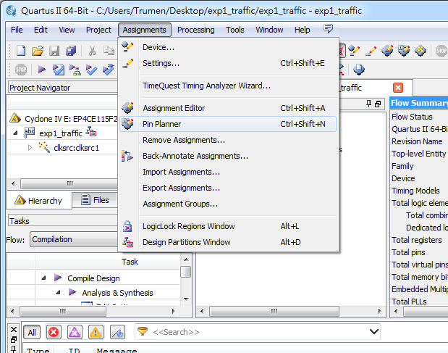
1
2

Slide 45
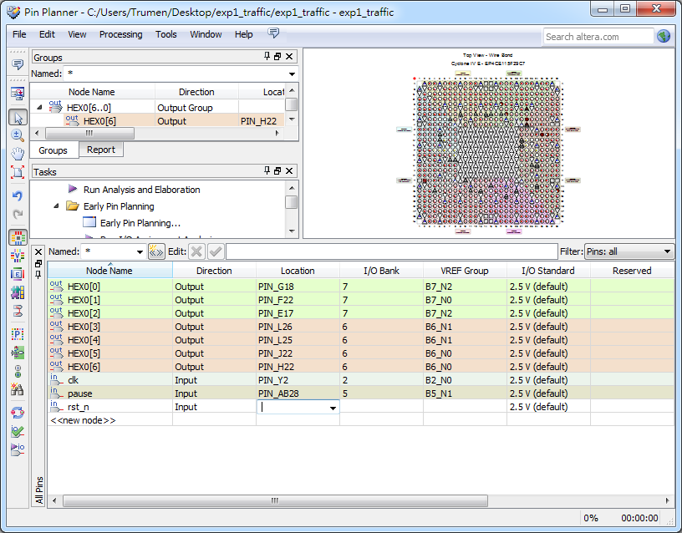
2
1
for DE2-115
Type “M23”, then push Enter
Now, you are finished creating your Quartus II design!

Slide 46
Create a Default TimeQuest SDC File

Slide 47
Create a Default TimeQuest SDC File
Timing settings are critically important for a successful design.
For this tutorial you will create a basic Synopsys Design Constraints File (.sdc) that the Quartus II TimeQuest Timing Analyzer uses during design compilation.
For more complex designs, you will need to consider the timing requirements more carefully.

Slide 48
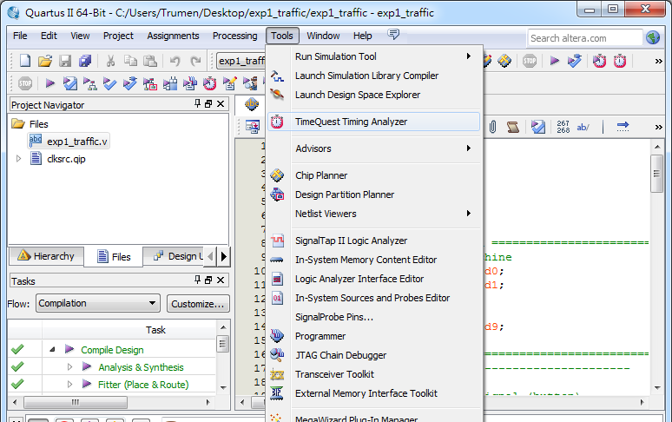
1
2

Slide 49
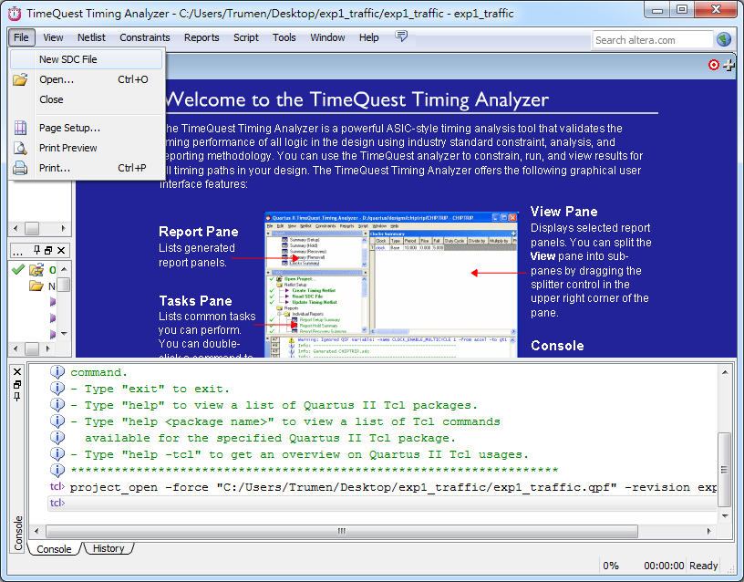
1
2

Slide 50
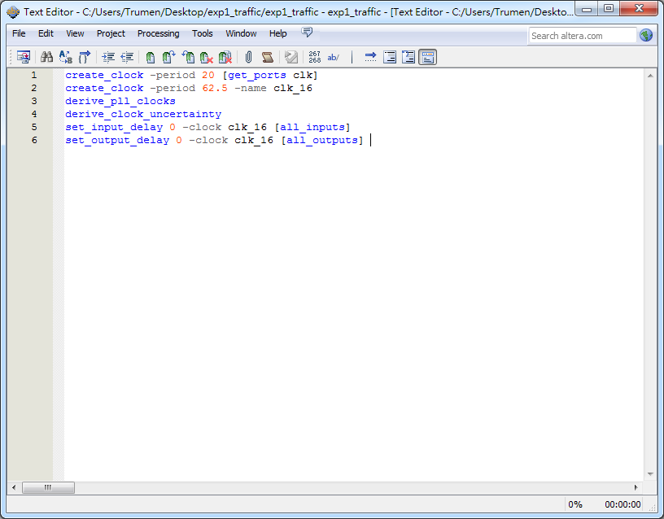
create_clock -period 20 [get_ports clk]
create_clock -period 62.5 -name clk_16
derive_pll_clocks
derive_clock_uncertainty
set_input_delay 0 -clock clk_16 [all_inputs]
set_output_delay 0 -clock clk_16 [all_outputs]
If we do not use pll:
create_clock -period 20 [get_ports clk]
derive_clock_uncertainty
set_input_delay 0 -clock clk [all_inputs]
set_output_delay 0 -clock clk [all_outputs]

Slide 51
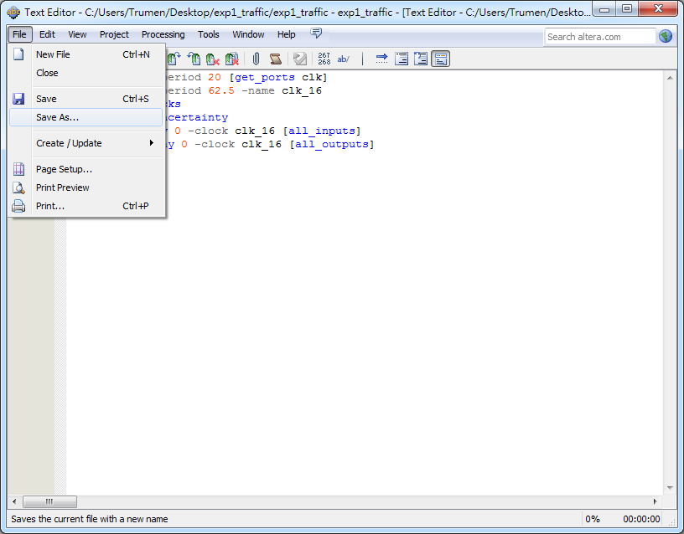
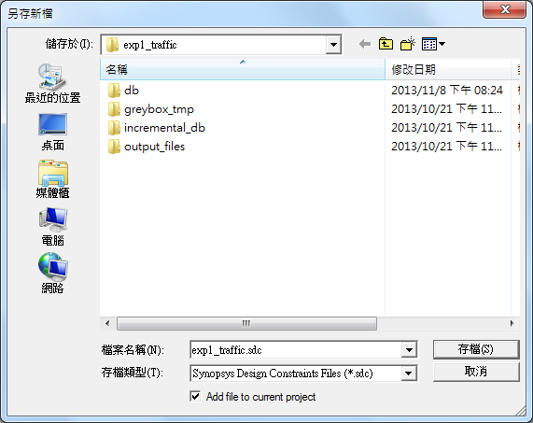
1
2
4
3

Slide 52
Compile and Verify Your Design

Slide 53
Compile Your Design
After creating your design you must compile it.
Compilation converts the design into a bitstream that can be downloaded into the FPGA.
The most important output of compilation is an SRAM Object File (.sof), which you use to program the device.

Slide 54
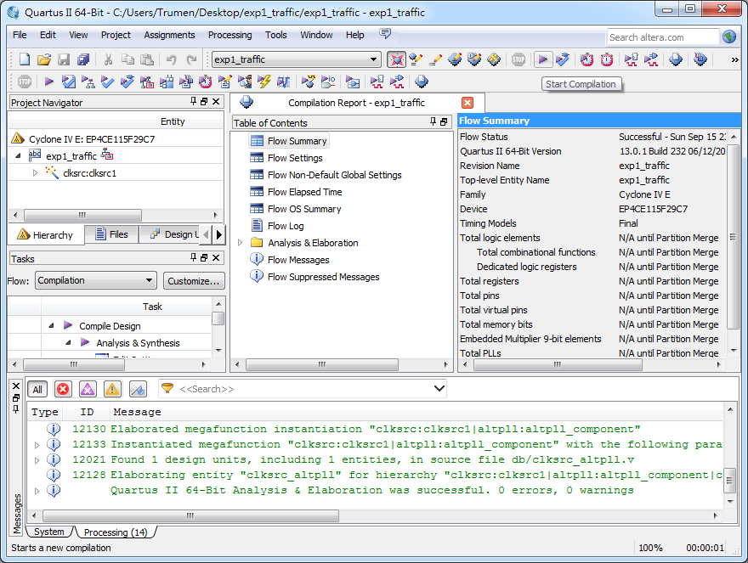
1

Slide 55
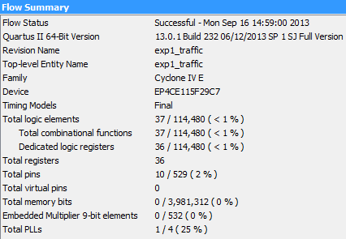
Compilation Report
Make sure there is no error.

Slide 56
Program the FPGA Device
After compiling and verifying your design you are ready to program the FPGA on the development board.
You download the SOF you just created into the FPGA using the USB-Blaster circuitry on the board.
USB cable
12-volt adapter
power

Slide 57
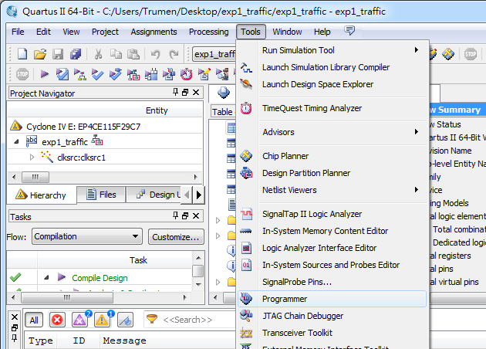
1
2

Slide 58
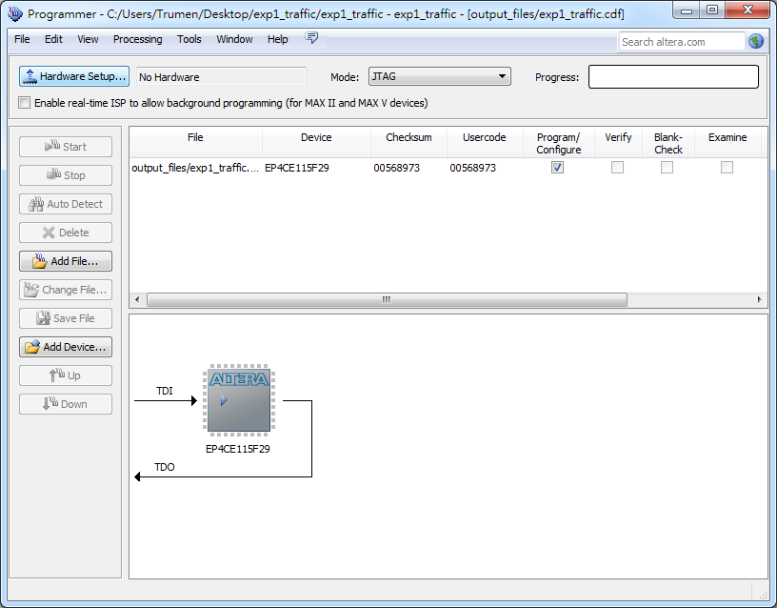
1

Slide 59
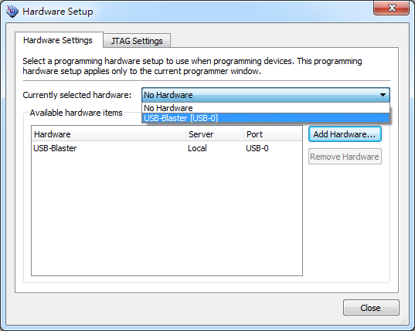
1
2

Slide 60
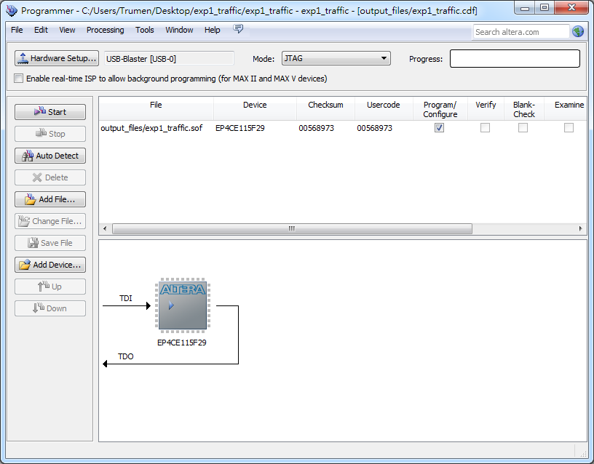
1

Slide 61
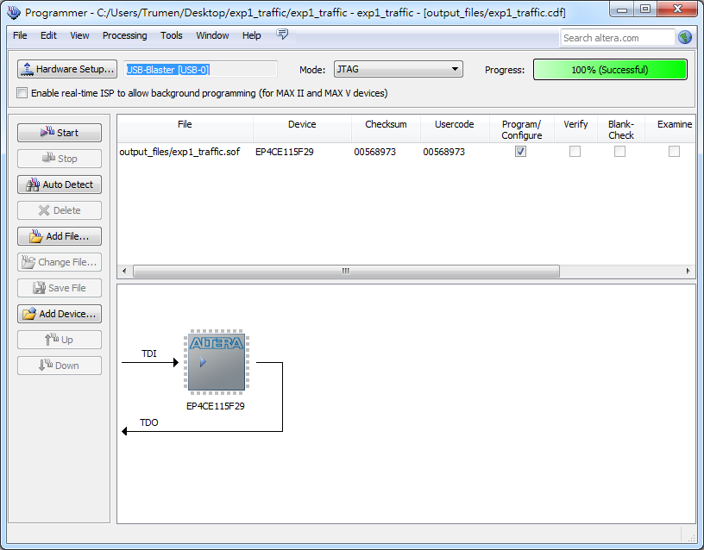
~~Finish~~

Slide 62
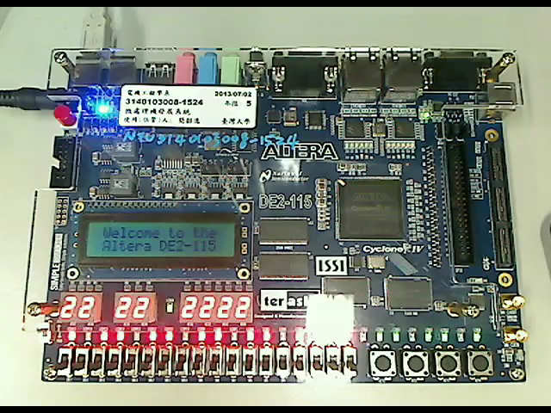
Demo Video
10 seconds countdown system

Slide 63
Configuring the Cyclone IV E FPGA

Slide 64
Configuring the FPGA
JTAG programming
AS programming
In this method of programming, named after the IEEE standards Joint Test Action Group, the configuration bit stream is downloaded directly into the Cyclone IV E FPGA. The FPGA will retain this configuration as long as power is applied to the board; the configuration information will be lost when the power is turned off.
In this method, called Active Serial programming, the configuration bit stream is downloaded into the Altera EPCS64 serial configuration device. It provides non-volatile storage of the bit stream, so that the information is retained even when the power supply to the DE2-115 board is turned off. When the board's power is turned on, the configuration data in the EPCS64 device is automatically loaded into the Cyclone IV E FPGA.

Slide 65
JTAG Chain (1/2)
To use JTAG interface for configuring FPGA device, the JTAG chain on DE2-115 must form a close loop that allows Quartus II programmer to detect FPGA device.

Slide 66
JTAG Chain (2/2)
Shorting pin1 and pin2 on JP3 can disable the JTAG signals on HSMC connector that will form a close JTAG loop chain on DE2-115 board. Thus, only the on board FPGA device (Cyclone IV E) will be detected by Quartus II programmer.
Notes:
If users want to include another FPGA device or interface containing FPGA device in the chain via HSMC connector, short pin2 and pin3 on JP3 to enable the JTAG signal ports on the HSMC connector.

Slide 67
Configuring the FPGA in
JTAG Mode (1/2)
This figure illustrates the JTAG configuration setup.

Slide 68
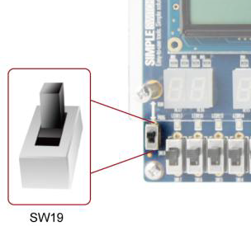
Configuring the FPGA in
JTAG Mode (2/2)
Ensure that power is applied to the DE2-115 board.
Configure the JTAG programming circuit by setting the RUN/PROG slide switch (SW19) to the RUN position.
Connect the supplied USB cable to the USB Blaster port on the DE2-115 board.
The FPGA can now be programmed by using the Quartus II Programmer to select a configuration bit stream file with the .sof filename extension.

Slide 69
Configuring the EPCS64 in
AS Mode (1/2)
This figure illustrates the AS configuration setup.

Slide 70
Configuring the EPCS64 in
AS Mode (2/2)
Ensure that power is applied to the DE2-115 board.
Connect the supplied USB cable to the USB Blaster port on the DE2-115 board.
Configure the JTAG programming circuit by setting the RUN/PROG slide switch (SW19) to the PROG position.
The EPCS64 chip can now be programmed by using the Quartus II Programmer to select a configuration bit stream file with the .pof filename extension.
Once the programming operation is finished, set the RUN/PROG slide switch back to the RUN position and then reset the board by turning the power switch off and back on; this action causes the new configuration data in the EPCS64 device to be loaded into the FPGA chip.

Slide 71
Programmer Object File
Programmer Object File is a binary file (with the extension .pof) containing the data for programming a configuration device.
A Programmer Object File for a configuration device can be generated by the Convert Programming Files command (File menu).

Slide 72
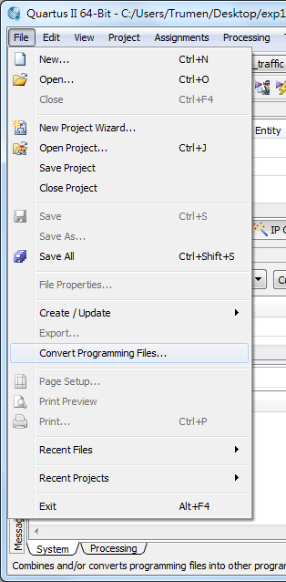
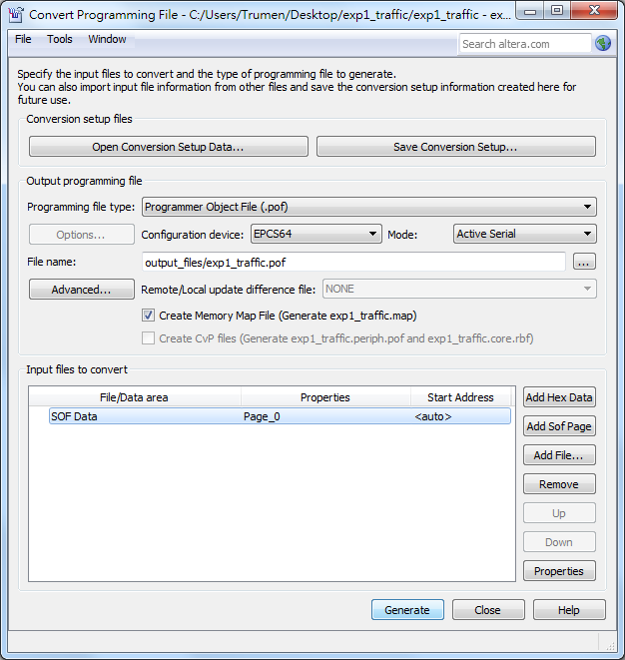
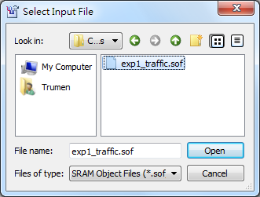
1
3
for DE2-115
7
4
8
2
5
6
9

Slide 73



1
2
3
4
5

Slide 74

2
1

Slide 75

~~Finish~~

Slide 76
The End.
Any question?

Slide 77
Reference
http://en.wikipedia.org/wiki/Field-programmable_gate_array
"My First FPGA for Altera DE2-115 Board" by Terasic Technologies Inc.
"DE2-115 User Manual" by Terasic Technologies Inc.

