Slide 1
Verilog Coding Guidelines
Digital Circuit Lab
TA: Po-Chen Wu

Slide 2
Outline
Introduction to Verilog HDL
Verilog Syntax
Combinational and Sequential Logics
Module Hierarchy
Write Your Design
Finite State Machine

Slide 3
Introduction to Verilog HDL

Slide 4
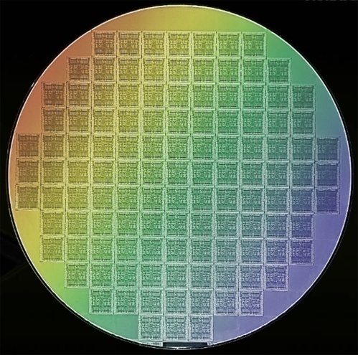
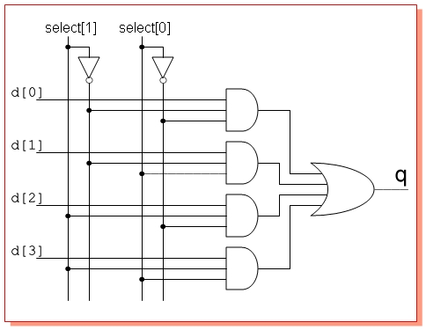
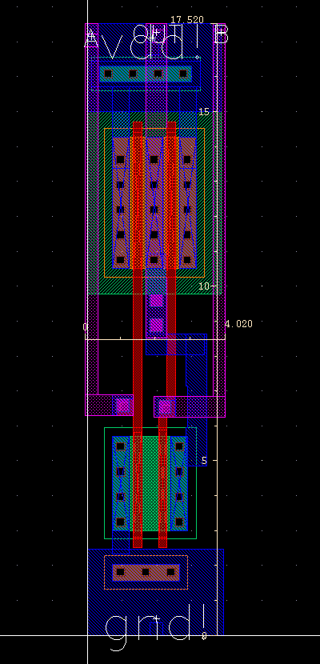
What is Verilog Doing…
Wafer
Chip
Logic
Module
+
DFF
MUX
-
Abs
Verilog
Backend
EDA Tools
Standard Cell
Layout

Slide 5
Verilog HDL
Verilog HDL
Hardware Description Language
Programming language
Describes a hardware design
Other hardware description language
VHDL

Slide 6
Represent a Circuit (1/2)
In software
max_abcd = max( max(a,b), max(c,d) );
In verilog ??
a
max
max_ab
b
max
max_abcd
c
max
d
max_cd

Slide 7
Represent a Circuit (2/2)
a
max
max_ab
b
max
max_abcd
c
max
d
max_cd
wire [3:0] a, b, c, d;
reg [3:0] max_ab; max_cd;
reg [3:0] max_abcd;
always@(*) begin
max_ab = (a > b)? a: b;
max_cd = (c > d)? c: d;
max_abcd = (max_ab > max_cd)? max_ab: max_cd;
end
data declaration
logic behavior

Slide 8
Verilog Syntax

Slide 9
Blocking and Nonblocking Statements (1/2)
Blocking Statements "="
A blocking statement must be executed before the execution of the statements that follow it in a sequential block.
Nonblocking Statements "<="
Nonblocking statements allow you to schedule assignments without blocking the procedural flow.

Slide 10
Blocking and Nonblocking Statements (2/2)
module block_nonblock();
reg a, b, c, d, e, f;
// Blocking assignments
initial begin
a = #10 1'b1; // The simulator assigns 1 to a at time 10
b = #20 1'b0; // The simulator assigns 0 to b at time 30
c = #40 1'b1; // The simulator assigns 1 to c at time 70
end
// Nonblocking assignments
initial begin
d <= #10 1'b1; // The simulator assigns 1 to d at time 10
e <= #20 1'b0; // The simulator assigns 0 to e at time 20
f <= #40 1'b1; // The simulator assigns 1 to f at time 40
end
endmodule

Slide 11
Data Types (1/3)
wire
Used as inputs and outputs within an actual module declaration.
Must be driven by something, and cannot store a value without being driven.
Cannot be used as the left-hand side of an = or <= sign in an always@ block.
The only legal type on the left-hand side of an assign statement.
Only be used to model combinational logic.

Slide 12
Data Types (2/3)
reg
Can be connected to the input port (but not output port) of a module instantiation.
Can be used as outputs (but not input) within an actual module declaration.
The only legal type on the left-hand side of an always@ (or initial) block = or <= sign.
Can be used to create registers when used in conjunction with always@(posedge Clock) blocks.
Can be used to create both combinational and sequential logic.

Slide 13
Data Types (3/3)
data declaration
wire [15:0] longdata; // 16-bit wire
wire shortvalue; // 1-bit wire
reg [3:0] areg; //4-bit reg
assign longdata = areg + 88;
always@(*) begin
if(shortvalue == 1'b1)
areg = shortvalue + 3;
else
areg = shortvalue + 7;
end
wire
reg
logic behavior

Slide 14
Value Set
0 - logic zero, or false condition
1 - logic one, or true condition
z - high-impedance state
x - unknown logic value – unrealistic value in design
0
logic low
z
high-impedance
x
unknown
1
logic high

Slide 15
Numbers
binary('b), decimal('d), hexadecimal('h), octal('o)
Format
<number>: reg data = 127;
'<base><number>: reg data = 'd127;
<width>'<base><number> → complete format
659 // decimal
'o7460 // octal
4'b1001 // 4-bit binary
3'b01x // 3-bit with unknown
16'hz // 16-bit high impedance
-8'd6 // two’s complement of 6
8'd-6 // illegal syntax
4af // illegal (requires 'h)
reg data =

Slide 16
Case-Sensitive Control
Suspends subsequent statement execution until any of the specified list of events occurs
Support event driven simulation
Sensitivity list
always@(… or … or … or…)
always@(a or b or c )
always@(*)
verilog 2001, automatic list generation

Slide 17
Operators (1/6)
Arithmetic operators
+, -, *, /, %
Bitwise operators
Perform the operation one bit of a operand and its equivalent bit on the other operand to calculate one bit for the result
~, &, |, ^, ~^
Arithmetic operators
Bitwise operators

Slide 18
Operators (2/6)
Unary reduction operators
Perform the operation on each bit of the operand and get a one-bit result
&, ~&, |, ~|, ^, ~^
&4’b1110→0
&4’b1111→1
Unary reduction AND
|4’b0000→0
|4’b0001→1
Unary reduction OR
^4’b1111→0
^4’b1110→1
Unary reduction operators
Unary reduction XOR

Slide 19
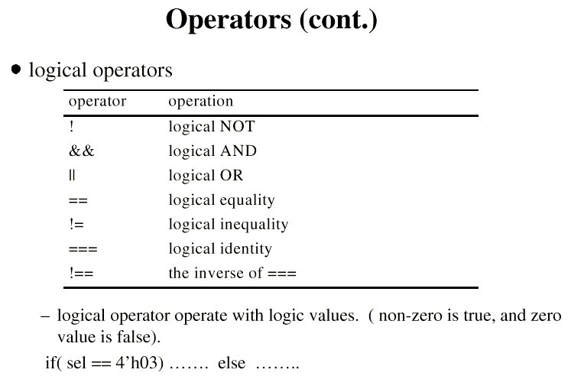
Operators (3/6)
Logical operators operate with logic values
Equality operators
Logical equality
==, !=
Case equality
===, !==
Logical negation
!
Logical
&&, ||
example
!4’b0100 → 0
!4’b0000 → 1
!4’b00z0 → x
Logical operators

Slide 20
Operators (4/6)

Slide 21
Operators (5/6)
Concatenation operator
{}
Join bits from two or more
expressions together
Very convenient
Multiple layers
{{},{}…}
Replication operator
{n{}}
a
b
c
d
y
y = {a[1:0], b[2], c[4,3], d[7:5]}
a
y
y = {{4{a[3]}},a}

Slide 22
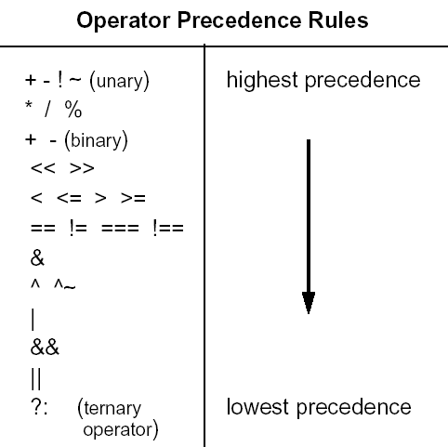
Operators (6/6)
Shift operators
<<, >>
Relational operators
<, <=, >=, >
Conditional operator
? :
Operator precedence
if(a <= b) d = 0;
else d = 1;
d = (a<=b) ? 0 : 1

Slide 23
Combinational and Sequential Logics

Slide 24
Two Types of Logics (1/2)
Combinational Logics
data-in → data-out
instant response
fixed arrangement
a
max
max_ab
b
max
max_abcd
c
max
d
max_cd

Slide 25
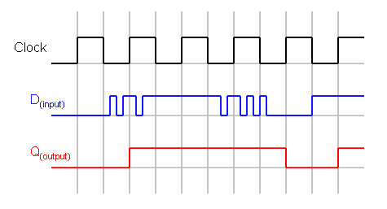
Two Types of Logics (2/2)
Sequential Logics
always and only update at
clock edges
posedge / negedge
memory
1 cycle
a
D Q
clk
a_d1
D Q
clk
a_d2
D Q
clk
a_d3
clk

Slide 26
Case-Sensitive Control (1/2)
register in sequential changes only at clock edges
with reset signal
always@(posedge clk) begin
……
end
always@(negedge clk) begin
……
end
always @(posedge clk or negedge rst_n) begin
......
end

Slide 27
Case-Sensitive Control (2/2)
Sequential Logics
always and only update at clock edges
posedge / negedge
reg [3:0] a, b; // declaration
always @(posedge clk or negedge rst_n) begin
if(rst_n ==1'b0) begin //registers
a <= 4'd0;
b <= 4'd0;
end
else begin
a <= next_a;
b <= next_b;
end

Slide 28
The Use of Sequential Circuits?
Temporal storage (memory)
Split long computation lines
timing issue
divide circuits into independent stages
work at the same time !!
Combinational logics handle the computation
Sequential logics store inter-stage temporal data

Slide 29
Sequential and Combinational Logics
Sequential Logic
(Register)
Sequential Logic
(Register)
Sequential Logic
(Register)
Combinational
Logic
Combinational
Logic
clk
always @(posedge clk) begin
if(~rst_n) begin
a <= 3'd0;
end
else begin
a <= next_a;
end
assign c = b [2:0];
assign d = c & 3'b101;
always@(a or d) begin
sum = a + d;
......
end

Slide 30
Sequential Circuit (1/3)
Synchronous reset
always @(posedge clk) begin
if(~rst_n) begin
a <= 8'd0;
end
else begin
a <= next_a;
end
clk
rst_n
next_a
a
8'h01
8'h5a
XX
8’h00
8’h01
8’h5a

Slide 31
Sequential Circuit (2/3)
Asynchronous reset
always @(posedge clk or negedge rst_n) begin
if(~rst_n) begin
a <= 8'd0;
end
else begin
a <= next_a;
end
clk
rst_n
next_a
a
8'h01
8'h5a
XX
8’h00
8’h01
8’h5a

Slide 32
Sequential Circuit (3/3)
Synchronous reset | Pros | Easy to synthesize, just another synchronous input to the design
 | Cons | Require a free-running clock, especially at power-up, for reset to occur
Asynchronous reset | Pros | Does not require a free-running clock Uses separate input on FF, so it does not affect FF data timing
 | Cons | Harder to implement, usually a tree of buffers is inserted at P&R Makes static timing analysis and cycle-based simulation more difficult, and can make the automatic insertion of test structures more difficult
Prefer

Slide 33
Module Hierarchy

Slide 34
What is a Module?
Group circuits into meaningful building blocks
Combine highly-related circuits
Leave simple i/o interface
Easier to reuse / maintain
Module
+
DFF
MUX
-
Abs

Slide 35
A Module
a
max
D Q
rst_n
clk
b
maxab
rst_n
clk
module maxab(clk,rst_n,a,b,maxab);
input clk;
input rst_n;
input [3:0] a;
input [3:0] b;
output [3:0] maxab;
reg [3:0] maxab;
wire [3:0] next_maxab;
assign next_maxab = (a>b)? a: b;
always@(posedge clk or negedge rst_n) begin
if (rst_n == 1'b0) begin
maxab <= 4'd0;
end
else begin
maxab <= next_maxab;
end
end
endmodule
module port definition
sequential logics
wire, reg declaration
ending your module!
combinational logics

Slide 36
Connection Between Modules (1/2)
Where you "cut" your design.
a
max
D Q
clk
maxabcd
b
max
D Q
clk
c
max
D Q
clk
d

Slide 37
Connection Between Modules (2/2)
Where you "cut" your design.
maxab
a
max
D Q
clk
maxabcd
b
max
D Q
clk
maxcd
c
max
D Q
clk
d

Slide 38
Module Instantiation
Build a module by smaller modules
module maxabcd(clk,rst_n,a,b,c,d,maxabcd);
input clk;
input rst_n;
input [3:0] a, b, c, d;
output [3:0] maxabcd;
wire [3:0] maxab, maxcd;
maxab m1(.clk(clk), .rst_n(rst_n), .a(a), .b(b), .maxab(maxab));
maxab m2(.clk(clk), .rst_n(rst_n), .a(c), .b(d), .maxab(maxcd));
maxab m3(.clk(clk), .rst_n(rst_n), .a(maxab), .b(maxcd), .maxab(maxabcd));
endmodule
maxab
a
max
DQ
clk
maxabcd
b
max
DQ
clk
c
max
DQ
clk
d
maxcd

Slide 39
Write Your Design

Slide 40
Use Parameters (1/2)
Build a module by smaller modules
`define INST_WakeUp 0
`define INST_GoToSleep 1
`define BUS_WIDTH 64
input [`BUS_WIDTH-1:0] databus;
case (instruction)
`INST_WakeUp:
…
`INST_GoToSleep:
…
endcase

Slide 41
Use Parameters (2/2)
Use parameter for reusable modules
Use localparam for inner-module variables
parameter [4:0] FA_BitSize = 8;
reg [FA_BitSize-1:0] = datain;
localparam FSM_StateSize = 5;
localparam [FSM_StateSize-1:0] FSM_Idle = 5'd0;

Slide 42
Finite State Machine

Slide 43
Finite State Machine (1/2)
Synchronous (i.e. clocked) finite state machines (FSMs) have widespread application in digital systems
Controllers in computational units and processors.
Synchronous FSMs are characterized by
A finite number of states
Clock-driven state transitions.

Slide 44
Finite State Machine (2/2)

Slide 45
Elements of FSM (1/2)
Memory elements (ME)
Memorize current state (CS)
Usually consist of FF or latch
N-bit FF have 2^{N} possible states
Next-state logic (NL)
Combinational logic
Produce next state
Based on current state (CS) and input (X)

Slide 46
Elements of FSM (2/2)
Output logic (OL)
Combinational logic
Produce outputs (Z)
Based on current state (Moore)
Based on current state and input (Mealy)

Slide 47
Moore Machine
Output is function of CS only
Not function of inputs
Next
State
(NS)
Current
State
(CS)
Input
X
Output
X
Next-state Logic
(NL)
Memory
Element
(ME)
Output
Logic
(OL)

Slide 48
Mealy Machine
Output is function of both
Input and current state
Next
State
(NS)
Current
State
(CS)
Input
X
Output
X
Next-state Logic
(NL)
Memory
Element
(ME)
Output
Logic
(OL)

Slide 49
Modeling FSM in Verilog
Sequential circuits
Memory elements of current state (CS)
Combinational circuits
Next-state logic (NL)
Output logic (OL)

Slide 50
The End.
Any question?

Slide 51
Reference
"Verilog_Coding_Guideline_Basic" by members of DSP/IC Design Lab
http://inst.eecs.berkeley.edu/~cs150/Documents/Nets.pdf by Chris Fletcher, UC Berkeley
CIC training course： "Verilog_9807.pdf"
http://www.asic-world.com/

