Slide 1
PyTorch Tutorial
Chih-Ning Chen
2025/08/07

Slide 2
Tutorial Outline
Introduction of PyTorch
  What is Pytorch and why we need it?
Practical Example: Handwritten Digit Classification
  Define Custom Dataset and Dataloader
  Create a Convolutional Neural Network
  Train the network
  Validate the network
  Save and load the model
PyTorch on Workstation
  Install Anaconda/Miniconda
  Basic command

Slide 3

What is Pytorch?

Slide 4
What is Pytorch?
CPU
Complicate & sequential processing
GPU
simple but fast & parallel computing
We would like to use GPU to accelerate the training of our neural network!!

Slide 5
What is Pytorch?
Data
Abundant NumPy arrays
Your code
Training procedure
GPU-accelerated libraries
Parallel, fast training
GPU
However, CUDA is low-level language and not easy for researchers to directly use it…

Slide 6
What is Pytorch?
Deep learning framework
(1) Quick to develop and test new ideas
(2) Run it all efficiently on GPU
(3) Automatically compute gradients
Data
Abundant NumPy arrays
Your code
Training procedure
GPU-accelerated libraries
Parallel, fast training
GPU

Slide 7
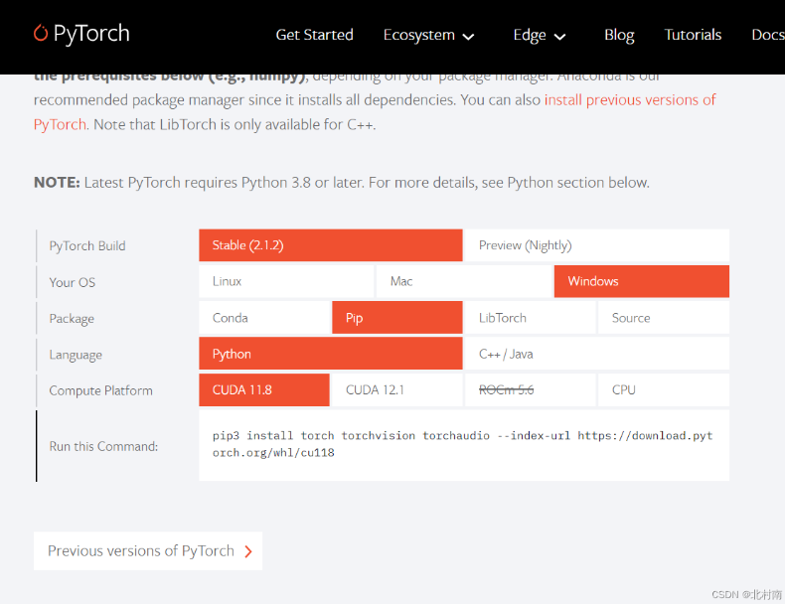
Installation Guide

Slide 8
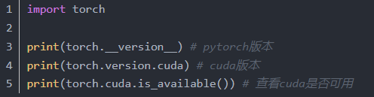

Installation Guide

Slide 9
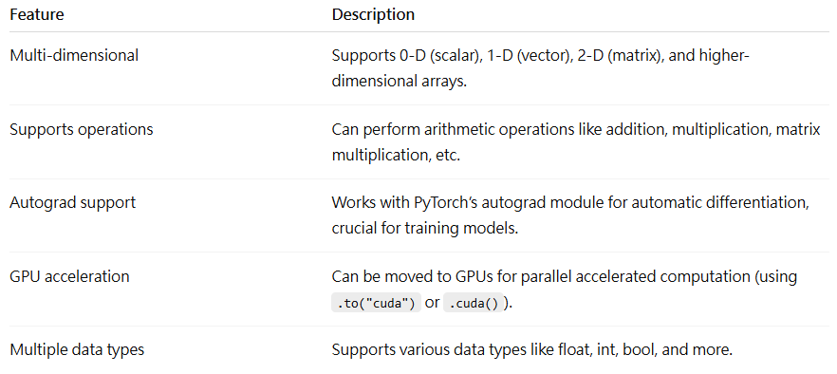
Tensor

Slide 10
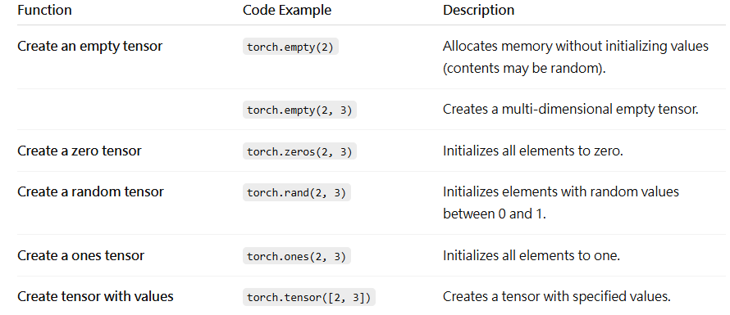
Tensor

Slide 11
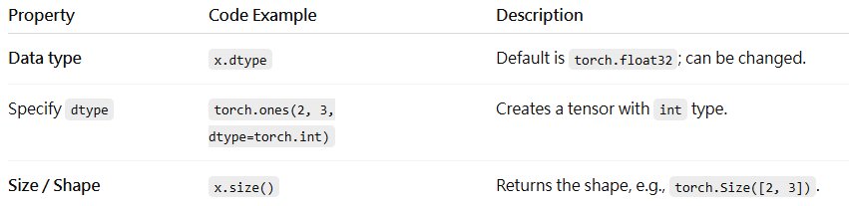
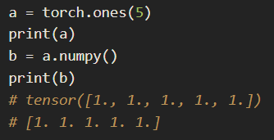
Tensor
Change Tensor to Numpy array

Slide 12
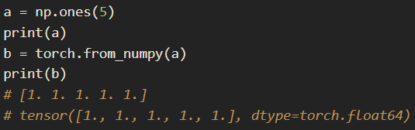
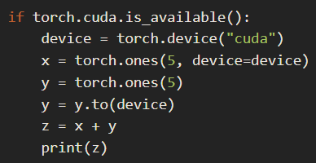
Tensor
Change Numpy array to Tensor
GPU

Slide 13
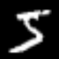
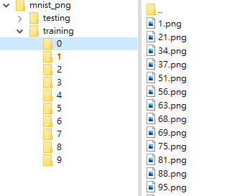
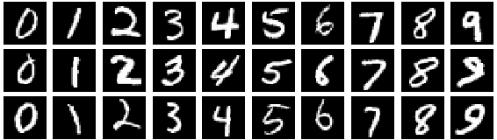
Handwritten Digit Classification
Objective
  train a CNN which can recognize a hand-written digit
Dataset: MNIST
CNN
Model
5
Dataset directory

Slide 14
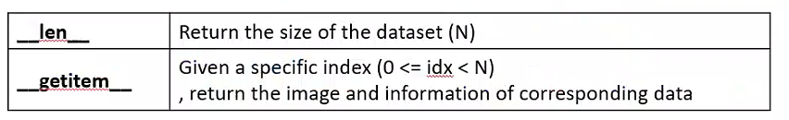
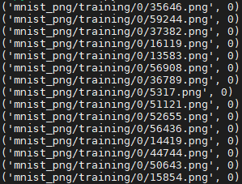
Dataset and Dataloader (1/5)
Dataset class
  Collect information (e.g. filename, label) of each data in the dataset
Dataset directory
MNIST Dataset

Slide 15
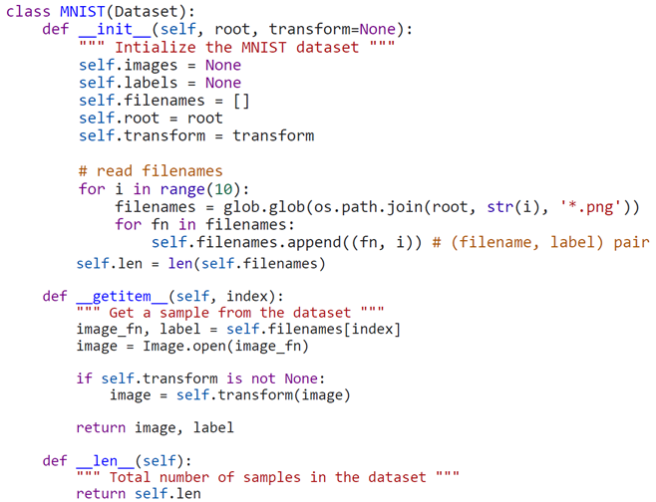
Create a dataset named “MNIST” inherited from Pytorch in-build Dataset class.
The list which will be used to collect each data in the dataset
Collect (filename, label) pair for each data in the dataset
Read an image and transform it

Slide 16
Dataset and Dataloader (1/5)
Tensor: multidimensional array of numbers
  A scalar is a tensor
  A vector is a tensor
  A matrix is a tensor
Tensor can run on GPU and we usually use Tensor structure to represent data
Comparison of Numpy data type and Tensor
 | Range of pixel value | Dimension of image
Numpy | [0, 255] (int) | (height, width, channel)
Tensor | [0, 1] (float) | (channel, height, width)

Slide 17
Dataset and Dataloader (1/5)
Dataloader class
  Load a fixed number (e.g. batchsize) of data for training or testing
MNIST Dataset
Training
or
Testing
Dataloader
.
.
.

Slide 18
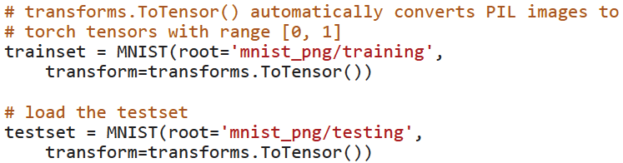
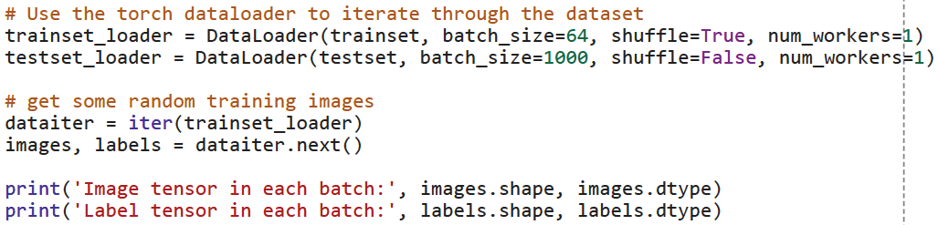
In train.py…
Create Dataset
We usually shuffle the training dataset for better training result!!
Create Dataloader

Slide 19

Creating a CNN (2/5)
Network class
  Define a custom network architecture
  forward: define the forward propagation
    Pytorch would automatically define the corresponding backward propagation : )
    That’s called Autograd

Slide 20
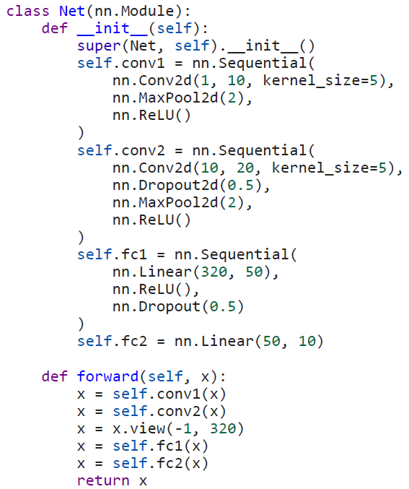
Create a CNN model named “Net” inherited from Pytorch in-build nn.Module class
Self-define a layer with various built-in layers
In this function, we define how the data flows through the model
Features
Result
Images
conv1
conv2
fc1
fc2
(64, 1, 28, 28)
(64, 320)
(64, 10)
In train.py…

Slide 21
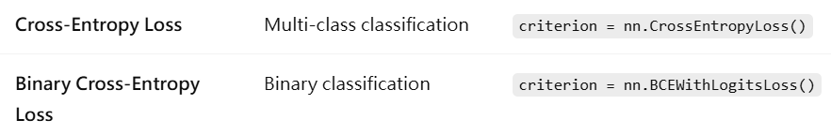
Train the network (3/5)
Before we start to train the network, we need…
  Loss function: to evaluate the performance of network
    Q: Can we just use accuracy as the criteria?
    A: No!! It is discrete (not continual) and non-differentiable; hence, the network cannot do back propagation.

Slide 22
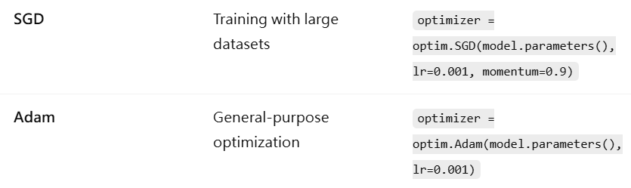
Train the network (3/5)
  Optimizer: to control the learning rate of network

Slide 23
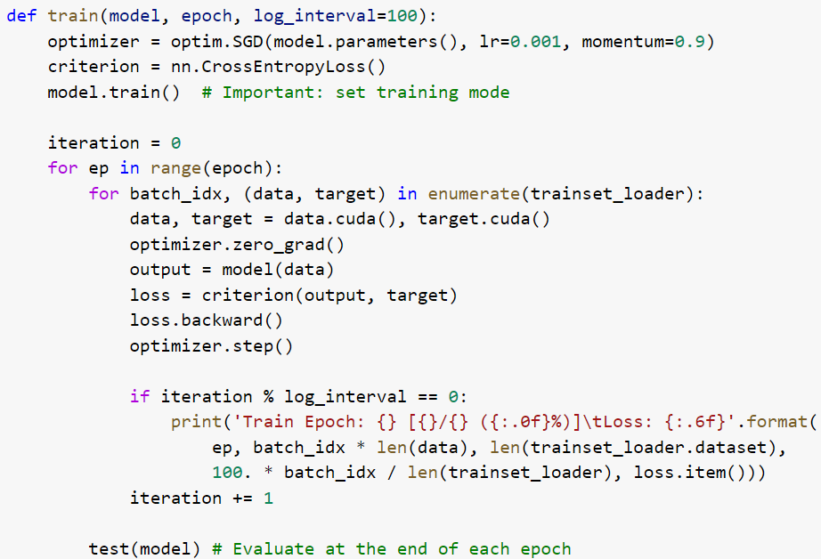
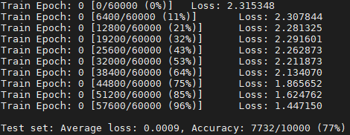
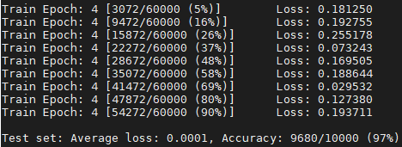
In every epoch, the whole dataset would be split into several batches and the network would be trained batch-by-batch.
Forward propagation and calculate the loss
Backward propagation (Autograd)
Update the network

Slide 24
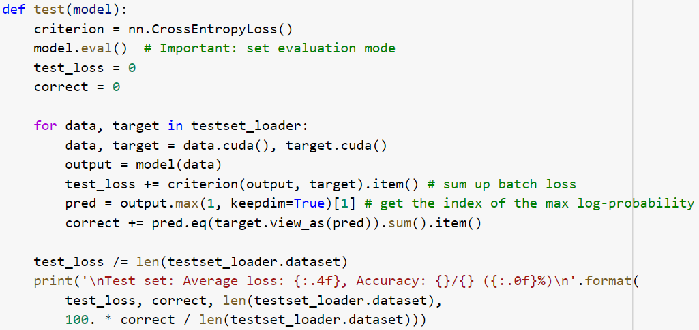
Validate the network (4/5)
Remember to validate the network after the learning of each epoch to avoid it overfitting on training dataset.
We use both accuracy and xe-loss to evaluate the performance of network for the testing data.

Slide 25
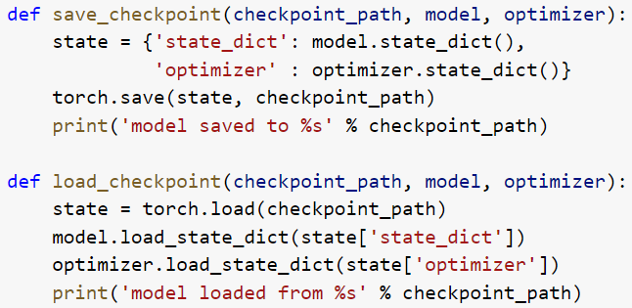
Save and load the model (5/5)
Usually, we save the temporary and final model after the learning of each epoch.

Slide 26
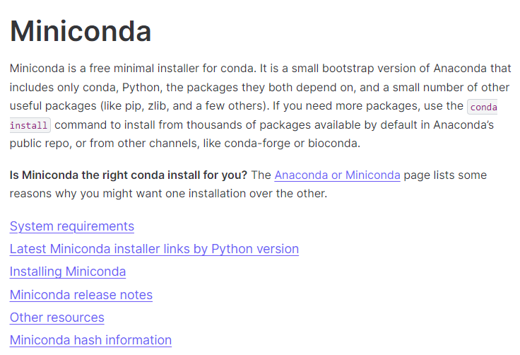
Anaconda/Miniconda
Separate packages for different projects (https://docs.anaconda.com/miniconda/)

Slide 27
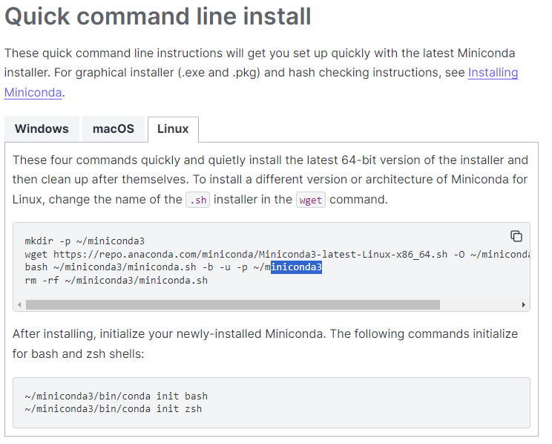
Install Anaconda/Miniconda
Download Miniconda Installer from the website
Install & Initialize conda on the workstation

Slide 28

Basic command
Create new env
Activate env & install required packages
Finish & run your code!
You can also check GPU status by this command

Slide 29
Lab Time!

