Slide 1
Paper Survey Skills
喻柏憲 (Po-Hsien Yu)
Media IC and System Lab
Graduate Institute of Electronics Engineering,
National Taiwan University

Slide 2

Outline
What does a paper look like?
Where to find papers?
Decide what to read
Reading broadly, reading deeply
Reading beyond papers

Slide 3
What does a paper look like?
Title
Abstract
Introduction
Related work
Proposed method
Experimental result
Conclusion
Here is a problem
It’s an important problem
It’s an unsolved problem
Here is my idea
My idea works (details, data)
Here’s how my idea compares to
other people’s approaches
https://www.microsoft.com/en-us/research/video/how-to-write-a-great-research-paper-4/

Slide 4
Where to find papers
Google
Author’s webpage, google scholar
  https://tsaishien-chen.github.io/
  https://scholar.google.com.tw/citations?user=DBydn38AAAAJ&hl=zh-TW
Digital library
  IEEE Xplore
  ACM DL
  arXiv.org (free; no peer-reviewed)
Online resources
  Graphics paper collection (e.g. SIGGRAPH, EuroGraphics)
  Computer Vision Foundation Open Access (e.g. CVPR, ICCV)

Slide 5
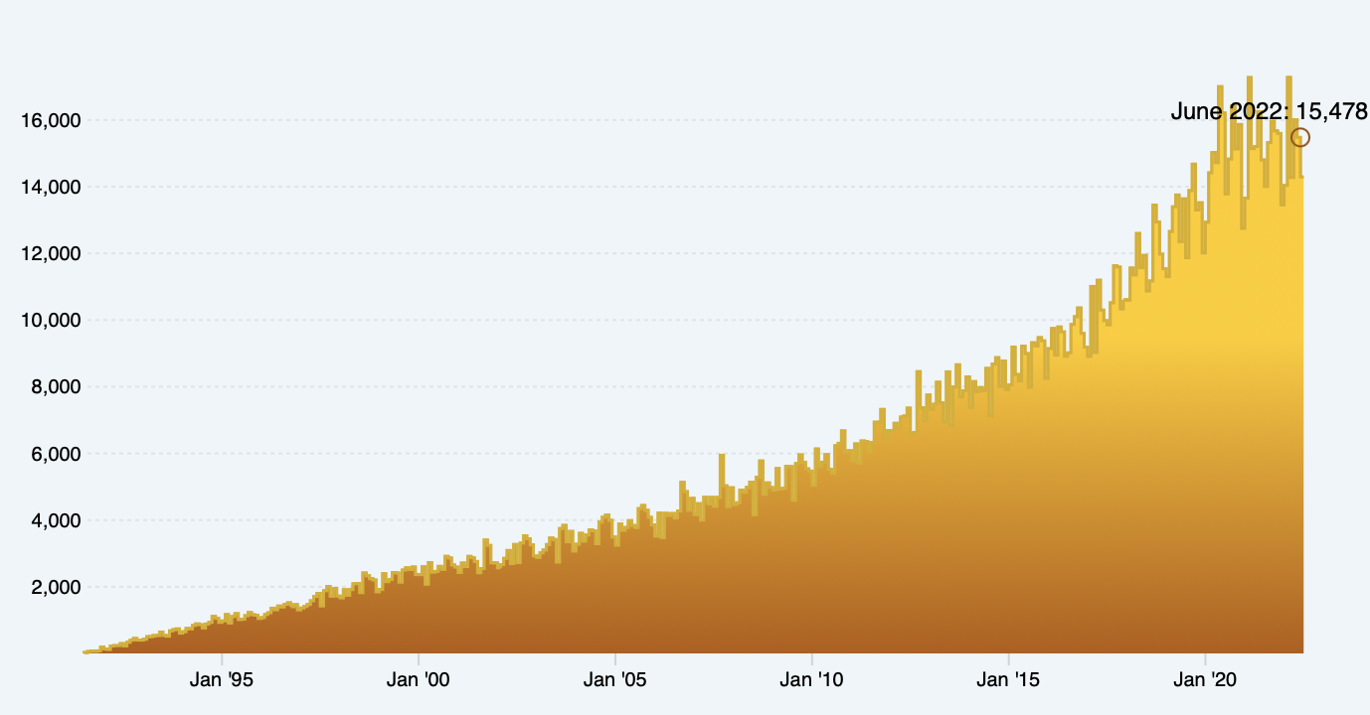
Decide what to read
As of June 2022 : 15478 submissions
Too many papers out there
Only very few of them are helpful to your own research
  Most papers are “noise”
Monthly submissions
arXiv usage statistics from:
https://arxiv.org/stats/monthly_submissions

Slide 6
Decide what to read
Choose papers by their relevance
  Why do you want to read this paper?
    Understand a new problem
    Update current research progress
    Understand a well-known algorithm
    Follow previous experimental setup
    Reproduce the results
    Learn how to write
Evaluate papers by their credibility
  Venue (journal impact factor, conference ranking)
  Authors (who, group, affiliation)
  Completeness (reproducibility, convincing experiments)

Slide 7

Understand a new problem
Questions to ask
  Why is this problem important?
  What are the challenges?
  What is the problem setting? (input, output)
  How to evaluate the results?
Also search for
  Textbooks
  e.g. http://szeliski.org/Book/
  Tutorials
  e.g. https://sites.google.com/view/cvpr2018tutorialongans/

Slide 8
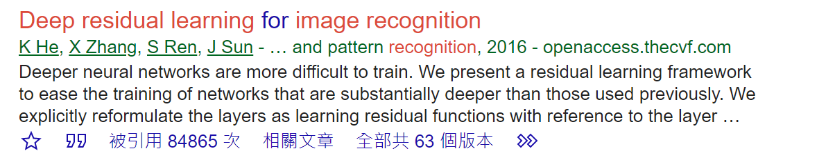
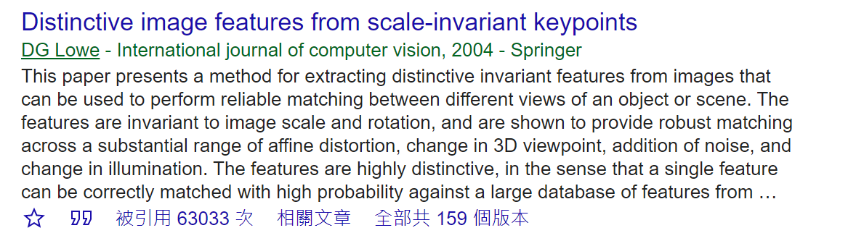
Update current research progress
Recognize key papers
  Mentioned by many other papers
  Citation (long term evaluation)
  Discussion in community
ResNet
SIFT

Slide 9
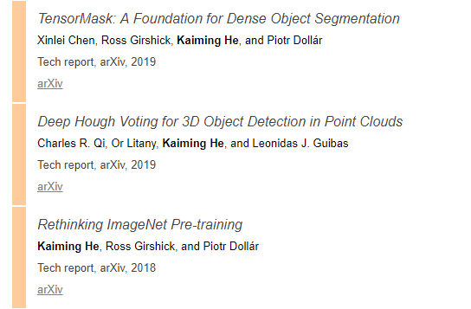
Update current research progress
Recognize key researchers in the field
  They usually update their new findings on personal web page
  e.g. Kaiming He (guided filter, ResNet, Mask R-CNN…)
https://scholar.google.com/citations?user=DhtAFkwAAAAJ&hl=en

Slide 10
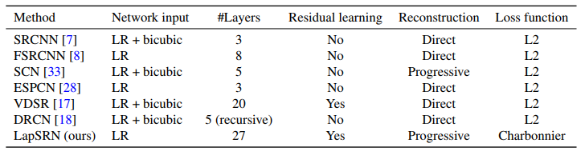
Update current research progress
Read the introduction & related work sections of recent papers
Table 1 of the paper: Deep Laplacian Pyramid Networks for Fast and Accurate Super-Resolution, CVPR 2017

Slide 11
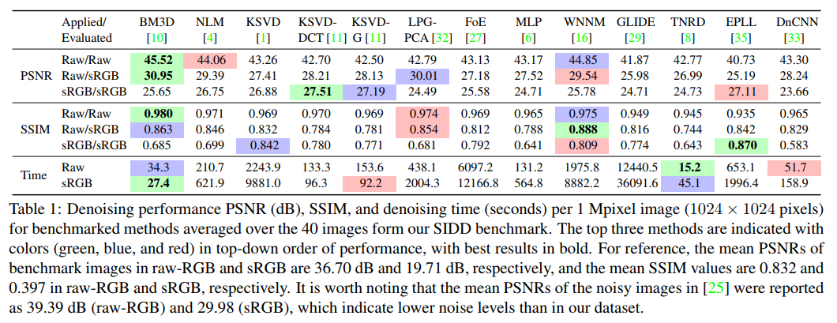
Update current research progress
Read evaluation/benchmark/dataset type papers
Table 1 of the paper: A High-Quality Denoising Dataset for Smartphone Cameras, CVPR 2018

Slide 12
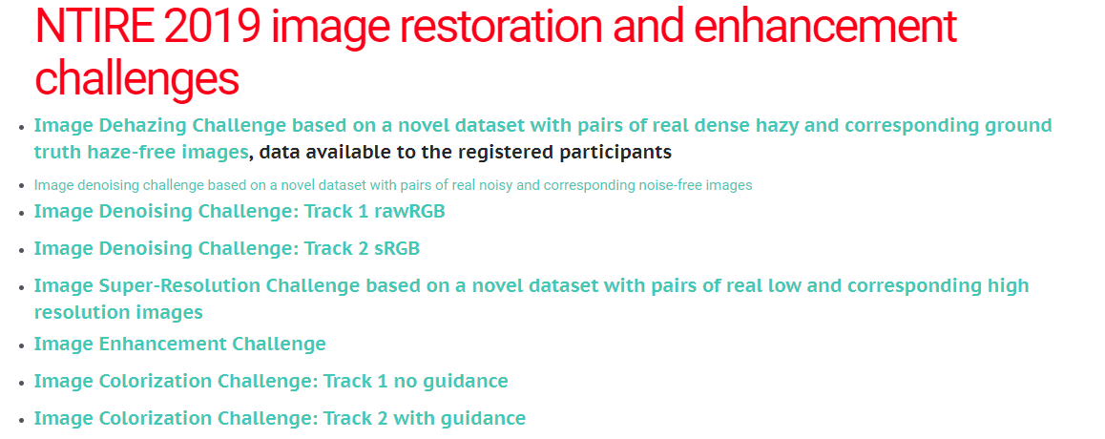
Update current research progress
Check leaderboards of open challenges

Slide 13
Update current research progress
Check leaderboards of open challenges
  COCO (detection/keypoints/caption/…)
  Cityscapes (semantic segmentation/instance segmentation)
  NTIRE (image restoration and enhancement)
  NVIDIA AI City Challenge (traffic analysis/vehicle Re-ID)
  Berkeley DeepDrive (autonomous driving)
  And many more…

Slide 14
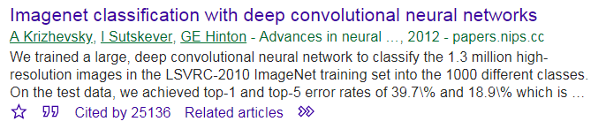
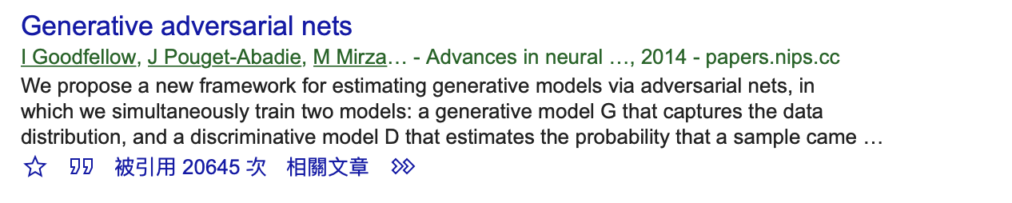
Update current research progress
Read fundamental research papers and apply them to more application oriented papers

Slide 15
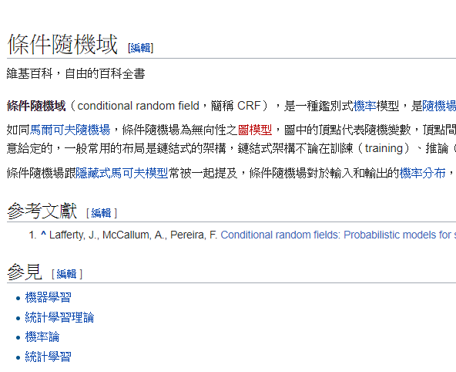
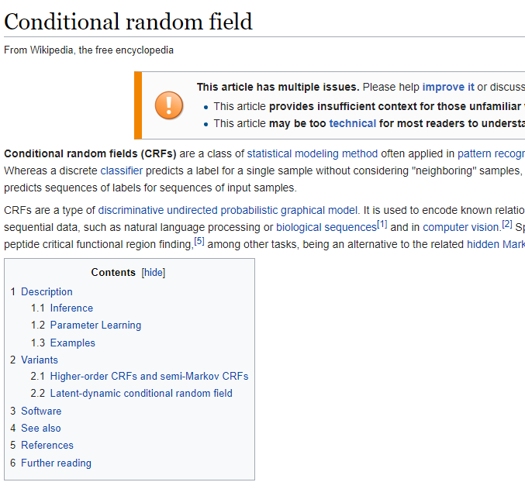
Understand a well-known algorithm
Wiki (read English version)
Find tutorials
Find existing textbooks/tutorials
Learn from source code (if exists)
Wiki CRF

Slide 16
    Follow previous experimental setup
There are common ways for experimental evaluation
  PSNR/SSIM: image quality
  Precision and recall/ROC: pattern recognition tasks
  IoU (intersection over union): segmentation
  Confusion matrix: classification
Also there are public datasets/benchmarks
  Older datasets may have certain bias to simplify the problem and tend to have overfitting problem
  e.g. Middlebury v2 vs. Middlebury v3

Slide 17
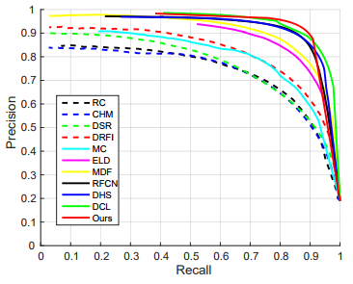
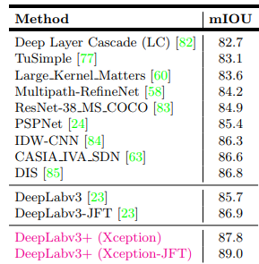
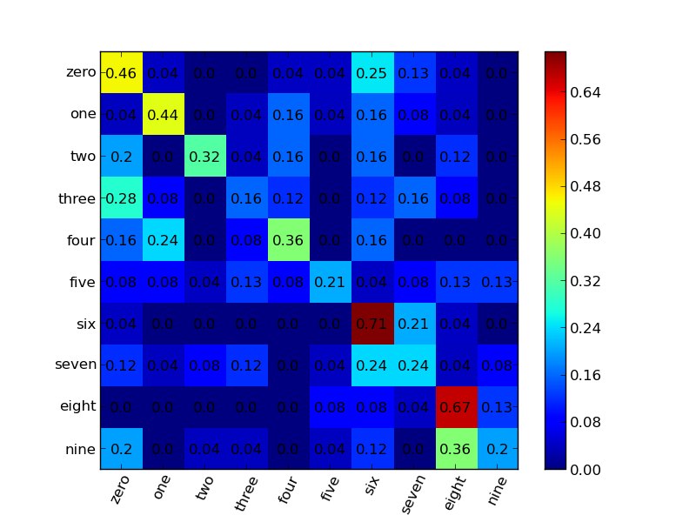
Follow previous experimental setup
PR curve
Mean IoU
Confusion matrix

Slide 18
    Reproduce the results
Reproduce a state-of-the-art technique
  Then bombard it with controlled experiments
  Look for surprises, cracks that lead to deeper realizations
Leverage existing papers
  As a building block in your research
Employ similar strategies for different problems
  Preprocessing/post-processing techniques
  Prior assumptions
  Neural network architecture
  Optimization skills

Slide 19
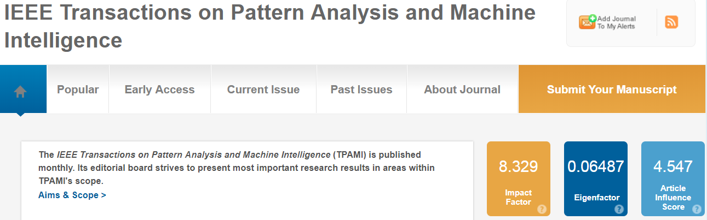
Venue
Better choose papers published in impactful venues
  Check h5-index for conference papers
  http://www.guide2research.com/topconf/
  Check impact factor for journal papers
Less noise
  Impactful conferences or journals usually (not always) have high-quality papers with novel ideas and good English writing

Slide 20
Venue (Conference)
Computer vision: CVPR, ICCV, ECCV, WACV, ACCV, BMVC
Computer graphics: SIGGRAPH, SIGGRAPH Asia, EG, HPG
HCI: CHI, UIST
Multi-media: ACMMM, ICME
(Image) signal processing: ICASSP, ICIP
Machine learning: NIPS, ICML, ICLR, AAAI, IJCAI
Circuits: ISSCC, VLSI, DAC
Architecture: ISCA, HPCA, MICRO
System: ISCAS, SiPS

Slide 21
Venue (Journal)
Just to name a few…
Computer vision: PAMI, IJCV, CVIU
Computer graphics: ACMTOG, TVCG, CGF, PG
Multi-media: TMM
(Image) signal processing: TSP, TIP
Circuits: JSSC
System: TCAS I, TCSVT

Slide 22
Reading broadly (but systematically)
Though some problems are new, the way new solutions come out could be similar to old problems
  e.g. image → video
Overcome new challenges and exploit new chances
  Videos are computationally more expensive
  Temporal coherency in videos
 | Filter | Patch-based | Sparse prior | Low-rank | Learning-based
Image denoising | O | O | O | O | O
Video denoising | O | O | O | ? | ?

Slide 23
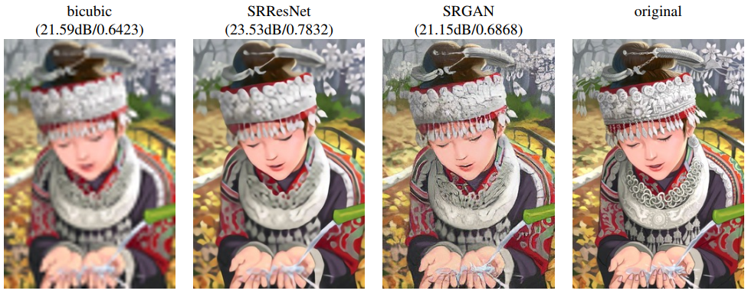
Reading broadly
Knowledge from different fields allows you redefine the problem (and perhaps no competitors can beat you)
  Photo-realistic super-resolution
Photo-Realistic Single Image Super-Resolution Using a Generative Adversarial Network, CVPR 2017

Slide 24
Reading deeply
Challenge what you read!
  Recognize the (implicit) assumptions
    So you can predict when they will fail
  Examine the methods
    Did they measure what they claim?
    Can they explain what they observed?
  Examine the statistics
    Did they do proper error analysis?
  Examine the conclusions
    Do the conclusions follow the observations?
    What other conclusions or correlations are there that they did not point out?

Slide 25
Reading beyond the paper
Papers are not the only product of research works
  Supplementary materials
  Presentation slides/posters
  Demo videos
  Code
  Dataset

Slide 26
Reading beyond the paper
Summarize in your own worlds
  What’s the insight?
  “If you can't explain it simply, you don't understand it well enough.” Albert Einstein
  “Simplicity is the ultimate sophistication.” Leonardo da Vinci
Creative thinking
  What’s next?
  Can you apply the idea to your own research?
Learning by hacking
  Are there flaws in the paper’s assumption/methods/experiments?
  How to design and conduct a toy example to verify your idea?

Slide 27
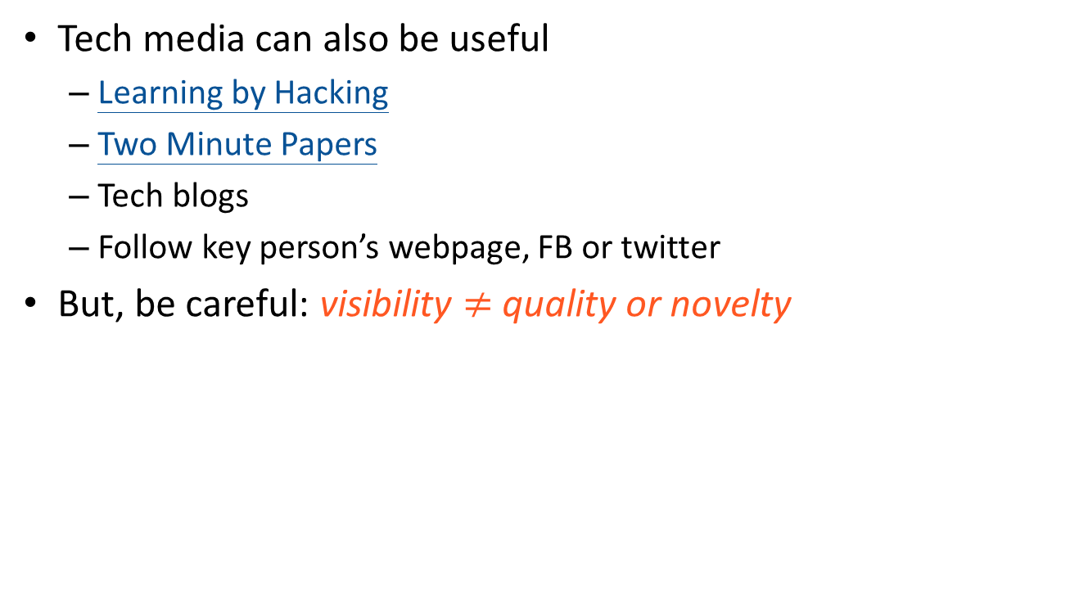
Reading beyond the paper
Tech media can also be useful
  Learning by Hacking
  Two Minute Papers
  Tech blogs
  Follow key person’s webpage, FB or twitter
But, be careful: visibility $≠$ quality or novelty

Slide 28

If you don’t read papers

