Slide 1
DLCV Application
Lecturer:Chih-Ning Chen
Media IC & System Lab
version1: Chih-Wei Wu

Slide 2
What You Will Learn
Get familiar with classic and modern network architectures.
Learn how to design lightweight neural networks
Introduce diffusion models..

Slide 3
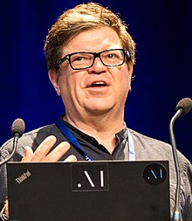
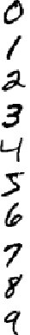
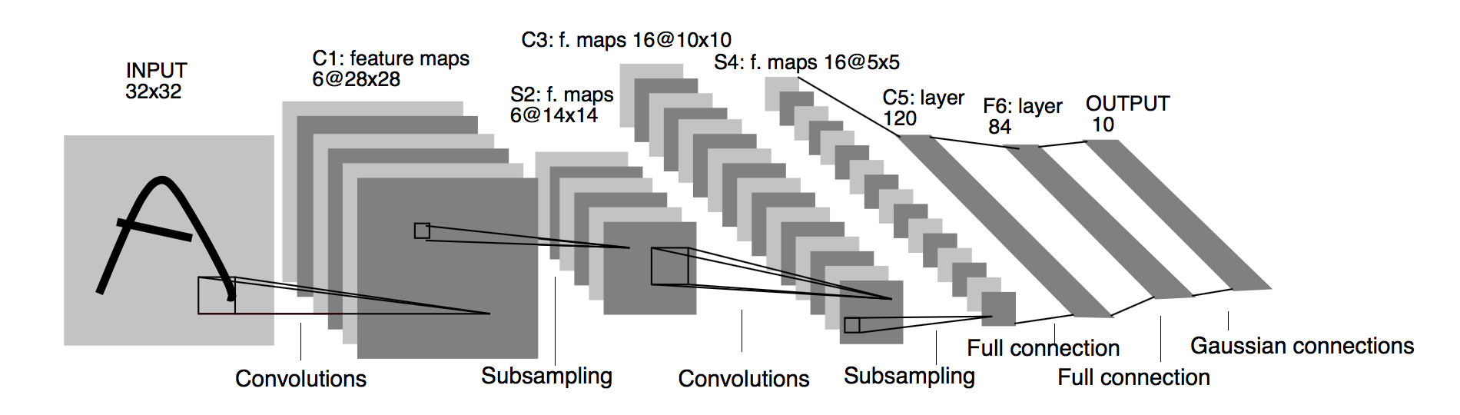
Recap
How to classify hand-written digits?
  Convolutional Neural Networks (CNN)
0
1
2
3
4
5
6
7
8
9
“LeNet-5” LeCun et al., 1998.

Slide 4
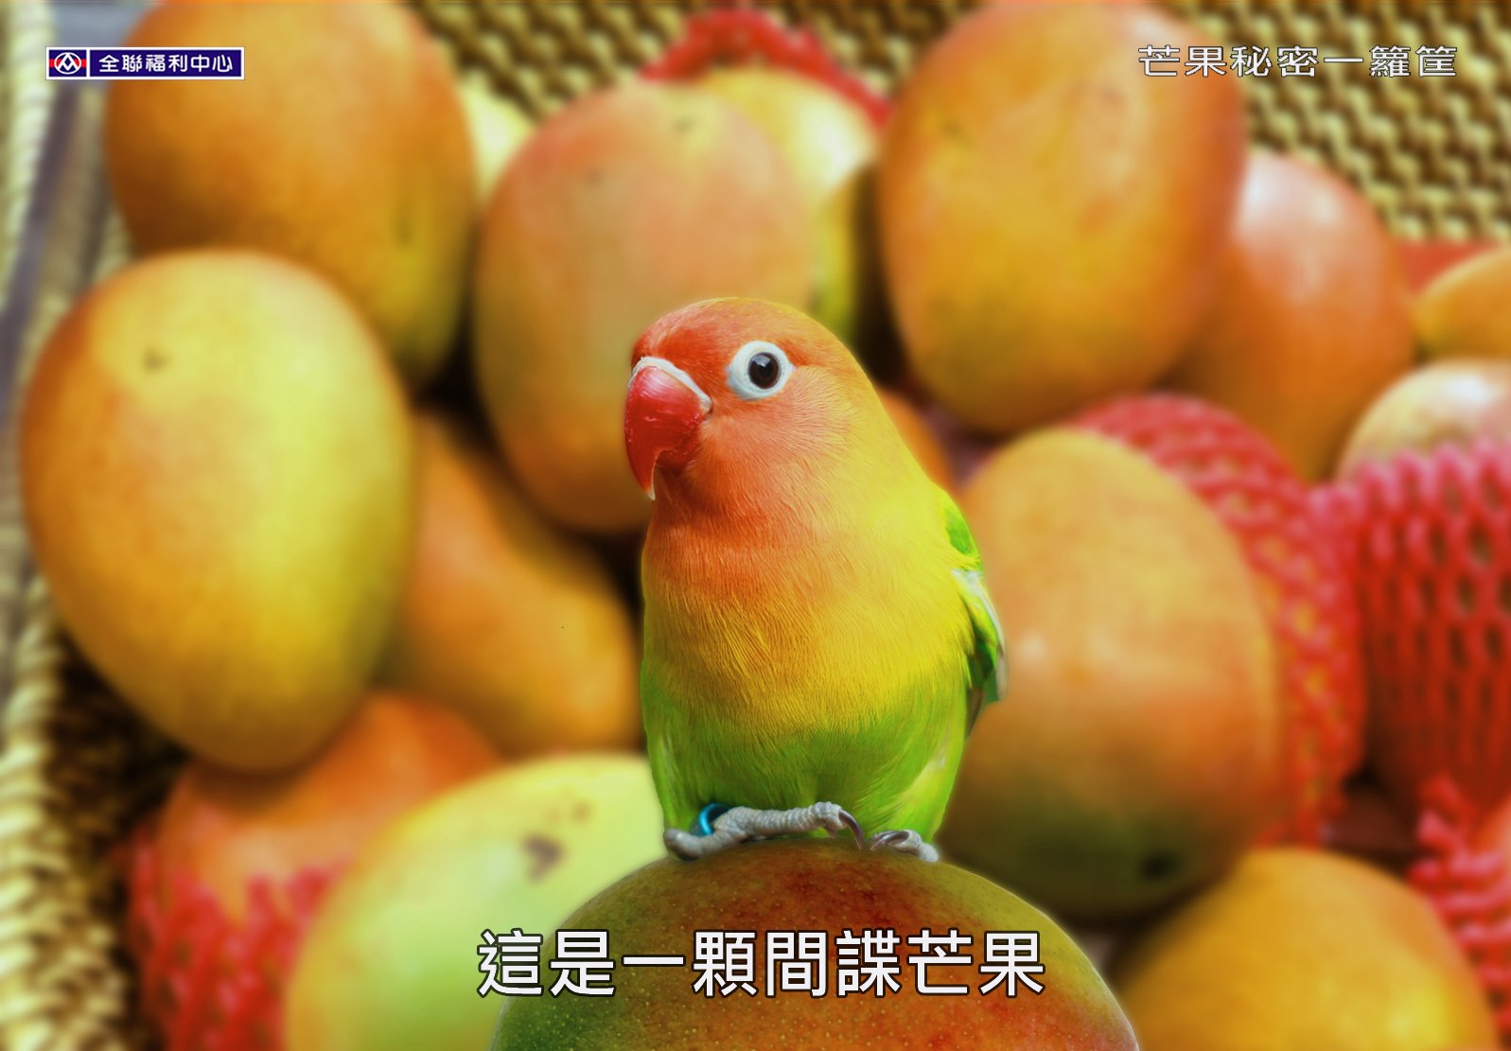
What about harder task?
Bird
Mango

Slide 5
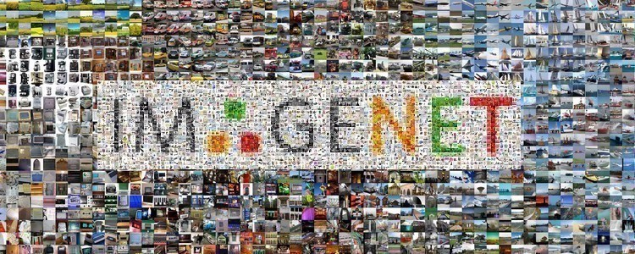
WHERE to START from?
All deep learning methods start from
data
1M images
1k classes
Annual competition2010-2017
“Imagenet” Fei-Fei et al., 2009.
Get awarded “The most impactful paper 10 years ago in CVPR”!

Slide 6
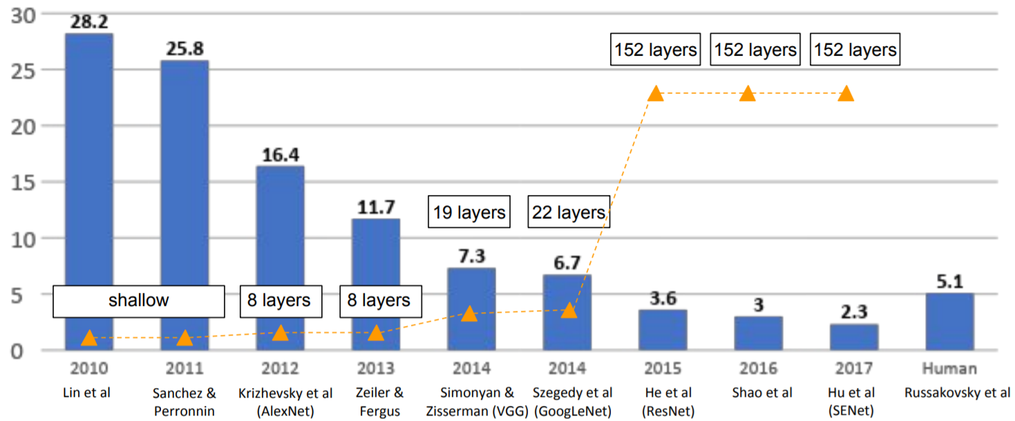
A Great SUCCESS
ImageNet Large Scale Visual Recognition Challenge winners
First CNN method

Slide 7
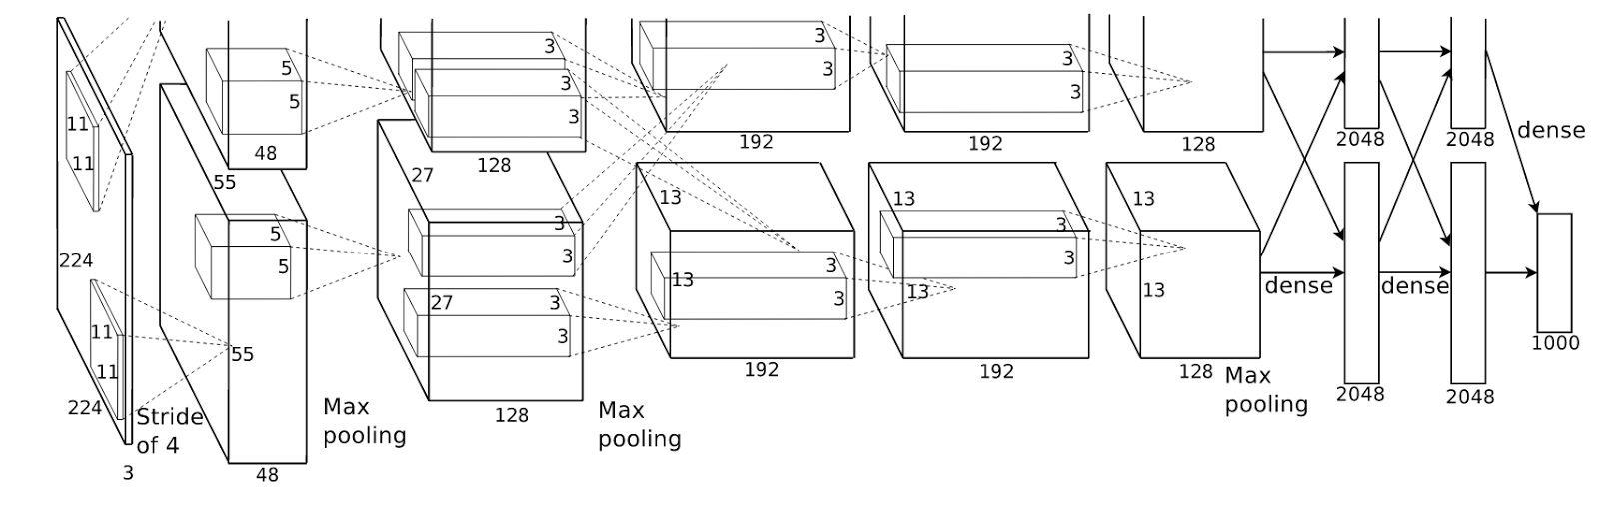
ALEXNET
Krizhevsky et al. 2012
8 layers (5 conv. + 3 fc.)
First to use ReLU
Propose dropout mechanism
Train on 2*GTX580, writing CUDA code by himself of course

Slide 8
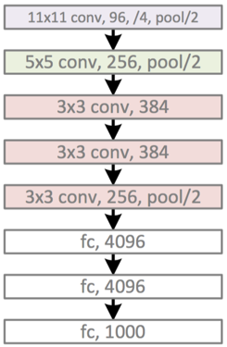
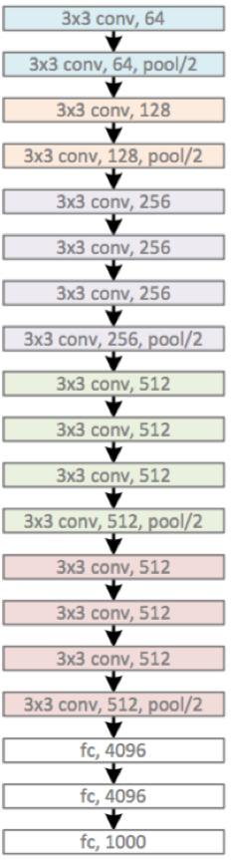
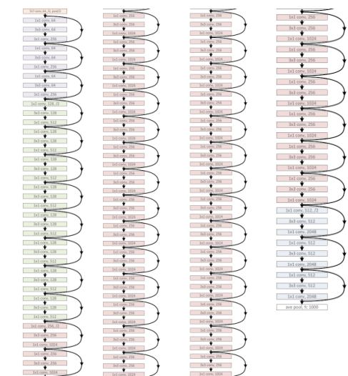
The bigger, The better!
AlexNet, ILSVRC 2012
(8 layers)
VGG-19, ILSVRC 2014
(19 layers)
ResNet-152, ILSVRC 2016
(152 layers)

Slide 9
LAYERs vs. ERROR RATE
ImageNet Large Scale Visual Recognition Challenge winners

Slide 10
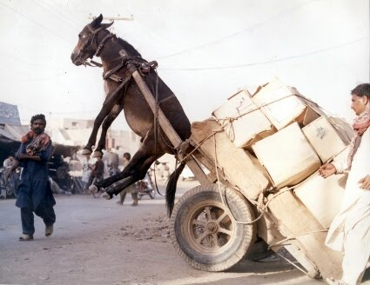
BIGness comes with some drawback…

Slide 11
VGGNet (16 layers)
[Simonyan and Zisserman, 2014]
Q: Stacking more layers will increase parameters, which may overfit the data
Use smaller filter (3x3 conv)
-> Three 3x3 (stride 1) conv layer have same receptive field of one 7x7 conv
-> Fewer parameters, more non-linearity
Downsample the image more times
-> Reduce memory usage
AlexNet
VGG-16

Slide 12
VGGNet (16 layers)
[Simonyan and Zisserman, 2014]
VGG-16
However, a closer look at parameter counts…
CONV3-64: [224x224x64] (3*3*3)*64 = 1,728
CONV3-64: [224x224x64] (3*3*64)*64 = 36,864
CONV3-128: [112x112x128] (3*3*64)*128 = 73,728
CONV3-128: [112x112x128] (3*3*128)*128 = 147,456
CONV3-256: [56x56x256] (3*3*128)*256 = 294,912
CONV3-256: [56x56x256] (3*3*256)*256 = 589,824
CONV3-256: [56x56x256] (3*3*256)*256 = 589,824
CONV3-512: [28x28x512] (3*3*256)*512 = 1,179,648
CONV3-512: [28x28x512] (3*3*512)*512 = 2,359,296
CONV3-512: [28x28x512 (3*3*512)*512 = 2,359,296
CONV3-512: [14x14x512] (3*3*512)*512 = 2,359,296
CONV3-512: [14x14x512] (3*3*512)*512 = 2,359,296
CONV3-512: [14x14x512] (3*3*512)*512 = 2,359,296
FC: [1x1x4096] 7*7*512*4096 = 102,760,448
FC: [1x1x4096] 4096*4096 = 16,777,216
FC: [1x1x1000] 4096*1000 = 4,096,000
FC is the most costly layer!

Slide 13
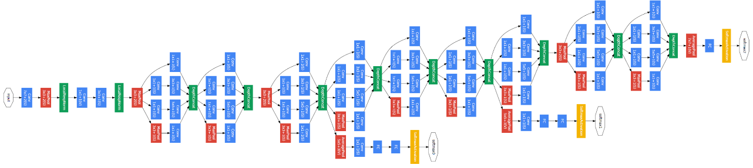
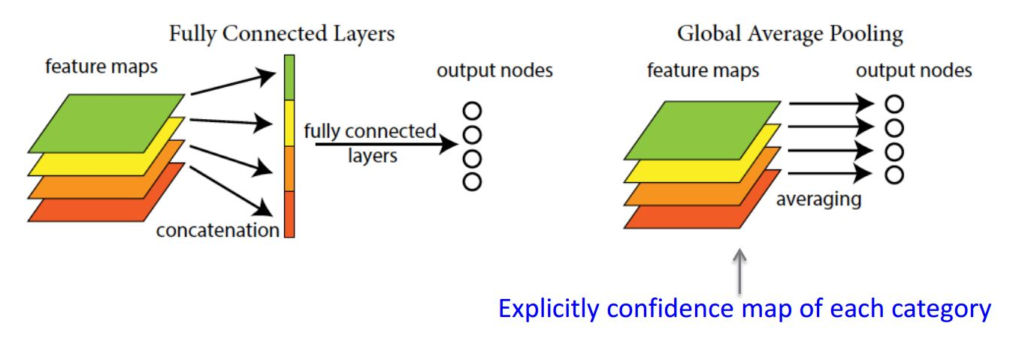
GOOGLENET (22 layers)
Szegedy et al., 2014
Avoid expensive FC layers
12x less params than AlexNet
How?
w/ FC
w/o FC

Slide 14
GOOGLENET (22 layers)
Szegedy et al., 2014
Q: Can we let the network choose its operation at each layer?
Concatenation
1x1 conv
3x3 conv
5x5 conv
1x1 conv
1x1 conv
1x1 conv
3x3 max pool
Previous layer
Inception Module

Slide 15
The REAL “DEEP” CNN…
ImageNet Large Scale Visual Recognition Challenge winners
Revolution of deep

Slide 16
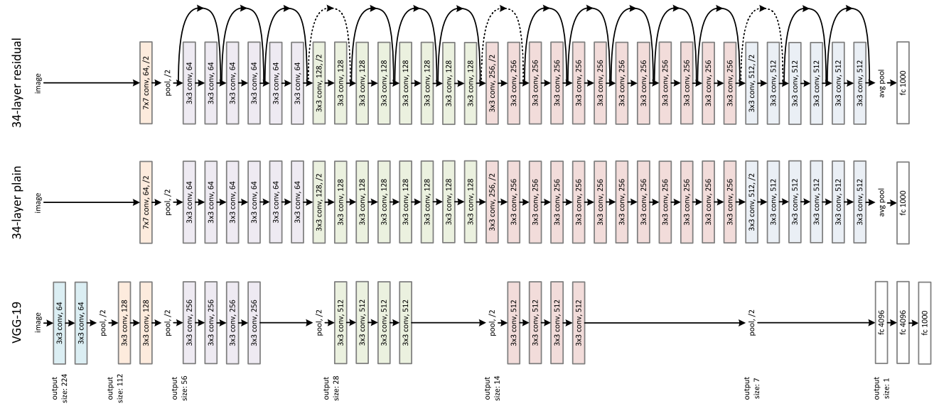
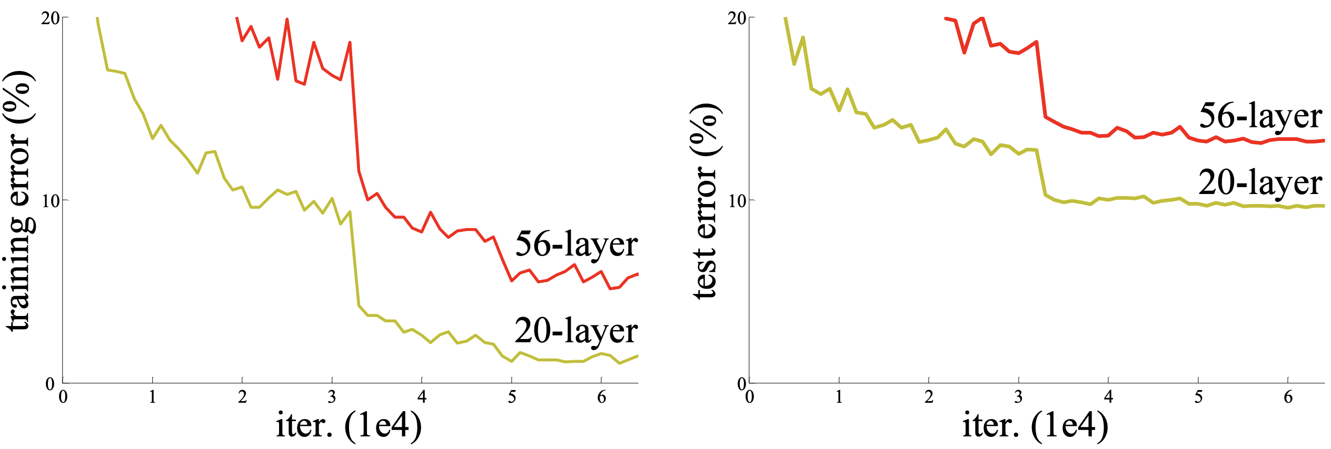
ResNet (152 layers)
He et al., 2015
Q: What happens when we continue stacking deeper layers on a “plain” convolutional neural network?
A: The deeper model performs worse on testing set, but is not caused by overfitting!

Slide 17
ResNet (152 layers)
He et al., 2015
Hypothesis: The problem is an optimization problem, deeper models are harder to optimize!
Solution:
F(x)+x
Learn the residual between input and output!
Relu
F(x)
+
conv
conv
Relu
Relu
x
Identity
conv
conv
x
x
“Plain” layer
Residual Block

Slide 18
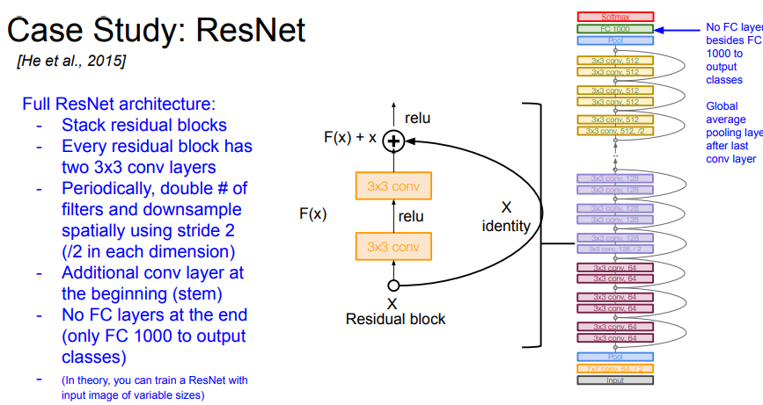
https://github.com/pytorch/vision/blob/master/torchvision/models/resnet.py

Slide 19
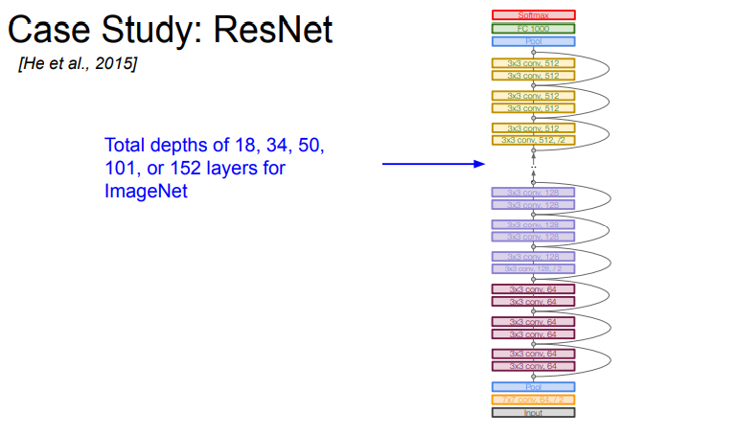

Slide 20
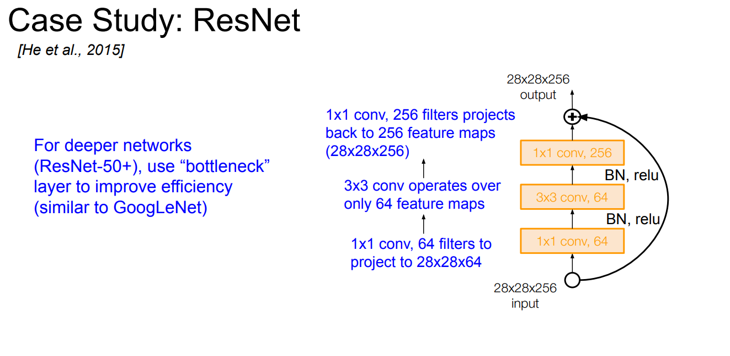

Slide 21
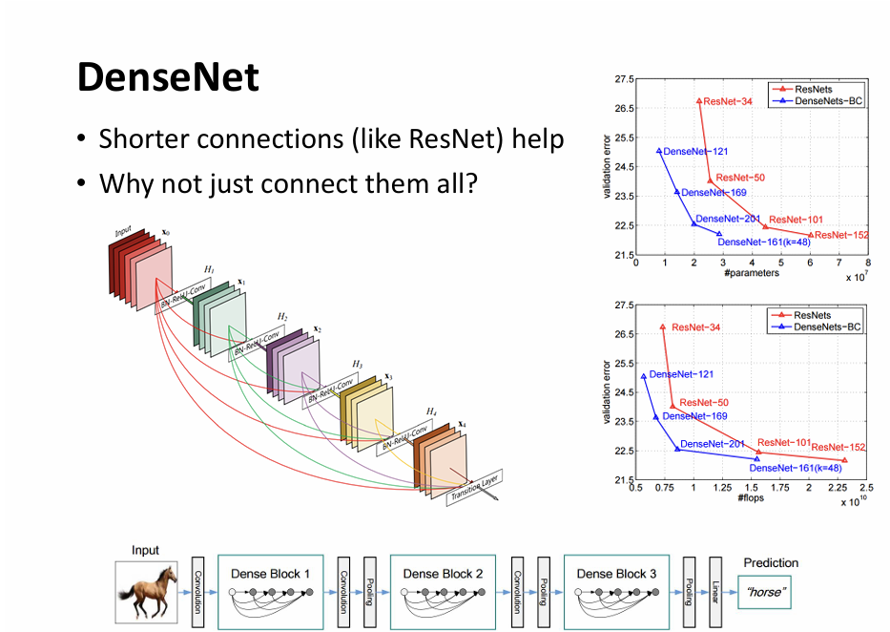

Slide 22
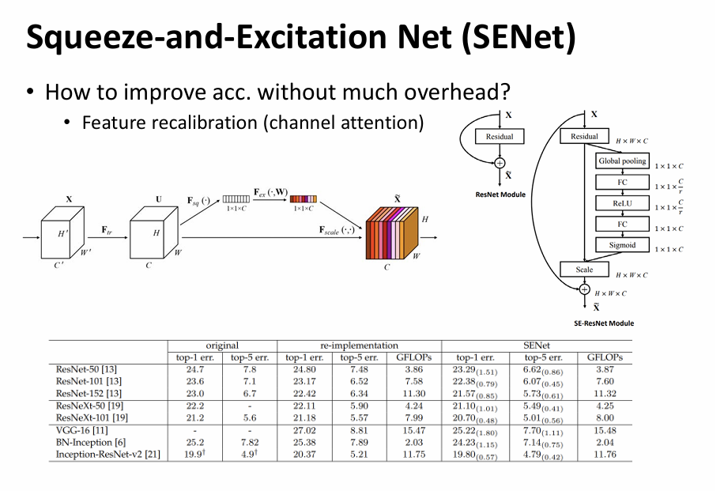

Slide 23
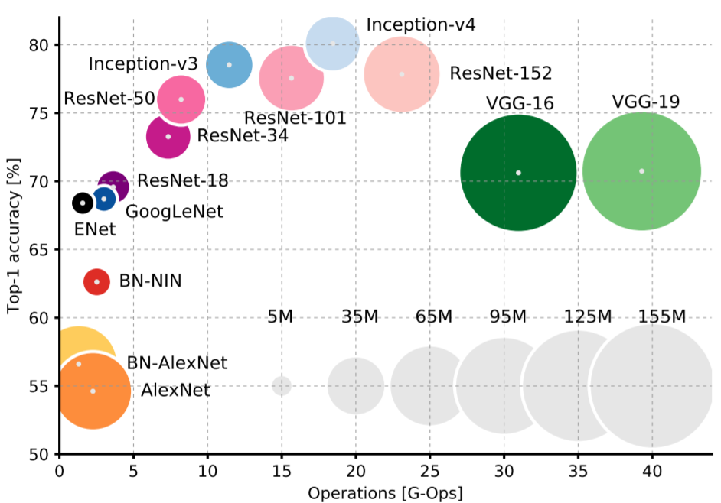
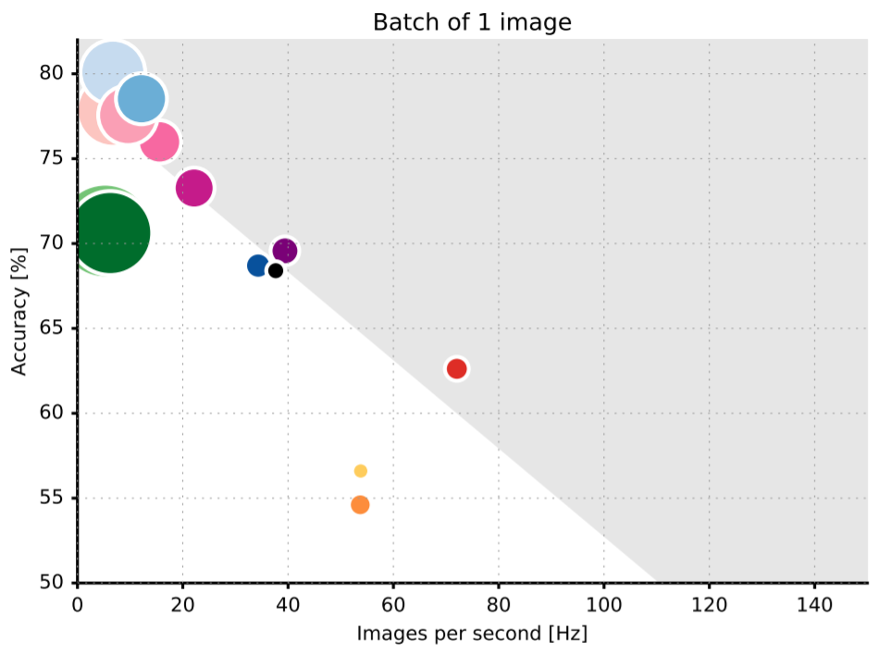
Quick comparison
Top1 vs. operations
(size ∝ parameters)
Accuracy vs. inference speed on TX1
(size∝ operations)
Canziani et al. “An Analysis of Deep Neural Network Models for Practical Applications” ArXiv, 2016.

Slide 24

Quick comparison
These are more likely to run on GPUs, what about low power device or even ASIC?
Top1 vs. operations
(size ∝ parameters)
Accuracy vs. inference speed on TX1
(size∝ operations)
Canziani et al. “An Analysis of Deep Neural Network Models for Practical Applications” ArXiv, 2016.

Slide 25
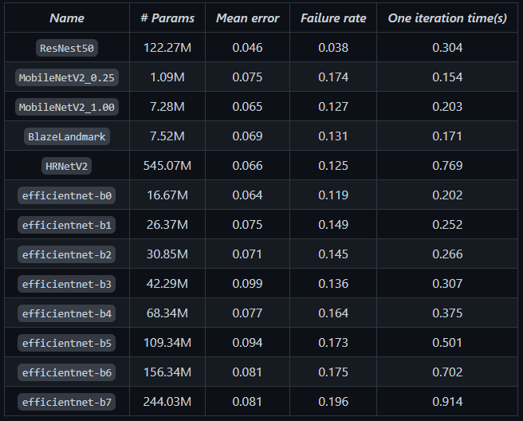
Practical Use
25

Slide 26
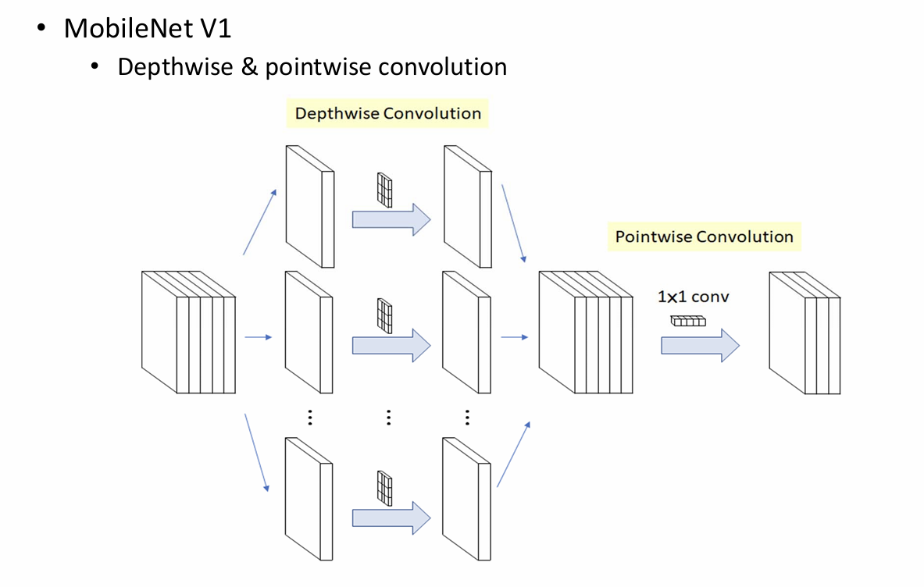
Mobilenet
Howard et al. 2017

Slide 27
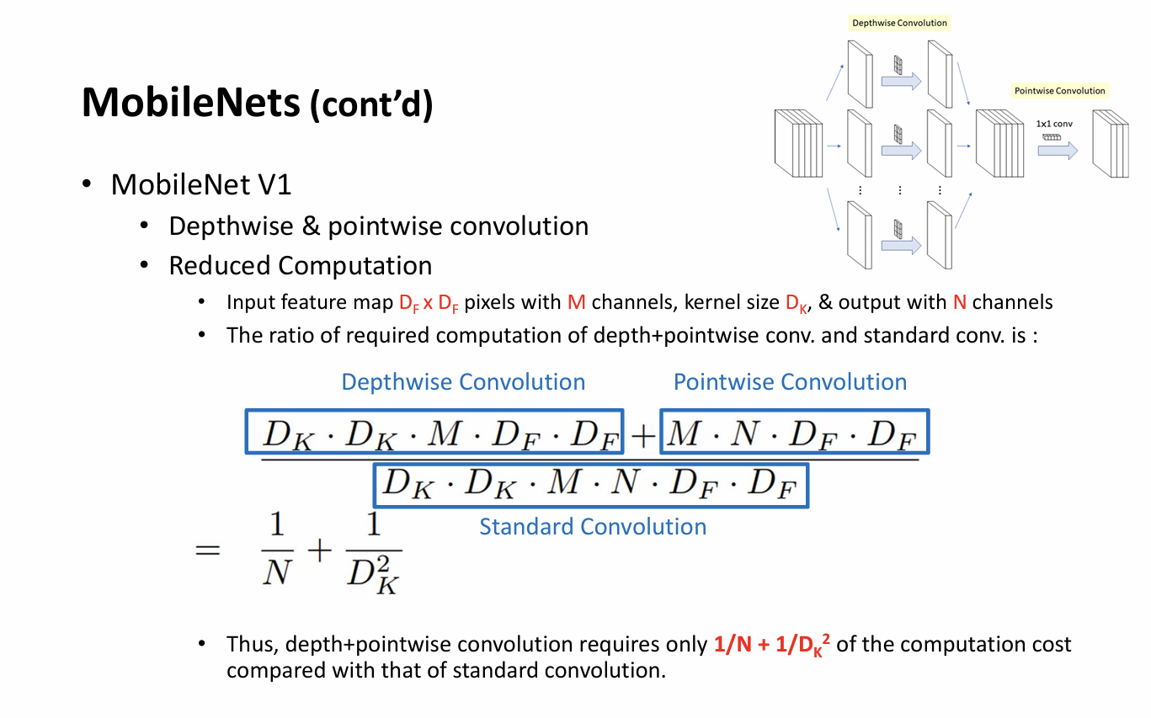
Mobilenet
Howard et al. 2017

Slide 28
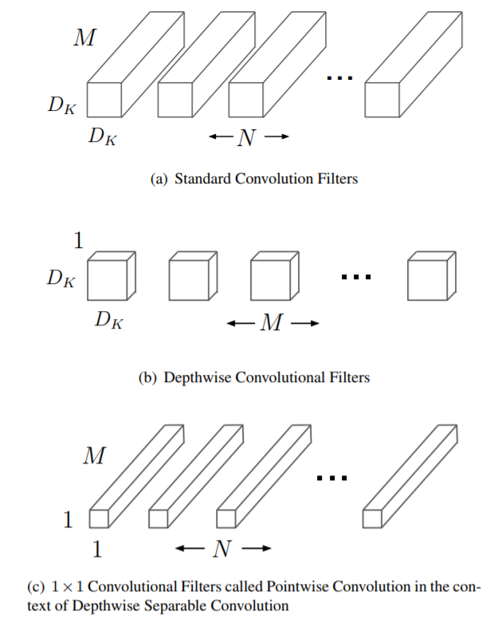
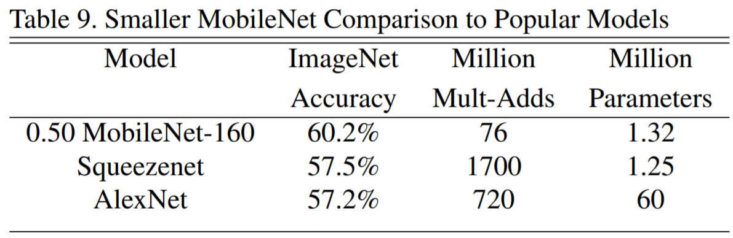

Mobilenet
Howard et al. 2017
Depthwise Separable Convolution
Computation cost:
[Standard conv] $D_{K}∙D_{K}∙M∙N∙D_{F}∙D_{F}$
[Depthwise separable conv]
$$D_{K}∙D_{K}∙M∙D_{F}∙D_{F}+M∙N∙D_{F}∙D_{F}$$
Total reduction: $\frac{1}{N}+\frac{1}{D_{K}^{2}}$

Slide 29
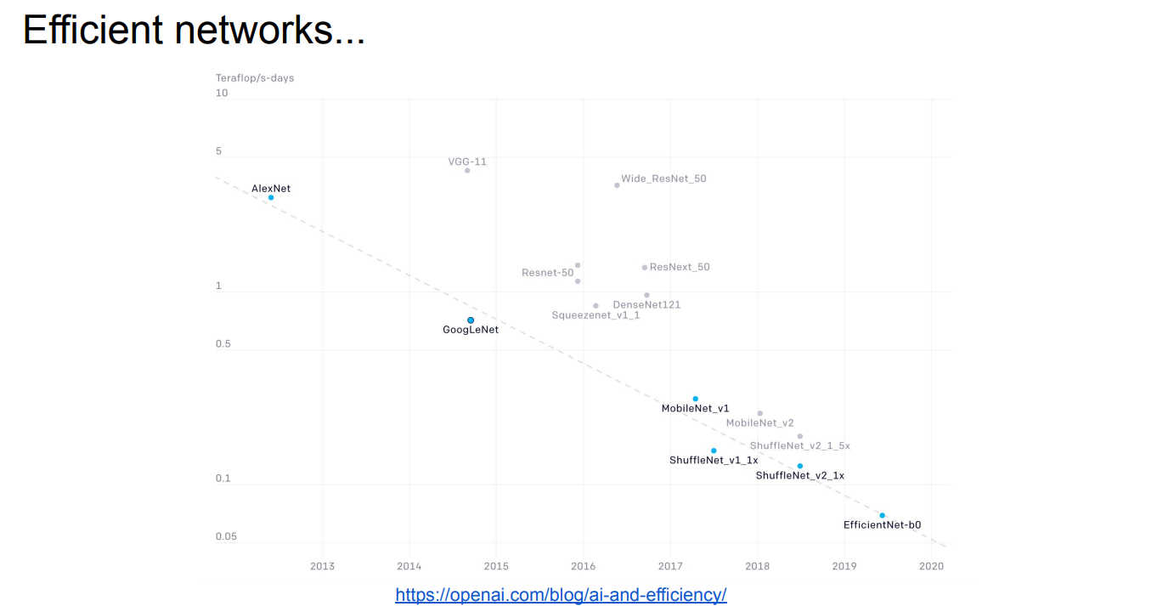

Slide 30
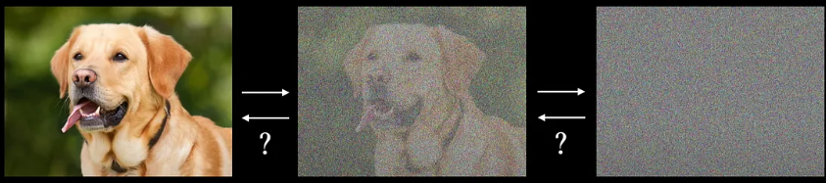
Diffusion Model

Slide 31
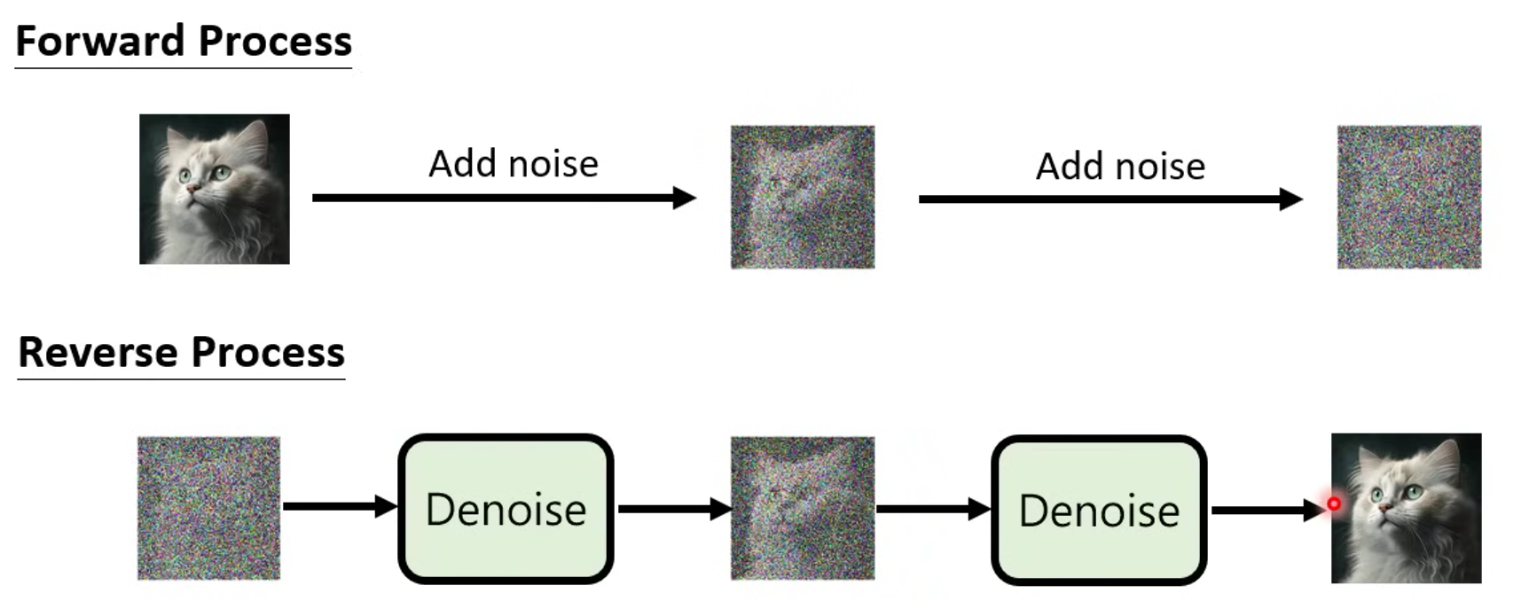
Diffusion Model
https://www.youtube.com/watch?v=ifCDXFdeaaM&list=PLJV_el3uVTsNi7PgekEUFsyVllAJXRsP-&index=4

Slide 32
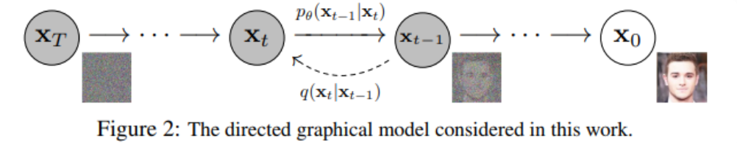

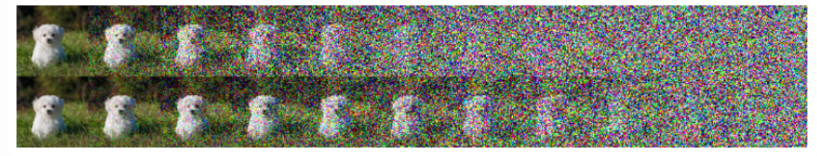
Diffusion Model
Markov chain

Slide 33

Diffusion Model
Reverse:
Loss function:

Slide 34

SUMMARY
Get familiar with common CNN architectures
Pick a CNN architecture to solve CV problems(?)
Learn to figure out critical issues in your problem, and design CNNs accordingly!

