Slide 1
Basic Hardware Simulation & Verification
Li-Yang Huang

Slide 2
References:
  Slides from VLSI Crash Course 2018, Yu Sheng Lin and Ricky Cheng

Slide 3
Introduction to NC-Verilog
The Cadence® NC-Verilog® simulator is a Verilog digital logic simulator.
We can use NC-Verilog to
  Compiles the Verilog source files.
  Elaborates the design and generates a simulation snapshot.
  Simulates the snapshot.

Slide 4

Running Verilog (1/2)
Run the Verilog simulation:
Another choice of running Verilog simulation:
ncverilog testbench.v exp2.rsa.v +access+r
ncverilog -f exp2_rsa.f +access+r
In exp2_rsa.f:

Slide 5


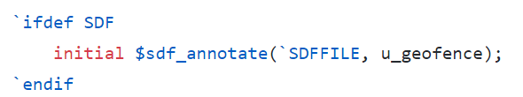
Running Verilog (2/2)
"+access+r" is added to enable waveform file dumping.
*.fsdb has smaller file size than *.vcd.
Gate-level simulation
In testbench.v, line 69~72
or

Slide 6
Introduction to nLint
nLint is a comprehensive HDL design rule checker fully integrated with the Debussy debugging system (Developed by SpringSoft).
We can use nLint to check the coding style of our design and if it is synthesizable.

Slide 7
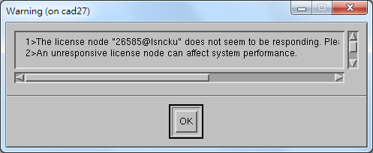
Start nLint
Type the following command:
  The token "&" enable you to use the terminal while nLint is running in the background.
nLint -gui &
Just ignore this warning.

Slide 8
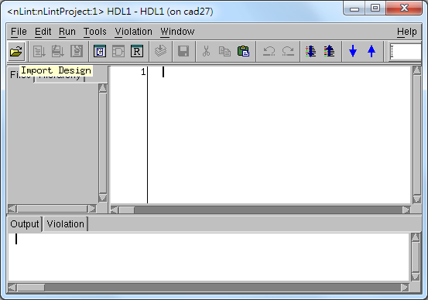
Specify the Design File
1

Slide 9
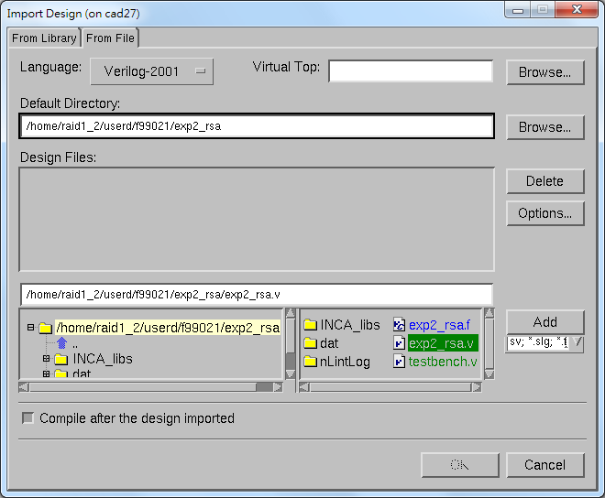
1
2
4
3
5

Slide 10
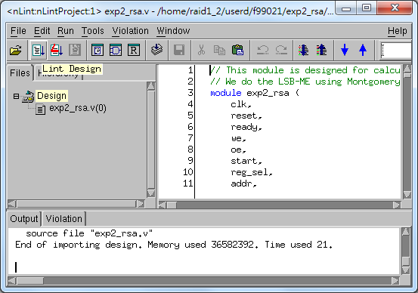
Start Checking
1

Slide 11
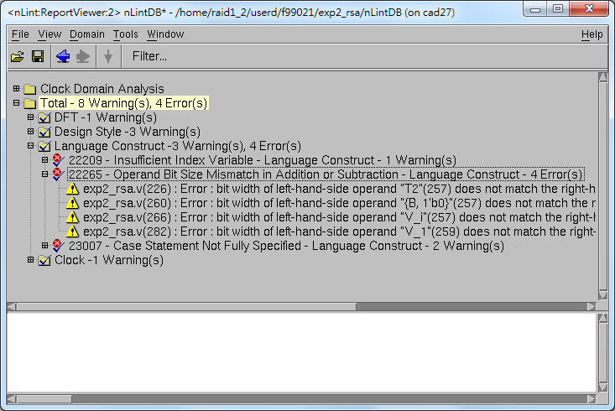
Not all the warnings or errors are valuable.

Slide 12
Introduction to nWave
nWave is one of the best waveform (*.vcd or *.fsdb) viewer.
We can debug easily by checking the waveform file dumped during simulation.

Slide 13
Start nWave
Type the following command:
  Also, the token "&" enable you to use the terminal while Verdi is running in the background.
nWave &
Just ignore this warning.

Slide 14
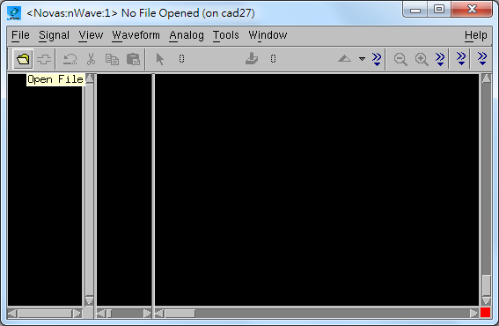
Open the FSDB File
1

Slide 15
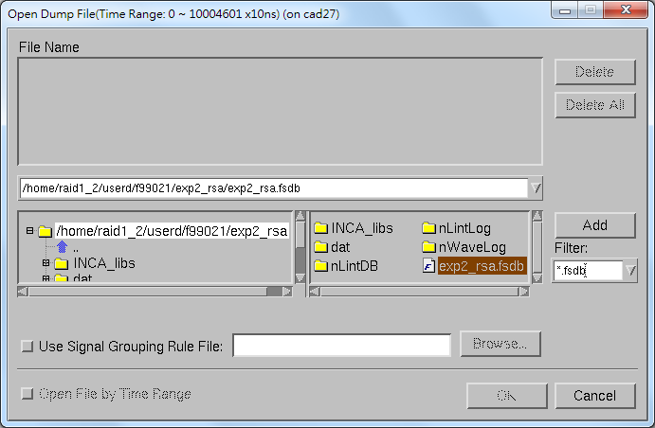
2
1
3

Slide 16
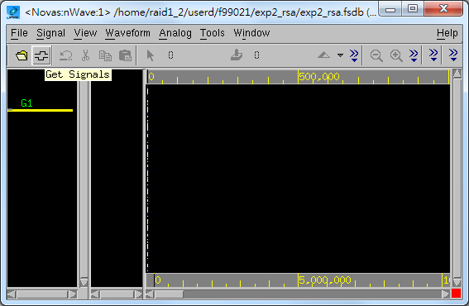
Choose Signals
1

Slide 17
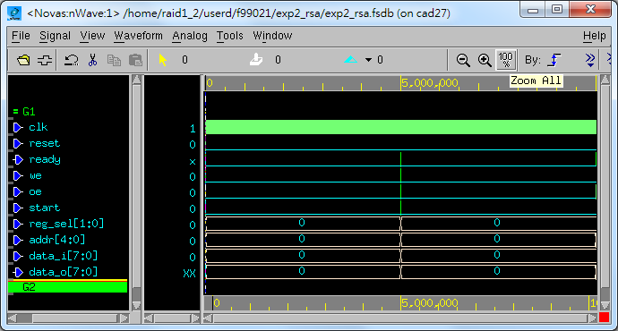
Browse the Whole Waveform
1

Slide 18
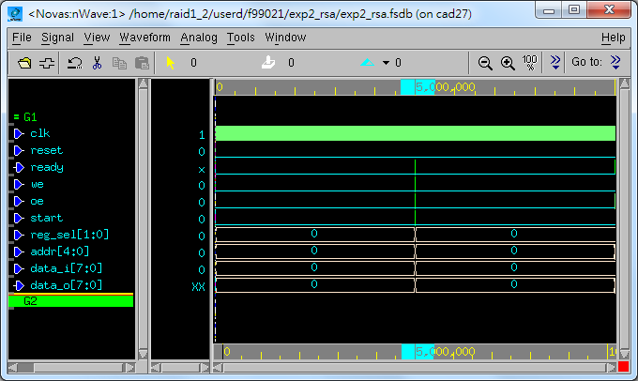
Browse the Specified Interval
press & drag

Slide 19
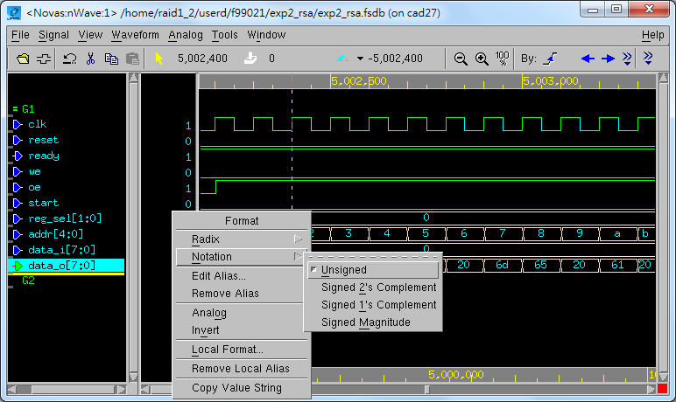

Change Sign Representation
2
3
1

Slide 20
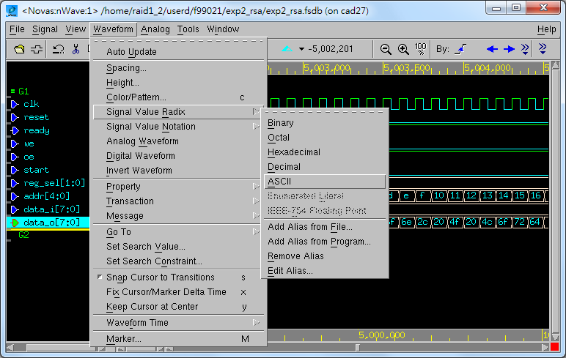
Change Radix Representation
2
3
4
1

Slide 21
Introduction to Verdi
The Verdi Automated Debug System is an advanced open platform for debugging digital designs with powerful technology that helps you:
  Comprehend complex and unfamiliar design behavior.
  Automate difficult and tedious debug processes.
  Unify diverse and complicated design environments.

Slide 22
Basic Function (1/2)
nTrace
  A source code viewer and analyzer that operates on the knowledge database (KDB) to display the design hierarchy and source code (Verilog, VHDL, SysmVerilog, SystemC, PSL, OVA, mixed) for selected design blocks.
  The main window of Verdi.

Slide 23
Basic Function (2/2)
nWave
  A state-of-the-art graphical waveform viewer and analyzer that is fully integrated with Verdi's source code, schematic, and flow views.
nSchema
  A schematic viewer and analyzer that generates interactive debug-specific logic diagrams showing the structure of selected portions of a design.
These two tools can be opened through nTrace.

Slide 24
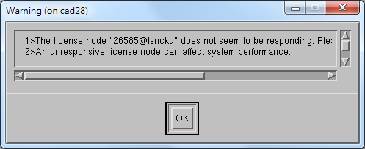
Start Verdi
Type the following command:
  Also, the token "&" enable you to use the terminal while Verdi is running in the background.
verdi &
Just ignore this warning.

Slide 25
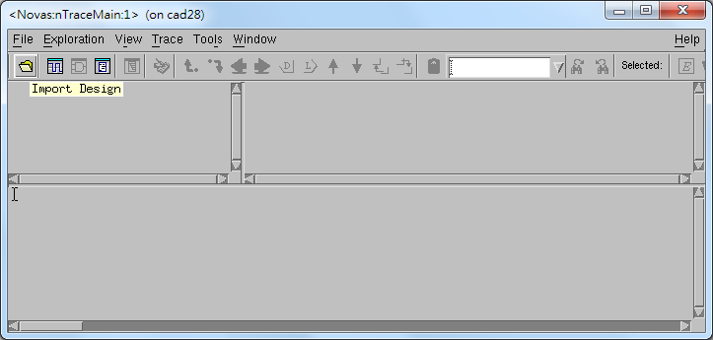
nTrace
1

Slide 26
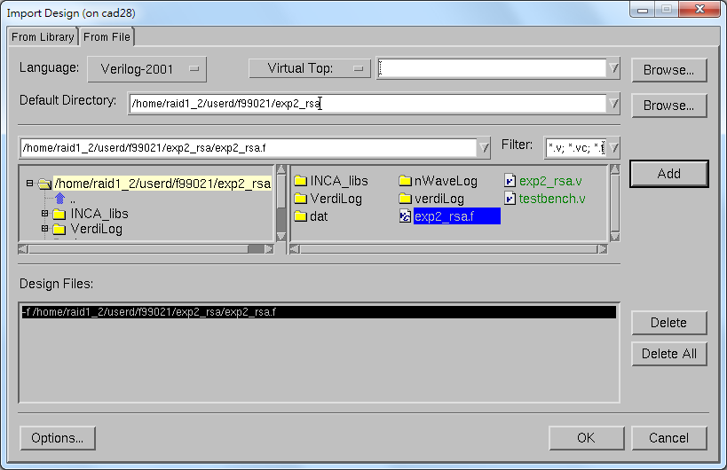
1
2
4
3
5

Slide 27
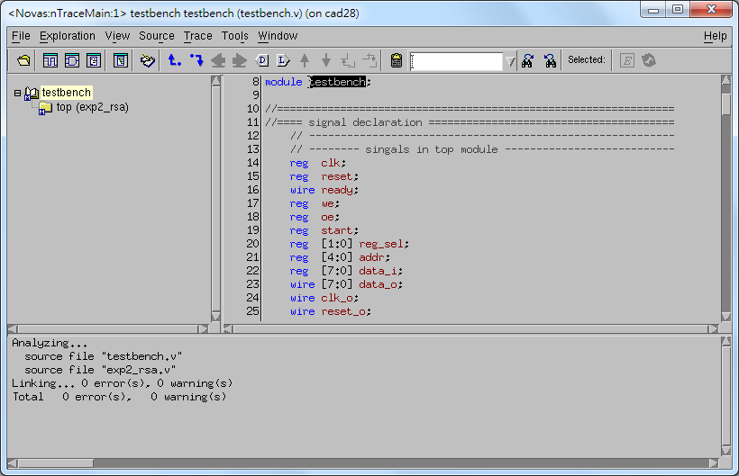
1 (double-click)
Netlist Code
Window
Hierarchical
Browser
Message
Window

Slide 28
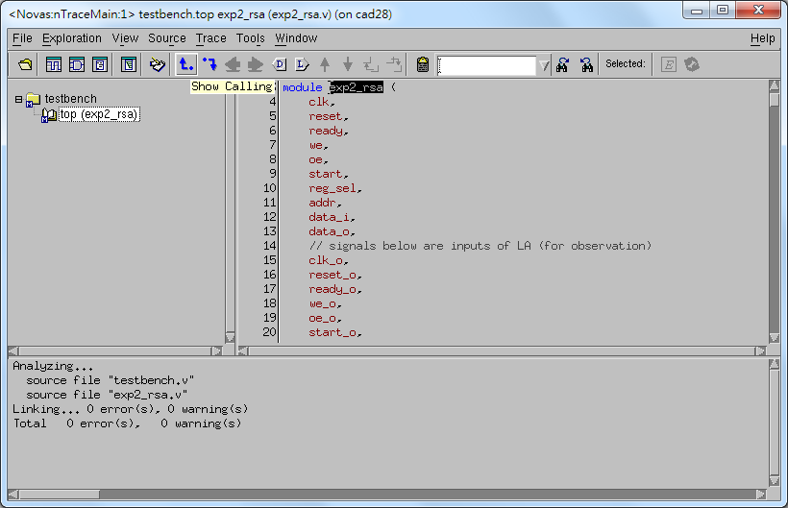
1
1
double-click

Slide 29
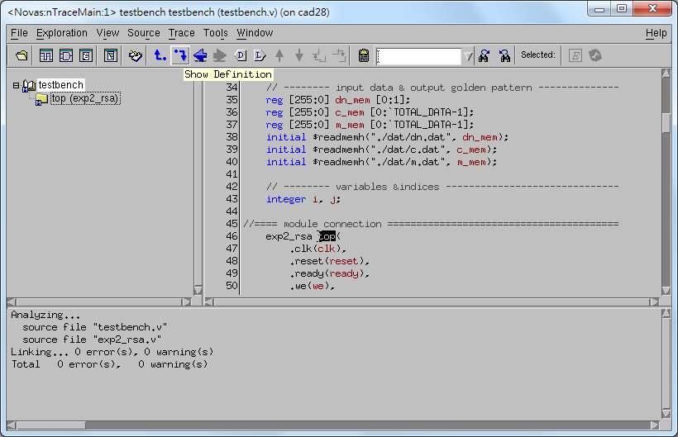
1
1
double-click

Slide 30
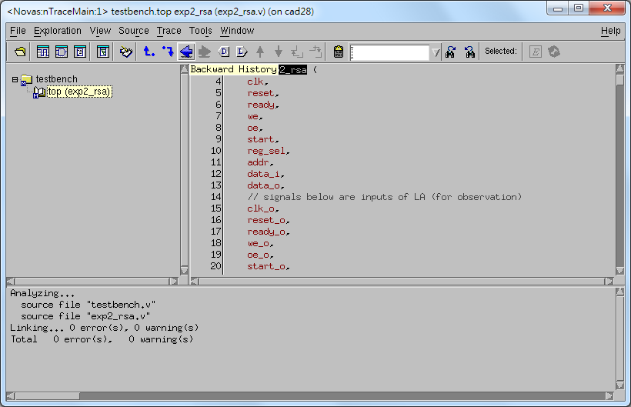
1

Slide 31

1

Slide 32
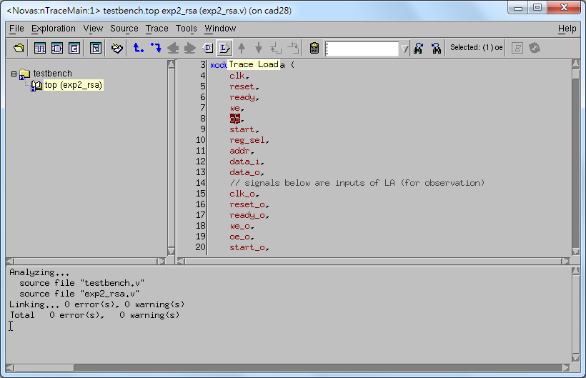
2
1

Slide 33
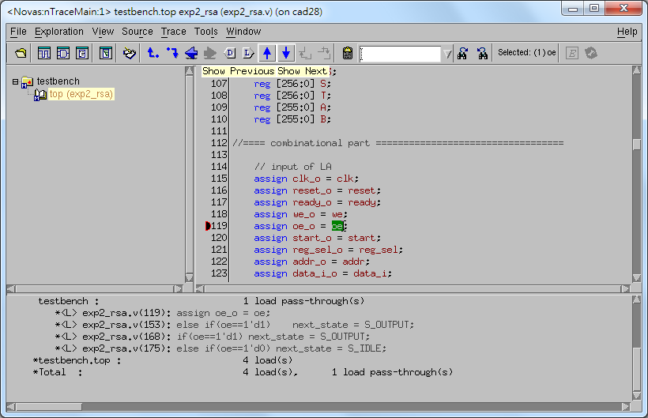

Slide 34
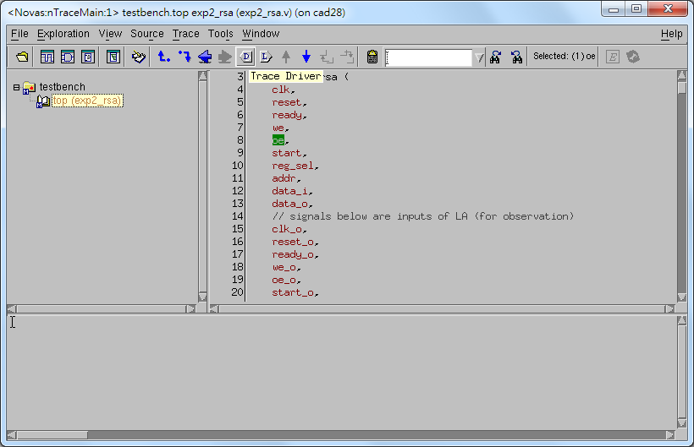
2
1

Slide 35
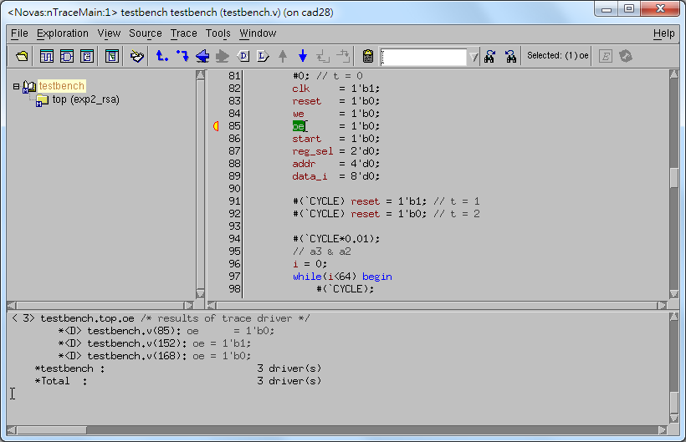

Slide 36
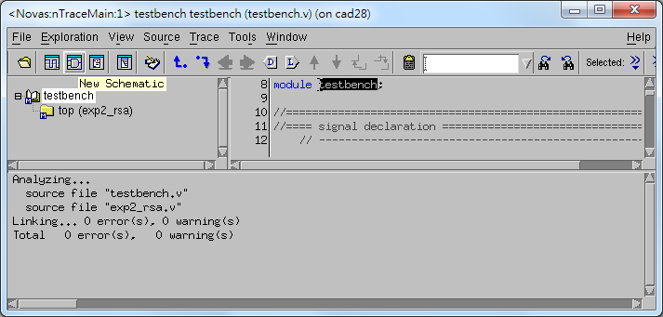
nSchema
1

Slide 37
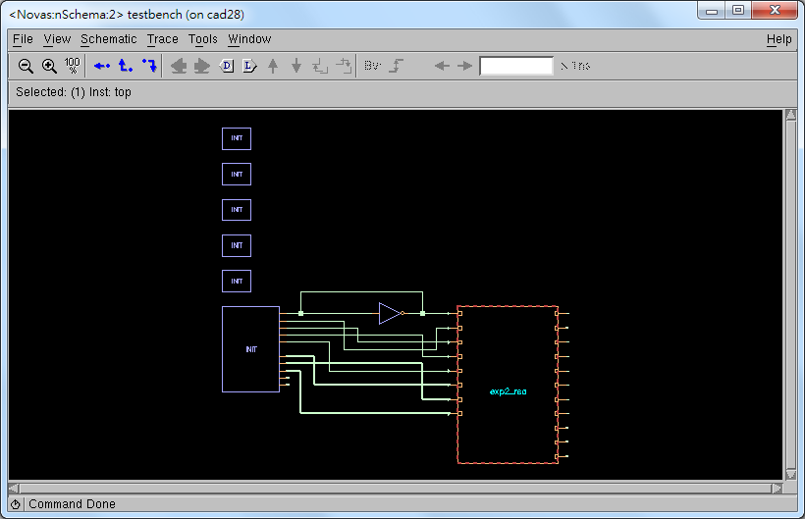
Push View In
1 (double-click)

Slide 38
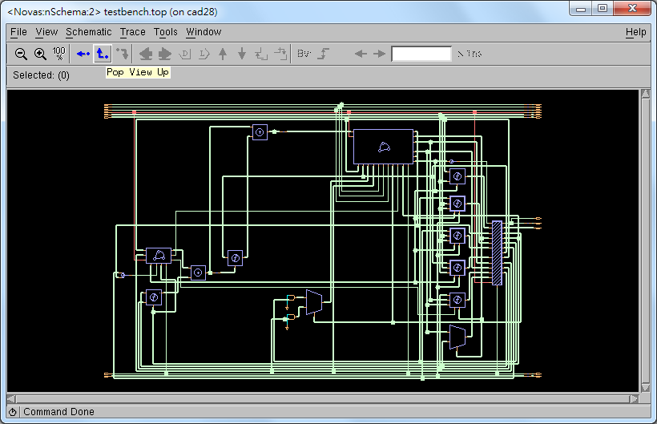
1

Slide 40

nWave
1

Slide 41
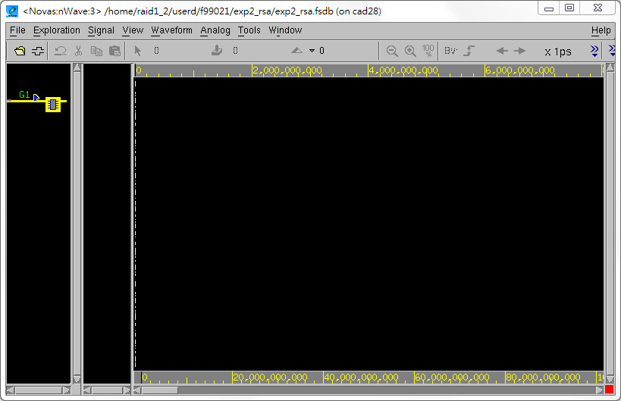
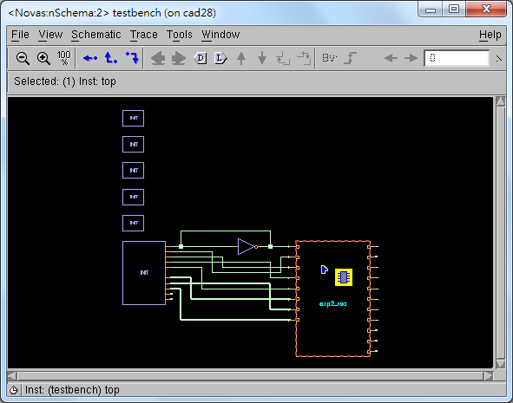
1
Press middle mouse button,
drag and then drop.

Slide 42
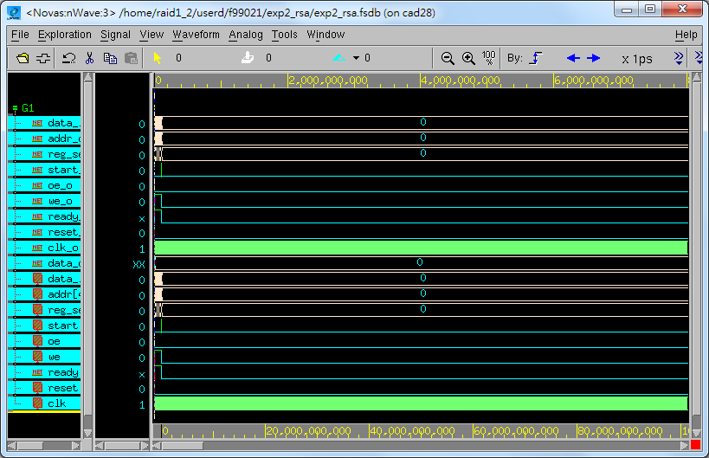

Slide 43
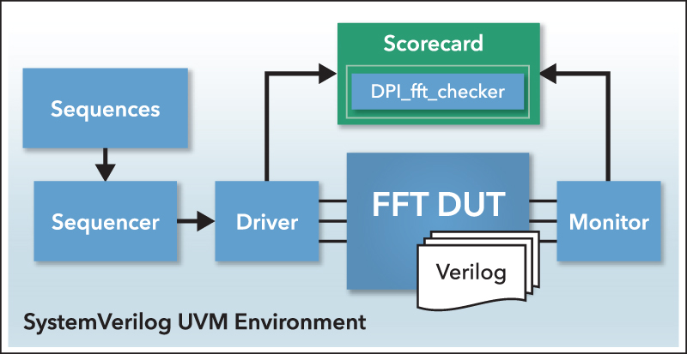
What Forms Verification?
I borrow the concept of UVM (Universal Verfication Methodology).
(We usually call this overall platform as testbench.)
Generate Golden Data
Your RTL
https://verificationacademy.com
Monitor output ports and collect data
Drive data to input ports

Slide 44
What Forms Verification?
Universal Verfication Methodology.
What does universal means?
Universal protocol largely enable code reuse!

Slide 45
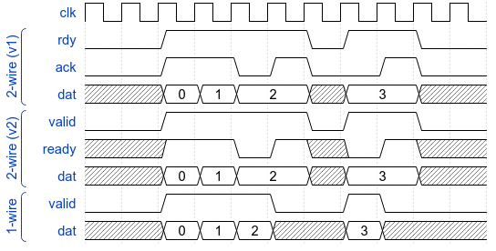
Some Effective Protocols

Slide 46
Importance of Protocol in Hardware Design
Design as dataflow, implement as protocol.
Benefits:
  Reuse verfication.
  Play-and-Plug.
  Uniform code.
  Widely used and easy to understand.
Protocol must be simple:
  Handshake (2-wire)
  Streaming (1-wire)

Slide 47
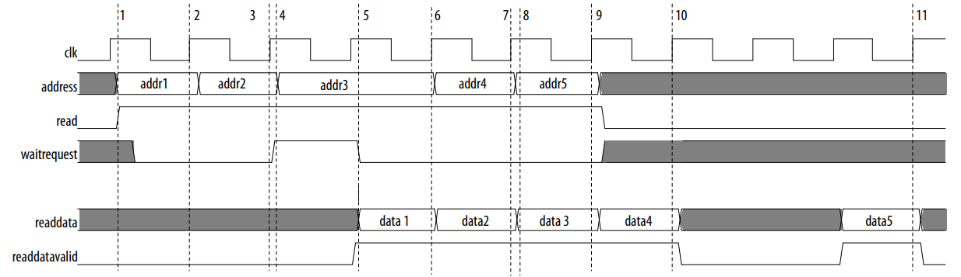
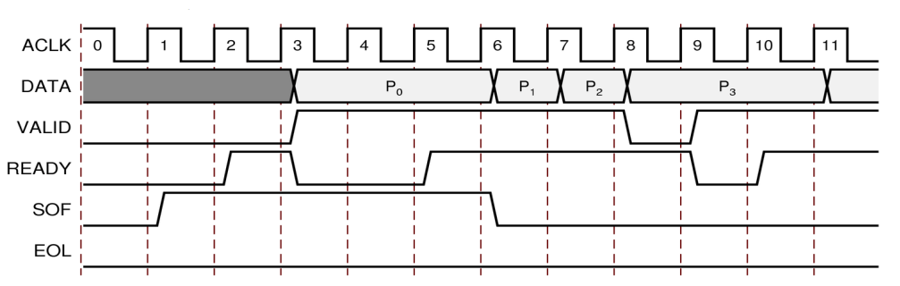
The Basic Protocols in Industry
Handshake and streaming are the foundation of complex ones!
Don't worry, we will explain later.
Streaming
Intel Avalon Protocol
https://www.altera.com/content/dam/altera-www/global/en_US/pdfs/literature/manual/mnl_avalon_spec.pdf
Handshake
ARM AXI Protocol
https://www.xilinx.com/support/documentation/ip_documentation/axi_ref_guide/v13_4/ug761_axi_reference_guide.pdf
Handshake

Slide 48
The Simplest Streaming Protocol
A valid bit indicate whether data bus hold a valid data.

Slide 49
Easy to Cascade Modules
You can easily add new stage to add new functionalities.
Input
Module A
Module B
Output
Input
Module A
Module C
Module B
Output

Slide 50
The Improved Handshake Protocol
A valid bit indicate whether data bus hold a valid data.
  But a ready bit indicate whether the receiver can got it.
How to split/merging two signals?
Done in 1 cycle
ack is 0, wait 1 more cycle

Slide 51
2 Versions of Handshake Protocol
The valid/ready is not a formal name, and this is the ARM's name.
There are 2 small variations.
The only difference: can ready be 1 if valid is 0?

Slide 52
2 Versions of Handshake Protocol
V2 can be converted V1 by simply a AND gate.
V1 is a valid V2.
AND

Slide 53
2 Versions of Handshake Protocol
In V1, the AND gate adds an extra combinational path.
In V1, you cannot know whether the next stage is OK to get data.
(For these reasons, I prefer V2)
AND

Slide 54
Brief Summarize
Streaming (1-wire) protocol.
  Very simple to use.
  But large, be sure you can always receive the data.
Handshake (2-wire) protocol.
  Can stop the data input.
  Very very commonly used!!
Both make easy-to-understand hardware pipeline.
Both are widely used in industries.

Slide 55
The Non-RTL Parts
The non-RTL parts can be implemented without Verilog!
This is usuallyed called co-simulation (co-sim).

Slide 56
Brief Conclusions - A Testbench Must
Instantiate (make a copy of) your module.
Driver to send data.
Monitor to receive and collect them.
Driver and Monitor might follow specific protocols.
The collected data are compared by Scoreboard.
  Golden (Mostly text file in Verilog, or programmatically when co-simed.)
  Generated by your RTL module and collected by Monitor.

Slide 57
No Need for Verify RTL with Verilog
Verilog provide external C accesses through VPI.
  https://en.wikipedia.org/wiki/Verilog_Procedural_Interface
Based on C, people develops Java, Python... versions.
AFAIK, there are quite a lot Python based frameworks.
  myhdl: https://github.com/myhdl/myhdl
  cocotb: https://github.com/potentialventures/cocotb
  nicotb: https://github.com/johnjohnlin/nicotb
We focus on this today.

Slide 58
Why Should I Write in Testbench Python?
You have learnt that.
Why should you write testbench with Verilog if you can write in Python?
Complete libraries: Numpy and DNN frameworks...
2nd~3rd place popular programming language.
Easy to learn and to write.
Not very fast compared with C
  Do you care about performance in RTL simulation?
Native asynchronize language support.
It's cooooool.

Slide 59
Bridging Python and Verilog (Events)
Add these lines in Python
  rst_out_ev, ck_ev = CreateEvents(["rst_out", "ck_ev",])
Add this lines in Verilog
  `Pos(rst_out, rst)
  `PosIf(ck_ev, clk, rst)
This means, whenever a clk posedge in Python, ck_ev is triggered
  Mostly your submodules use 1 reset and clock and you just copy it.
That is,
  Python yield ck_ev = Verilog @posedge clk
However, simply writing yield in Python doesn't make thing easier.
  We will explain later.

Slide 60
Bridging Python and Verilog (Wires)
API to connect Verilog wires
  my_data_bus = CreateBus((
  ("", "a_signal", (4,2)),
  ("dut", "sig"),
  ("dut", "sig2"),
  ))
The Verilog to be connected
  logic [7:0] a_signal [4][2];
  DUT my_dut(
  .clk(clk),
  .sig(sig)
  )
hierarchy: toplevel → ""
name: a_signal
shape: (4,2)

Slide 61
Access Verilog Wires in Python
my_data_bus = CreateBus((
("", "a_signal", (4,2)),
("dut", "sig"),
("dut", "sig2"),
))
my_data_bus.Read()
my_data_bus.Write()
my_data_bus.a_signal.value → Numpy array of shape (4,2)
my_data_bus.sig.value → Numpy array of shape (1,)
my_data_bus.sig2.value → Numpy array of shape (1,)

Slide 62
Drive Verilog Wire In Python (Quite Easy!)
Probability = A/B (default = 1/5)
master = TwoWire.Master(irdy, iack, iint, ck_ev, A=1, B=5)
values = master.values
def it():
for N in Ns:
values.iint[0] = N
yield values
yield from master.SendIter(it())
yield from master.SendIter(it(), latency=100)
Access data bus by name
values.iint is a Numpy array of size (1,)
This randomly drive the input.
This drive data every 100 cycles.

Slide 63
Conclusions
Introduce the idea behind SystemVerilog UVM.
With Python, you can do the same thing much easily.
We introduce Nicotb today.
  Document: https://johnjohnlin.github.io/nicotb/
And there are many choices.
  myhdl: https://github.com/myhdl/myhdl
  cocotb: https://github.com/potentialventures/cocotb

