Slide 1
Python OpenCV Lab 2024
周奕節
2024.08.14

Slide 2
Outline
Prerequisite
Lab1: Basic Image Processing
  Image Filtering
  Image PCA Analysis
Lab2: Homography

Slide 3
Outline
Prerequisite
Lab1: Basic Image Processing
  Image Filtering
  Image PCA Analysis
Lab2: Homography

Slide 4
工作站
Refer to 421 wiki to get remote host and port.
For today’s labs, we use MediaGti.
  Remote host: 140.112.48.127
  Port: 10820

Slide 5
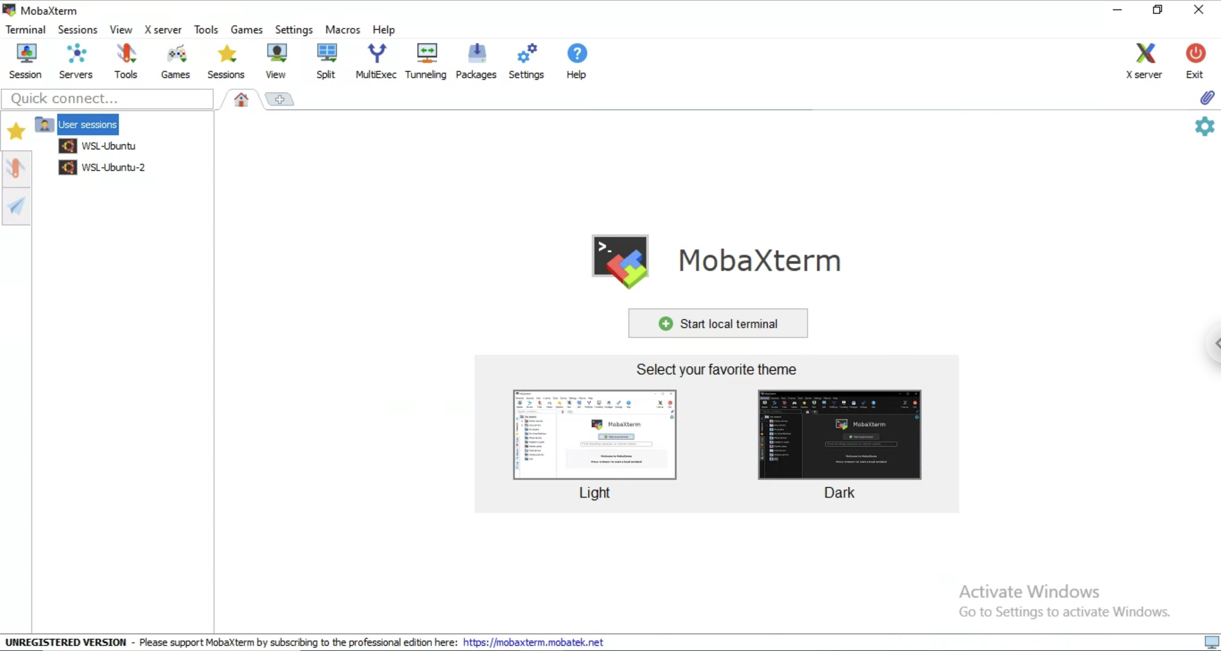
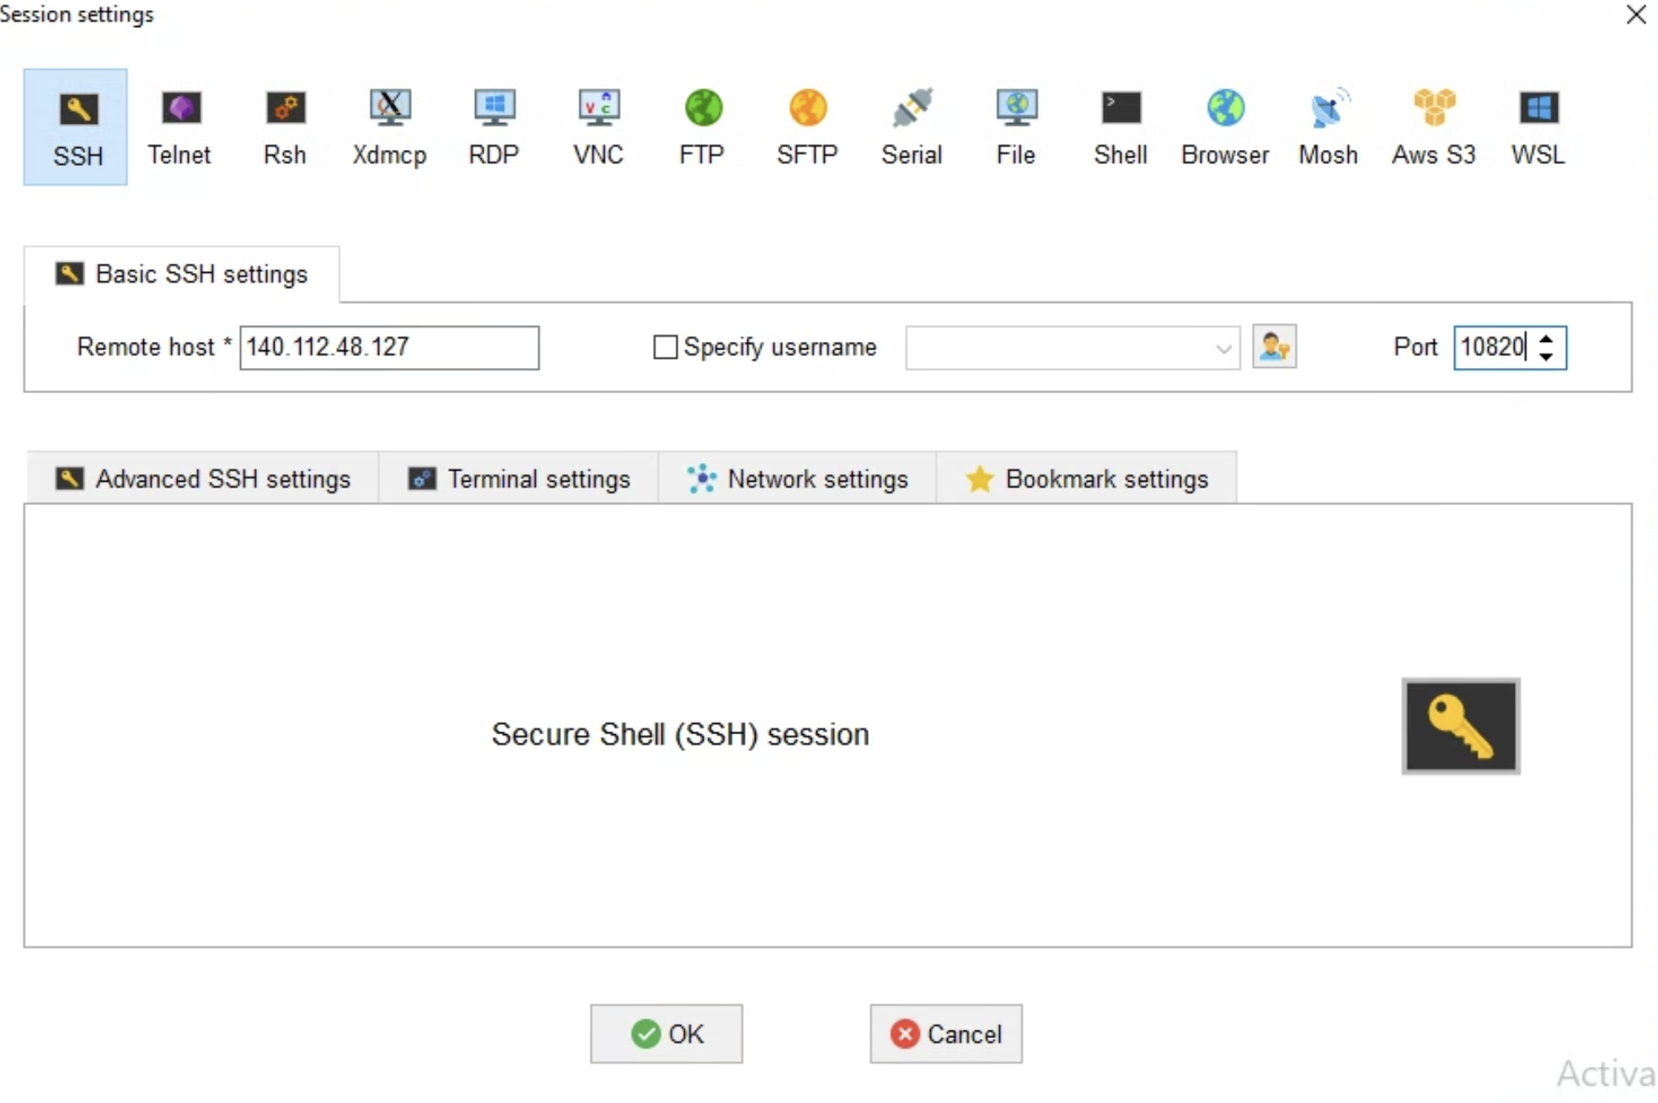
MobaXterm
1
2
3
4
5
6. When you log in, type $passwd to update the password.

Slide 6
SSH
Open terminal.
Type $ssh username@140.112.48.127 -p 10820
Enter your password.
Type $passwd to update the password.

Slide 7
Optional: Easier SSH login (1/2)
Generate an SSH key pair on your computer.
  Type $ssh-keygen -t ed25519
  This will create a private key at ~/.ssh/id_ed25519 and the corresponding public key at ~/.ssh/id_ed25519.pub
Append the contents of the public key to the ~/.ssh/authorized_keys file on the server. (If the path does not exist, you can create it by yourself)
Subsequent logins will be authenticated using keys, eliminating the need for a password.

Slide 8
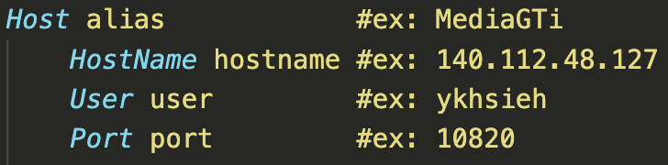
Optional: Easier SSH login (2/2)
It is crumbersome to type $ssh username@140.112.48.127 -p 10820 every time you want to log in.
Create a file named ~/.ssh/config and add the following contents:
You can simply use $ssh <alias> to log in.

Slide 9
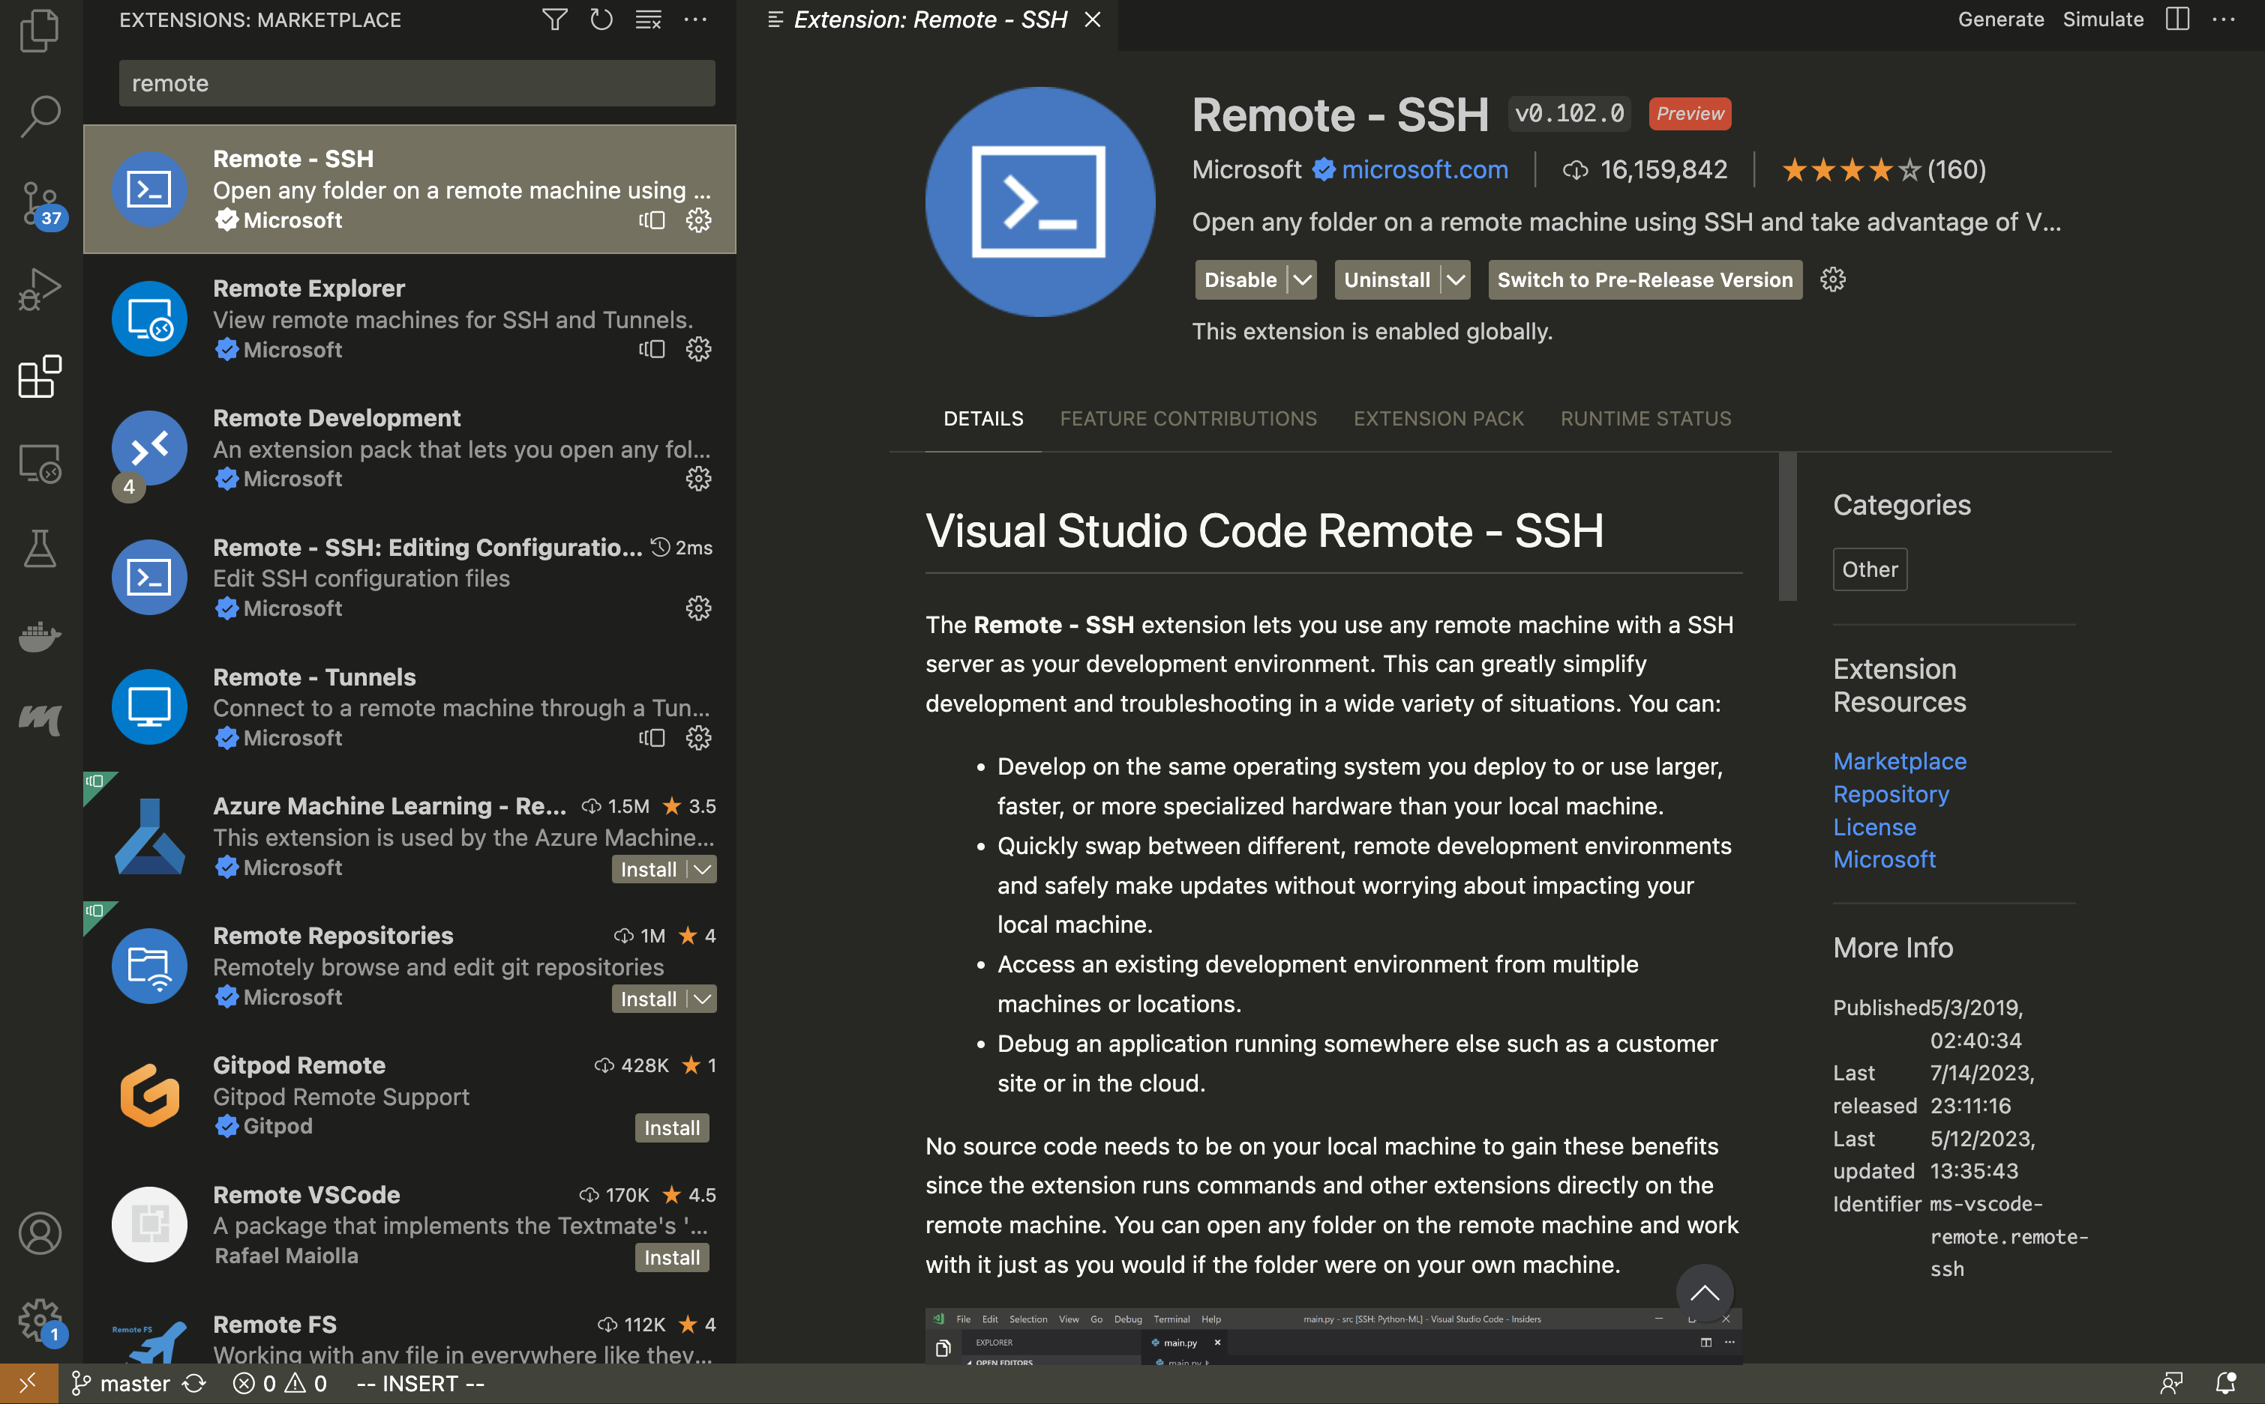
Optional: VSCode Plugin

Slide 10
Linux Commend
Tutorial: https://blog.techbridge.cc/2017/12/23/linux-commnd-line-tutorial/, Google
Basic:
  cd, ls, git, mkdir, mv, rm, …
Useful tool:
  tmux, nvidia-htop, nvidia-smi, jupyter notebook, anaconda, …

Slide 11
Python Grammar
Tutorial: http://cs231n.github.io/python-numpy-tutorial/, Google
Basic:
  print(), if else, for loop
Useful
  List, indexing of list
  Ex: a = [1,2,4]; a[0] = 1; a[-1] = 4; a[:2] = [1,2]
Optional
  Function declaration (if some process is repeated)

Slide 12
NumPy
Tutorial: http://cs231n.github.io/python-numpy-tutorial/, Google
Import library:
  import numpy as np
Basic:
  Array initialization, basic property (shape, data type), indexing
Useful:
  Build-in function for array operation: argmin, matmul

Slide 13
OpenCV
Tutorial: https://docs.opencv.org/4.5.2/, Google
Basic
  Image read, write, resize, color conversion, …
Useful
  Padding, filtering, other CV tasks

Slide 14
[Supplement] some tips for image read/write
All image read method
  OpenCV
  Pillow
  Matplotlib
  Scikit-image
  Imageio
  Scipy.misc (unavailable after 1.1.0)
Shape: (H, W, C)
In OpenCV, the default color order is BGR
Change to np.array and change dtype from uint8 to floatXX before some operations
More examples in ImageRead.ipynb

Slide 15
Outline
Prerequisite
Lab1: Basic Image Processing
  Image Filtering
  Image PCA Analysis
Lab2: Homography

Slide 16
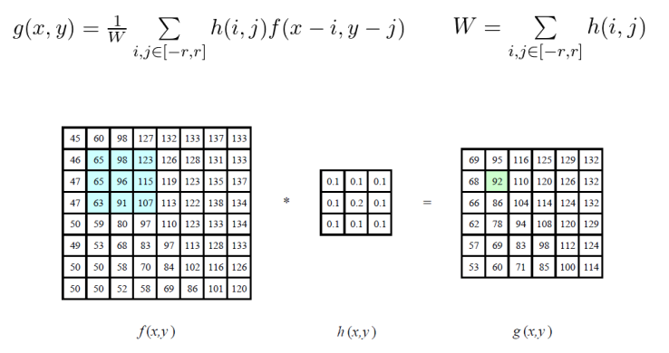
Image Filtering (1/2)
Weighted sum of the region of the input

Slide 17
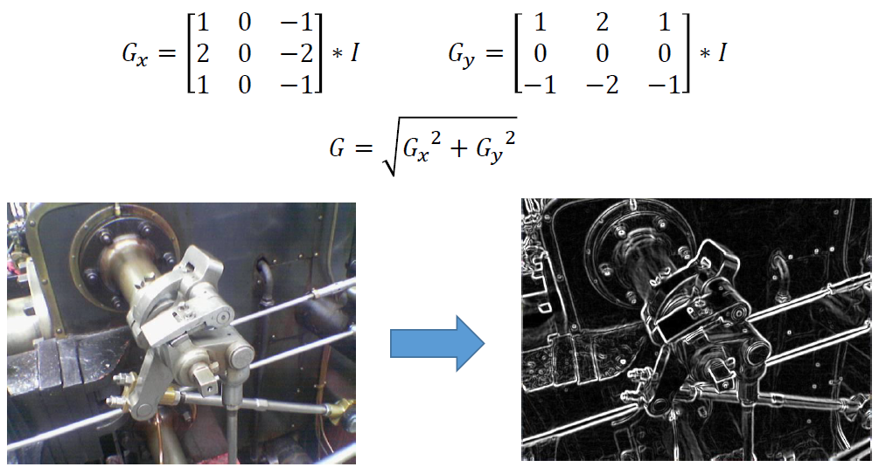
Image Filtering (2/2)
Sobel filter: used in edge detection

Slide 18
Principal component Analysis (PCA) (1/5)
Definition:
  PCA is defined as an orthogonal linear transformation that transforms the data to a new coordinate system such that the greatest variance by some scalar projection of the data comes to lie on the first coordinate (called the first principal component), the second greatest variance on the second coordinate, and so on (wikipedia)
Goal:
  Linear dimension reduction
  Visualize data
  Reduce computations and storage

Slide 19




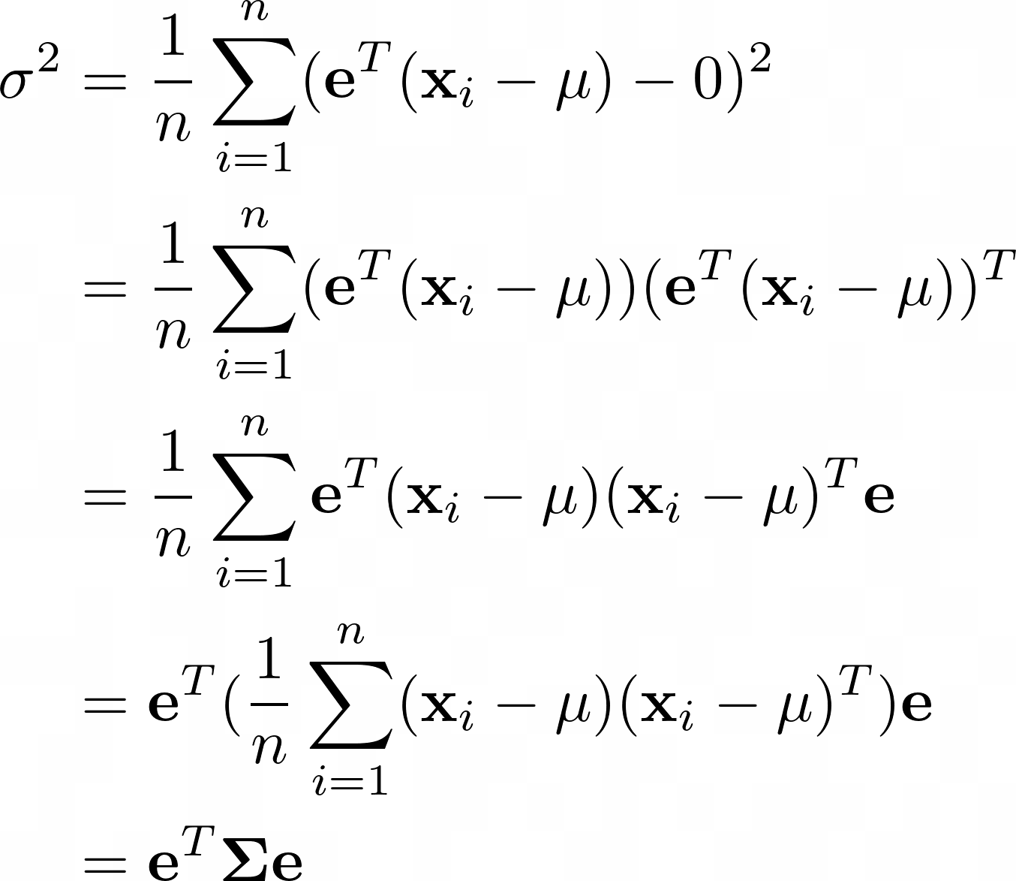


Principal component Analysis (PCA) (2/5)
For a set of samples ${\{x_{i}\}}_{i=1}^{n}$
If $e$ is a unit vector, the projection of vector ${(x}_{i}−μ)$ onto $e$is
The variance of the projections is
Covariance matrix

Slide 20
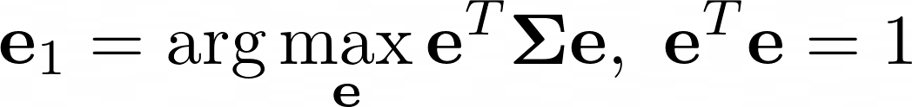
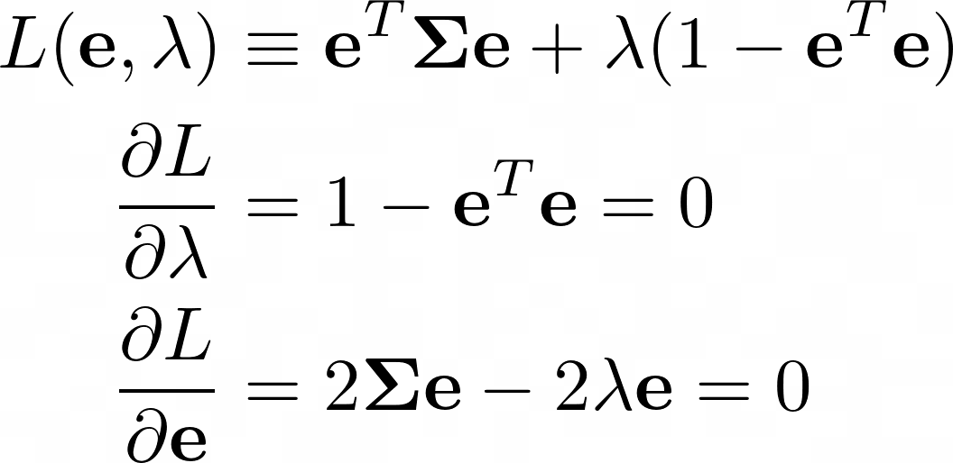
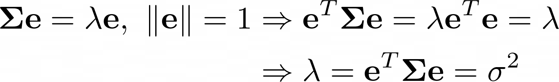

Principal component Analysis (PCA) (3/5)
The first principle component:
  Choose a unit vector $e$ so as to maximize $σ^{2}$
  Using the method of Lagrange multipliers:
  Equavalent to finding the largest eigenvalue and the conresponding eigenvector

Slide 21
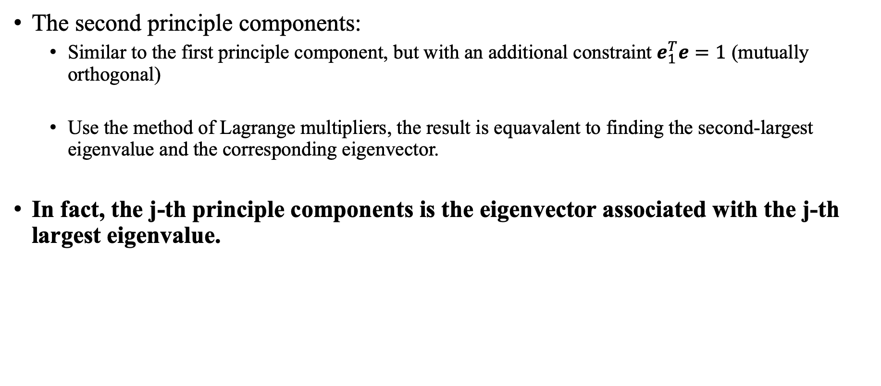
Principal component Analysis (PCA) (4/5)
The second principle components:
  Similar to the first principle component, but with an additional constraint $e_{1}^{T}e=1$ (mutually orthogonal)
  Use the method of Lagrange multipliers, the result is equavalent to finding the second-largest eigenvalue and the corresponding eigenvector.
In fact, the j-th principle components is the eigenvector associated with the j-th largest eigenvalue.

Slide 22
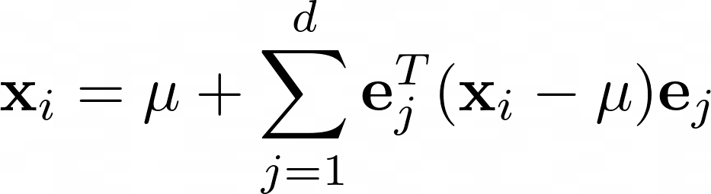
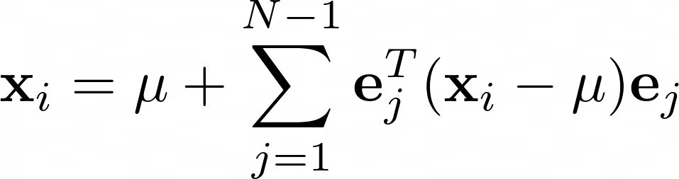
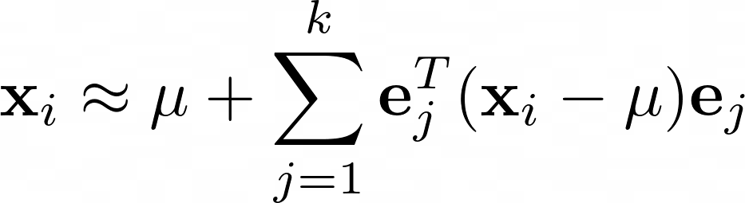
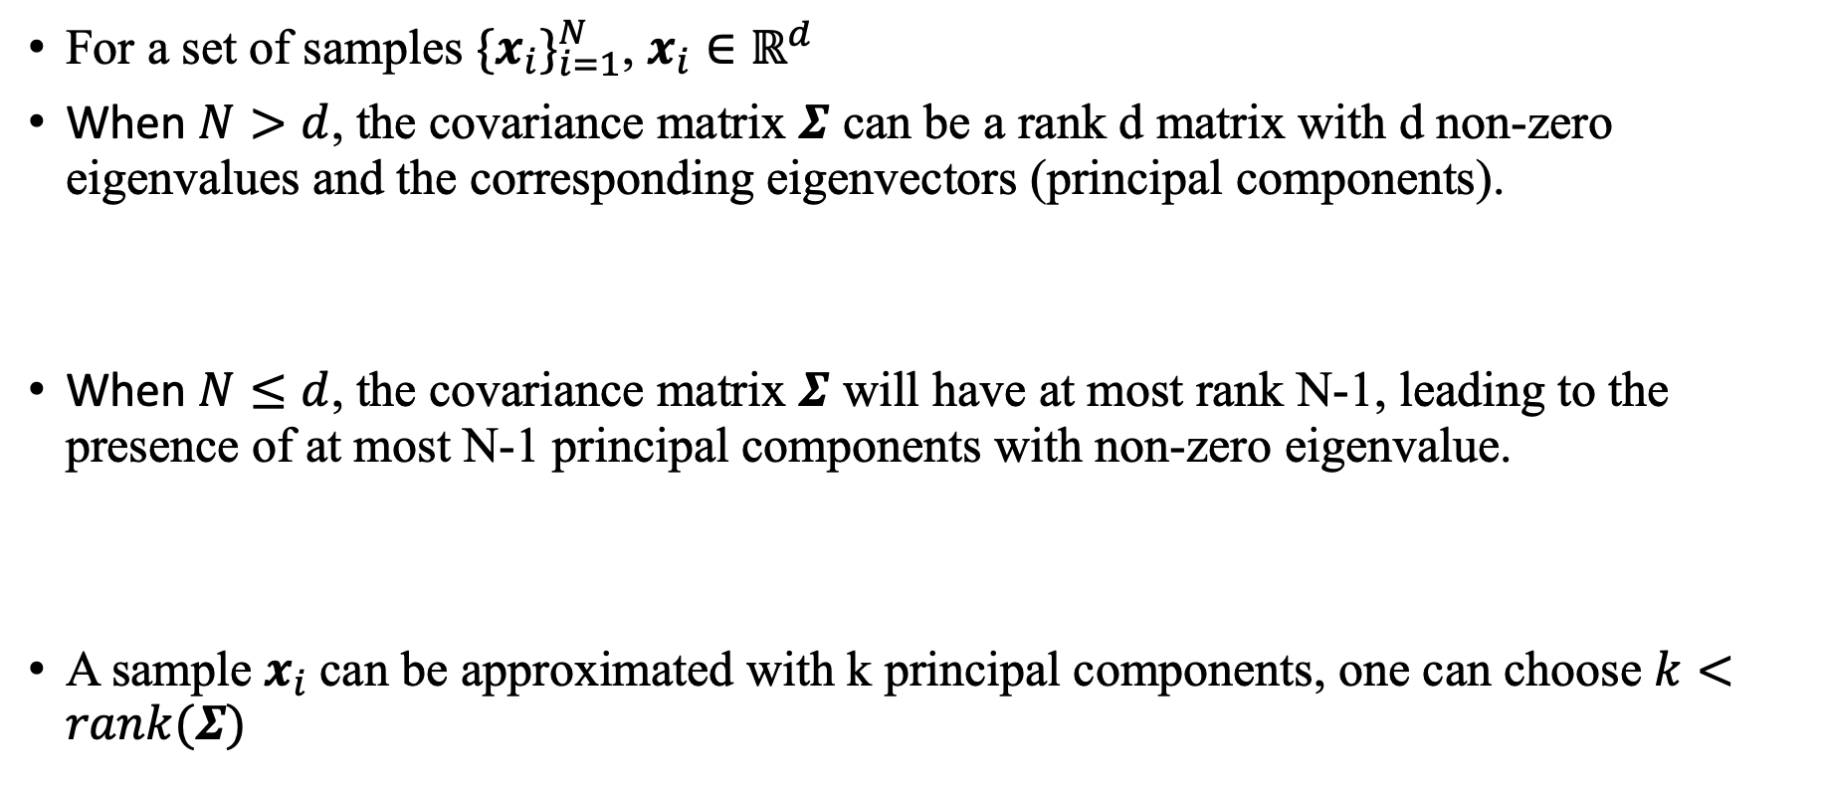
Principal component Analysis (PCA) (5/5)
For a set of samples ${\{x_{i}\}}_{i=1}^{N}$, $x_{i}∈ℝ^{d}$
When $N>d$, the covariance matrix $Σ$ can be a rank d matrix with d non-zero eigenvalues and the corresponding eigenvectors (principal components).
When $N≤d$, the covariance matrix $Σ$ will have at most rank N-1, leading to the presence of at most N-1 principal components with non-zero eigenvalue.
A sample $x_{i}$can be approximated with k principal components, one can choose $k<rank(Σ)$
Notes:
N<=d
只能找到最多d-1個principle components
想像三維空間中的兩個點，
通過兩個點的向量會是第一個components
然後垂直那個向量的任何向量variance都是0
1 * 3 3*1

Slide 23
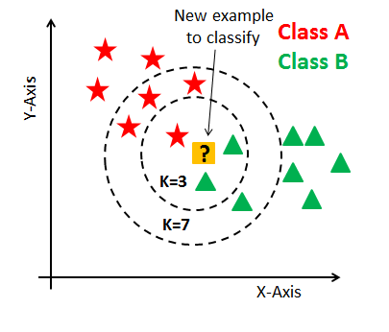
KNN classifier
k nearest neighbors classifier

Slide 24
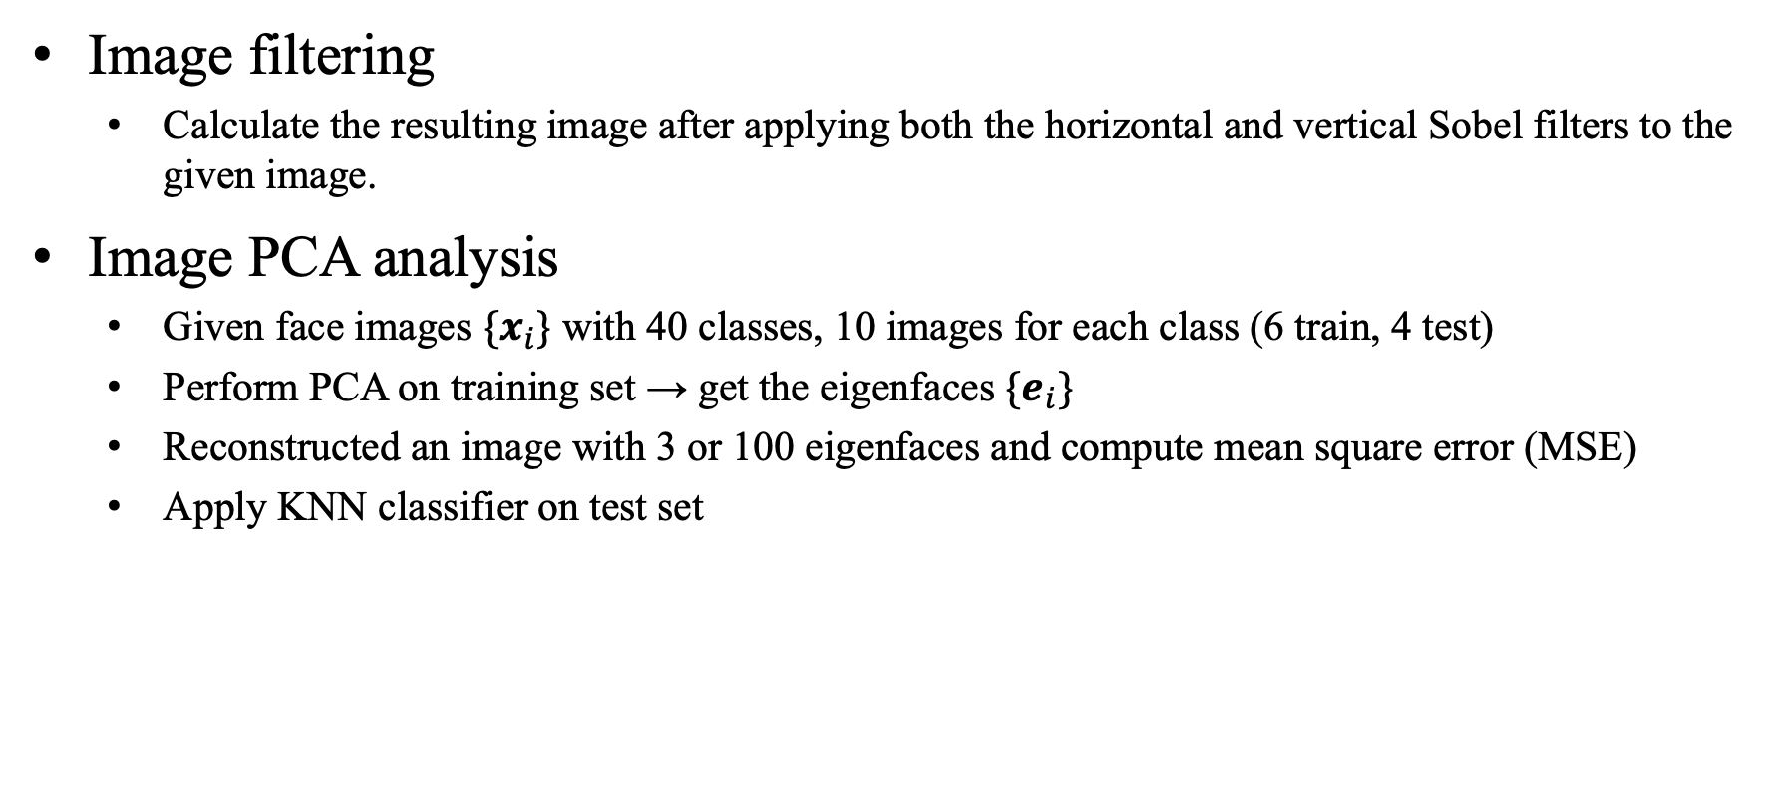
Lab1
Image filtering
  Calculate the resulting image after applying both the horizontal and vertical Sobel filters to the given image.
Image PCA analysis
  Given face images ${\{x}_{i}\}$ with 40 classes, 10 images for each class (6 train, 4 test)
  Perform PCA on training set → get the eigenfaces $\{e_{i}\}$
  Reconstructed an image with 3 or 100 eigenfaces and compute mean square error (MSE)
  Apply KNN classifier on test set

Slide 25
PCA Tips
Training set
Testing set
Training set
Testing set
Scikit-learn flow
(recommended)
np.mean()
fit()
mean face
Self-implement flow
Train - mean
Test - mean
class:
sklearn.decomposition.PCA()
transform()
np.linalg.svd()
eigenvectors
(from the column of V)
attribute:
mean_: mean face
components_: eigenvectors
(eigenfaces)
np.dot()
or np.matmul()
np.dot()
or np.matmul()
output:
the length of the projection on each eigenvector
the length of the projection on each eigenvector

Slide 26
Outline
Prerequisite
Lab1: Basic Image Processing
  Image Filtering
  Image PCA Analysis
Lab2: Homography

Slide 27
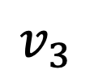





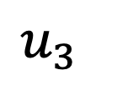

Lab2: Homography
$$u_{2}$$
$$v_{1}$$
$$v_{2}$$
$$u_{1}$$
Homography
(projective transformation)
H
$$u_{4}$$
$$v_{3}$$
$$v_{4}$$
$$u_{3}$$

Slide 28
Recap of Homography (1/2)
Matrix form:
Equations:

Slide 29
Recap of Homography (2/2)
Degree of freedom:
  9 - 1 = 8 DoF
Constraint

Slide 30
Solution (1/2)

Slide 31
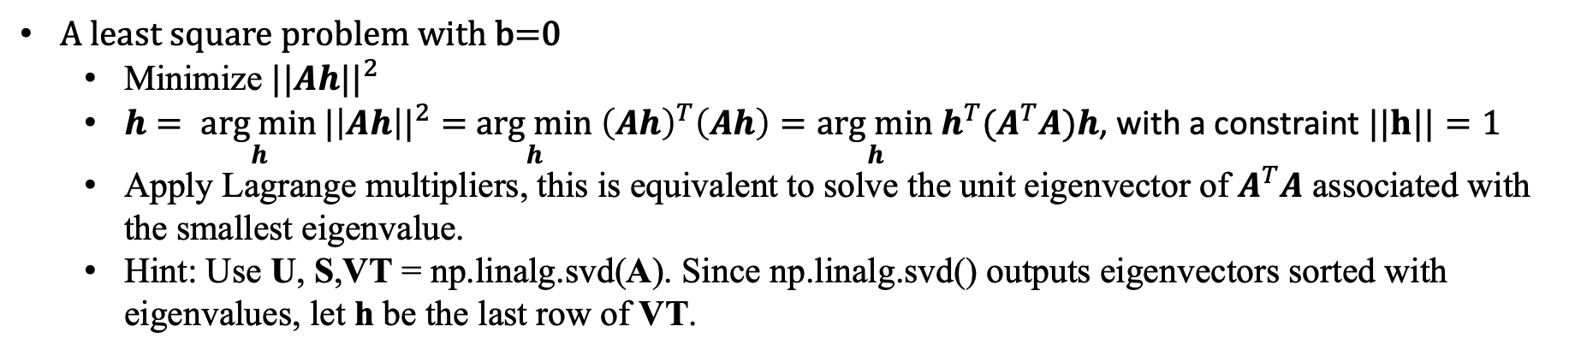
Solution (2/2)
Construct a linear system using N vertices:
A least square problem with b=0
  Minimize ${||Ah||}^{2}$
  $h= \underset{h}{arg min}{{|\left|Ah\right||}^{2}=}$ $\underset{h}{arg min} {\left(Ah\right)}^{T}\left(Ah\right)=\underset{h}{arg min} h^{T}{(A}^{T}A)h$, with a constraint $||h||=1$
  Apply Lagrange multipliers, this is equivalent to solve the unit eigenvector of $A^{T}A$ associated with the smallest eigenvalue.
  Hint: Use U, S,VT = np.linalg.svd(A). Since np.linalg.svd() outputs eigenvectors sorted with eigenvalues, let h be the last row of VT.

Slide 32
Lab2 problem
Make the QR code frontal parallel
Calling function cv2.findHomography is FORBIDDEN!!!

Slide 33
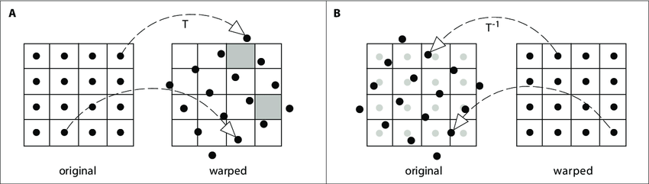
Backward warping
Prevent holes in output space
Pixel value at sub pixel location like (30.21, 22.74)?
  Bilinear interpolation
  Nearest neighbor
Forward Warping
Backward Warping

