Slide 1
Introduction to
Deep Learning
Tang-I Wang
Media IC and System Lab
Graduate Institute of Electronics Engineering,
National Taiwan University
All of the slides are copy from
(1) http://media.ee.ntu.edu.tw/crash_course/2023/Intro_DL.pptx
(2) http://cs231n.stanford.edu/syllabus.html
(3) https://speech.ee.ntu.edu.tw/~hylee/ml/2017-spring.php

Slide 2
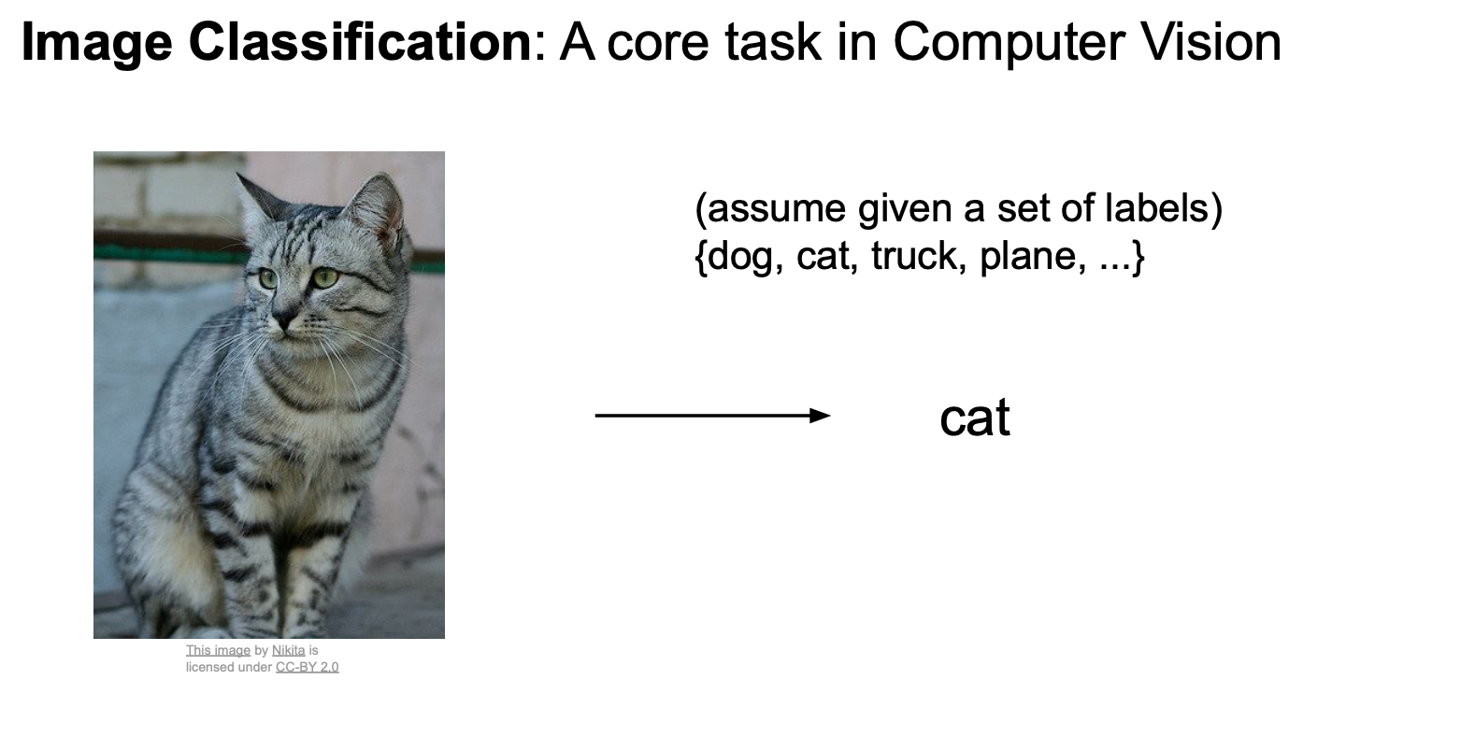

Slide 3
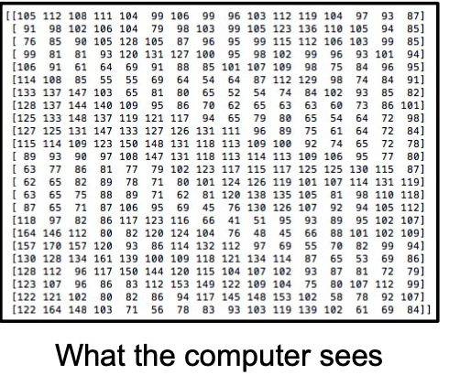
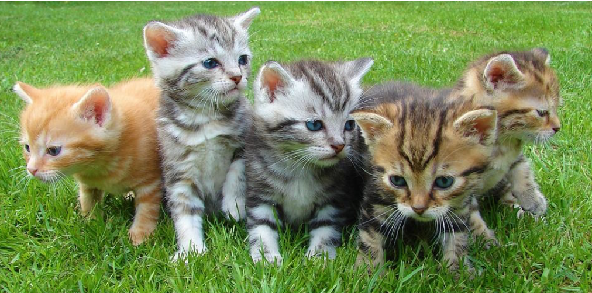
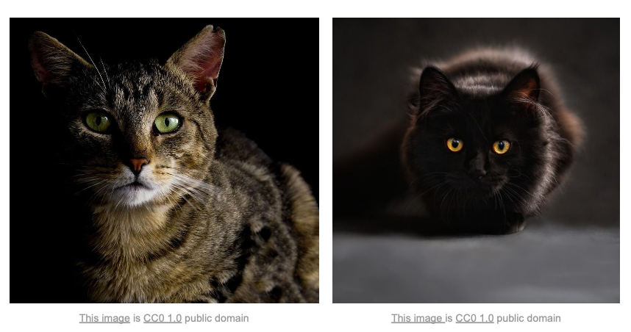
Problems
Semantic gap
Viewpoint changes
Background clutter
Illumination
Occlusion
Inter-class variation

Slide 4
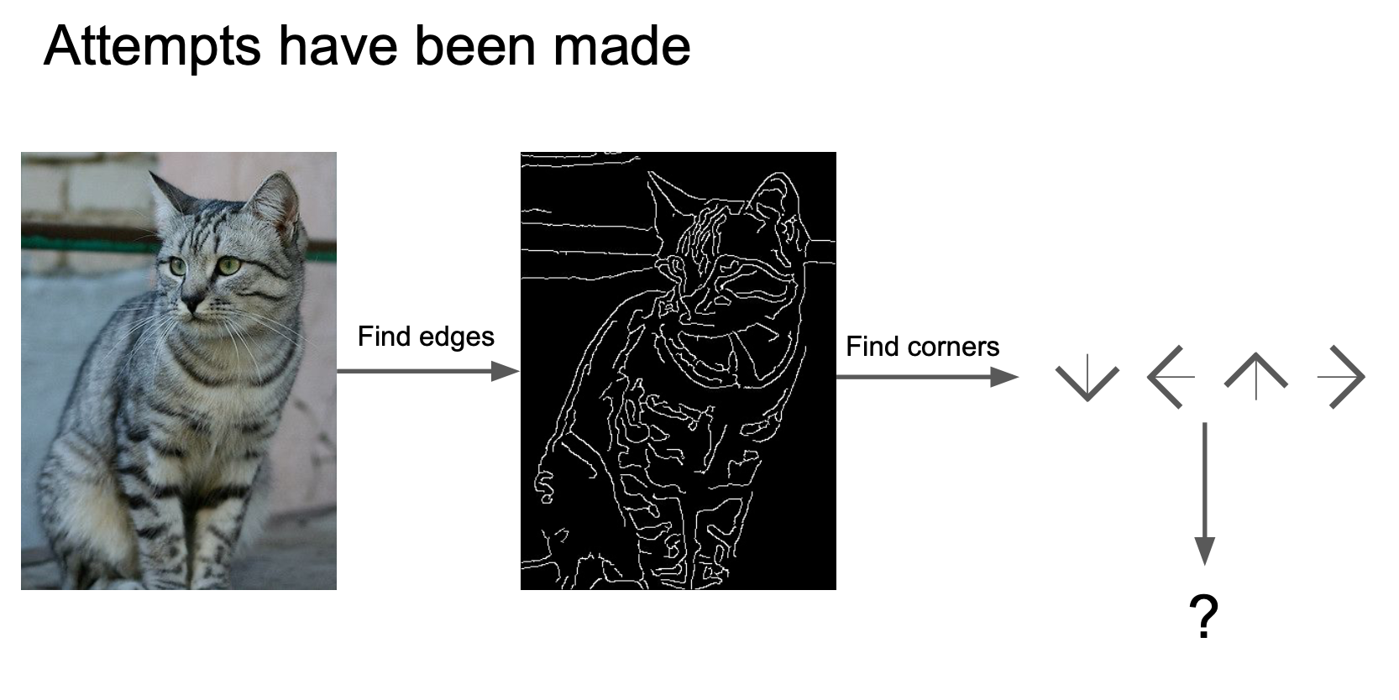

Slide 5
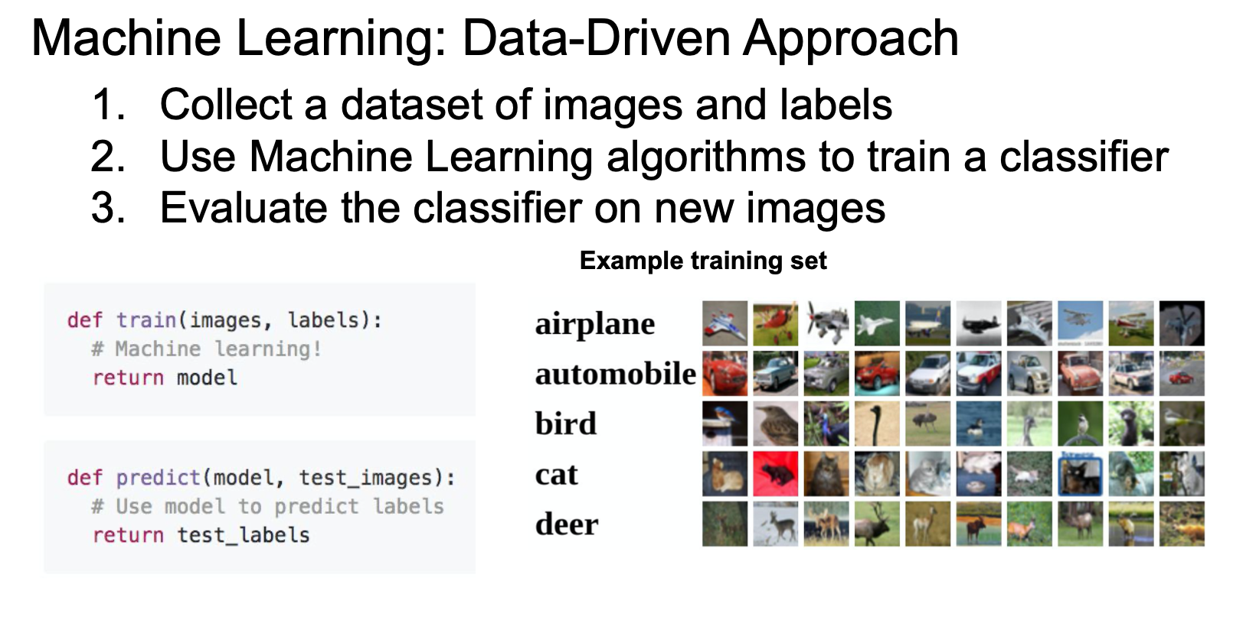

Slide 6

Machine Learning Pipeline
Learning from Observations
Recipe for practitioners:
  Collect (lots of) examples $X→Y$ (data + labels)
  Choose a suitable function $f\left(x;θ\right)$
  Choose a loss function $ℒ$
  Optimize $θ$ to minimize $ℒ$

Slide 7
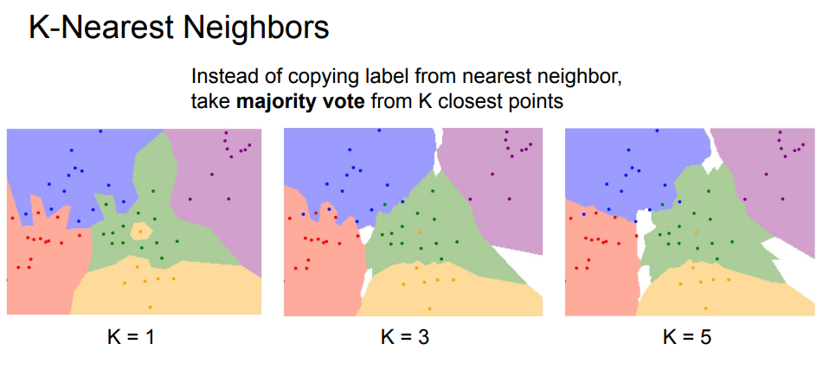

Let’s talk about classifier first
Supposed the feature is the image itself, so $f\left(x;θ\right)$is a just a classifier
We can (1) learn a K-nearest neighbor classifier

Slide 8
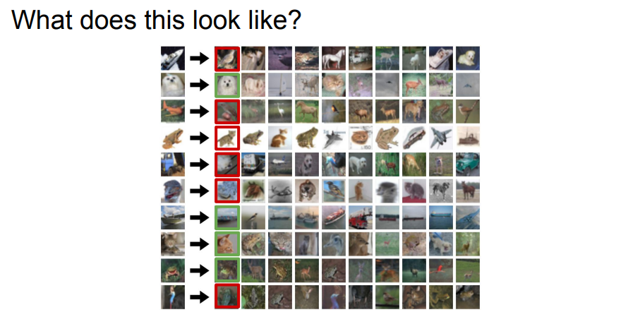

Slide 9
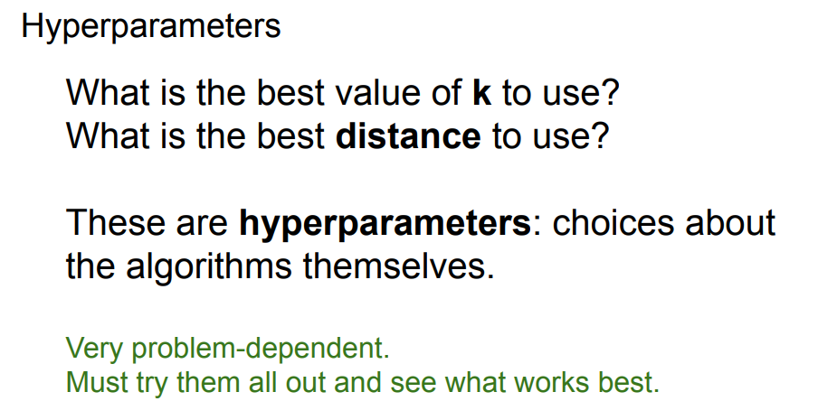

Slide 10
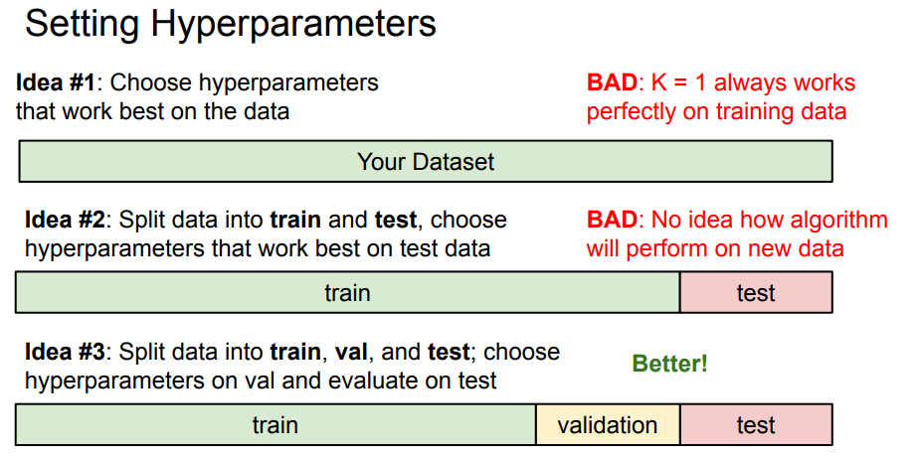

Slide 11
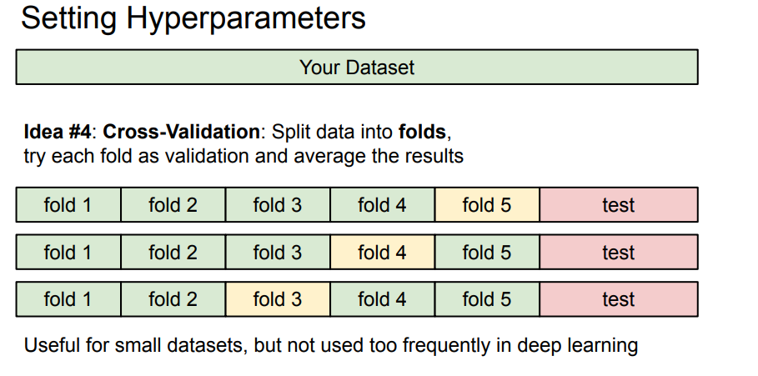

Slide 12
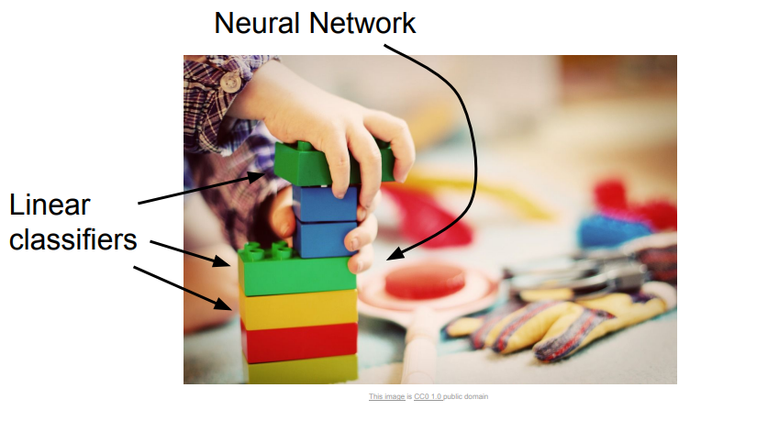
Let’s talk about classifier first
Supposed the feature is the image itself…
We can (2) learn a Linear Classifier

Slide 13
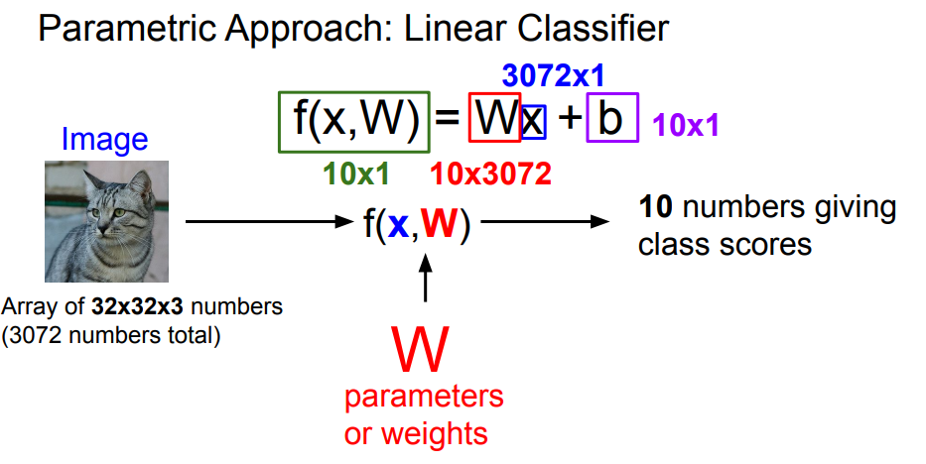

Slide 14
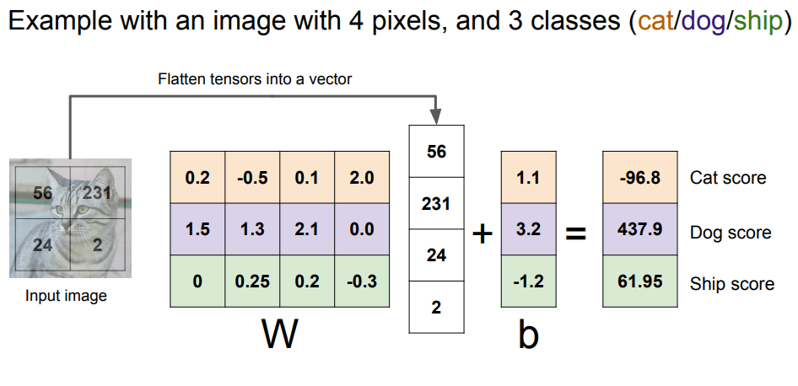

Slide 15
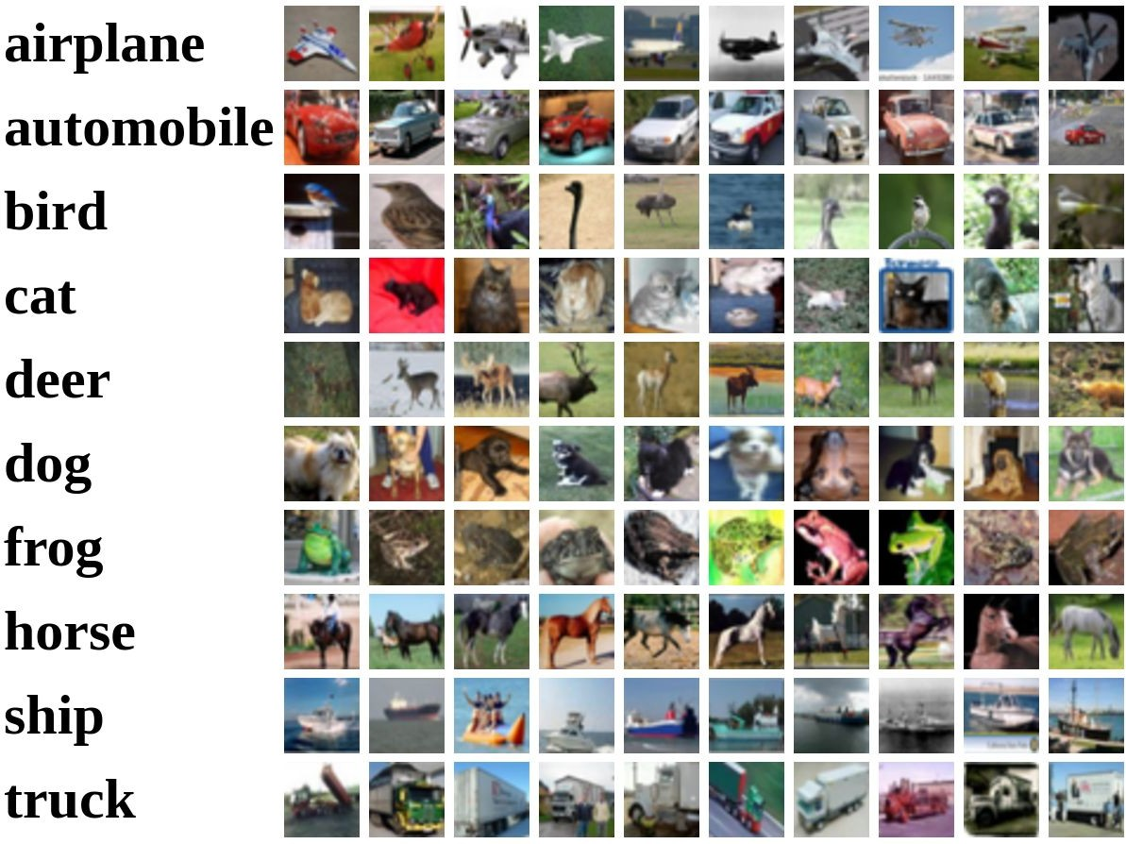
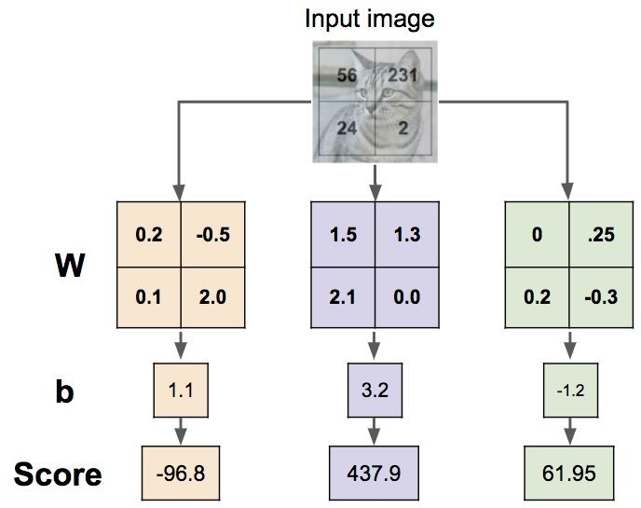

Interpreting a Linear Classifier: Visual Viewpoint

Slide 16
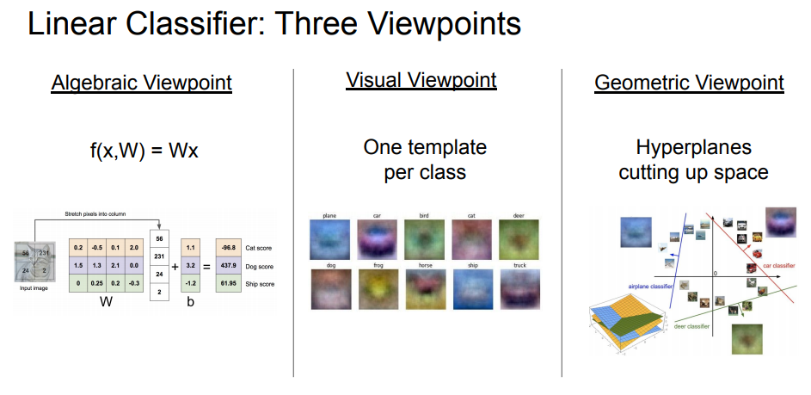

Slide 17
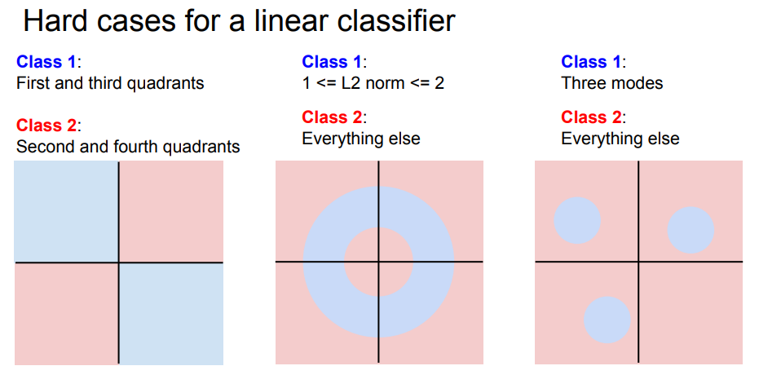

Slide 18
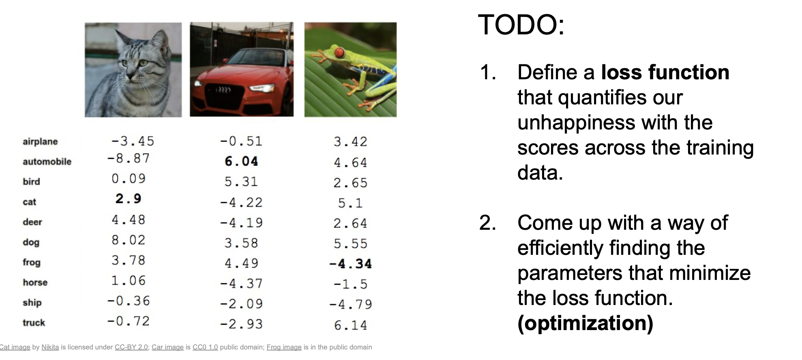
Loss & Optimization

Slide 19
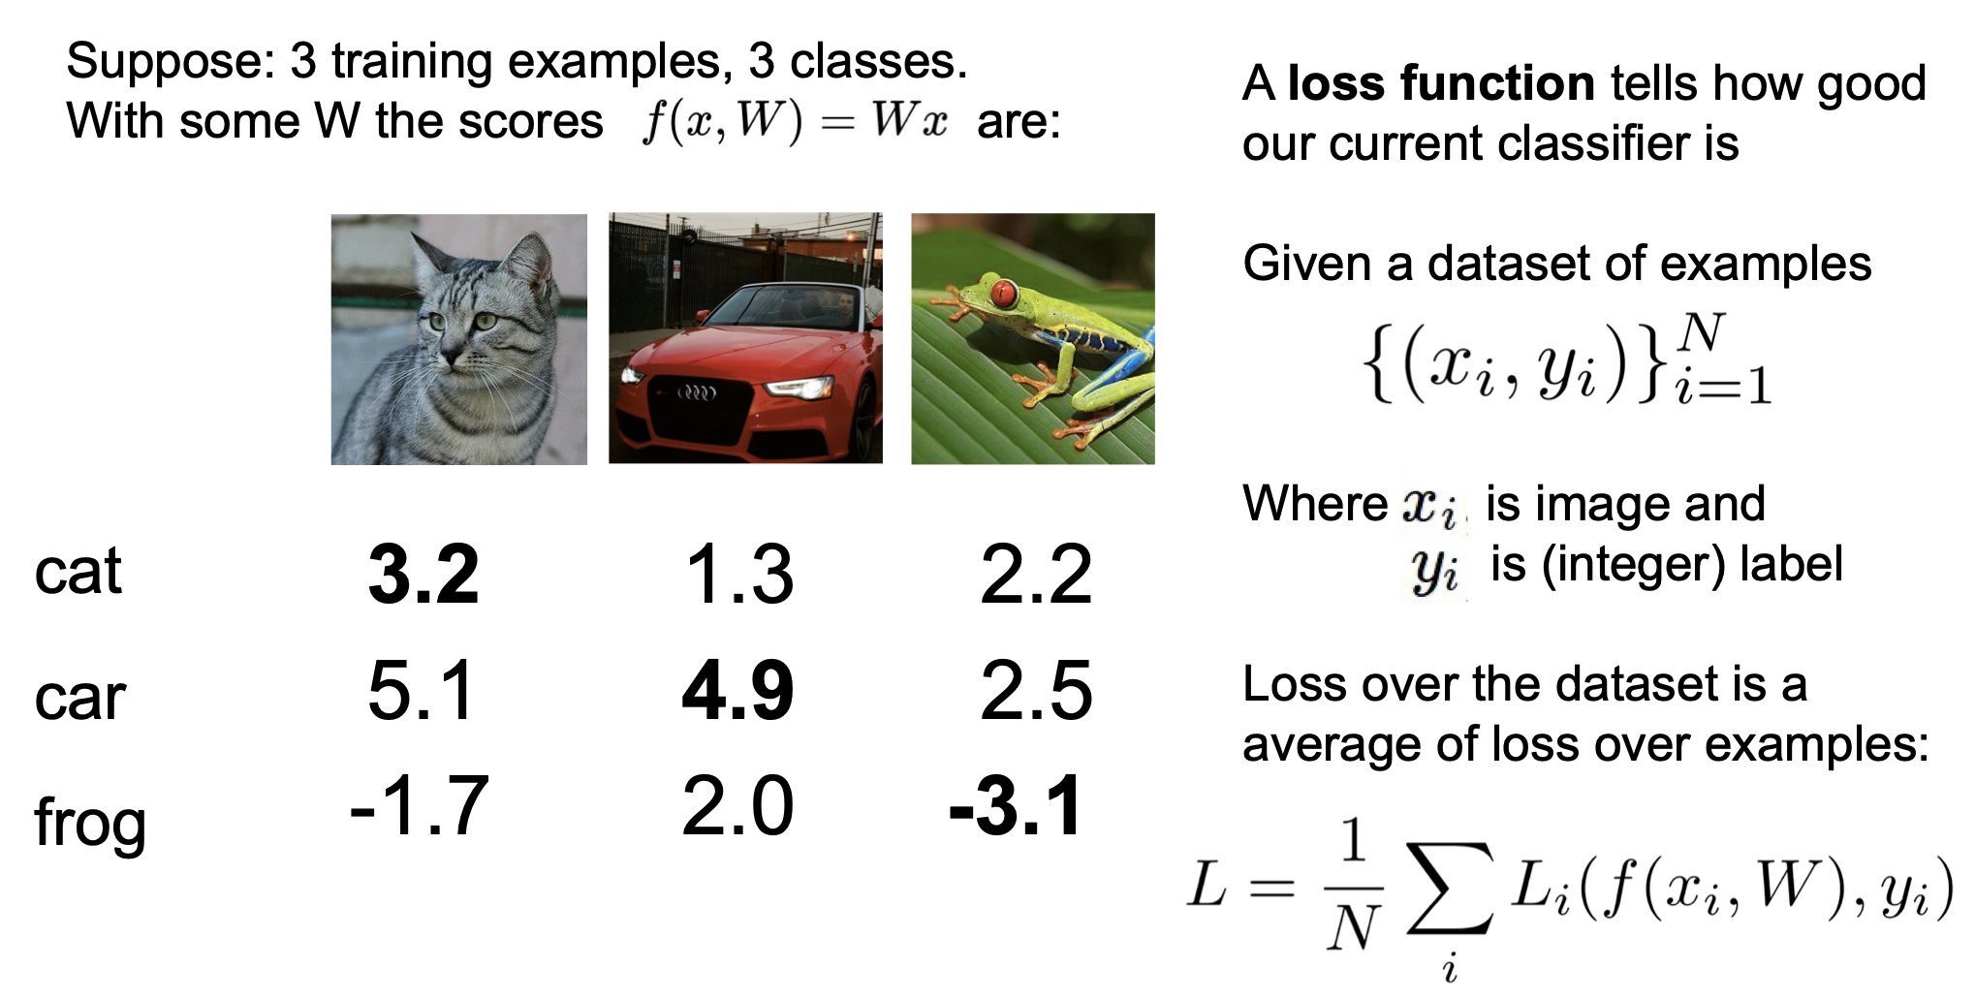

Slide 20
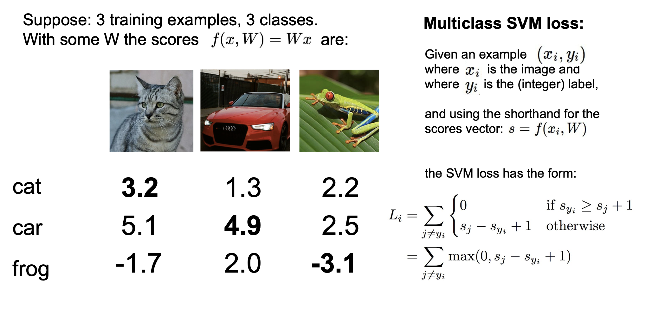

Slide 21
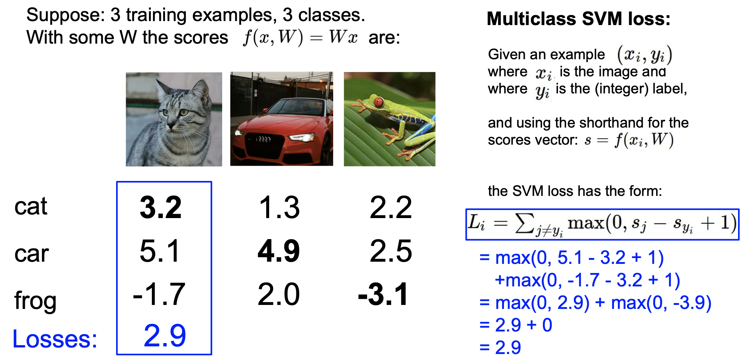
v
v

Slide 22
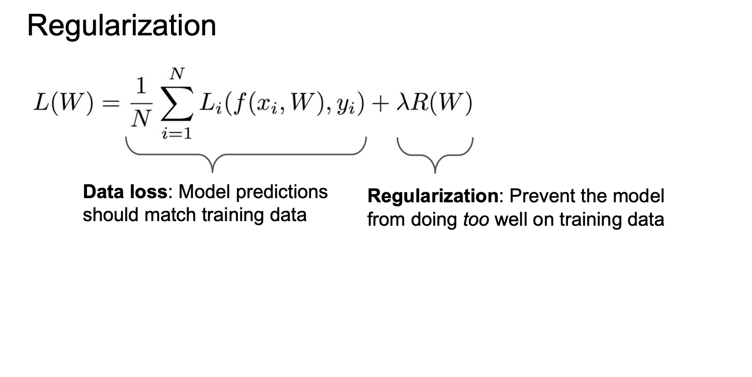

Slide 23
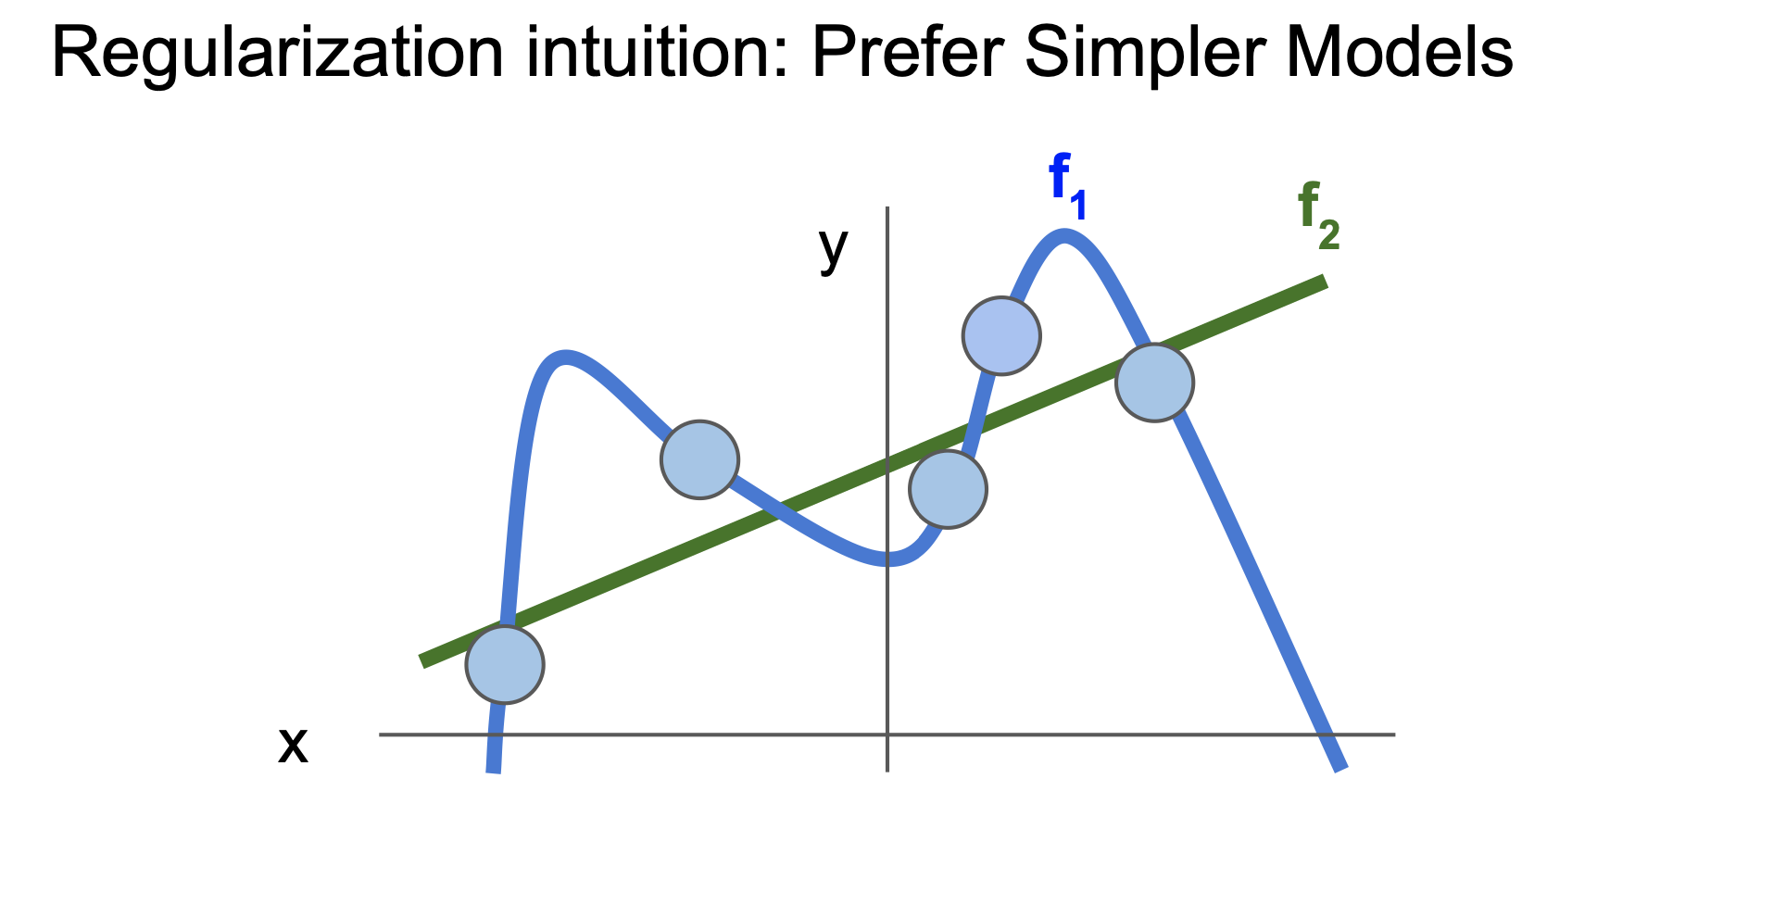

Slide 24
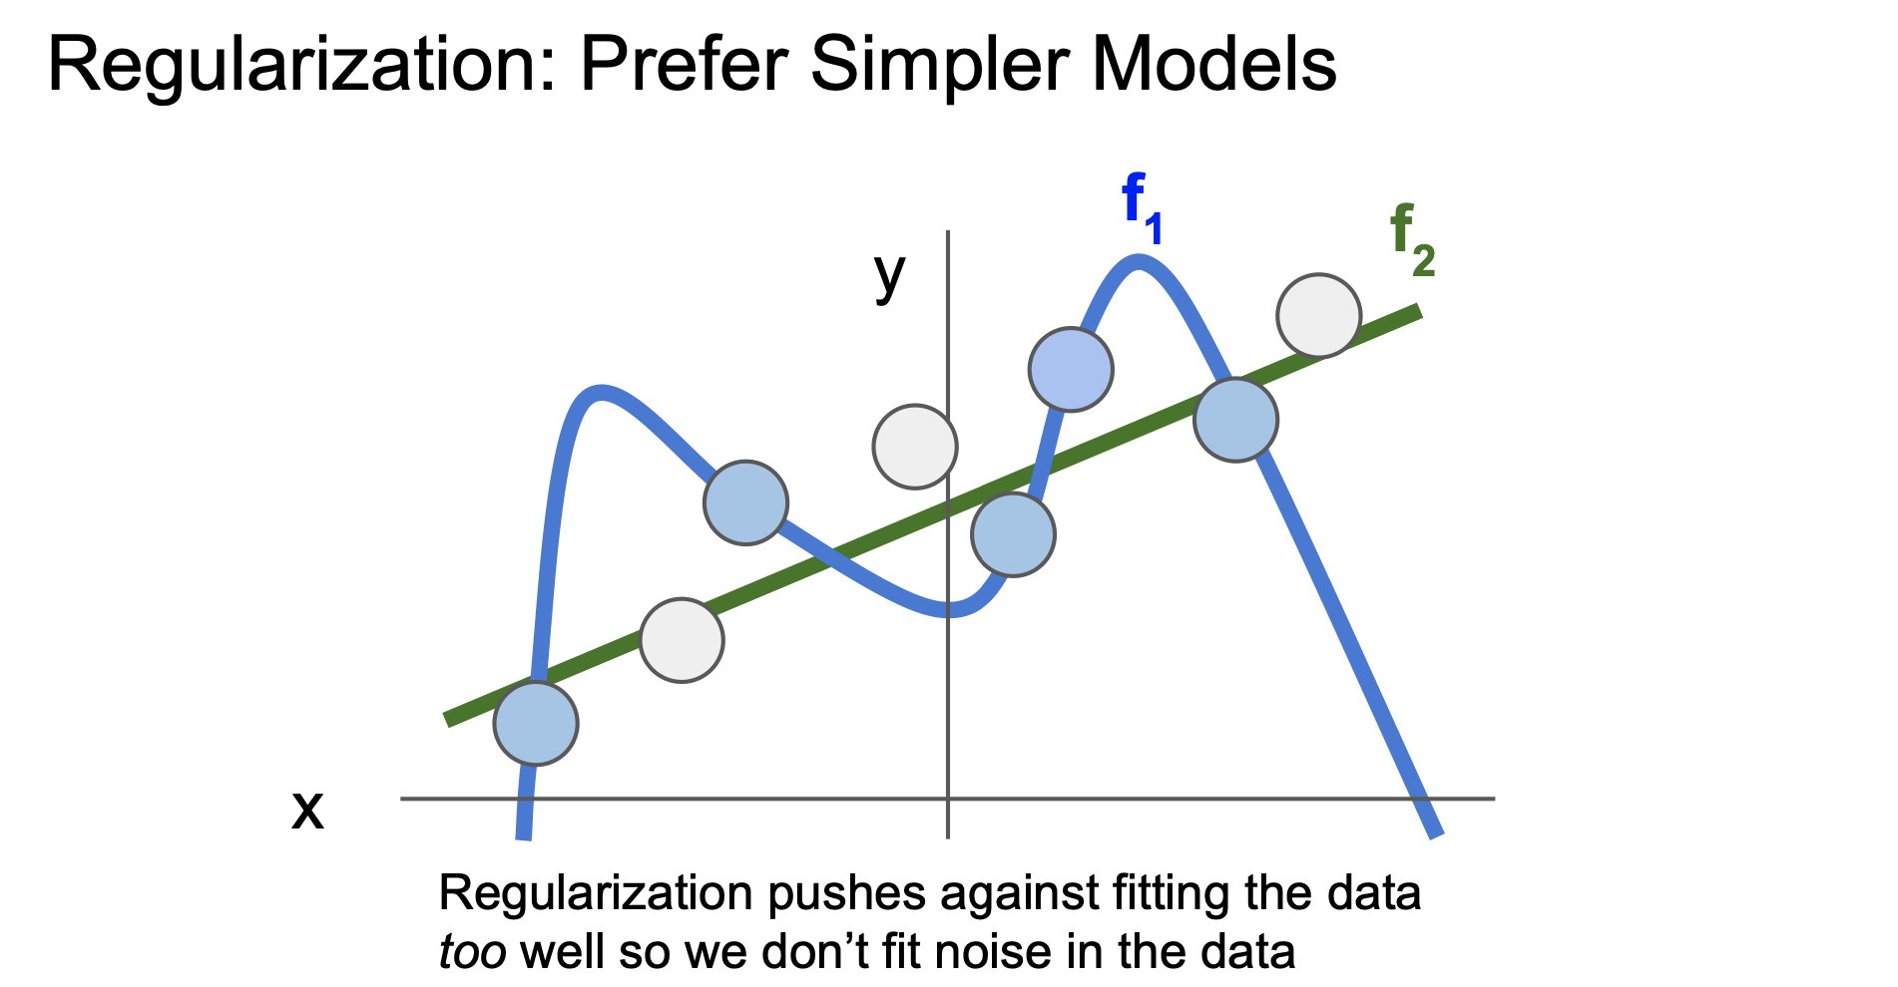

Slide 25
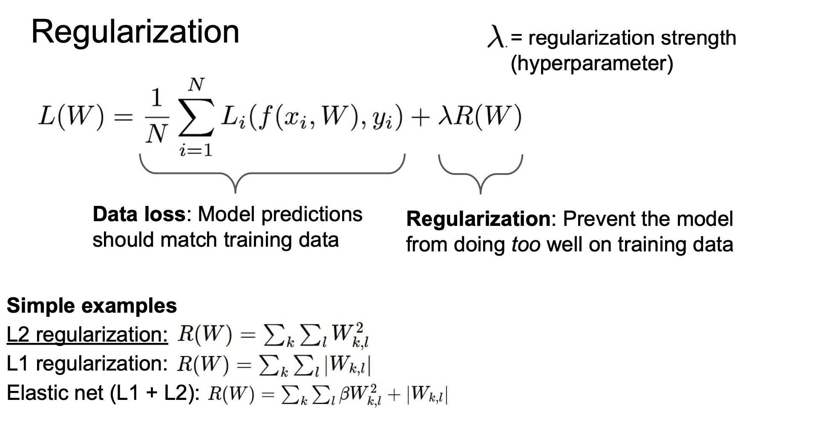

Slide 26
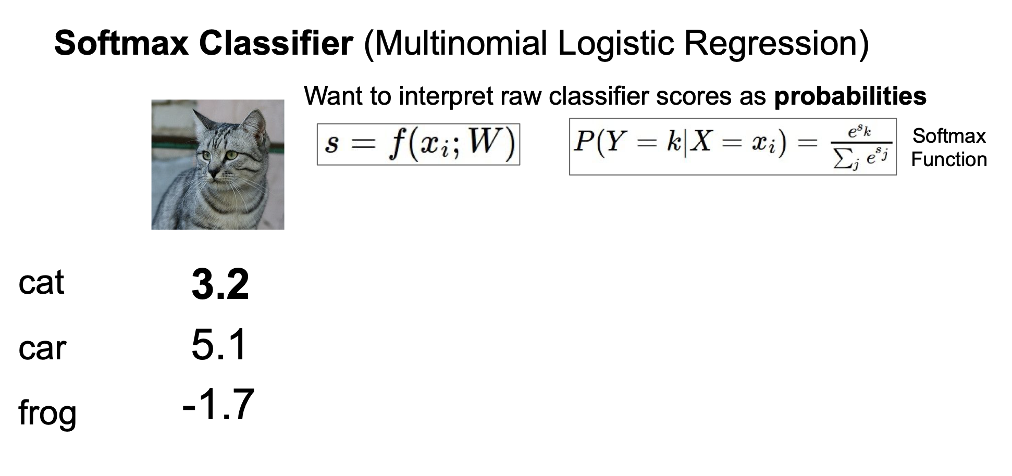

Slide 27
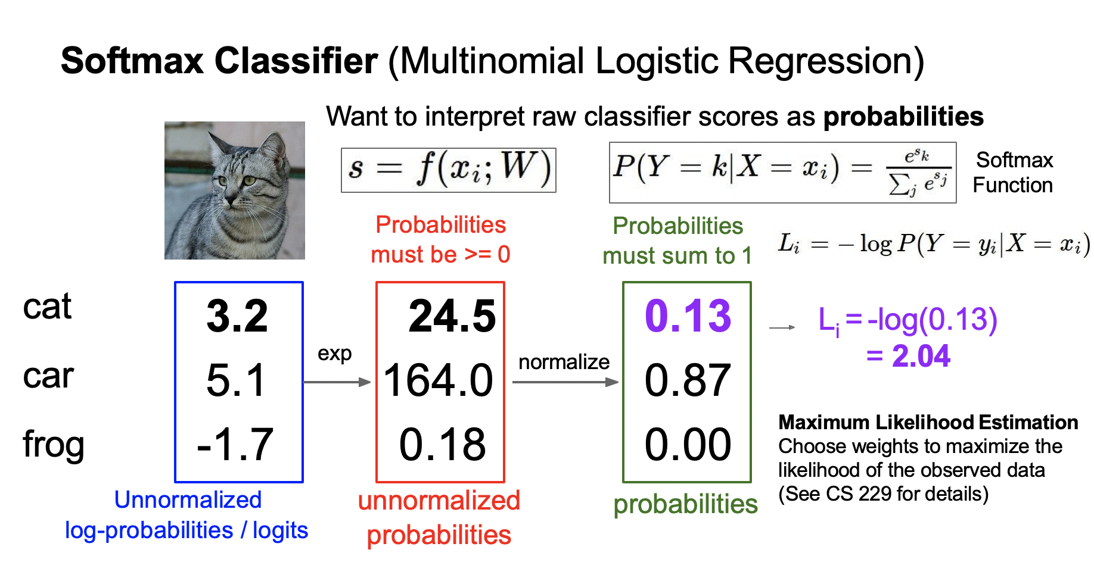
v

Slide 28
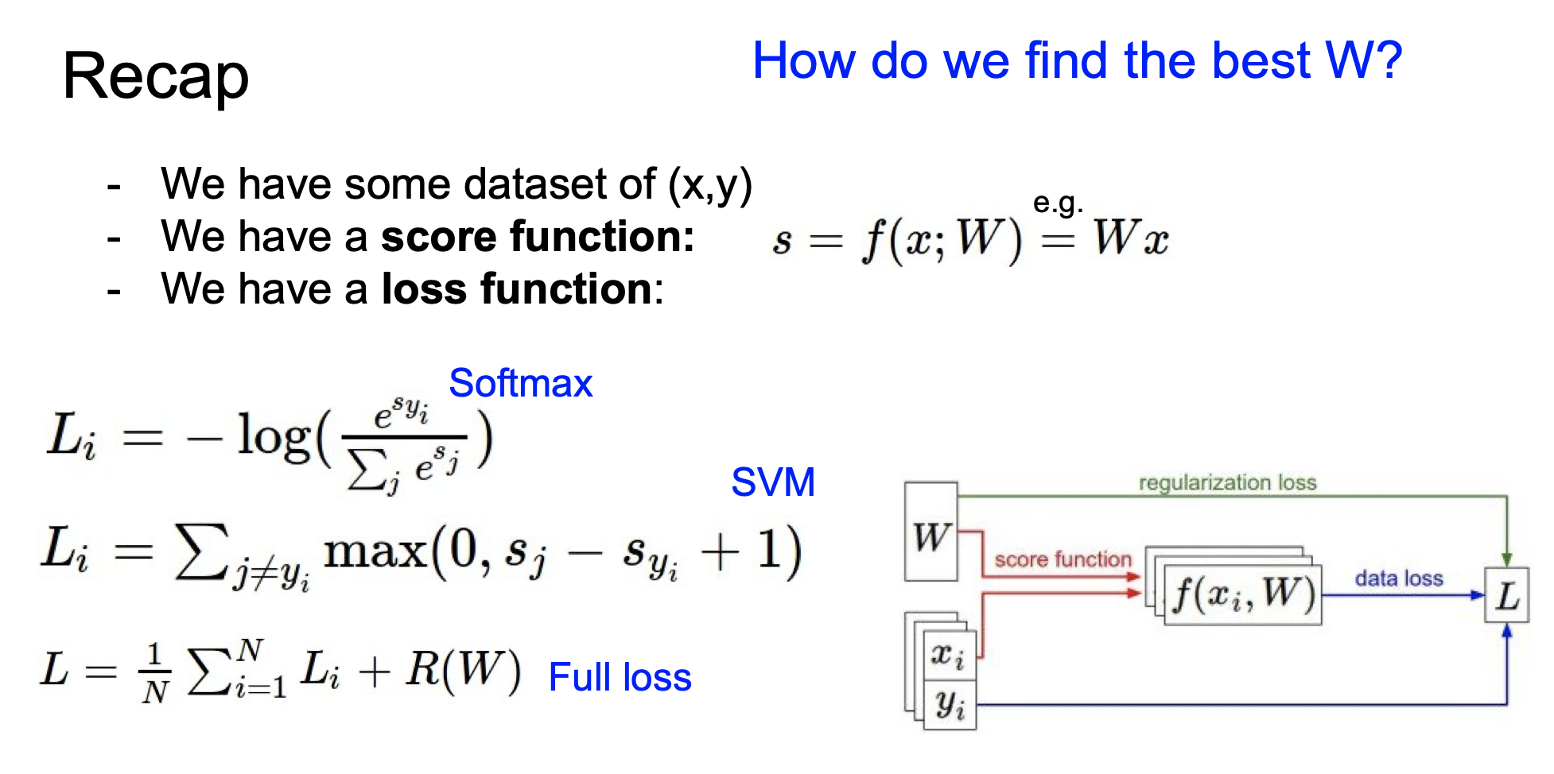
v

Slide 29
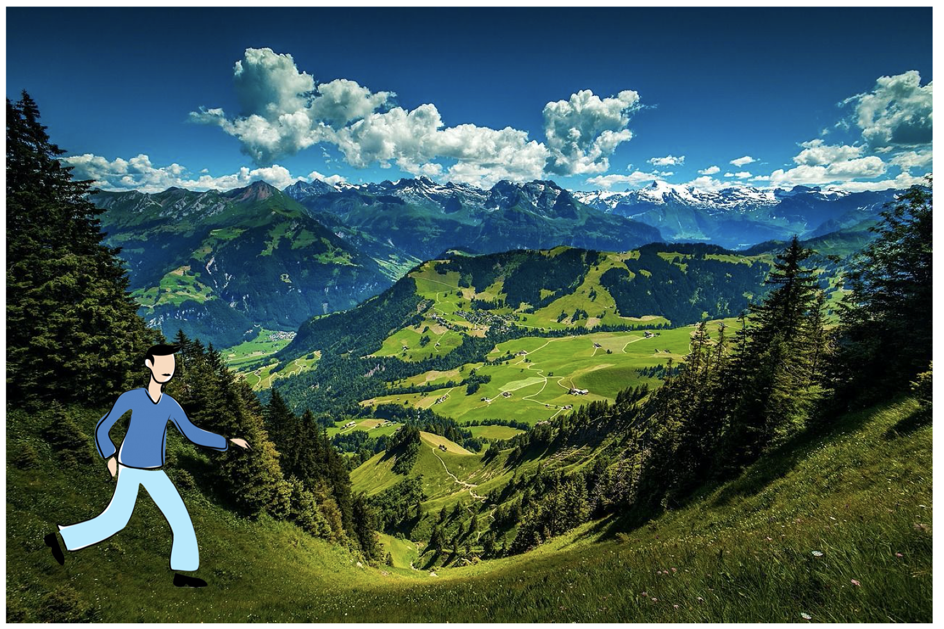
Optimization

Slide 30
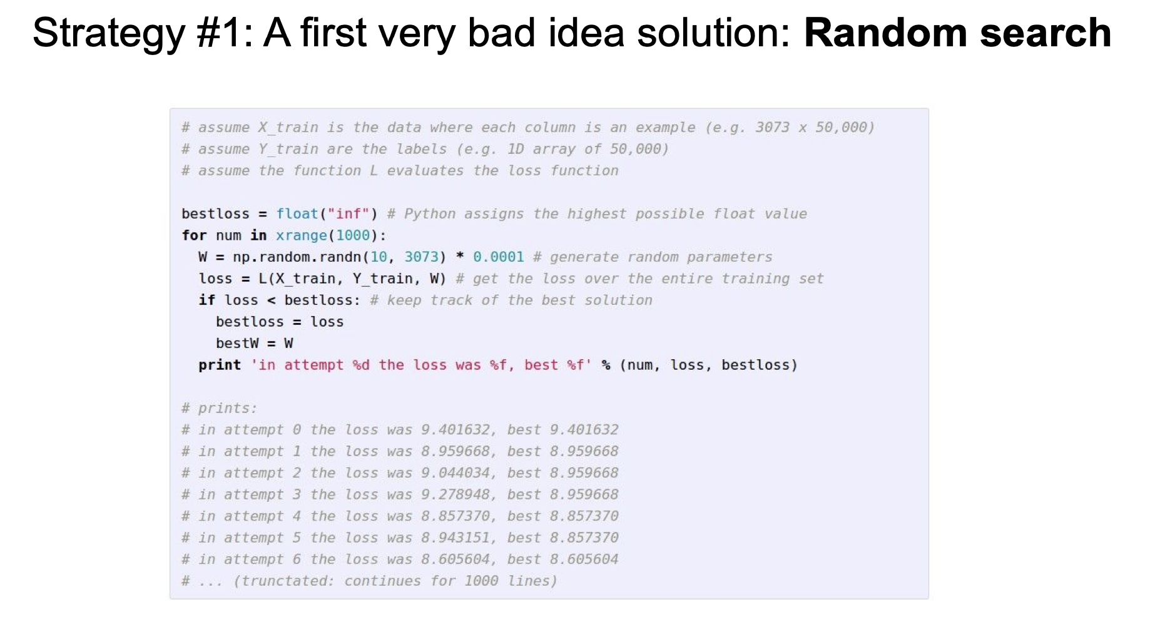

Slide 31
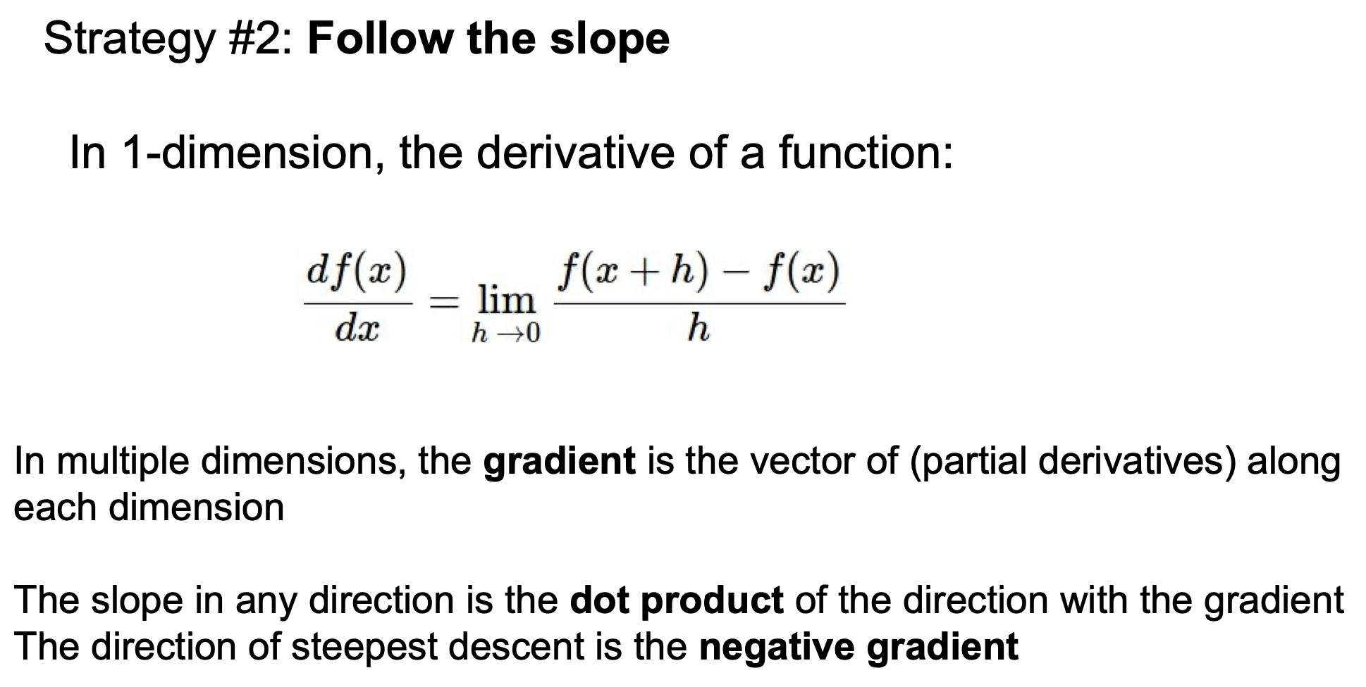

Slide 32
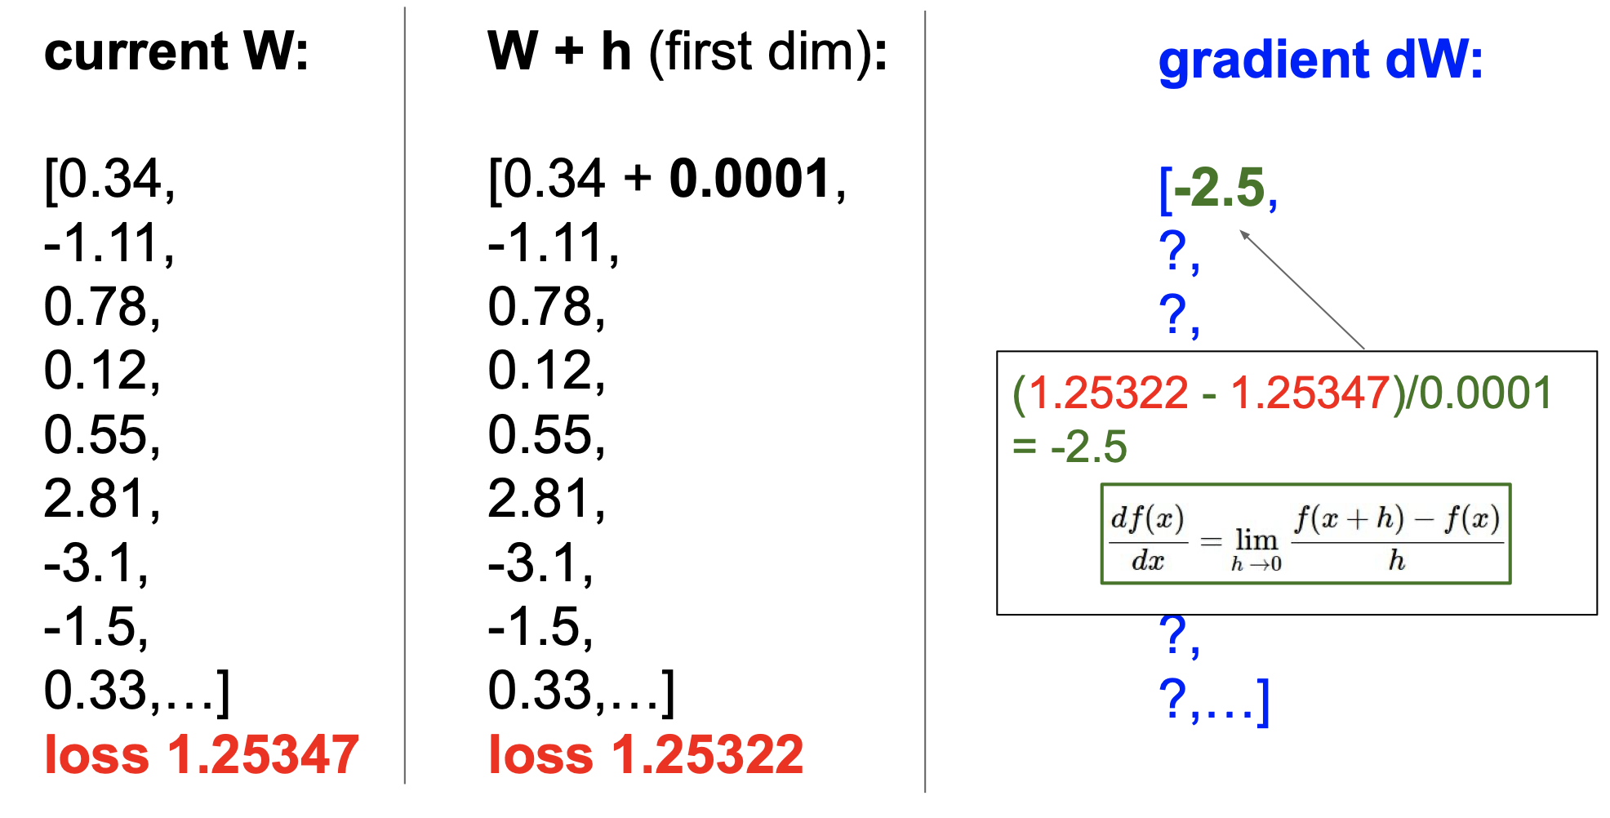

Slide 33
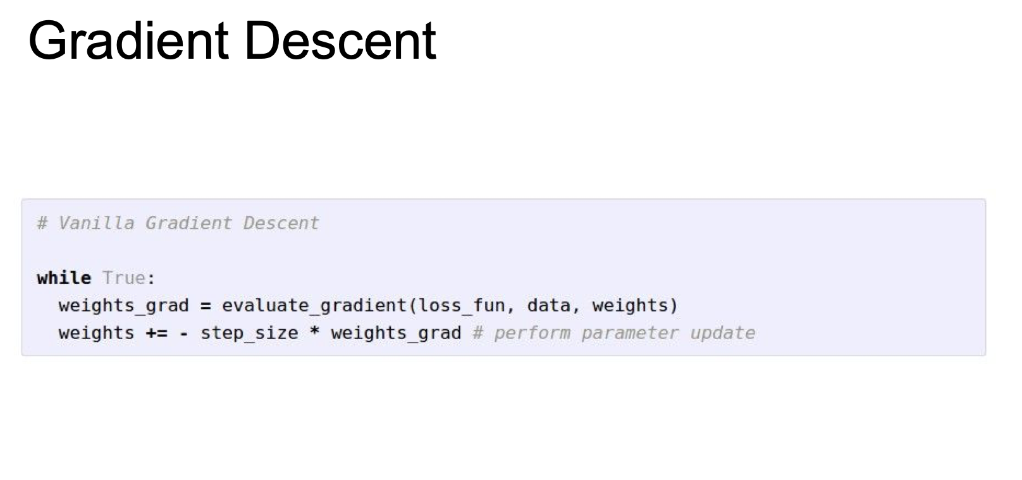

Slide 34
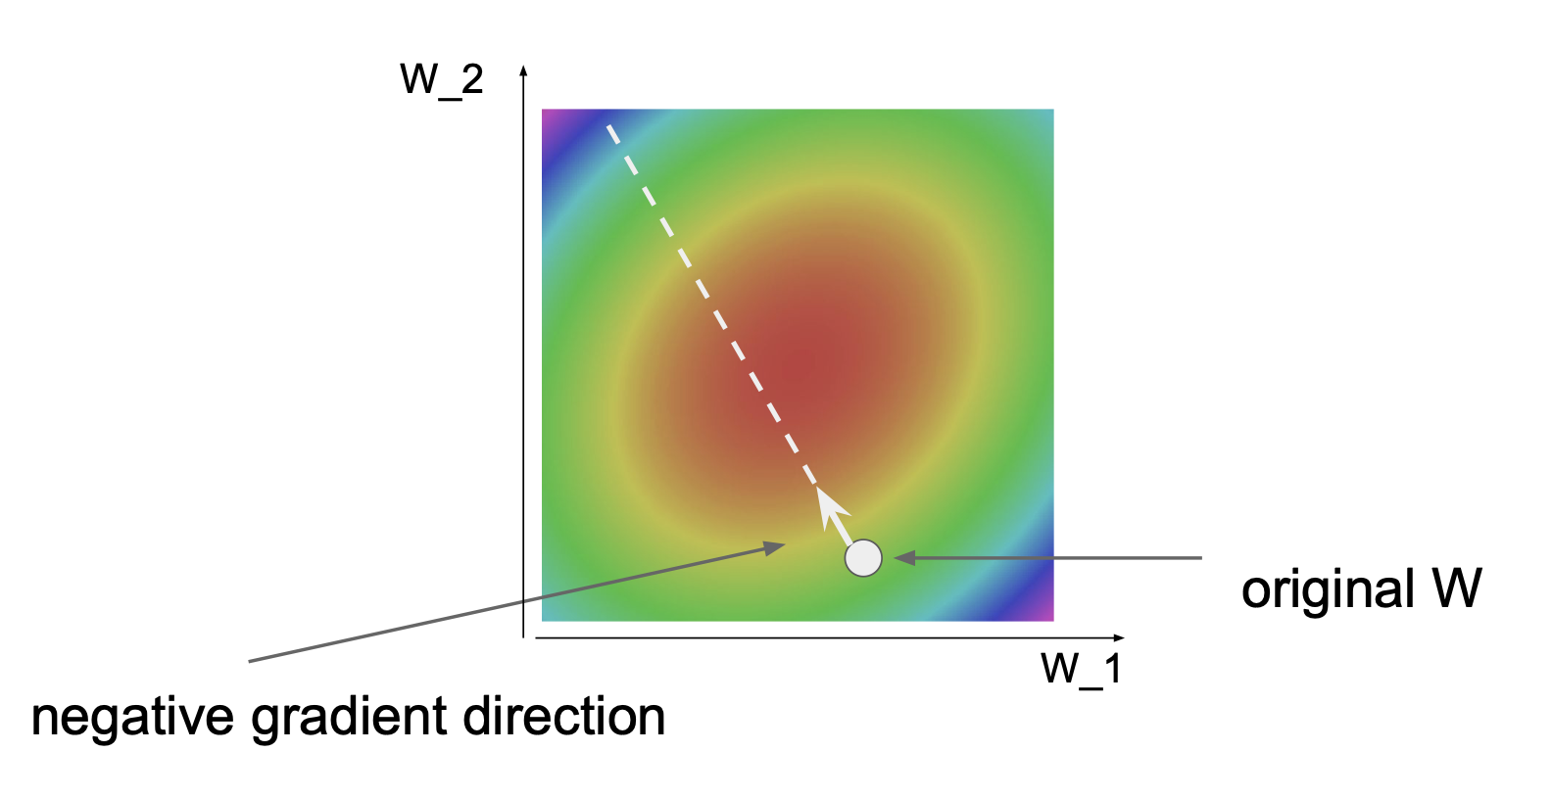

Slide 35
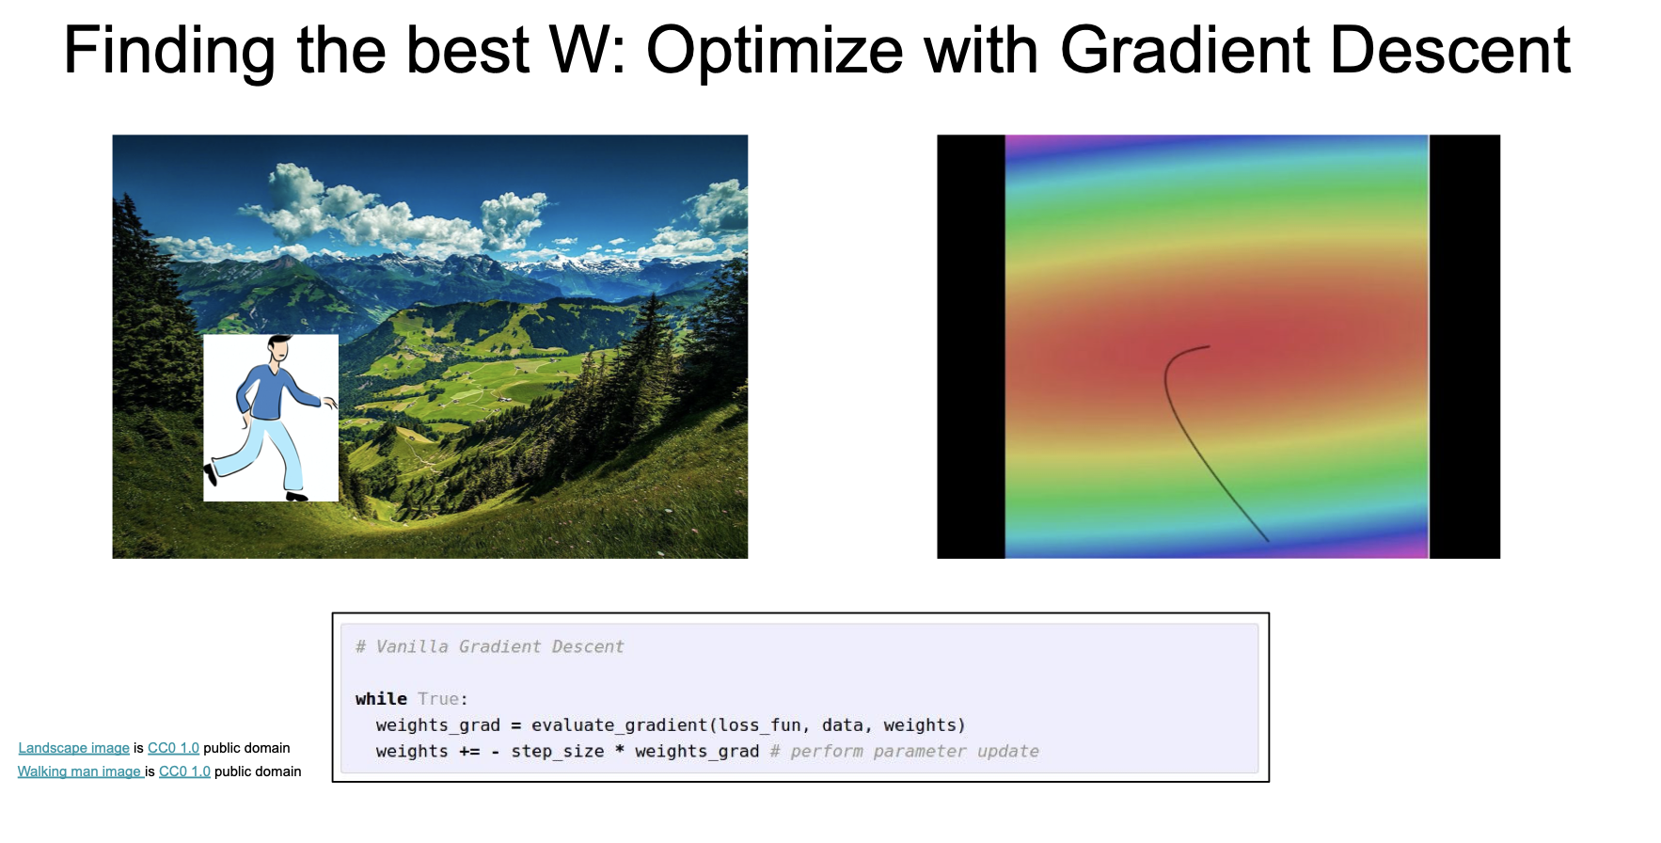

Slide 36
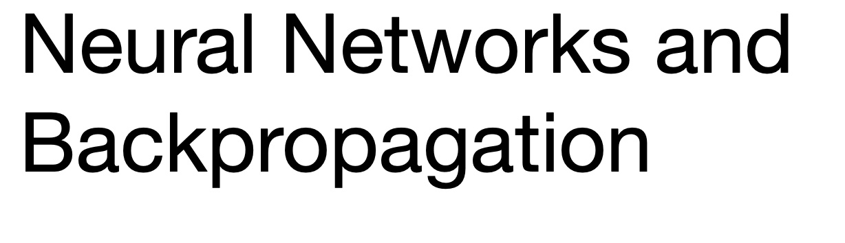

Slide 37
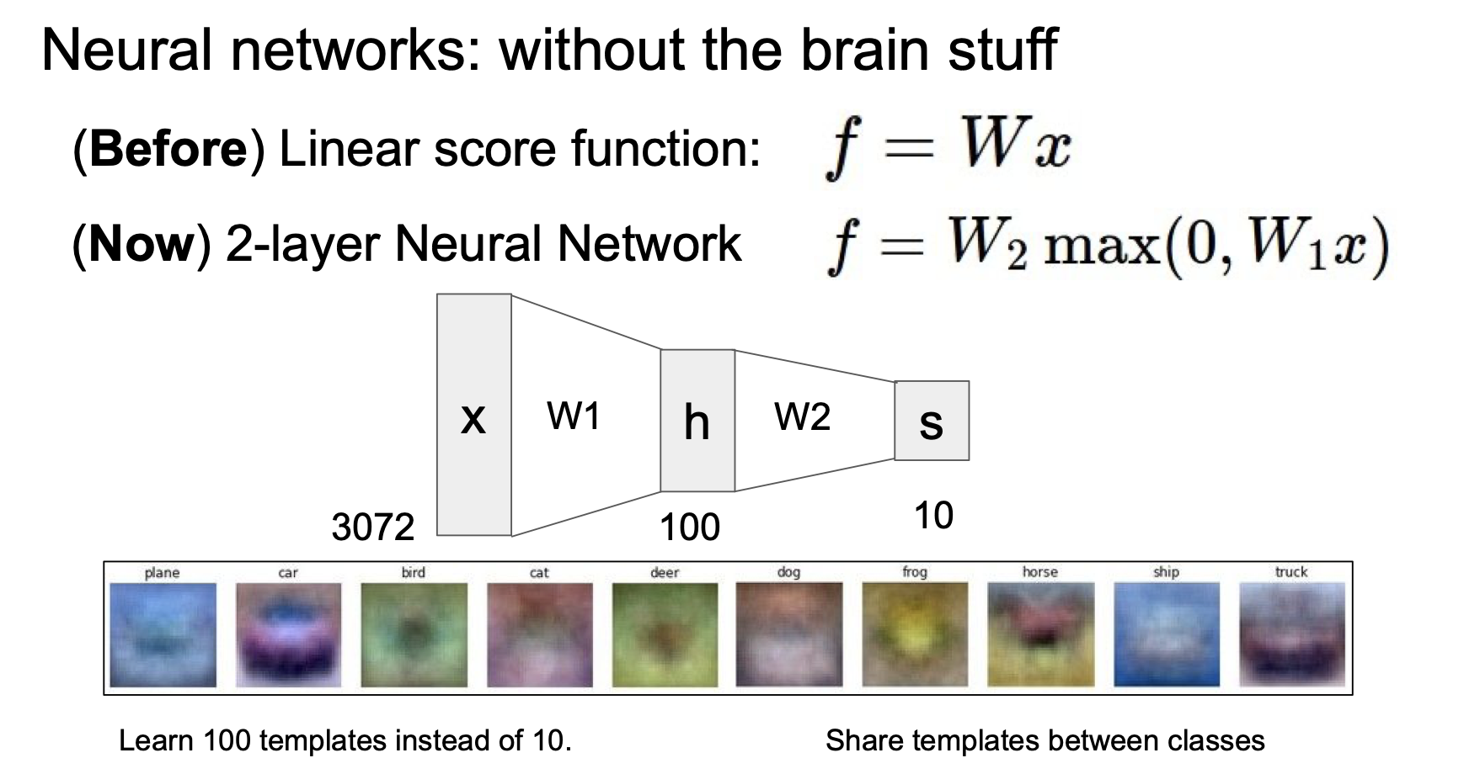

Slide 38
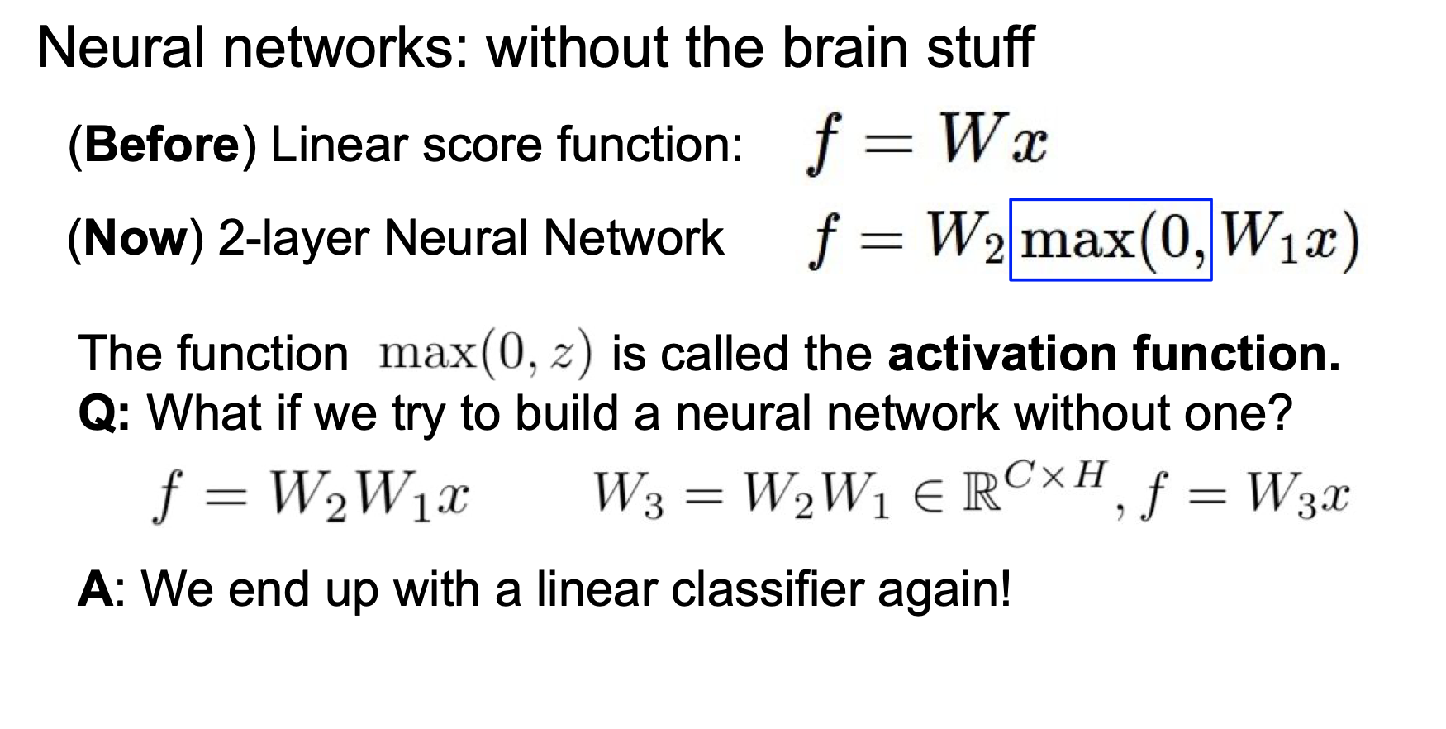
v

Slide 39
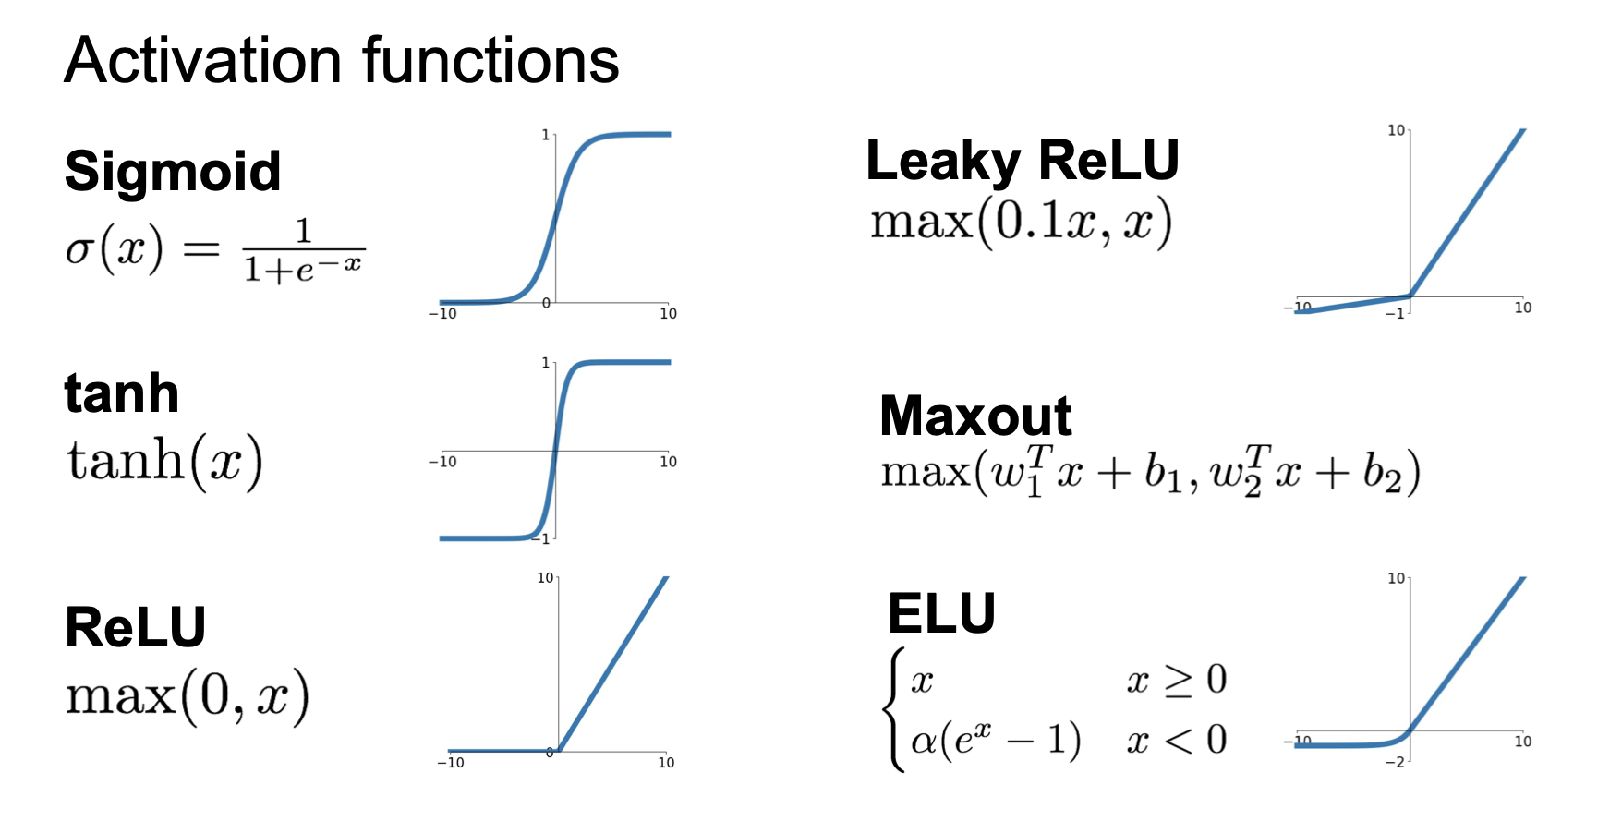

Slide 40
Gradient Descent
Network parameters
Starting Parameters
……
Millions of parameters ……
To compute the gradients efficiently, we use backpropagation.
Notes:
A network can have millions of parameters.
Backpropagation is the way to compute the gradients efficiently (not today)
Ref: http://speech.ee.ntu.edu.tw/~tlkagk/courses/MLDS_2015_2/Lecture/DNN%20backprop.ecm.mp4/index.html
What is the suitable value for η?
I don’t know. Depend on C(θ)

Slide 41
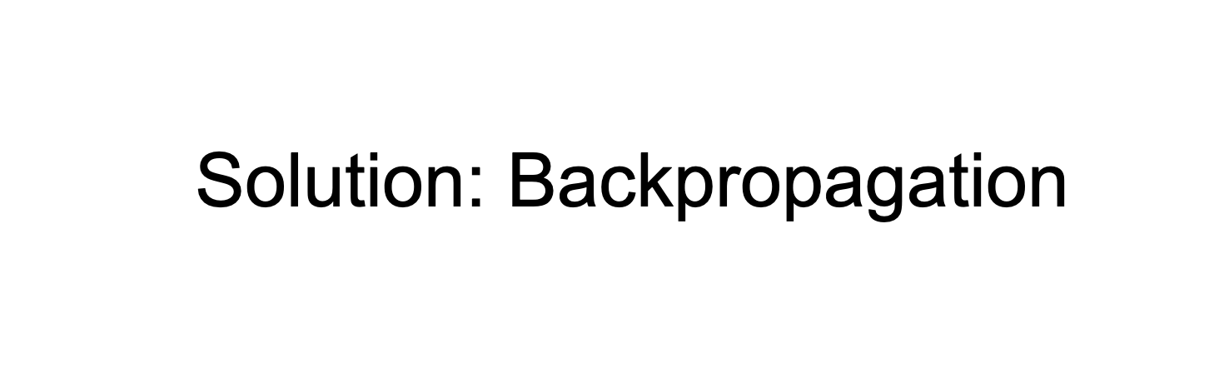

Slide 42
Chain Rule
Case 1
Case 2

Slide 43

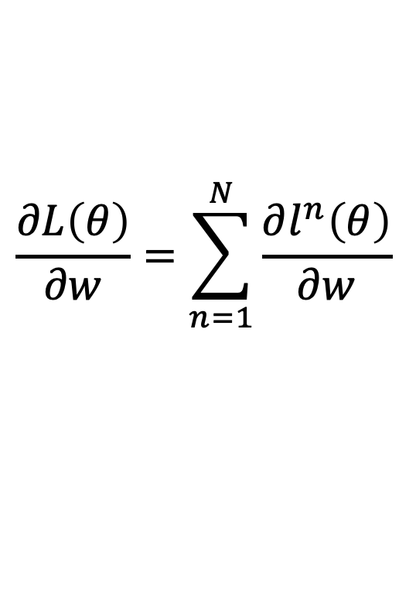

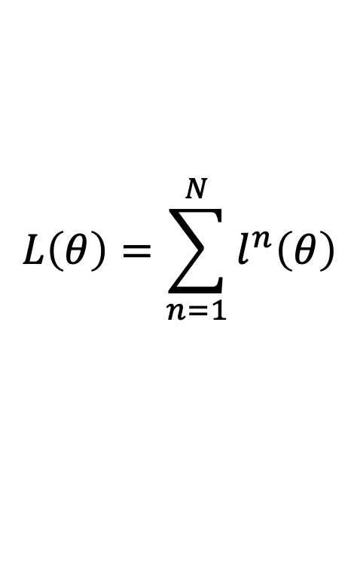





Backpropagation
x^{n}
NN
$$θ$$
y^{n}
$${\hat{y}}^{n}$$
$$l^{n}$$
$$L\left(θ\right)=\sum_{n=1}^{N}{l^{n}\left(θ\right)}$$
$$\frac{∂L\left(θ\right)}{∂w}=\sum_{n=1}^{N}{\frac{∂l^{n}\left(θ\right)}{∂w}}$$
$$y_{1}$$
$$x_{1}$$
$$x_{2}$$
$$y_{2}$$

Slide 44







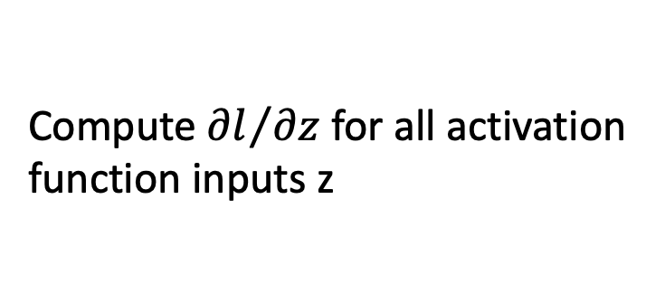


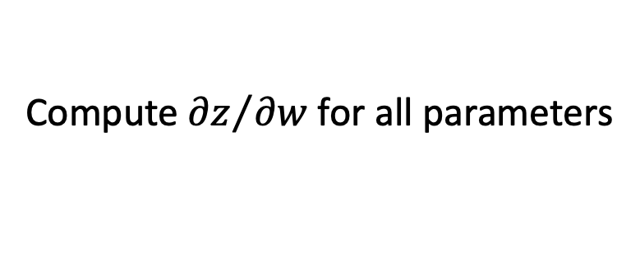

Backpropagation
$$w_{1}$$
$$z$$
$$x_{1}$$
……
$$y_{1}$$
$$w_{2}$$
b
……
$$z=x_{1}w_{1}+x_{2}w_{2}+b$$
$$x_{2}$$
$$y_{2}$$
Forward pass:
$$\frac{∂l}{∂w}=?$$
$$\frac{∂z}{∂w}\frac{∂l}{∂z}$$
Compute ${∂z}/{∂w}$ for all parameters
Backward pass:
(Chain rule)
Compute ${∂l}/{∂z}$ for all activation function inputs z
Notes:
後面的值很大

Slide 45













Backpropagation – Forward pass
Compute ${∂z}/{∂w}$ for all parameters
$$w_{1}$$
$$z$$
$$x_{1}$$
……
$$y_{1}$$
$$w_{2}$$
b
……
$$z=x_{1}w_{1}+x_{2}w_{2}+b$$
$$x_{2}$$
$$y_{2}$$
$${∂z}/{∂w_{1}}=?$$
$$x_{1}$$
The value of the input connected by the weight
$${∂z}/{∂w_{2}}=?$$
$$x_{2}$$

Slide 46



Backpropagation – Forward pass
Compute ${∂z}/{∂w}$ for all parameters
1
0.98
2
0.86
3
1
-2
-1
-1
1
0
-2
-1
0.12
-2
0.11
-1
-1
1
-1
4
0
0
2
$$\frac{∂z}{∂w}=−1$$
$$\frac{∂z}{∂w}=0.12$$
$$\frac{∂z}{∂w}=0.11$$
Notes:
That’s it. We have done the forward pass.

Slide 47














Backpropagation – Backward pass
Compute ${∂l}/{∂z}$ for all activation function inputs z
$$w_{1}$$
$$z$$
$$a$$
$$x_{1}$$
$$a=σ\left(z\right)$$
$$w_{2}$$
b
$$x_{2}$$
$$σ\left(z\right)$$
$$\frac{∂l}{∂z}$$
$$=\frac{∂a}{∂z}\frac{∂l}{∂a}$$
$$σ′\left(z\right)$$
$$σ′\left(z\right)$$

Slide 48








Backpropagation – Backward pass
Compute ${∂l}/{∂z}$ for all activation function inputs z
$$w_{1}$$
$$z$$
$$a$$
$$w_{3}$$
$$z′$$
$$x_{1}$$
$$a=σ\left(z\right)$$
$$z′=aw_{3}+⋯$$
$$w_{2}$$
b
$$w_{4}$$
$z$’’
$$x_{2}$$
$$\frac{∂l}{∂z}$$
$$=\frac{∂a}{∂z}\frac{∂l}{∂a}$$
$$\frac{∂l}{∂a}=\frac{∂z′}{∂a}\frac{∂l}{∂z′}+\frac{∂z′′}{∂a}\frac{∂l}{∂z′′}$$
(Chain rule)
?
?
Assumed it’s known
$$w_{3}$$
$$w_{4}$$
Notes:
How to explain this chain rule

Slide 49




Backpropagation – Backward pass
Compute ${∂l}/{∂z}$ for all activation function inputs z
$$w_{1}$$
$$z$$
$$a$$
$$w_{3}$$
$$z′$$
$$x_{1}$$
$$\frac{∂l}{∂z}$$
$$\frac{∂l}{∂z′}$$
$$w_{2}$$
b
$$w_{4}$$
$z$’’
$$x_{2}$$
$$\frac{∂l}{∂z′′}$$
$$\frac{∂l}{∂z}=σ′\left(z\right)\left[w_{3}\frac{∂l}{∂z′}+w_{4}\frac{∂l}{∂z′′}\right]$$
Notes:
How to explain this chain rule

Slide 50



Backpropagation – Backward pass
$$σ′\left(z\right)$$
$$w_{3}$$
$$\frac{∂l}{∂z}$$
$$\frac{∂l}{∂z′}$$
$$w_{4}$$
$σ′\left(z\right)$ is a constant because z is
already determined in the forward pass.
$$\frac{∂l}{∂z′′}$$
$$\frac{∂l}{∂z}=σ′\left(z\right)\left[w_{3}\frac{∂l}{∂z′}+w_{4}\frac{∂l}{∂z′′}\right]$$
Notes:
How to explain this chain rule

Slide 51




Backpropagation – Backward pass
Compute ${∂l}/{∂z}$ for all activation function inputs z
$$w_{1}$$
$$z$$
$$a$$
$$w_{3}$$
$$z′$$
$$x_{1}$$
$$y_{1}$$
$$\frac{∂l}{∂z}$$
$$\frac{∂l}{∂z′}$$
$$w_{2}$$
b
$$w_{4}$$
$z$’’
$$y_{2}$$
$$x_{2}$$
$$\frac{∂l}{∂z′′}$$
Case 1. Output Layer
$$\frac{∂l}{∂z′}=\frac{∂y_{1}}{∂z′}\frac{∂l}{∂y_{1}}$$
$$\frac{∂l}{∂z′′}=\frac{∂y_{2}}{∂z′′}\frac{∂l}{∂y_{2}}$$
Done!
Notes:
How to explain this chain rule

Slide 52




Backpropagation – Backward pass
Compute ${∂l}/{∂z}$ for all activation function inputs z
Case 2. Not Output Layer
$$z′$$
……
$$\frac{∂l}{∂z′}$$
$z$’’
……
$$\frac{∂l}{∂z′′}$$
Notes:
How to explain this chain rule

Slide 53







Backpropagation – Backward pass
Compute ${∂l}/{∂z}$ for all activation function inputs z
Case 2. Not Output Layer
$$z′$$
$$a′$$
$$w_{5}$$
$$z_{a}$$
$$\frac{∂l}{∂z′}$$
$$\frac{∂l}{∂z_{a}}$$
$$w_{6}$$
$z$’’
$$z_{b}$$
$$\frac{∂l}{∂z′′}$$
$$\frac{∂l}{∂z_{b}}$$
Notes:
How to explain this chain rule

Slide 54


Backpropagation – Backward pass
Compute ${∂l}/{∂z}$ for all activation function inputs z
Case 2. Not Output Layer
Compute ${∂l}/{∂z}$ recursively
$$z′$$
$$a′$$
$$w_{5}$$
$$z_{a}$$
$$\frac{∂l}{∂z′}$$
$$\frac{∂l}{∂z_{a}}$$
$$σ′\left(z′\right)$$
Until we reach the output layer ……
$$w_{6}$$
$z$’’
$$z_{b}$$
$$\frac{∂l}{∂z′′}$$
$$\frac{∂l}{∂z_{b}}$$
Notes:
How to explain this chain rule

Slide 55

















Backpropagation – Backward Pass
Compute ${∂l}/{∂z}$ for all activation function inputs z
Compute ${∂l}/{∂z}$ from the output layer
$$\frac{∂l}{∂z_{1}}$$
$$\frac{∂l}{∂z_{3}}$$
$$\frac{∂l}{∂z_{5}}$$
$$z_{1}$$
$$z_{3}$$
$$z_{5}$$
$$y_{1}$$
$$x_{1}$$
$$x_{2}$$
$$y_{2}$$
$$z_{2}$$
$$z_{4}$$
$$z_{6}$$
$$\frac{∂l}{∂z_{2}}$$
$$\frac{∂l}{∂z_{4}}$$
$$\frac{∂l}{∂z_{6}}$$

Slide 56







Backpropagation – Backward Pass
Compute ${∂l}/{∂z}$ for all activation function inputs z
Compute ${∂l}/{∂z}$ from the output layer
$$\frac{∂l}{∂z_{1}}$$
$$\frac{∂l}{∂z_{3}}$$
$$\frac{∂l}{∂z_{5}}$$
$$z_{1}$$
$$z_{3}$$
$$z_{5}$$
$$y_{1}$$
$$x_{1}$$
$$σ′\left(z_{1}\right)$$
$$σ′\left(z_{3}\right)$$
$$σ′\left(z_{2}\right)$$
$$σ′\left(z_{4}\right)$$
$$x_{2}$$
$$y_{2}$$
$$z_{2}$$
$$z_{4}$$
$$z_{6}$$
$$\frac{∂l}{∂z_{2}}$$
$$\frac{∂l}{∂z_{4}}$$
$$\frac{∂l}{∂z_{6}}$$

Slide 57





Backpropagation – Summary
Forward Pass
Backward Pass
…
…
…
…
$$a$$
$$\frac{∂z}{∂w}$$
X
$$\frac{∂l}{∂z}$$
$$=\frac{∂l}{∂w}$$
$$=a$$
for all w

Slide 58

Can the network be simplified by considering the properties of images?

Slide 59


Why CNN for Image
Some patterns are much smaller than the whole image
A neuron does not have to see the whole image to discover the pattern.
Connecting to small region with less parameters
“beak” detector

Slide 60


Why CNN for Image
The same patterns appear in different regions.
“upper-left beak” detector
Do almost the same thing
They can use the same set of parameters.
“middle beak” detector

Slide 61


Why CNN for Image
Subsampling the pixels will not change the object
bird
bird
subsampling
We can subsample the pixels to make image smaller
Less parameters for the network to process the image

Slide 62

The whole CNN
Property 1
Some patterns are much smaller than the whole image
Convolution
Property 2
Max Pooling
The same patterns appear in different regions.
Can repeat many times
Property 3
Convolution
Subsampling the pixels will not change the object
Max Pooling
Flatten

Slide 63


Slide 64


Slide 65


Slide 66


Slide 67


Slide 68
CNN – Max Pooling
1 | -1 | -1
-1 | 1 | -1
-1 | -1 | 1
-1 | 1 | -1
-1 | 1 | -1
-1 | 1 | -1
Filter 1
Filter 2
3
-1
-3
-1
-1
-1
-1
-1
-3
1
0
-3
-1
-1
-2
1
-3
-3
0
1
-1
-1
-2
1
3
-2
-2
-1
-1
0
-4
3

Slide 69
CNN – Max Pooling
New image
but smaller
1 | 0 | 0 | 0 | 0 | 1
0 | 1 | 0 | 0 | 1 | 0
0 | 0 | 1 | 1 | 0 | 0
1 | 0 | 0 | 0 | 1 | 0
0 | 1 | 0 | 0 | 1 | 0
0 | 0 | 1 | 0 | 1 | 0
Conv
3
0
-1
1
Max
Pooling
3
1
0
3
2 x 2 image
6 x 6 image
Each filter
is a channel

Slide 70
The whole CNN
3
0
-1
1
Convolution
3
1
0
3
Max Pooling
Can repeat many times
A new image
Convolution
Smaller than the original image
The number of the channel is the number of filters
Max Pooling

Slide 71

The whole CNN
cat dog ……
Convolution
Max Pooling
A new image
Fully Connected Feedforward network
Convolution
Max Pooling
A new image
Flatten

Slide 72
Flatten
3
0
1
3
0
-1
1
3
3
1
-1
0
3
Flatten
1
Fully Connected Feedforward network
0
3

Slide 73


