Slide 1
Computer Vision: Geometry 101
2024 Crash Course
Speaker: Hsiang-Cheng Yang (楊翔誠)
Advisor: Prof. Shao-Yi Chien
Date: 2024 / 08 / 14

Slide 2
Outline
1. Title
2. Projective 2D Geometry
3. Estimation of Transformations
4. Pinhole Camera Model
5. Ending

Slide 3
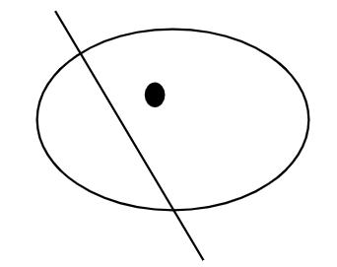
Projective 2D Geometry
Points, lines & Conics
Transformations & Invariants

Slide 4
Homogeneous Coordinates
Homogeneous representation of lines
Homogeneous representation of points
Degrees of Freedom
${ex: (2,3,1)}^{T}$ = ${(4,6,2)}^{T}={(6,9,3)}^{T}$

Slide 5
Points and Lines
Homogeneous Coordinate
Intersections of lines
The intersection of two lines l and l’ is x = l x l’
Line joining two points
The line through two points x and x’ is l = x x x’

Slide 6
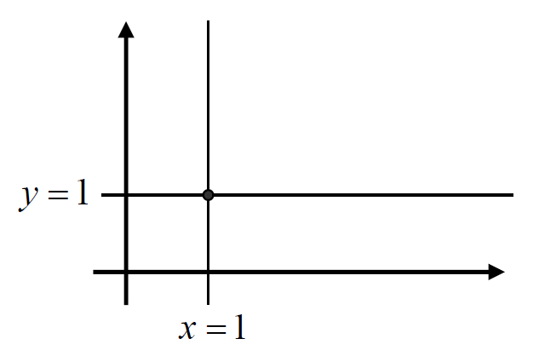
Points and Lines (cont.)
Exercise
Example 1
Example 2
Determine the line passing through the two points (2,4) and (5,13)

Slide 7
Points and Lines (cont.)
Solution
Example 2
Determine the line passing through the two points (2,4) and (5,13)
1.Homogeneous representation of points
2.Homogeneous representation of lines
3.Equation of the line

Slide 8
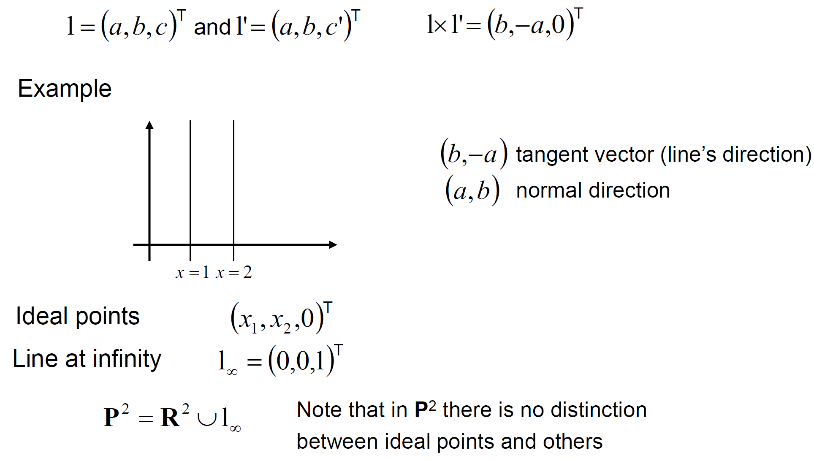
Ideal Points and the Line at Infinity
Intersections of parallel lines
Projection 座標系 = 二維座標系 + Line at Infinity

Slide 9
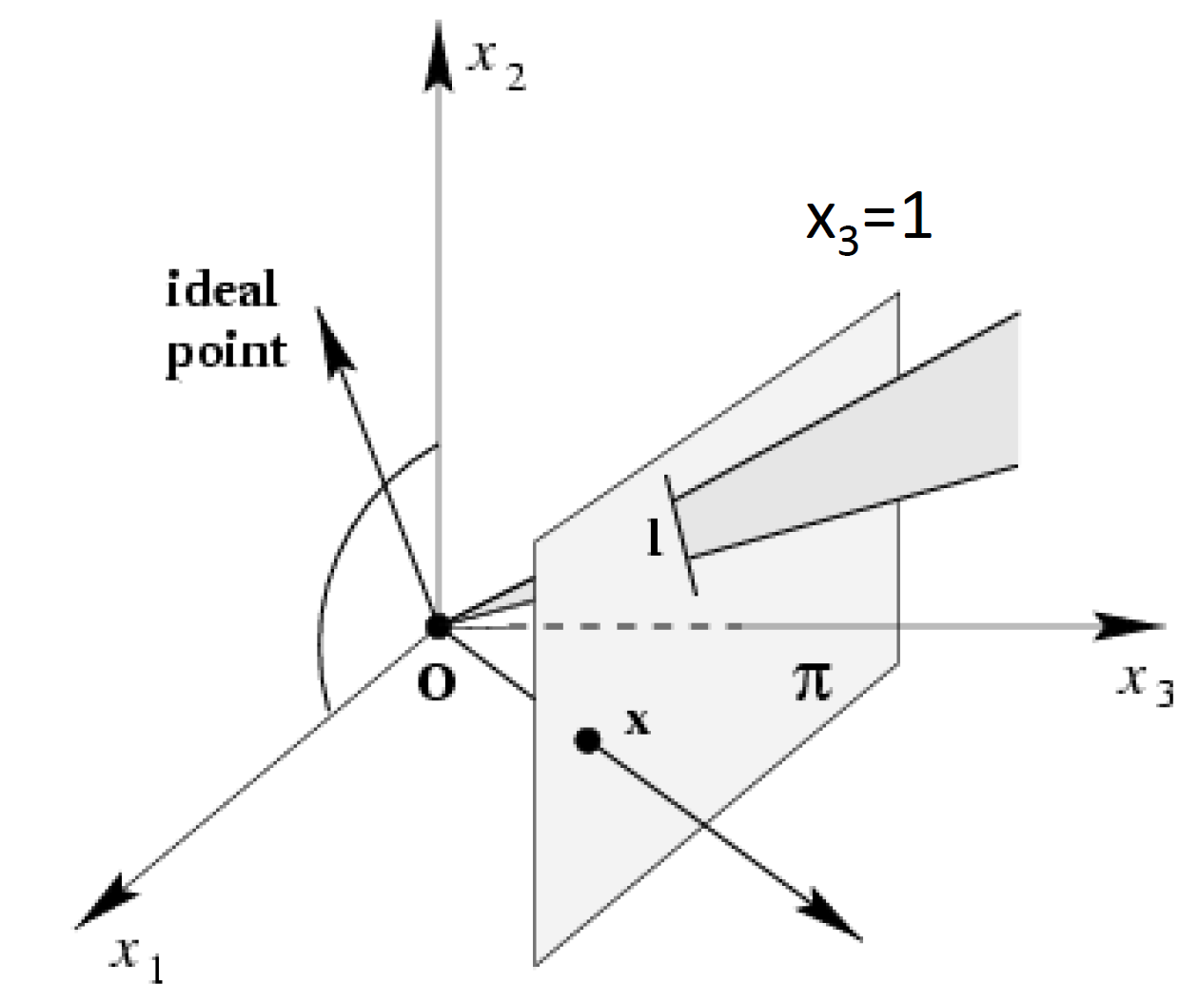
A Model for the Projective Plane

Slide 10
Projective Transformations
Definition
Theorem
Definition: Projective Transformation

Slide 11
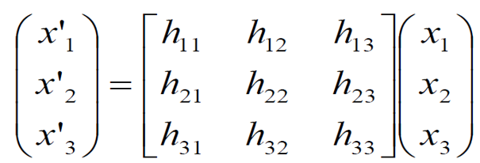
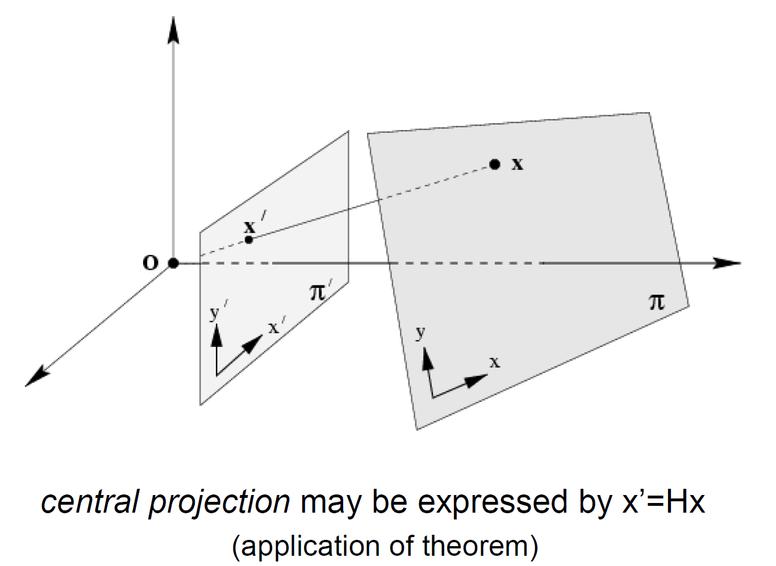
Mapping between Planes
2D → 2D

Slide 12
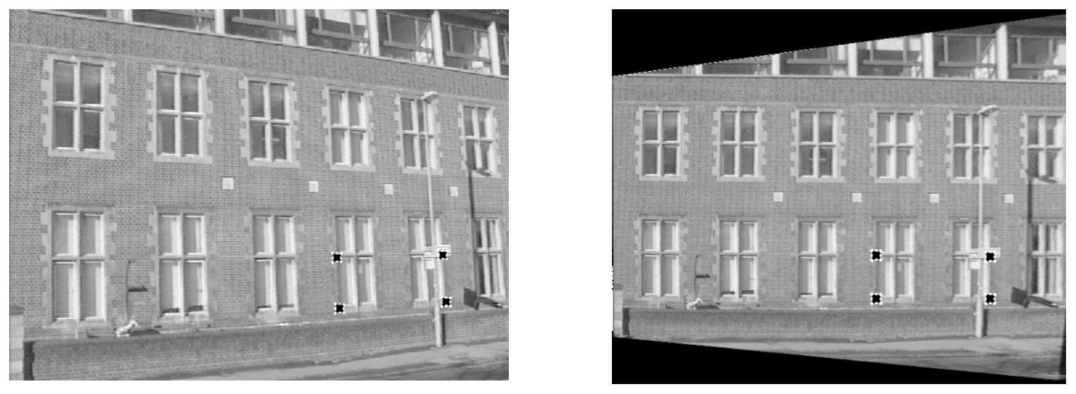
Removing Projective Distortion

Slide 13
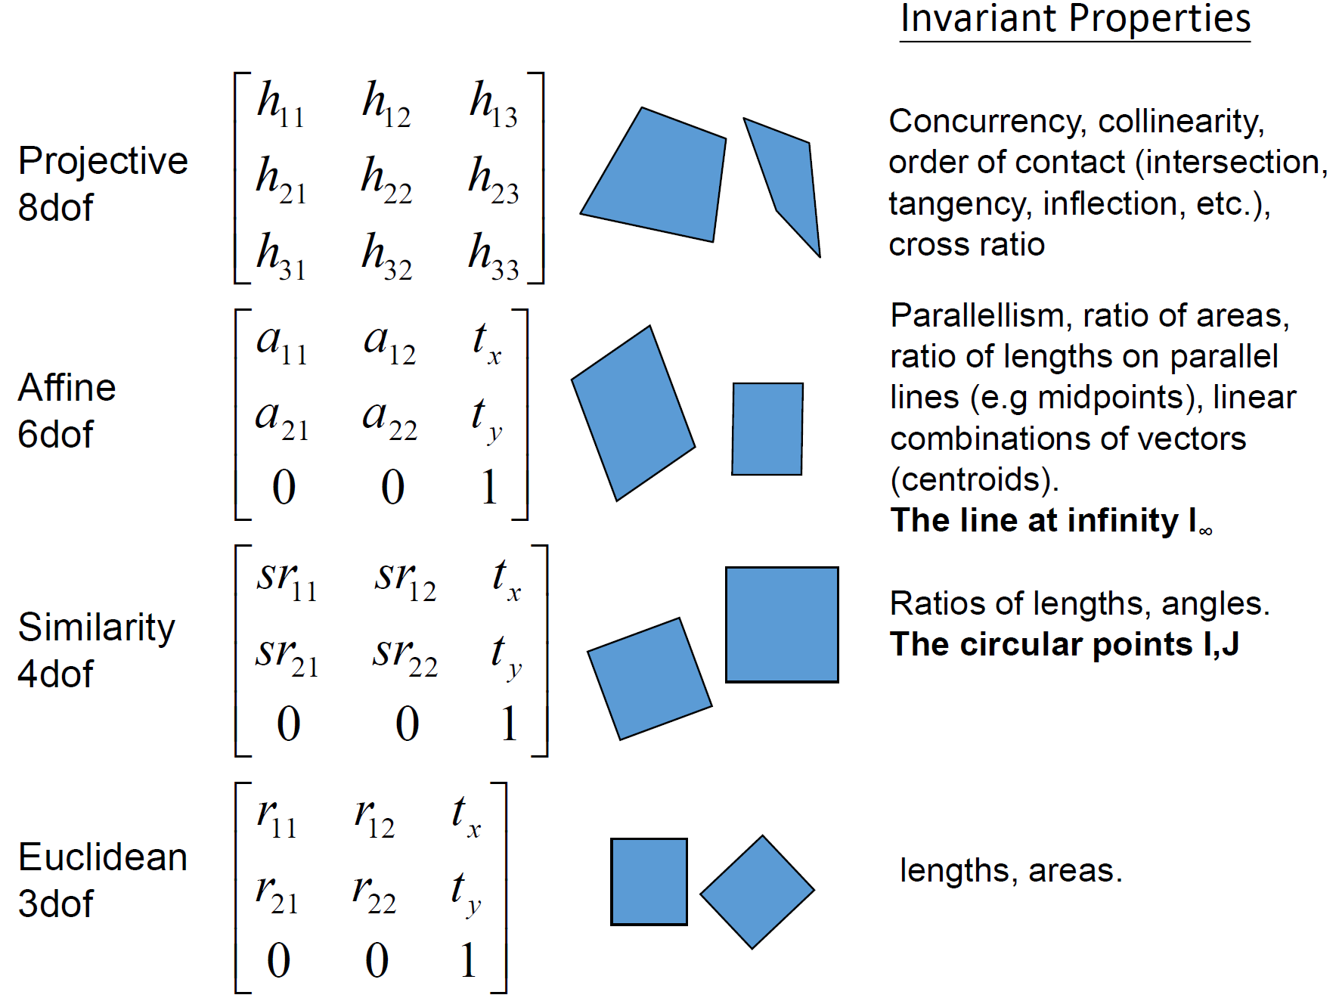
Summary of Transformations

Slide 14
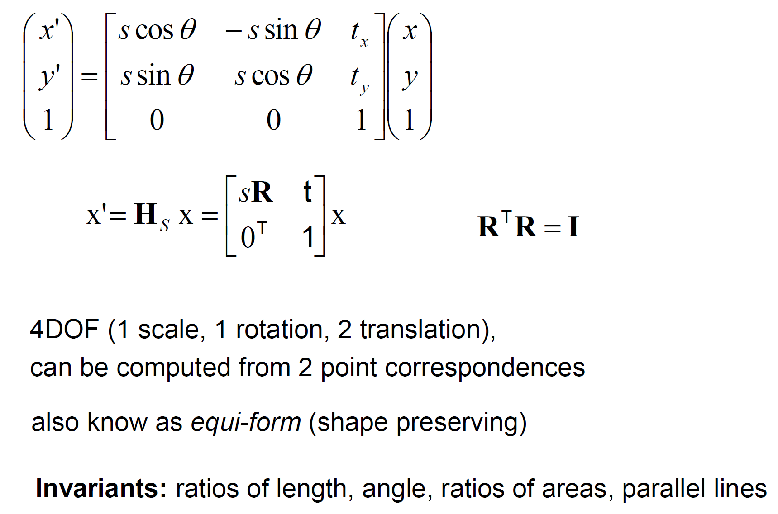
Summary of Transformations (cont.)
Class I: Isometries
Class II: Similarities

Slide 15
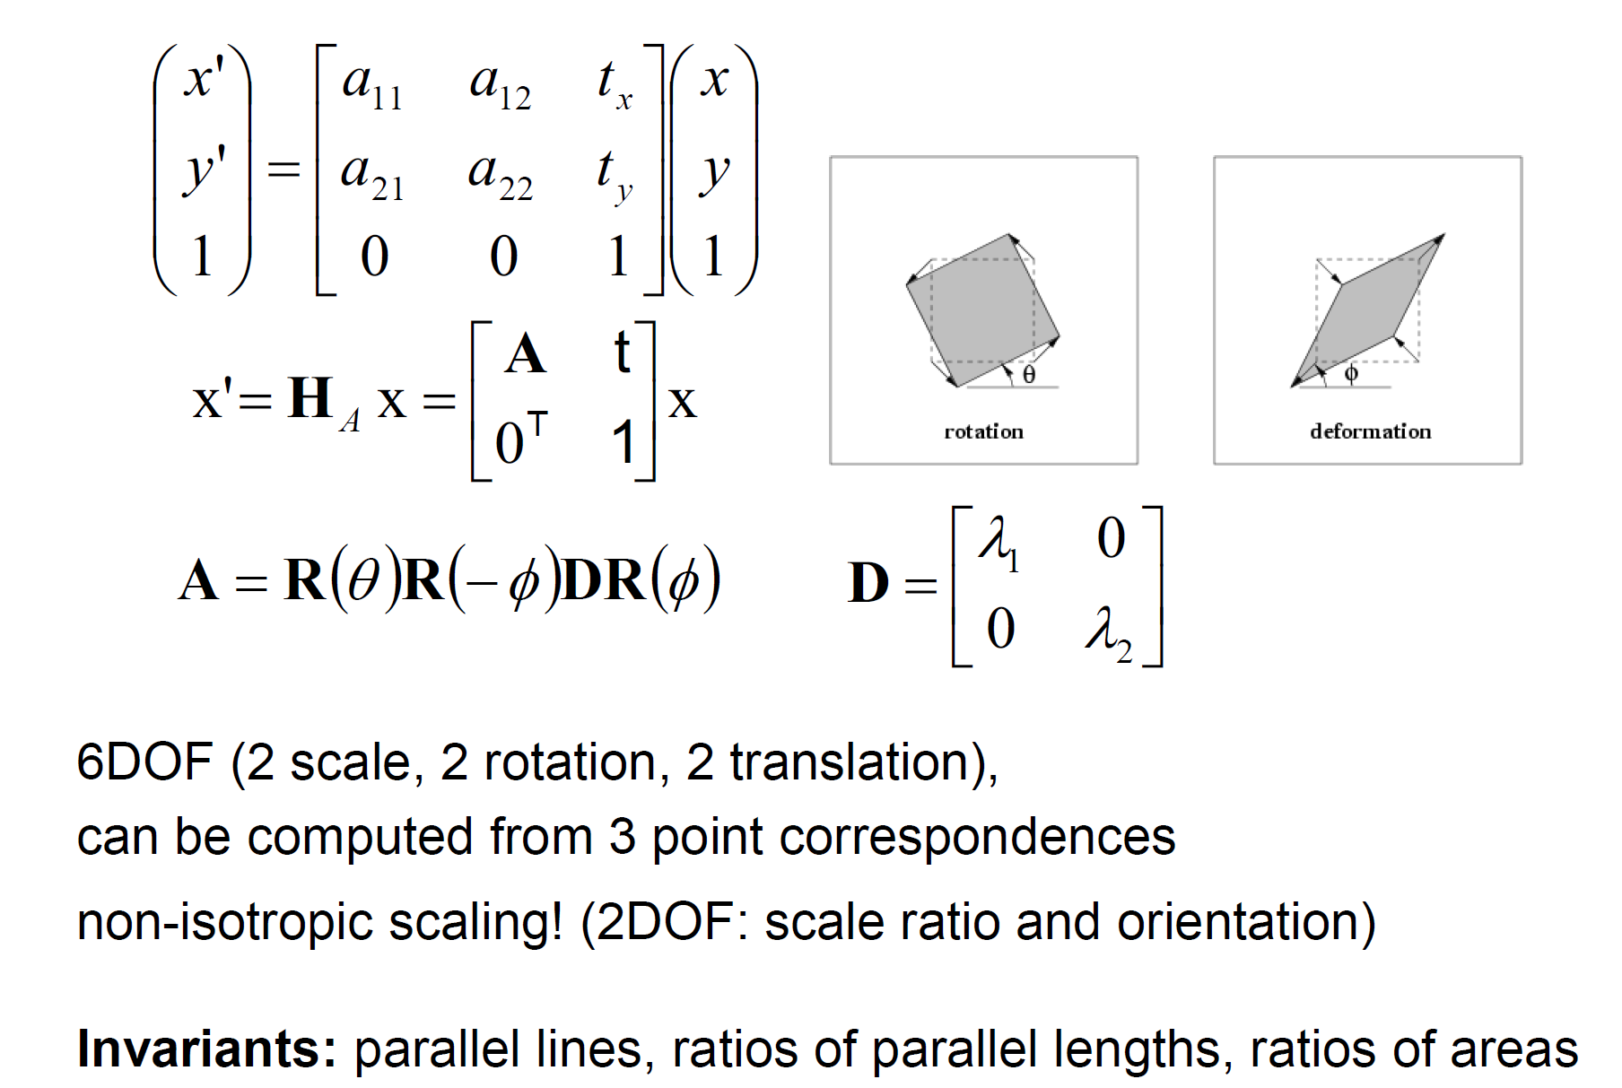
Summary of Transformations (cont.)
Class III: Affine Transformations
Class IV: Projective Transformations

Slide 16
Application

Slide 17
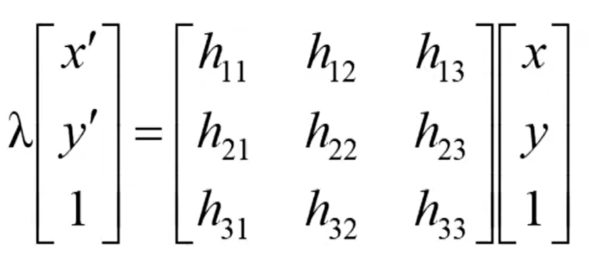
2D Homography
Given a set of (Xi, Xi’), compute H (Xi = HXi)
Minimal Solution: 4 points yield an exact solution for H
No exact solution (noise)

Slide 18
Gold Standard Algorithm
Direct Linear Transformation (DLT)

Slide 19
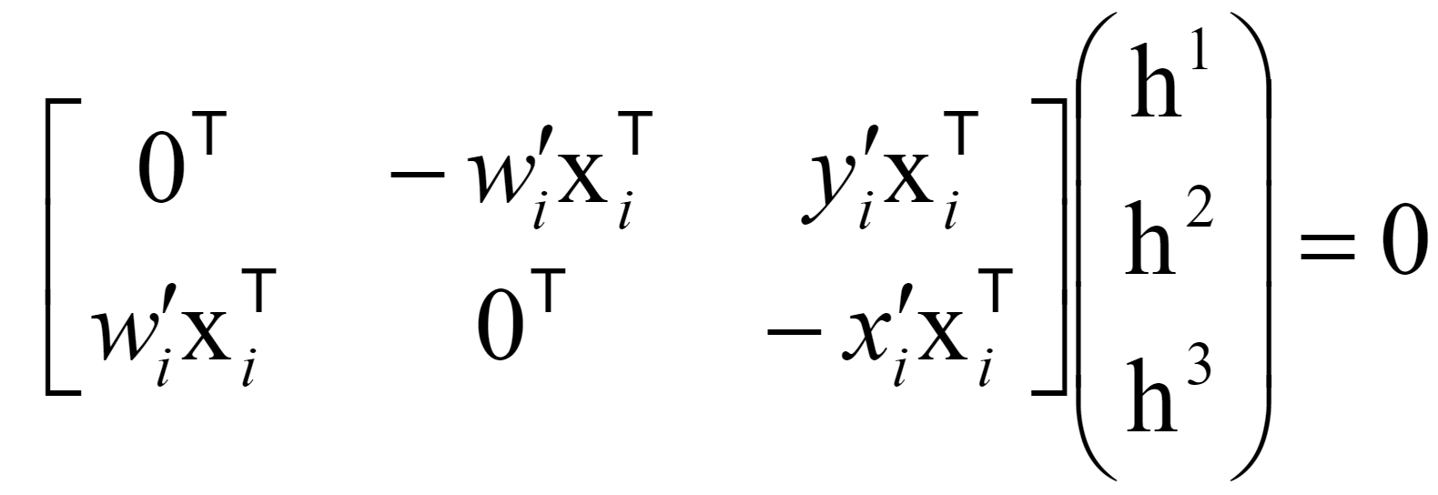
Direct Linear Transformation
Only 2 out of 3 equations are linearly independent
Solving for H
Additional constraint: ||h|| = 1
Ah = 0 not possible, so minimize ||Ah||

Slide 20
Direct Linear Transformation (cont.)
DLT Algorithm

Slide 21
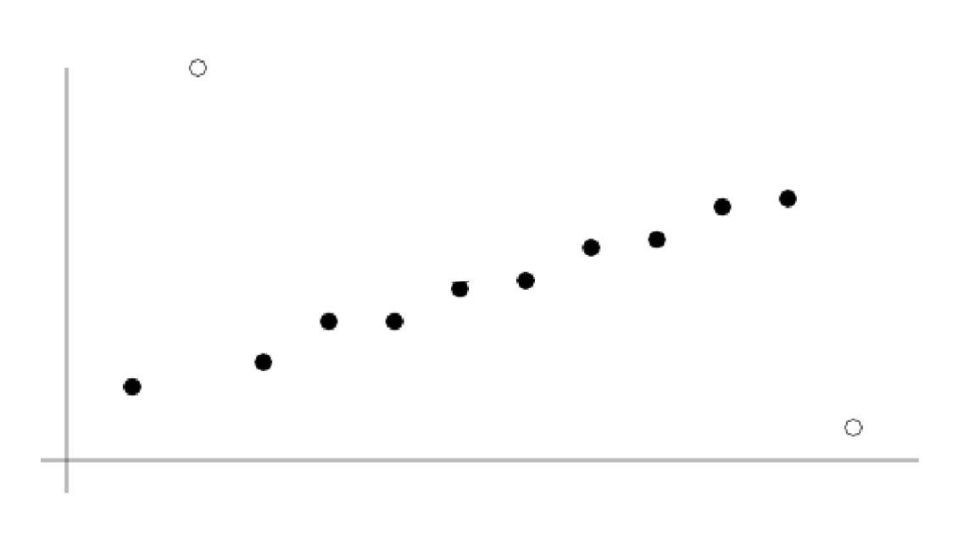
Robust Estimation
Gross outliers?

Slide 22
Robust Estimation (cont.)
RANSAC: RANdom SAmple Consensus

Slide 23
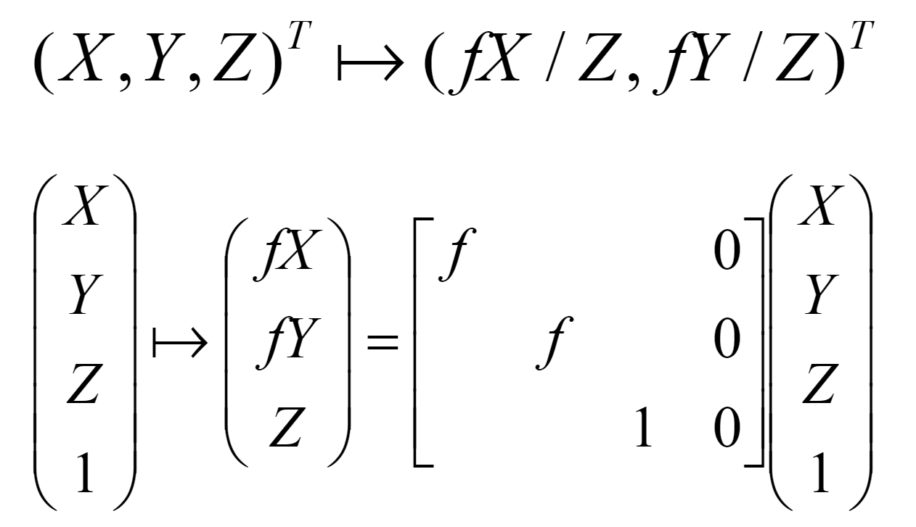
Camera Models
Pinhole Camera Model
Camera Plane

Slide 24
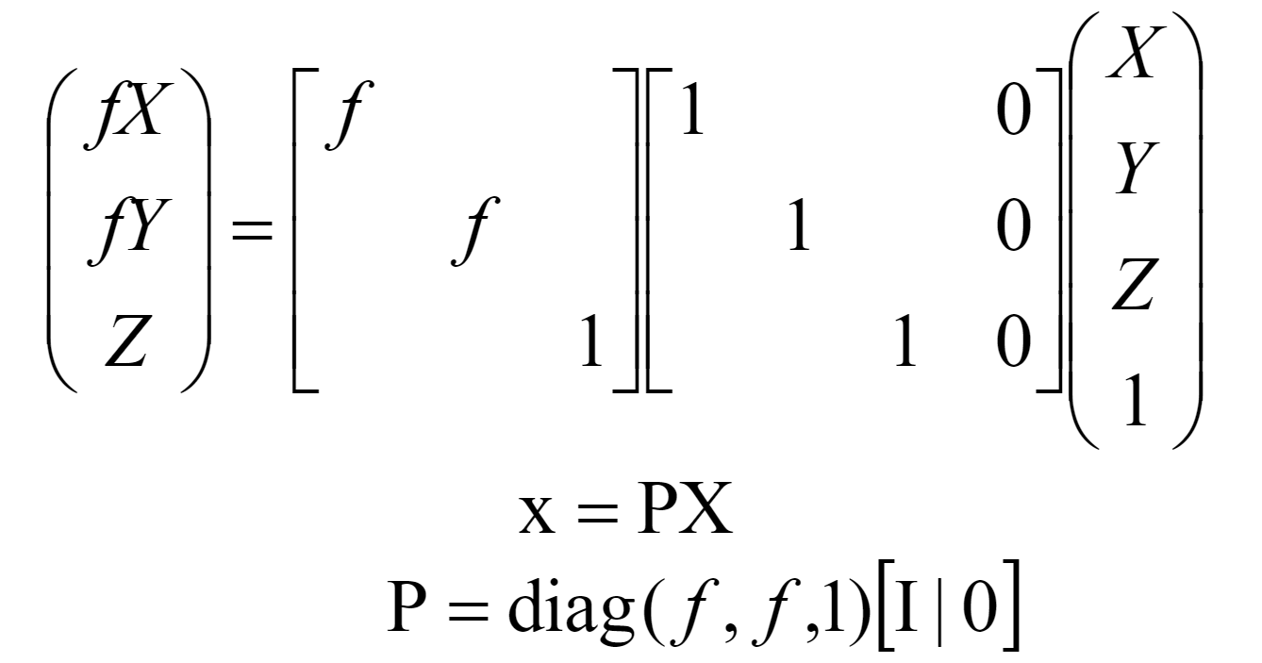
Pinhole Camera Model

Slide 25
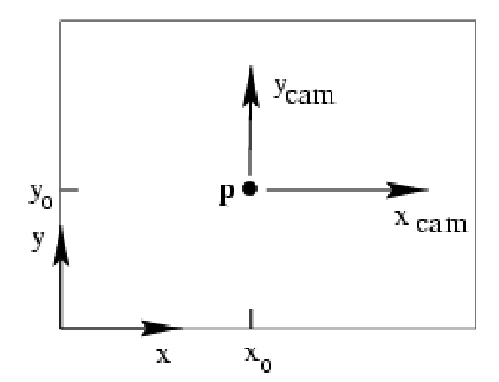
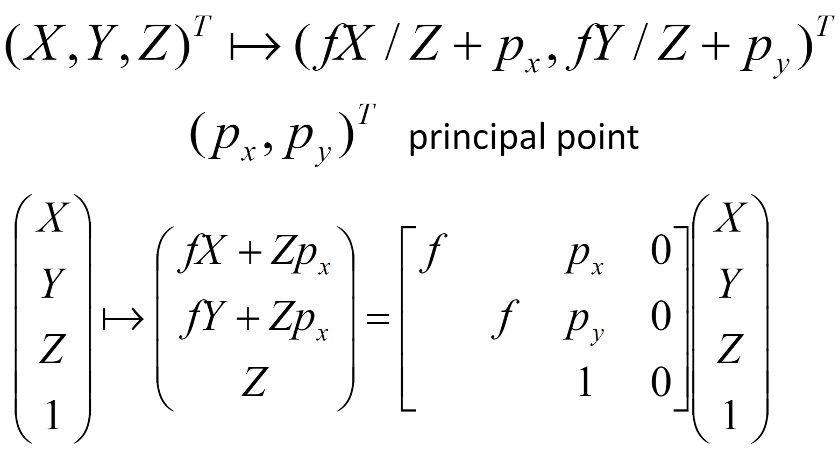
Pinhole Camera Model (cont.)
Principal Point Offset
(0,0,0,1)
→ (0,0,1)
→ (Px,Py,1)
?

Slide 26
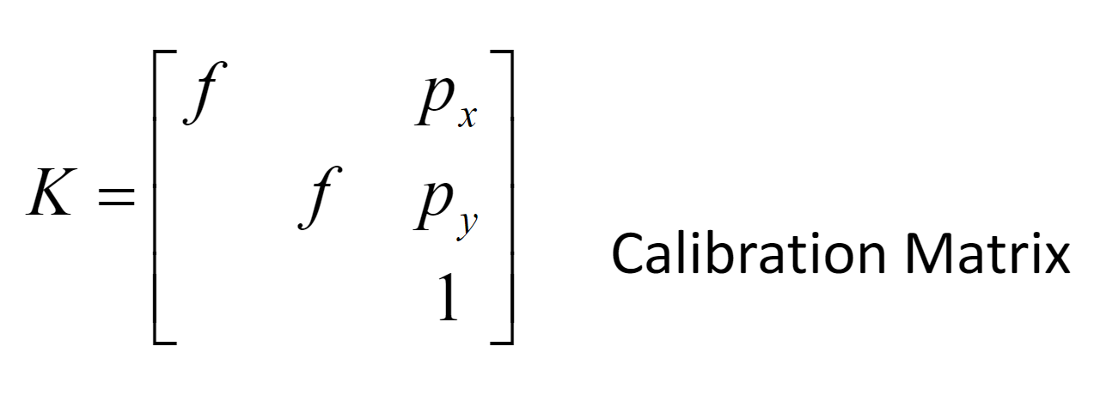
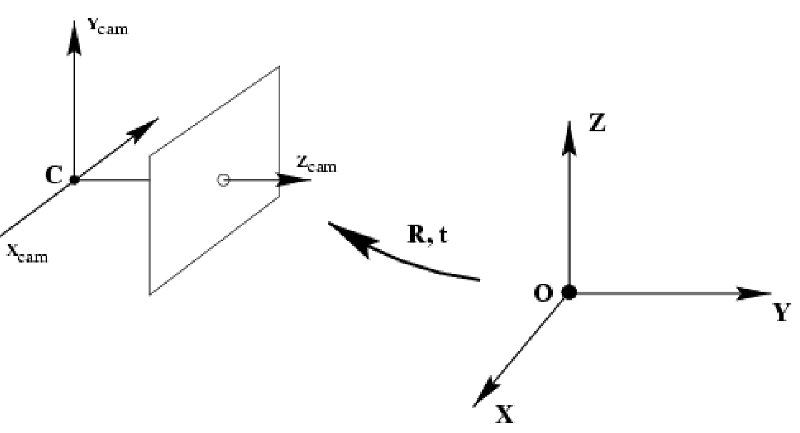
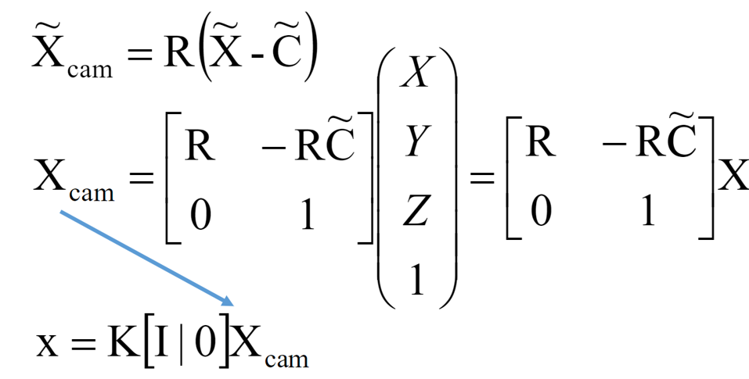
Pinhole Camera Model (cont.)
Calibration Matrix
Rotation and Translation

Slide 27
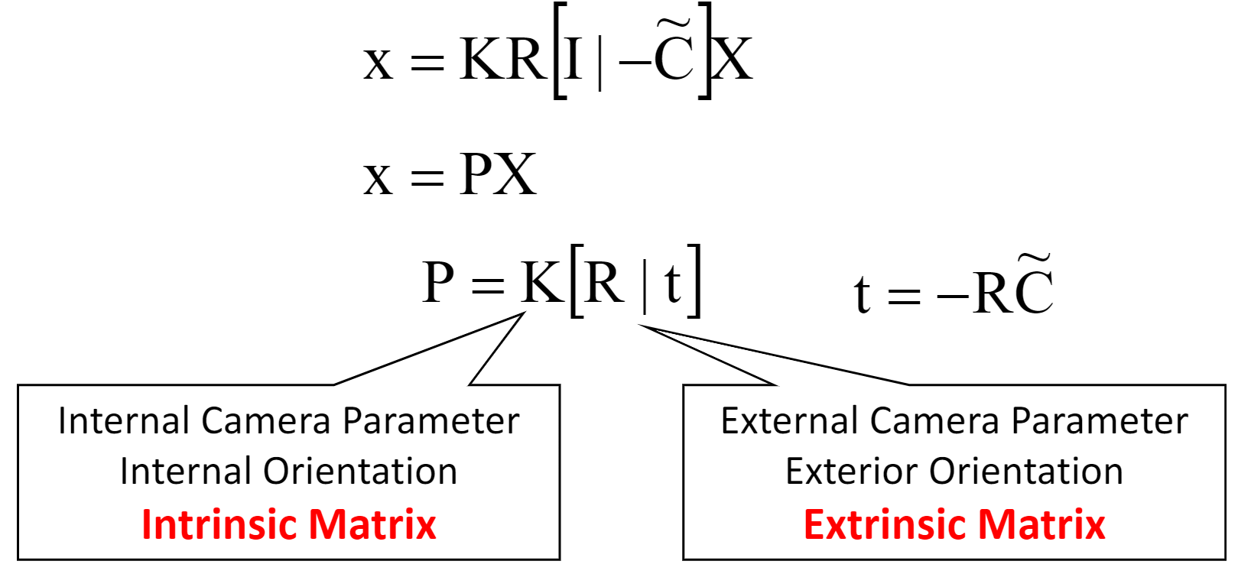
Pinhole Camera Model (cont.)
Rotation and Translation
可被校正
旋轉、平移

Slide 28
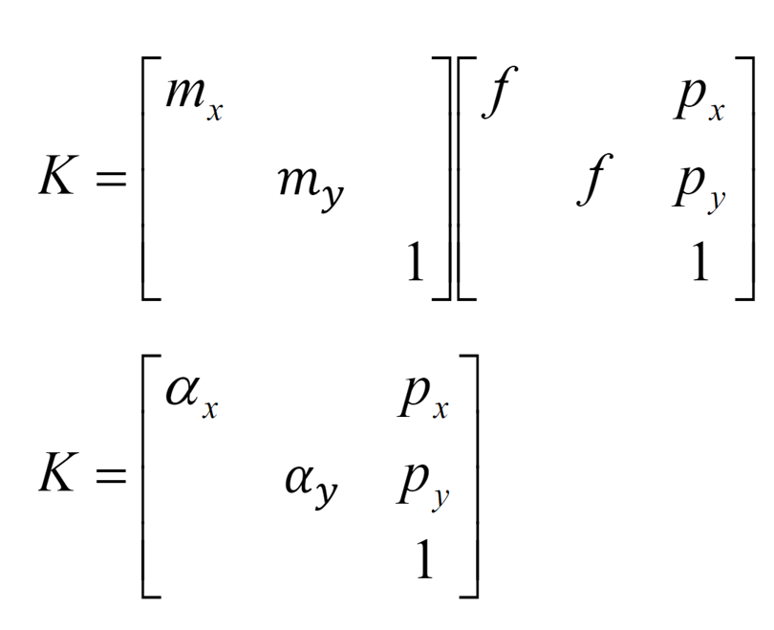
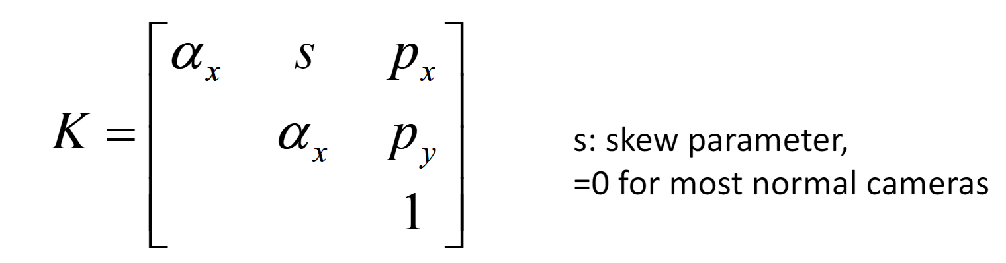
Pinhole Camera Model (cont.)
CCD (Charge-Coupled Device) Camera
Finite Projective Camera

Slide 29
Congratulations!

