Slide 1
DLCV Application
Lecturer: Tzu-Ching Huang 黃子青
Media IC & System Lab
version1: Chih-Wei Wu

Slide 2
What You Will Learn
Get familiar with classic and modern network architectures.
Learn how to design lightweight neural networks.

Slide 3
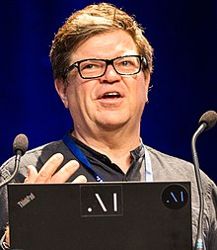
Recap
How to classify hand-written digits?
Convolutional Neural Networks (CNN)
0
1
2
3
4
5
6
7
8
9
“LeNet-5” LeCun et al., 1998.
Notes:
捲積神經網路之父Yann LeCun

Slide 4
What about harder task?
Bird
Mango

Slide 5
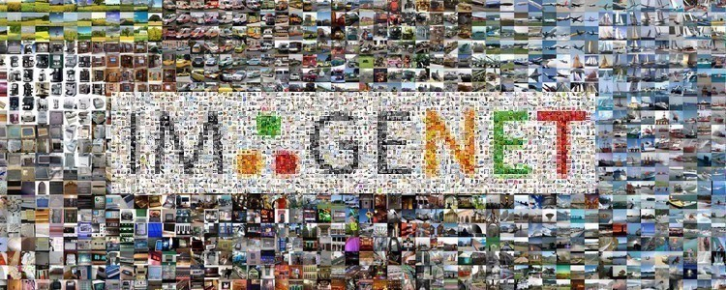
WHERE to START from?
All deep learning methods start from
data
1M images
1k classes
Annual competition2010-2017
“Imagenet” Fei-Fei et al., 2009.
Just get awarded “The most impactful paper 10 years ago in CVPR”!

Slide 6
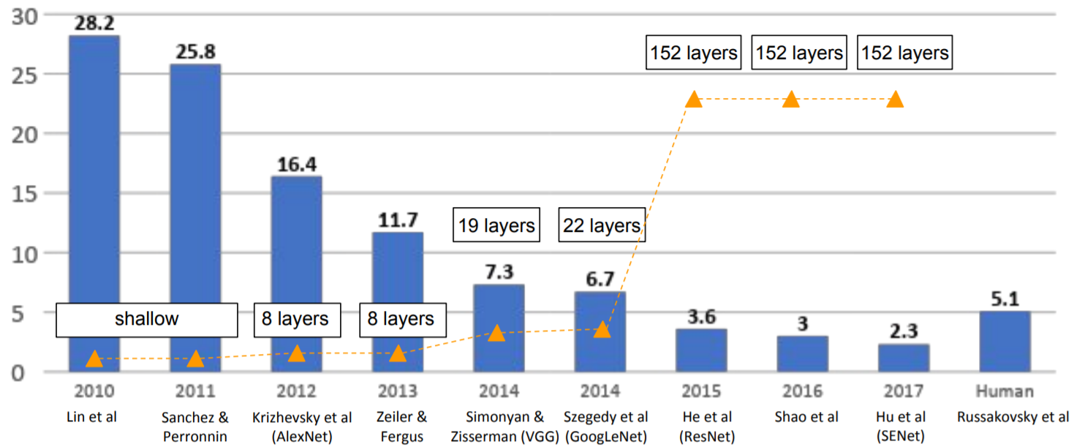
A Great SUCCESS
ImageNet Large Scale Visual Recognition Challenge winners
First CNN method

Slide 7
ALEXNET Krizhevsky et al. 2012
8 layers (5 conv. + 3 fc.)
First to use ReLU
Propose dropout mechanism
Train on 2*GTX580, writing CUDA code by himself of course

Slide 8
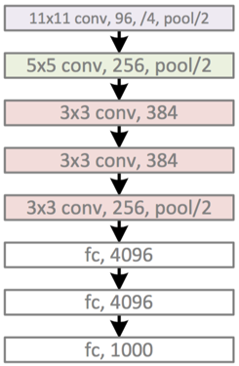
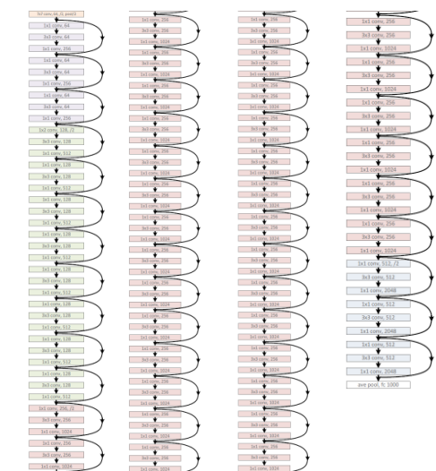
The bigger, The better!
AlexNet, ILSVRC 2012
(8 layers)
VGG-19, ILSVRC 2014
(19 layers)
ResNet-152, ILSVRC 2016
(152 layers)

Slide 9
LAYERs vs. ERROR RATE
ImageNet Large Scale Visual Recognition Challenge winners

Slide 10
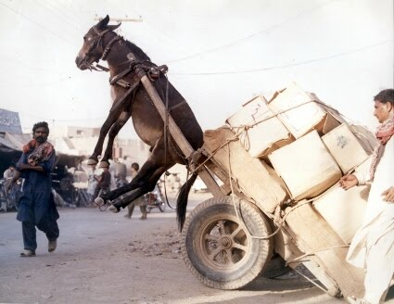
BIGness comes with some drawback…

Slide 11
VGGNet (16 layers) [Simonyan and Zisserman, 2014]
Q: Stacking more layers will increase parameters, which may overfit the data
Use smaller filter (3x3 conv) -> Three 3x3 (stride 1) conv layer have same receptive field of one 7x7 conv -> Fewer parameters, more non-linearity
Downsample the image more times -> Reduce memory usage
AlexNet
VGG-16

Slide 12
VGGNet (16 layers) [Simonyan and Zisserman, 2014]
VGG-16
However, a closer look at parameter counts…
CONV3-64: [224x224x64] (3*3*3)*64 = 1,728
CONV3-64: [224x224x64] (3*3*64)*64 = 36,864
CONV3-128: [112x112x128] (3*3*64)*128 = 73,728
CONV3-128: [112x112x128] (3*3*128)*128 = 147,456
CONV3-256: [56x56x256] (3*3*128)*256 = 294,912
CONV3-256: [56x56x256] (3*3*256)*256 = 589,824
CONV3-256: [56x56x256] (3*3*256)*256 = 589,824
CONV3-512: [28x28x512] (3*3*256)*512 = 1,179,648
CONV3-512: [28x28x512] (3*3*512)*512 = 2,359,296
CONV3-512: [28x28x512 (3*3*512)*512 = 2,359,296
CONV3-512: [14x14x512] (3*3*512)*512 = 2,359,296
CONV3-512: [14x14x512] (3*3*512)*512 = 2,359,296
CONV3-512: [14x14x512] (3*3*512)*512 = 2,359,296
FC: [1x1x4096] 7*7*512*4096 = 102,760,448
FC: [1x1x4096] 4096*4096 = 16,777,216
FC: [1x1x1000] 4096*1000 = 4,096,000
FC is the most costly layer!

Slide 13
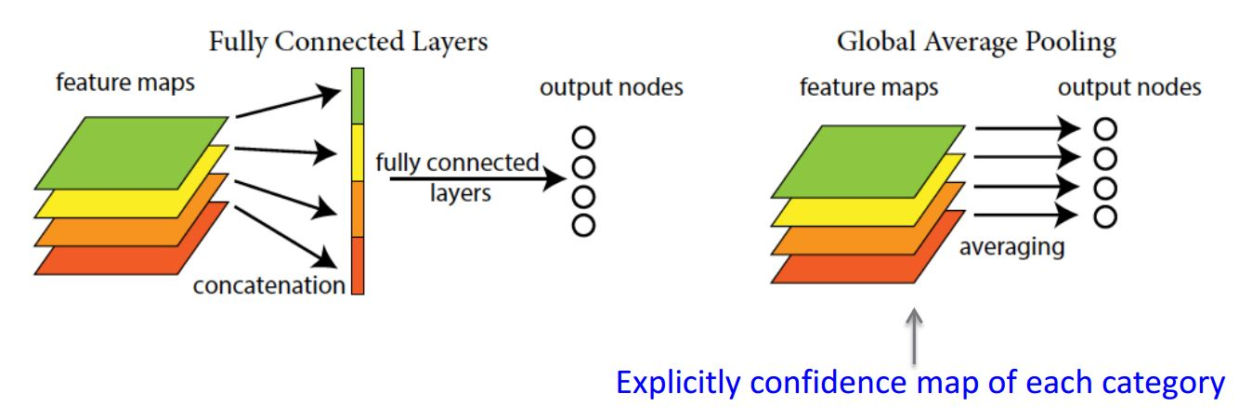
GOOGLENET (22 layers) Szegedy et al., 2014
Avoid expensive FC layers
12x less params than AlexNet
How?
w/ FC
w/o FC

Slide 14
GOOGLENET (22 layers) Szegedy et al., 2014
Q: Can we let the network choose its operation at each layer?
Concatenation
1x1 conv
3x3 conv
5x5 conv
1x1 conv
1x1 conv
1x1 conv
3x3 max pool
Previous layer
Inception Module

Slide 15
GOOGLENET (22 layers) Szegedy et al., 2014
Q: But why not this? (w/o additional 1x1 conv)
Concatenation
1x1 conv
3x3 conv
5x5 conv
3x3 max pool
Previous layer
Naïve Inception Module

Slide 16
GOOGLENET (22 layers) Szegedy et al., 2014
Q: But why not this? (w/o additional 1x1 conv)
A: Computation counts too high!
Conv ops:
[1x1 c128] 28x28x128x1x1x256
[3x3 c192] 28x28x192x3x3x256
[5x5 c96] 28x28x96x5x5x256
Total: 854M ops
Concatenation
28x28x128
28x28x192
28x28x96
28x28x256
1x1 c128
3x3 c192
5x5 c96
3x3 max pool
Previous layer
Input: 28x28x256
Naïve Inception Module

Slide 17
GOOGLENET (22 layers) Szegedy et al., 2014
Solution: Adding “bottleneck” layers (1x1 conv) to reduce feature depth
Conv ops:
[1x1 c64] 28x28x64x1x1x256
[1x1 c64] 28x28x64x1x1x256
[1x1 c128] 28x28x128x1x1x256
[3x3 c192] 28x28x192x3x3x64 [5x5 c96] 28x28x96x5x5x64
[1x1 c64] 28x28x64x1x1x256
Total: 358M ops
(Previous: 854M ops)
Concatenation
28x28x128
28x28x192
28x28x96
28x28x64
1x1 c128
3x3 c192
5x5 c96
1x1 c64
28x28x64
28x28x64
28x28x256
1x1 c64
1x1 c64
3x3 max pool
Previous layer
Input: 28x28x256
Inception Module

Slide 18
The REAL “DEEP” CNN…
ImageNet Large Scale Visual Recognition Challenge winners
Revolution of deep

Slide 19
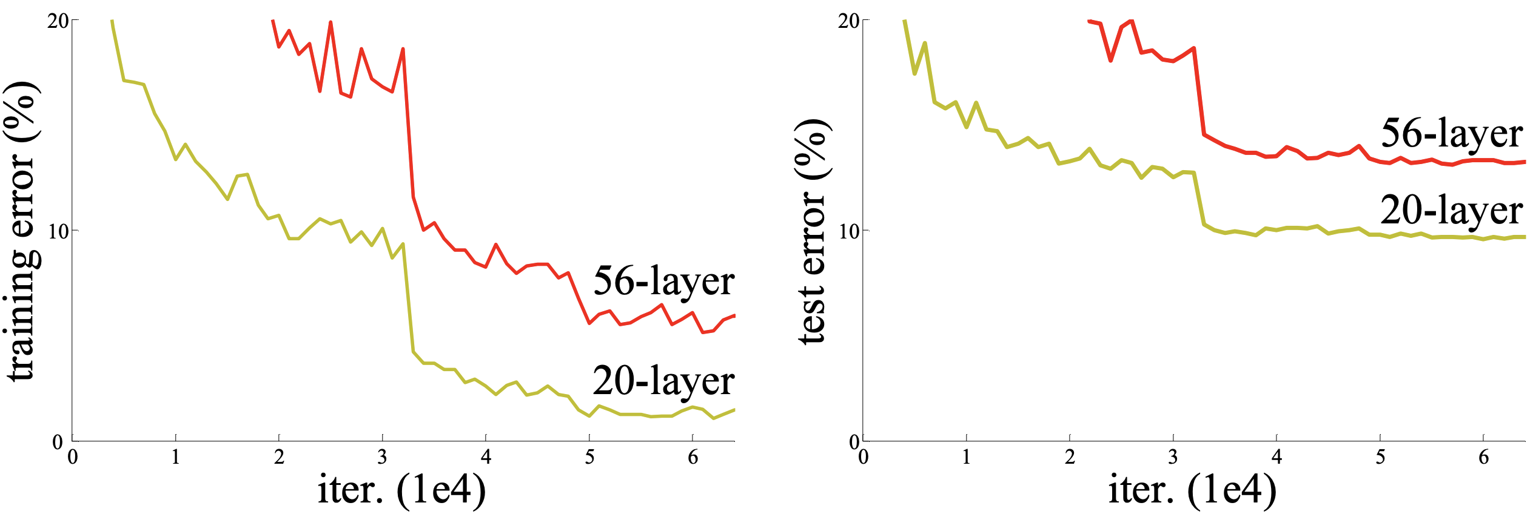
ResNet (152 layers) He et al., 2015
Q: What happens when we continue stacking deeper layers on a “plain” convolutional neural network?
A: The deeper model performs worse on testing set, but is not caused by overfitting!

Slide 20
ResNet (152 layers) He et al., 2015
Hypothesis: The problem is an optimization problem, deeper models are harder to optimize!
Solution:
F(x)+x
Learn the residual between input and output!
Relu
F(x)
+
conv
conv
Relu
Relu
x
Identity
conv
conv
x
x
“Plain” layer
Residual Block

Slide 21
https://github.com/pytorch/vision/blob/master/torchvision/models/resnet.py

Slide 26
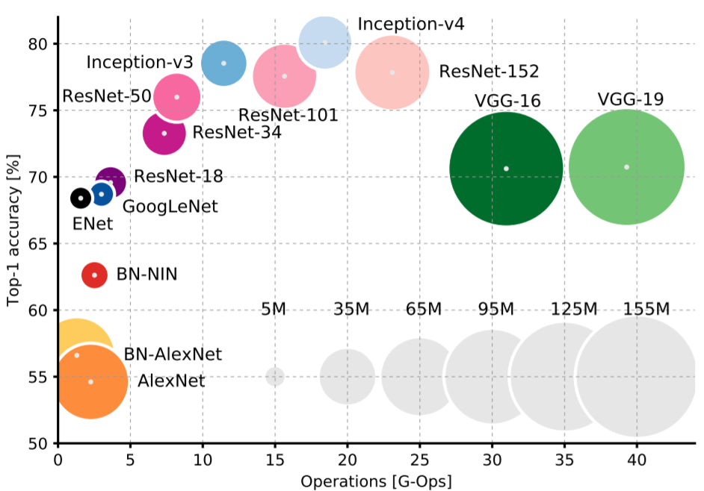
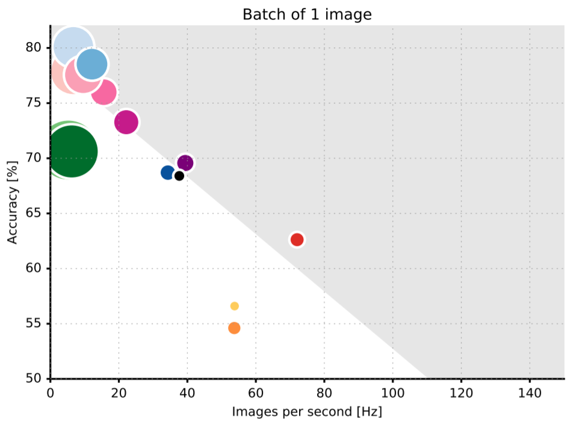
Quick comparison
Top1 vs. operations
(size ∝ parameters)
Accuracy vs. inference speed on TX1 (size∝ operations)
Canziani et al. “An Analysis of Deep Neural Network Models for Practical Applications” ArXiv, 2016.

Slide 27
Quick comparison
These are more likely to run on GPUs, what about low power device or even ASIC?
Top1 vs. operations
(size ∝ parameters)
Accuracy vs. inference speed on TX1 (size∝ operations)
Canziani et al. “An Analysis of Deep Neural Network Models for Practical Applications” ArXiv, 2016.

Slide 28
Practical Use
28

Slide 29
Mobilenet Howard et al. 2017

Slide 30
Mobilenet Howard et al. 2017

Slide 31
Mobilenet Howard et al. 2017
Depthwise Separable Convolution
Computation cost:
[Standard conv] $D_{K}∙D_{K}∙M∙N∙D_{F}∙D_{F}$
[Depthwise separable conv] $$D_{K}∙D_{K}∙M∙D_{F}∙D_{F}+M∙N∙D_{F}∙D_{F}$$
Total reduction: $\frac{1}{N}+\frac{1}{D_{K}^{2}}$

Slide 32
Shufflenet Zhang et al. 2018

Slide 33
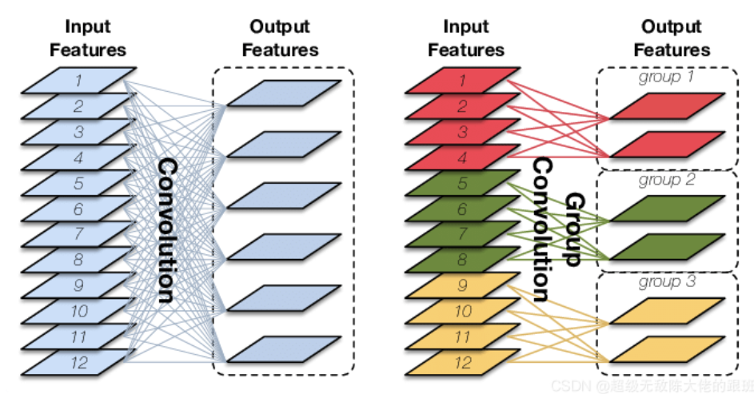
Shufflenet Zhang et al. 2018
Grouped Convolution(分成𝐺組，則該層的參數量減少為原來的1 / 𝐺)
(Used in AlexNet, ResNeXt)

Slide 34
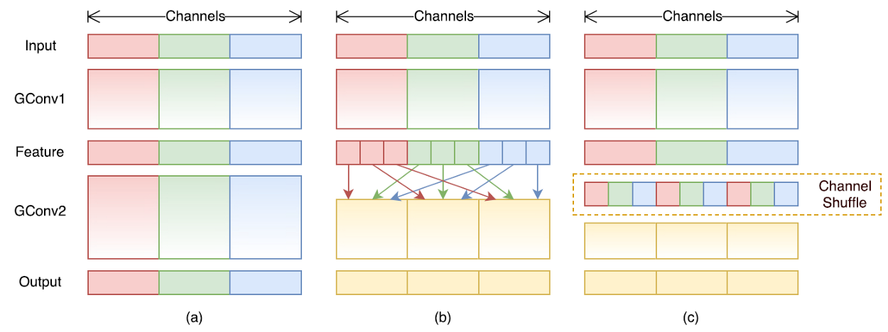
Shufflenet Zhang et al. 2018
Two Stacked Group Convolutions (GConv1 & GConv2)
Shuffle the channels before convolution (done by transposing)
Equivalent implementation of (b)

Slide 36
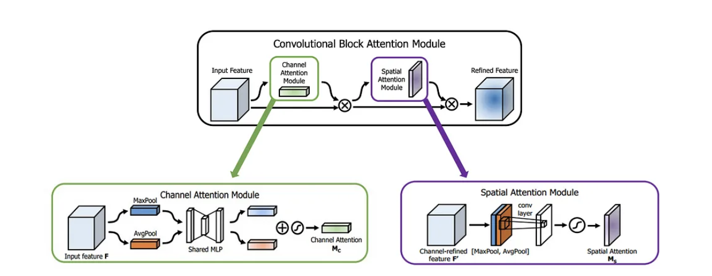
CBAM
Woo et al. 2018
Notes:
Convolutional Block Attention Module

Slide 37
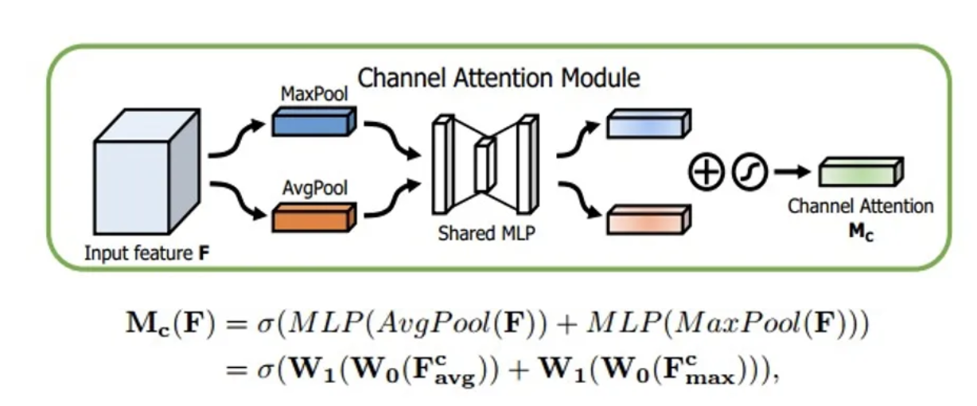
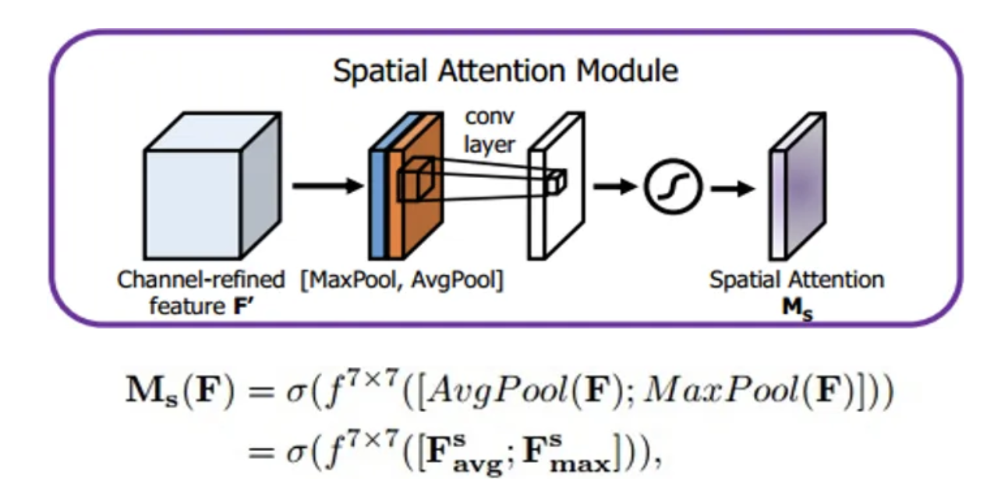
CBAM
Woo et al. 2018
Notes:
Convolutional Block Attention Module

Slide 38
A ConvNet for the 2020s…
ALEXNET
VGG, GoogLeNet
ResNet
CNN
2012
2014
2015
ConvNeXT
2020
2021
Transformer
ViT
Swin-Transformer

Slide 39
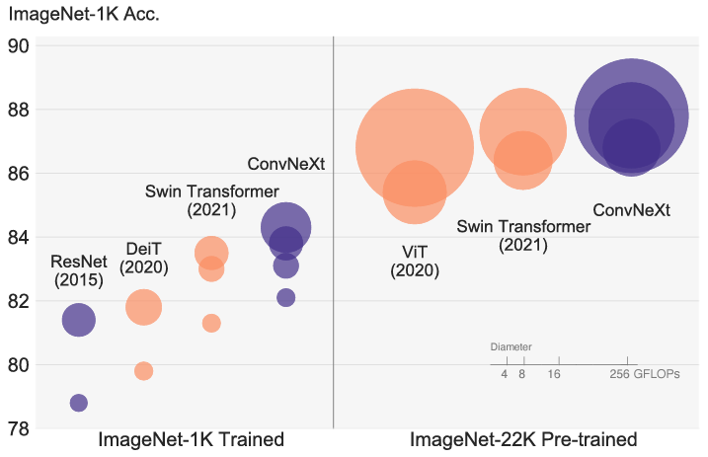
ConvNeXT

Slide 40
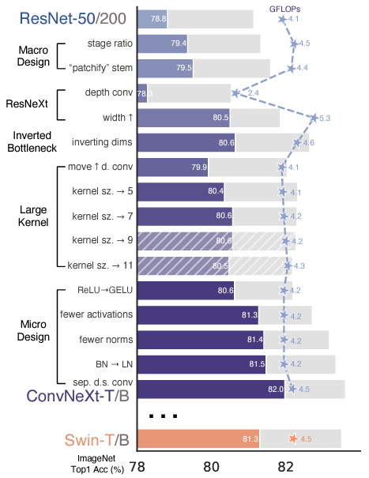
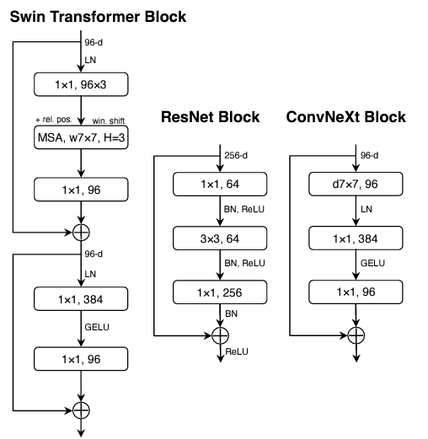
Conclusion We hope that the new results prompt people to rethink the importance of convolution in computer vision.

Slide 41
SUMMARY
Get familiar with common CNN architectures
Pick a CNN architecture to solve CV problems(?)
Learn to figure out critical issues in your problem, and design CNNs accordingly!

