Slide 1
Neural Network Training Tips
Lecturer : Yu-Lun , Chang
Media IC & System Lab

Slide 2
Outline
Problems of activation functions
Data preprocessing
Weight initialization
Batch normalization
Transfer learning
Optimizer
Learning Rate
Dropout
Data augmentation
Choosing Hyperparameters

Slide 3
Activation Function

Slide 4
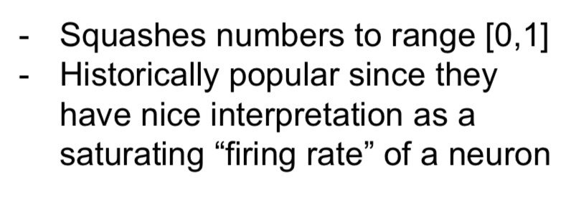
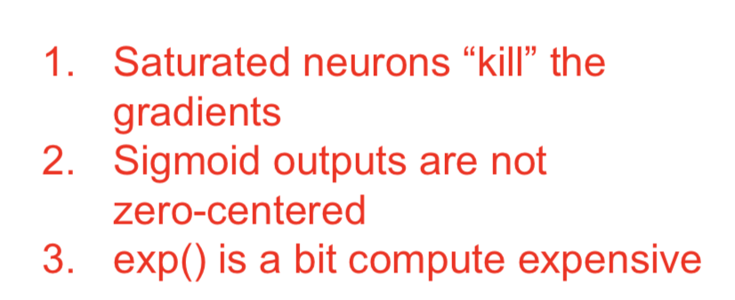
Problems of Sigmoid

Slide 5
Problems of Tanh

Slide 6
Problems of ReLU

Slide 7
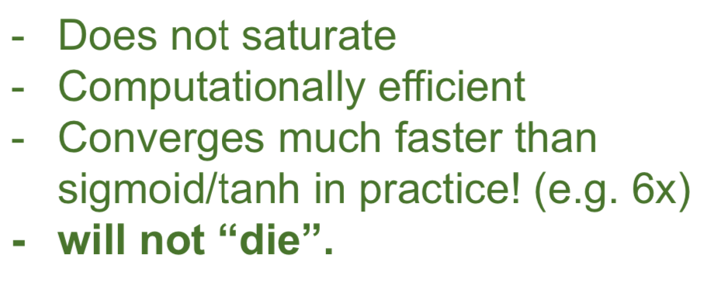
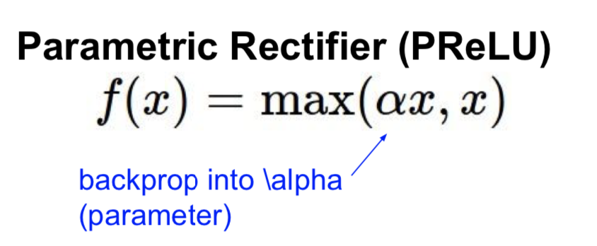
Someone likes it when doing generating task

Slide 8
MaxOut

Slide 9
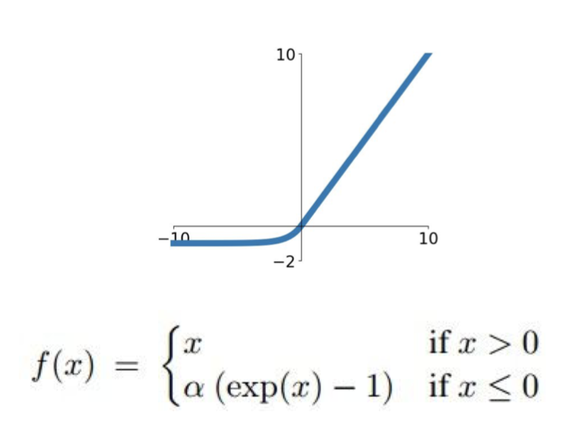
TLDR , In practice
Using ReLU is great enough.
Try out LeakyReLU , Maxout, ELU, SELU
Don’t use sigmoid, except the need of [0~1].
https://arxiv.org/pdf/1706.02515.pdf
ELU

Slide 10
Data Preprocessing
You want zero-mean data !

Slide 11
TLDR , In practice

Slide 12
Weight Initialization

Slide 13
Normal Distribution?

Slide 14
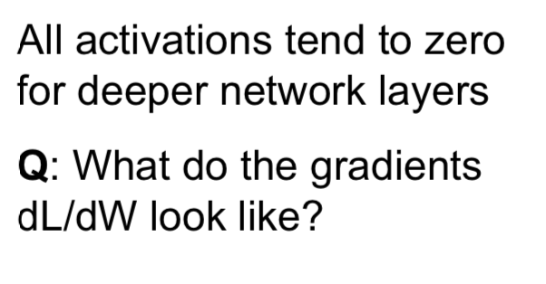
Weight Initialization: Activation statistics

Slide 15
Increase std

Slide 16
Weight Initialization: “Xavier” Initialization

Slide 17
How about ReLU

Slide 18
Weight Initialization: Kaiming Initialization

Slide 19
It is not so important for using which initialization method…

Slide 20
Batch Normalization

Slide 21
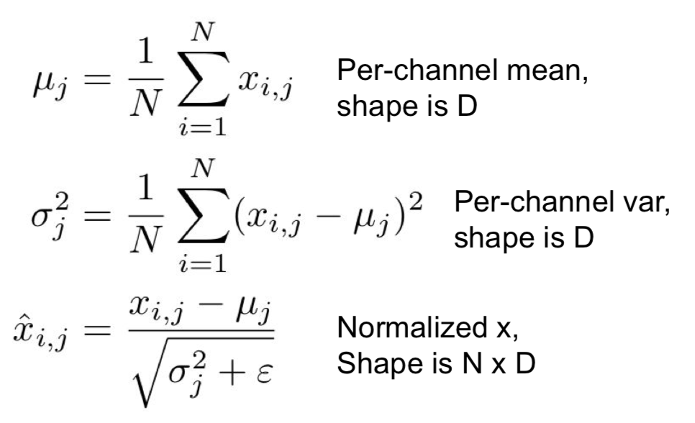
Batch Normalization

Slide 22
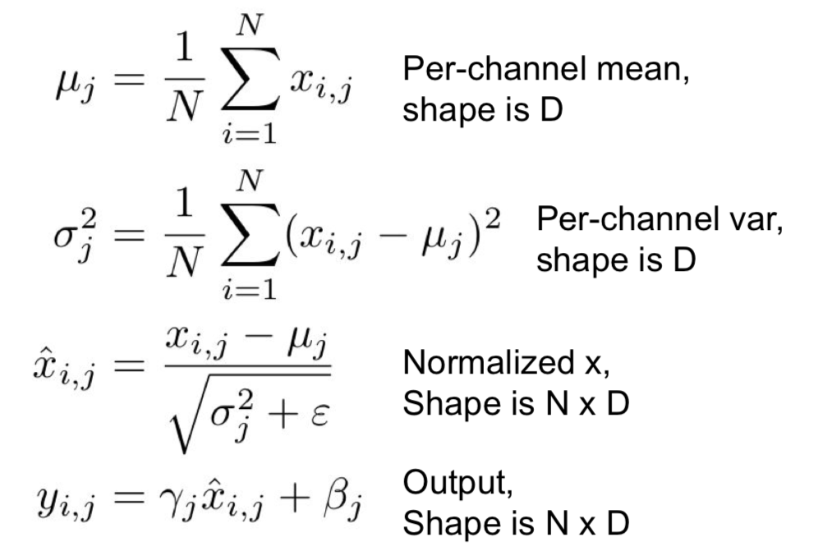
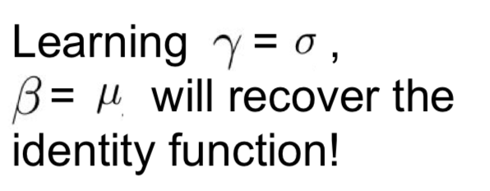
Batch Normalization
N→ mini-batch size during training.
What about testing ??

Slide 23
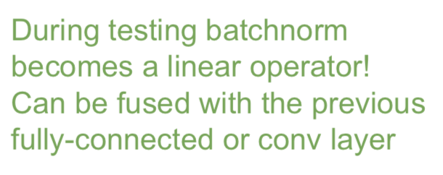
BN -- Testing Time

Slide 24
2D-BN for ConvNet

Slide 25
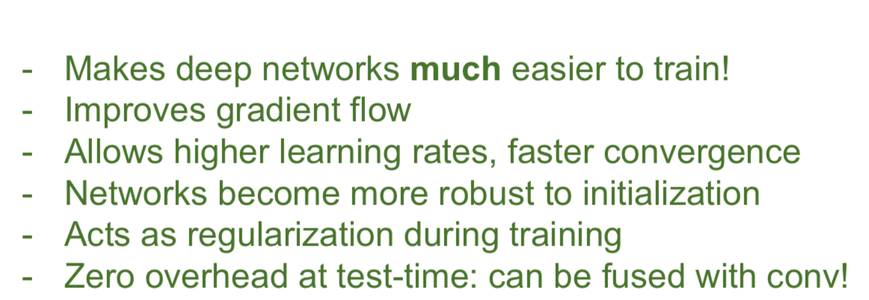
In practice
Layer Norm, Instance Norm, Group Norm …

Slide 26
Different Norm…

Slide 27
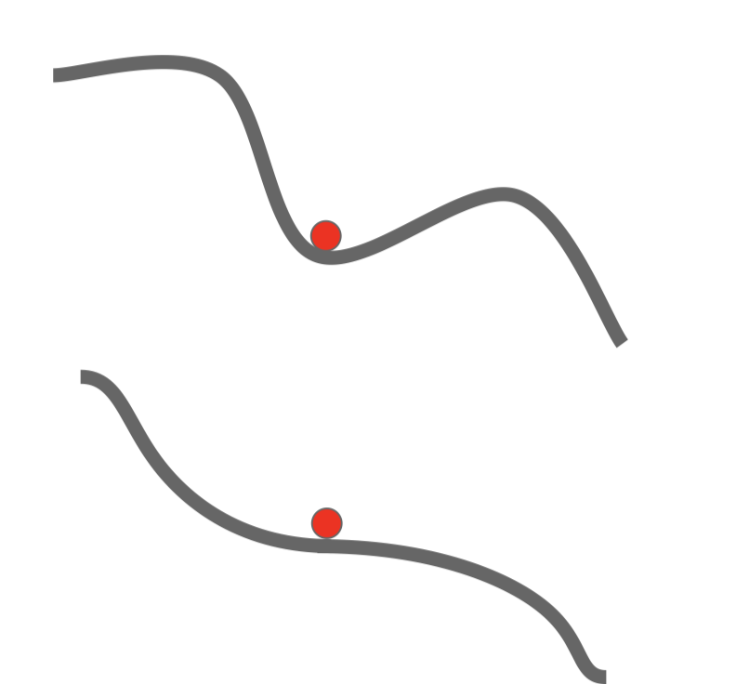
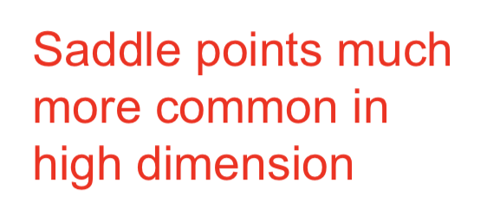
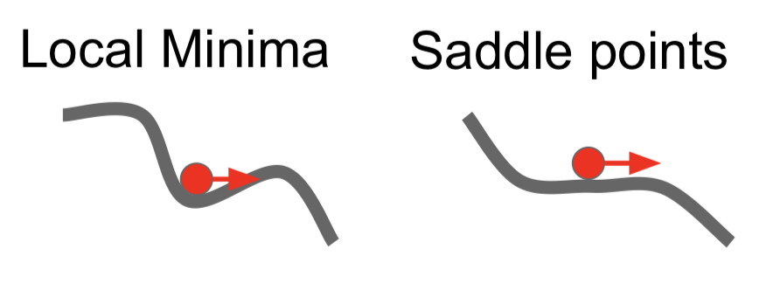
Problem of SGD Optimizer

Slide 28
Transfer learning

Slide 29
Transfer learning

Slide 31
SGD + Momentum

Slide 32
Nesterov Momentum

Slide 33
All kinds of optimizers…
SGD
SGD + Momentum
AdaGrad
RMSProp
Adam (great!), combining momentum, AdaGrad,RMSProp

Slide 34
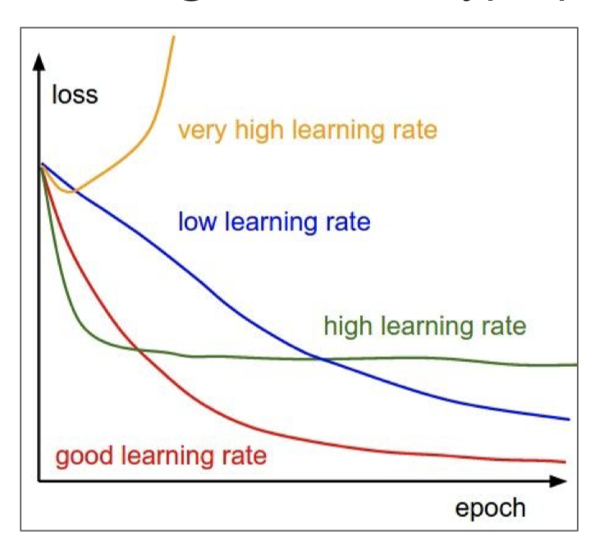
Learning Rate

Slide 35
Learning Rate Decay

Slide 36
Learning rate decay

Slide 37
Linear Warmup

Slide 38
TLDR, In Practice

Slide 39
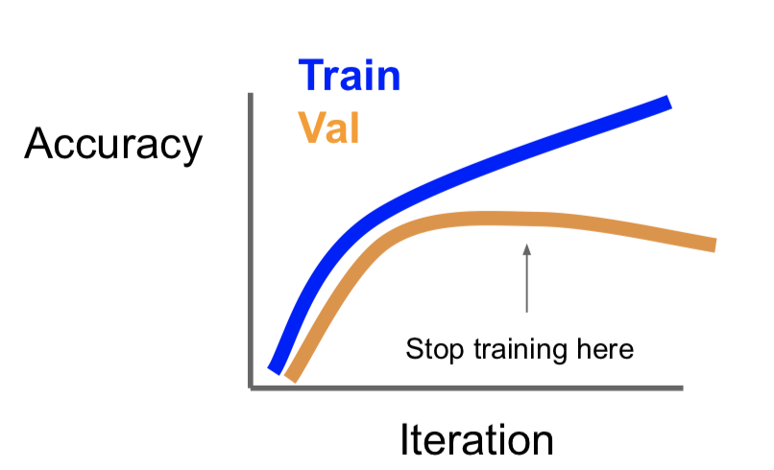
Beyond Training Error-- Early Stopping

Slide 40
Improve Performance -- Regularization

Slide 41
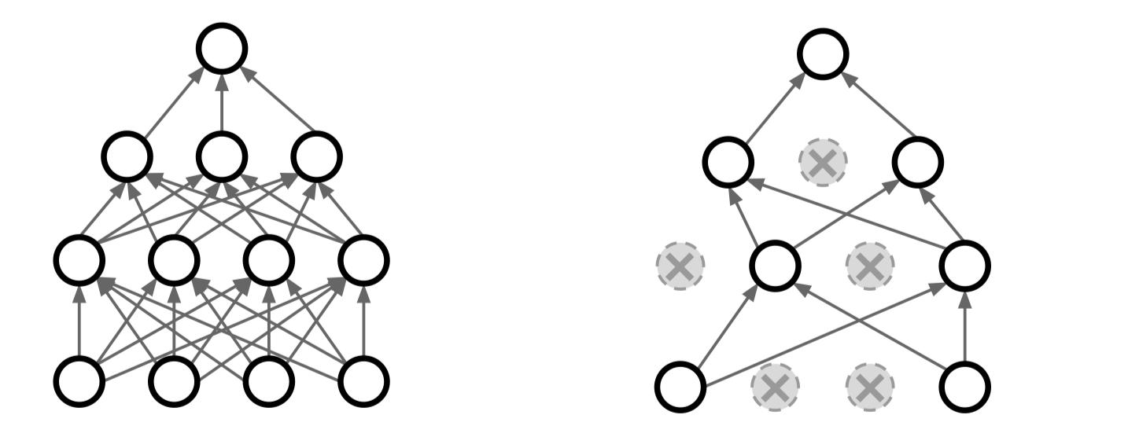
Dropout

Slide 42
Dropout

Slide 43
Dropout -- Test time

Slide 44
Data Augmentation

Slide 45
Data Augmentation

Slide 46
CutOut

Slide 47
Mixup

Slide 48
In practice

Slide 49
Choosing Hyperparameters

Slide 50
Choosing Hyperparameters

Slide 51
Summary

Slide 52
HOPE YOU CAN ENJOY YOUR LIFE WITH DEEP LEARNING !

Slide 53
Reference
All slides are copied from CS231n course.
http://cs231n.stanford.edu/syllabus.html

