Slide 1
Computer Vision: Filter & Feature
2024 Crash Course
Media IC & System Lab, GIEE, NTU
Speaker: Yen Yu, Lin (林彥妤)
Email: yylin@media.ee.ntu.edu.tw
Date: 2024/08/14

Slide 2
Reference
Slides from Computer Vision, Prof. Shao-Yi Chien, National Taiwan University

Slide 3
Filter

Slide 4
Image Filtering
What is filtering?
  Forming a new image whose pixel values are transformed from original pixel values
• Goals
  To extract useful information from images
    e.g. edges
    To transform images into another domain where we can modify/enhance image properties
      e.g. denoising, image decomposition

Slide 5
Image Filtering
Try it yourself!
http://setosa.io/ev/image kernels/

Slide 6
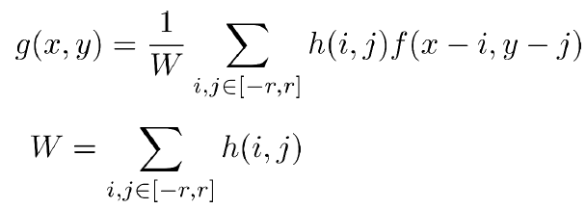
Image Filtering
Convolution
  Linear shift invariant (LSI)
Output size changed… ☹
Figure 3.10 from Computer Vision: Algorithms and Applications

Slide 7
Image Filtering
Padding
Zero padding
Symmetric
Replicate
Circular

Slide 8

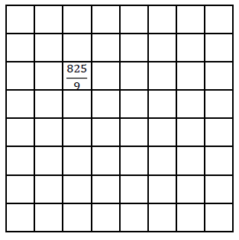


Image Filtering
Box filter
  Average filter
  Compute summation if ignoring 1/𝑁
  Complexity: 𝑂($r^{2}$)
Box filter

Slide 9
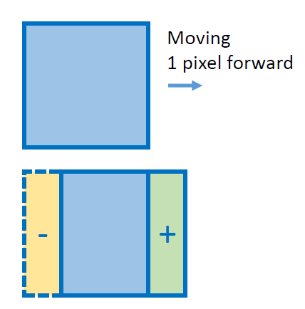
Image Filtering
Box filter in 𝑂(𝑟)
  Moving sum technique
Source: Ben Weiss

Slide 10

Image Filtering
Note: 𝑂(1)filter is also called constant time filter
Box filter in 𝑂(1)
  Integral image (sum area table)
    Computing integral image: 2 addition + 1 subtraction
    Obtaining box sum: 2 subtraction + 1 addition
    Regardless of box size
Sum = 24
19 + 17 –11 + 3 = 28
Sum = 48 –14 –13 + 3 = 24

Slide 11

Image Filtering
Gaussian filter
  The kernel weight is a Gaussian function
  Center pixels contribute more weights
1D illustration of Gaussian functions

Slide 12


Image Filtering
Gaussian filter
  2D case:
  Complexity: 𝑂($r^{2}$)

Slide 13
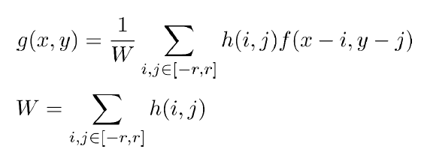
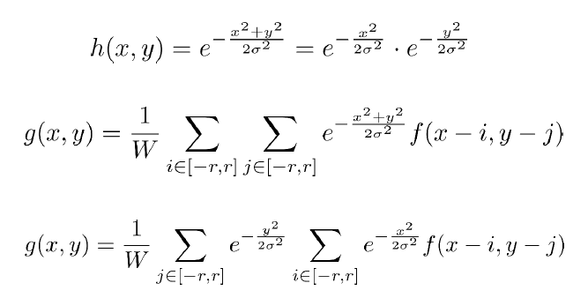
Image Filtering
Gaussian filter in 𝑂(𝑟)
  Gaussian kernel is separable
(The same technique can be applied to other separable)

Slide 14
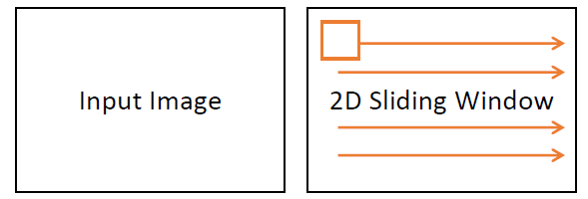
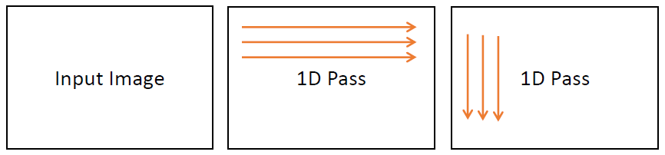

Image Filtering
Gaussian filter in 𝑂(𝑟)
Direct 2D implementation: 𝑂($r^{2}$)
Separable implementation: 𝑂(𝑟)

Slide 15
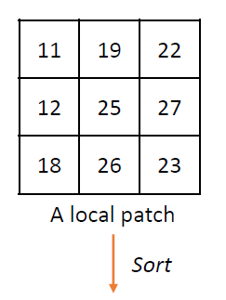
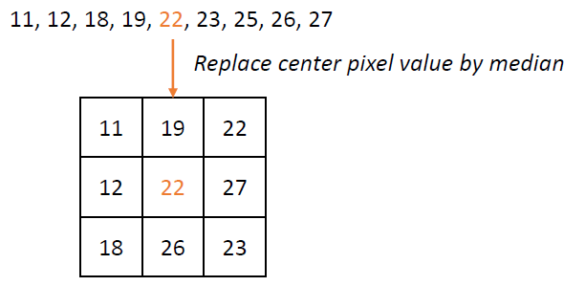
Image Filtering
Median filter
  3x3 example:

Slide 16
Image Filtering
Median filter
  Useful to deal with salt and pepper noise
Original
Add salt & pepper
Gaussian filter
Median filter
Source: https://www.pinterest.com/pin/304485624782669932

Slide 17
Edge Detection
Convert a 2D image into a set of curves
  Extract salient features of the scene
  More compact than pixels

Slide 18
Edge Detection
Origin of edges
surface color discontinuity
depth discontinuity
surface normal discontinuity
illumination discontinuity

Slide 19
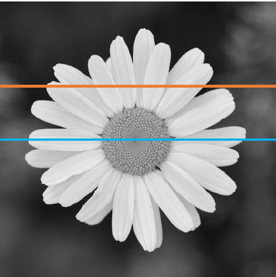
Edge Detection
Characterizing edges
Gradient magnitude

Slide 20

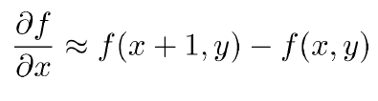
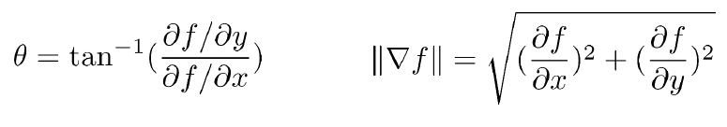
Edge Detection
How to compute gradient for digital images?
Take discrete derivative
Gradient direction and magnitude

Slide 21



Discrete Derivative
Backward difference Equivalent to convolve with:
Forward difference
Central difference
[1, -1]
[-1, 1]
[1, 0, -1]

Slide 22
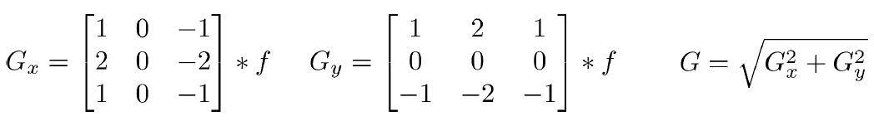
Edge Detection
Sobel filter
Input image
𝐺
After thresholding

Slide 23
Edge Detection
Effect of noise
  Difference filters respond strongly to noise
  Solution: smooth first

Slide 24

Edge Detection
Differentiation is convolution, which is associative:
This saves one operation!

Slide 25
Edge Detection
Tradeoff between smoothing and localization
  Smoothing filter removes noise but blurs edges ☹
No filtering
Gaussian filter, 𝜎=2
Gaussian filter, 𝜎=5

Slide 26
Edge Detection
Criteria for a good edge detector
  Good detection
    Find all real edges, ignoring noise
  Good localization
    Locate edges as close as possible to the true edges
    Edge width is only one pixel
Bad localization
Not edge
Missing edge

Slide 27
Edge Detection
Canny edge detector
  The most widely used edge detector
  The best you can find in existing tools like MATLAB, OpenCV…
Algorithm:
  Apply Gaussian filter to reduce noise
  Find the intensity gradients of the image
  Apply non-maximum suppression to get rid of false edges
  Apply double threshold to determine potential edges
  Track edge by hysteresis: suppressing weak edges that are not connected to strong edges

Slide 28
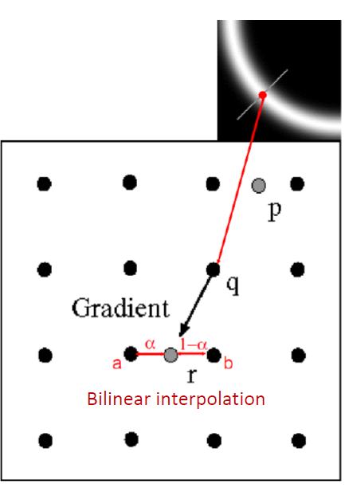
Non-Maximum Suppression
Gradient magnitude
After NMS

Slide 29
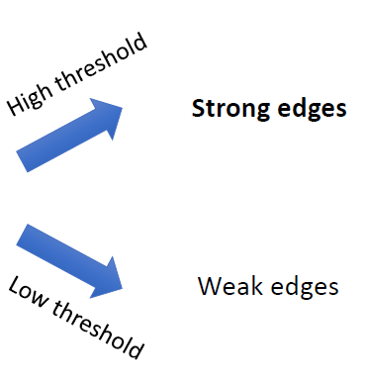
Double Thresholding

Slide 30
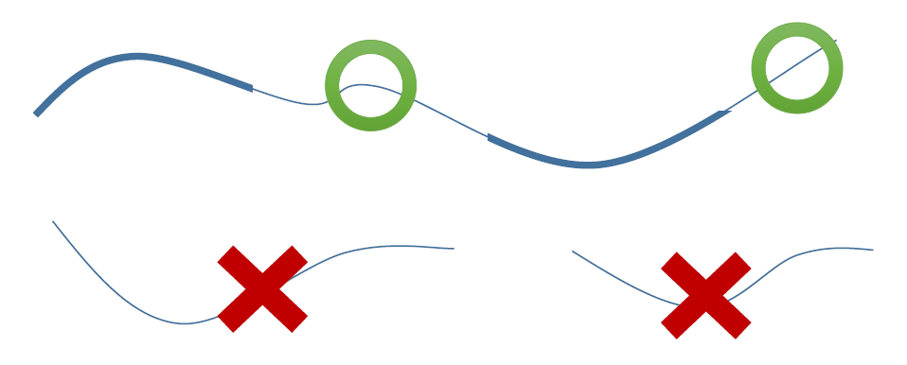
Hysteresis
Find connected components from strong edge pixels to finalize edge detection

Slide 31
Feature

Slide 32
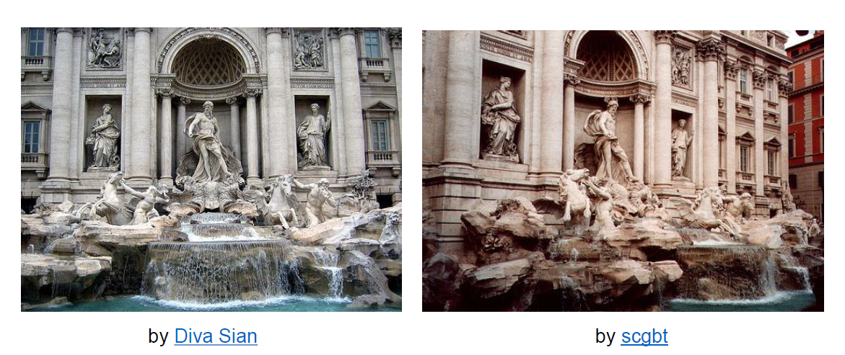
How the Visual Cortex Represents the World?
The same place?

Slide 33
The Requirement for the Features
We don’t make it by matching pixel values, but with some higher level information: features
Requirements
  Invariant: to lighting, color, rotation, scale, view angle…
  Locality: features are local, so robust to occlusion and clutter (no prior segmentation)
  Distinctiveness: individual features can be matched to a large database of objects
  Quantity: many features can be generated for even small objects
  Efficiency: close to real-time performance
  …

Slide 34
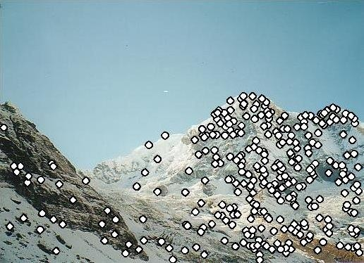
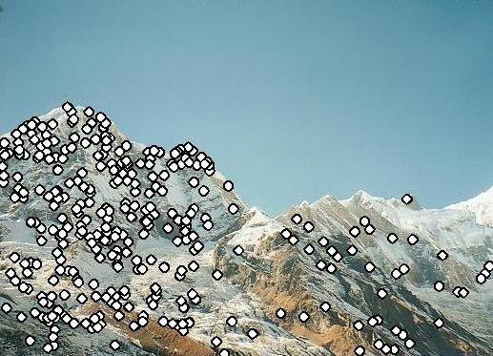
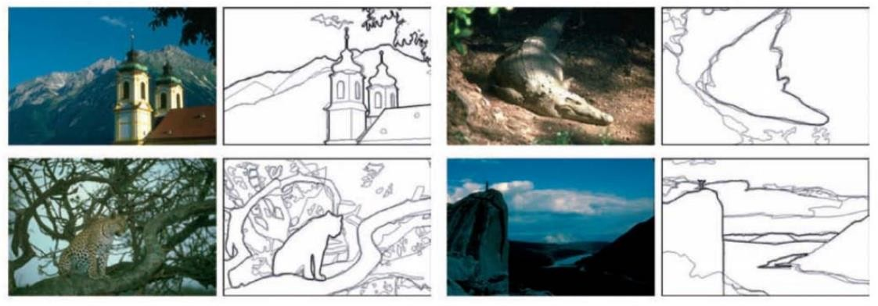
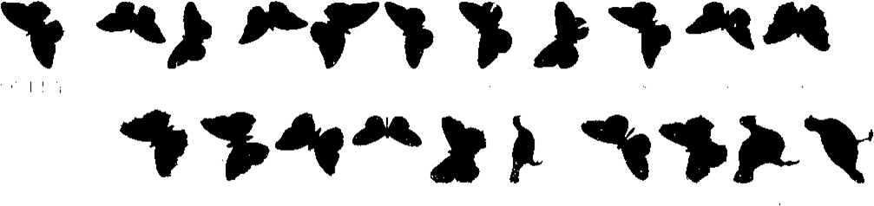
Features
Interest points
Edge and lines
Others

Slide 35
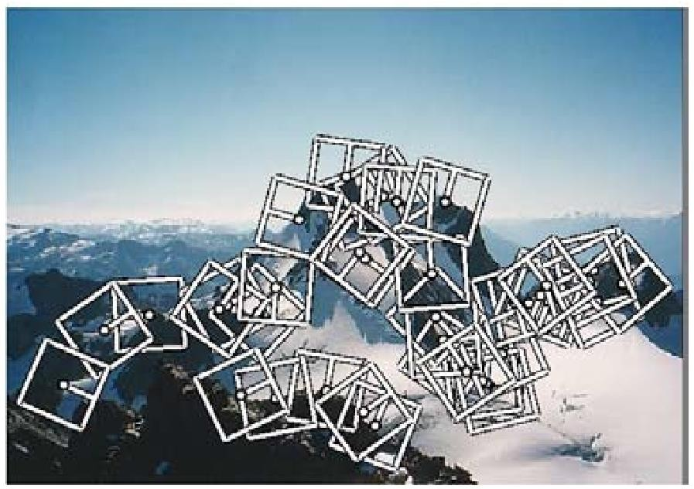
Keypoint Detection and Matching Pipeline
Feature detection
Feature description
Feature matching
Feature tracking

Slide 36
Feature Detection – Harris Corner Detector
Local measure of feature uniqueness
  How does the window change when you shift it?
  Shifting the window in any direction causes a big change
“flat” region:
no change in all directions
“edge”:
no change along the edge direction
“corner”: significant change in all directions
Slide adapted from Darya Frolova, Denis Simakov, Weizmann Institute.

Slide 37
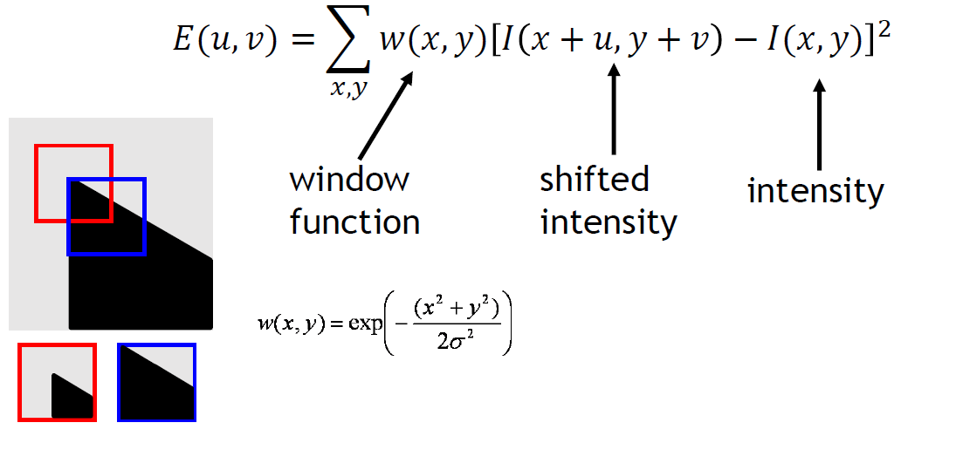
Feature Detection – Harris Corner Detector
Change of intensity for the shift (u,v):

Slide 38
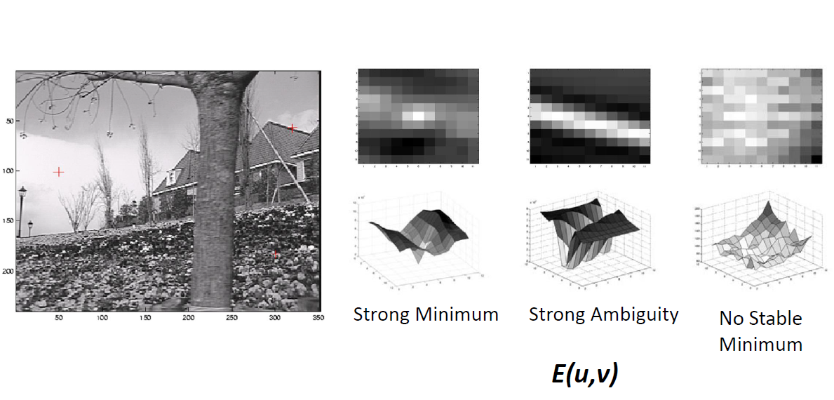
Feature Detection – Harris Corner Detector

Slide 39
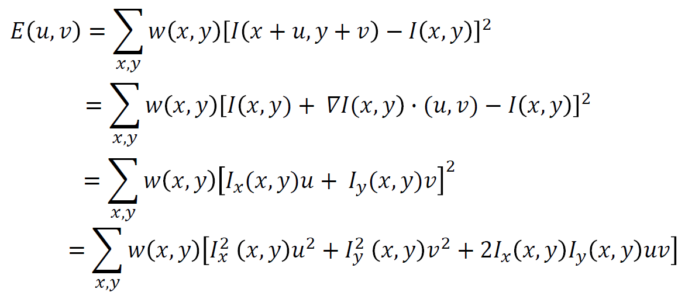
Feature Detection – Harris Corner Detector
Small motion assumption
→ use Taylor Series expansion

Slide 40
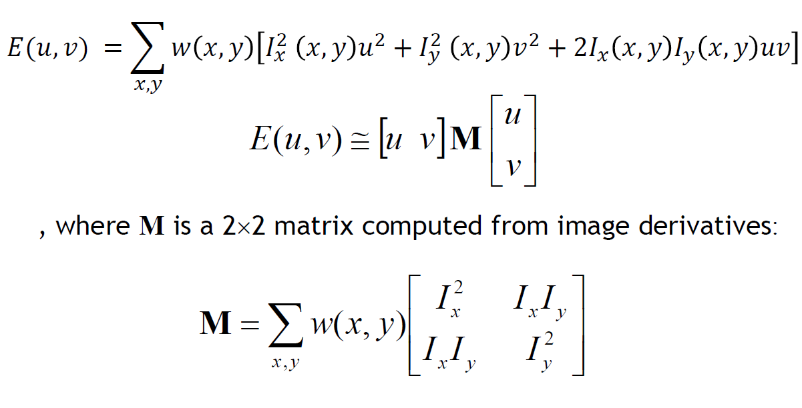
Feature Detection – Harris Corner Detector

Slide 41
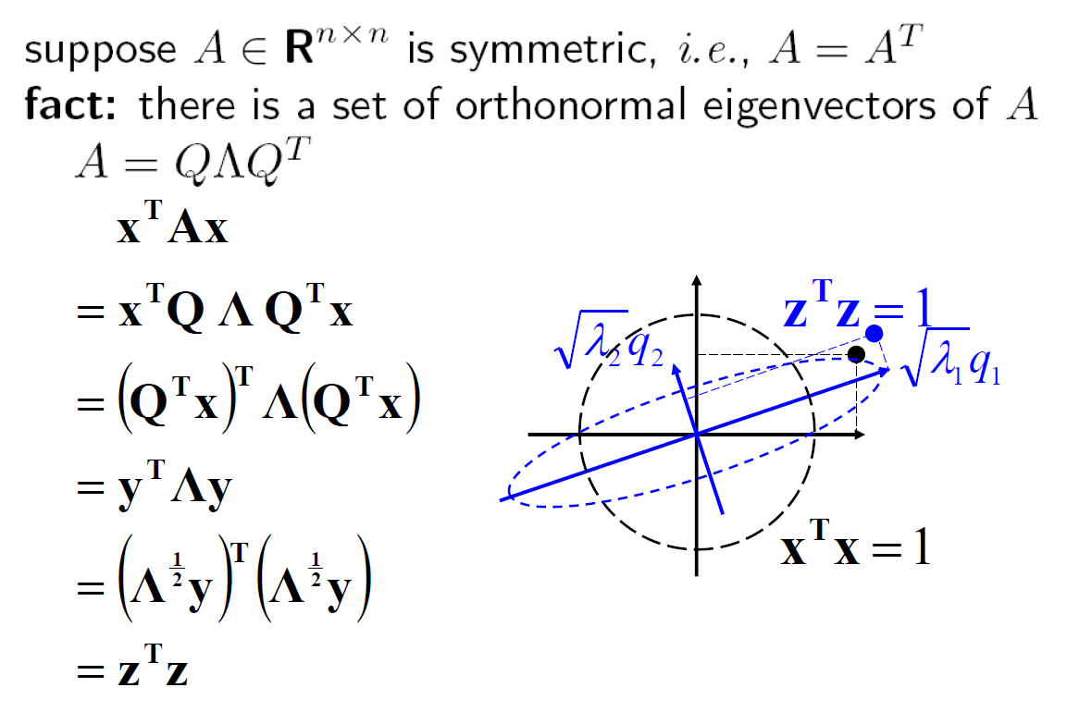
Eigenvectors of Symmetric Matrices

Slide 42
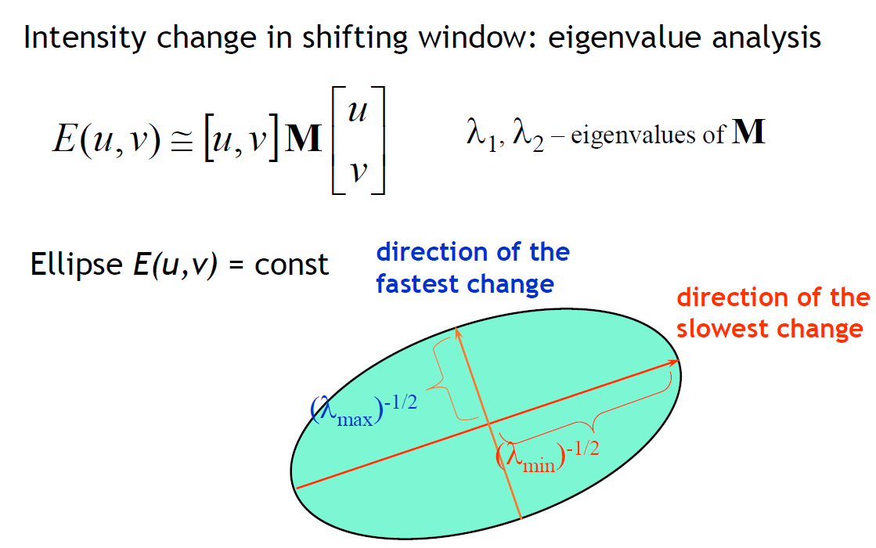
Feature Detection – Harris Corner Detector

Slide 43
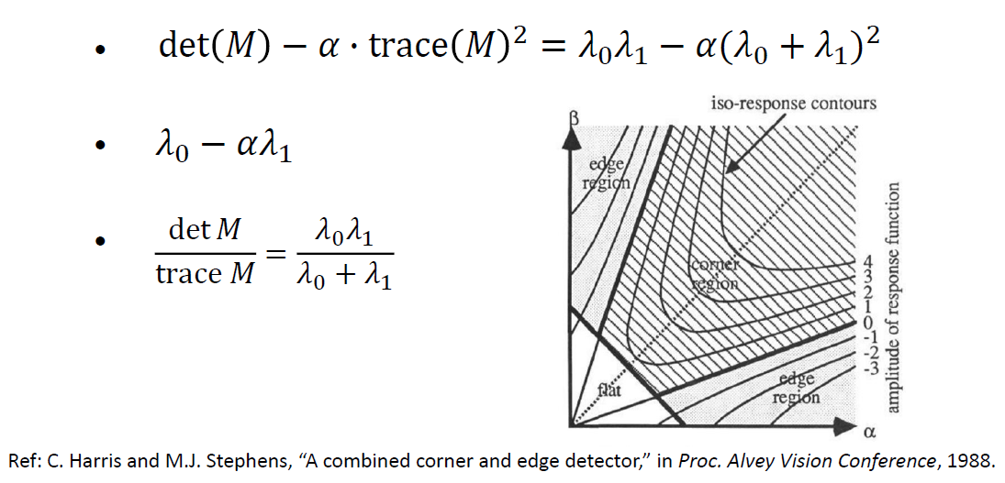
Feature Detection – Harris Corner Detector
Feature scoring function

Slide 44
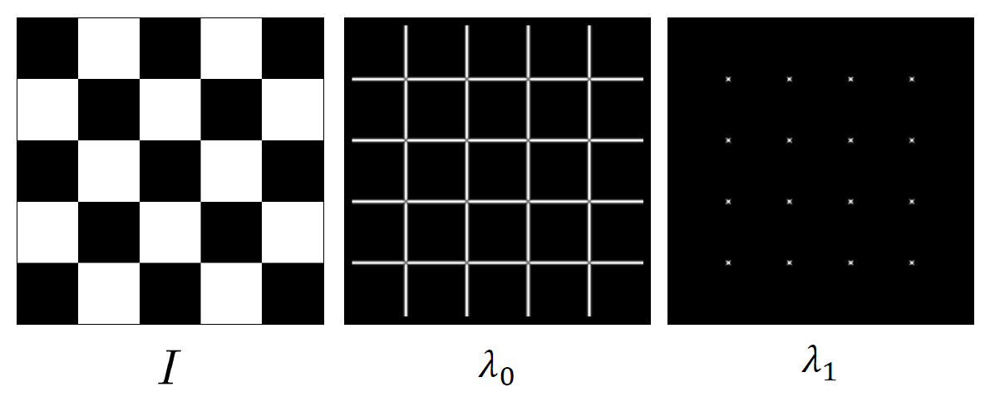
Feature Detection – Harris Corner Detector
Whole feature detection flow:
  Compute the gradient at each point in the image
  Create the M matrix from the entries in the gradient
  Compute the eigenvalues.
  Find points with large Feature scoring function

Slide 45
Harris Detector Example

Slide 46
Harris Detector Example
f value (red high, blue low)

Slide 47
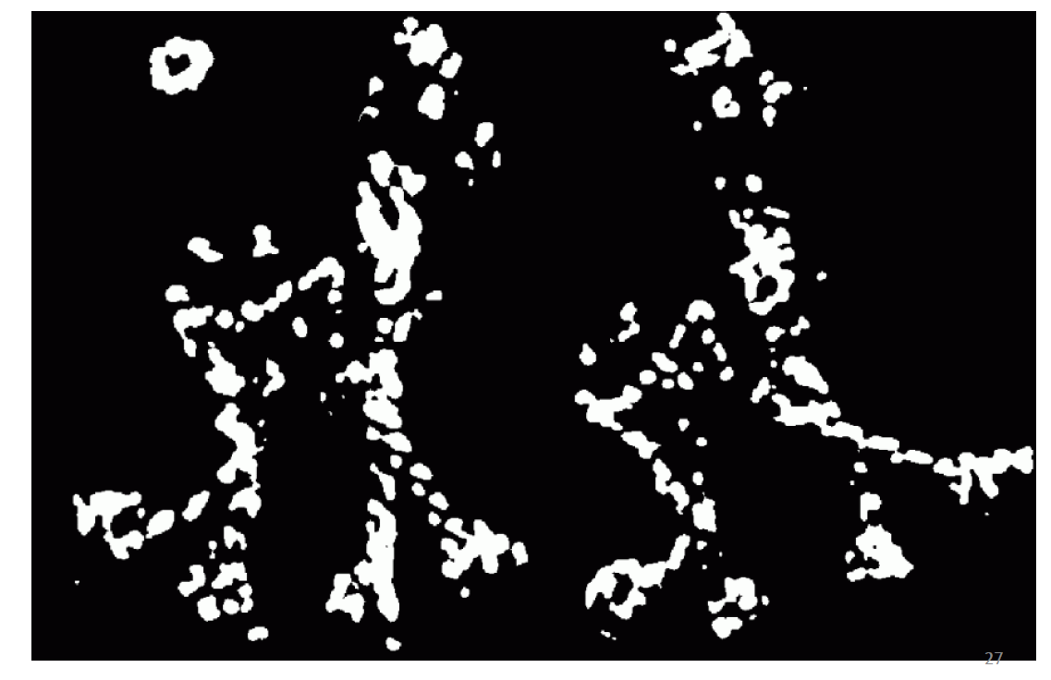
Harris Detector Example
Threshold (f > value)

Slide 48
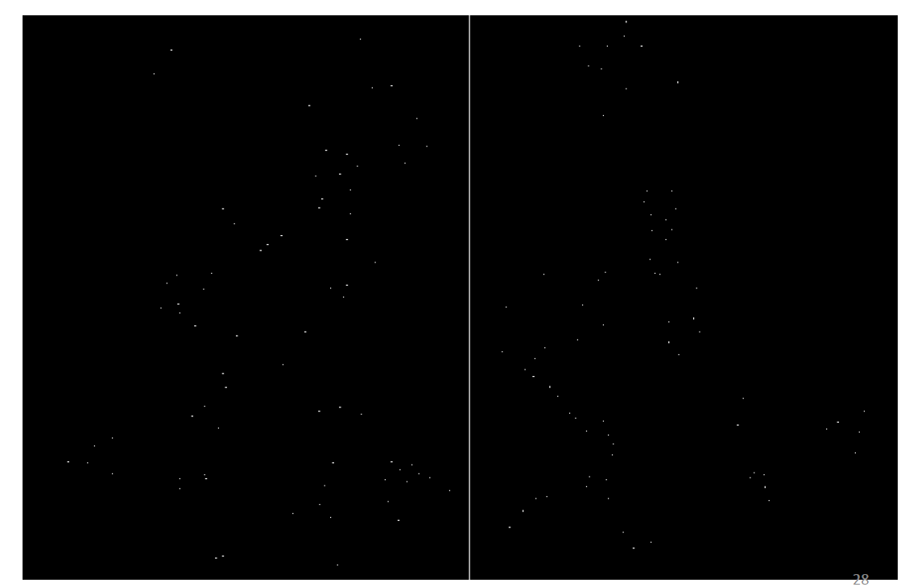
Harris Detector Example
Find Local Maxima of f

Slide 49
Harris Detector Example
Harris Features (in Red)

Slide 50
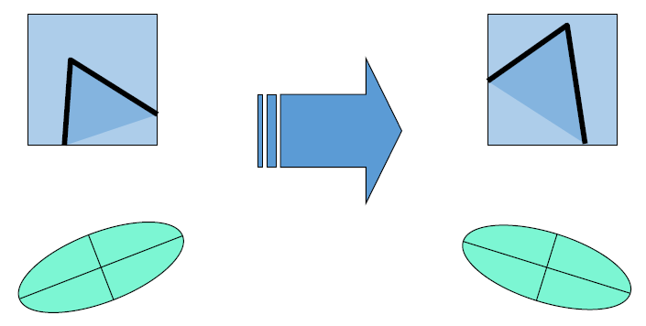
Harris Detector: Invariance Properties
Rotation
Ellipse rotates but its shape (i.e. eigenvalues) remains the same
Corner response is invariant to image rotation

Slide 51
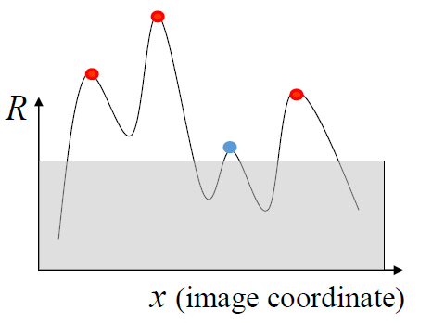
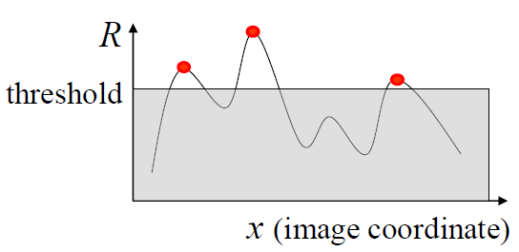
Harris Detector: Invariance Properties
Affine intensity change: I → aI + b
  Only derivatives are used =>
  invariance to intensity shift I → I + b
  Intensity scale: I → a I
Partially invariant to affine intensity change

Slide 52
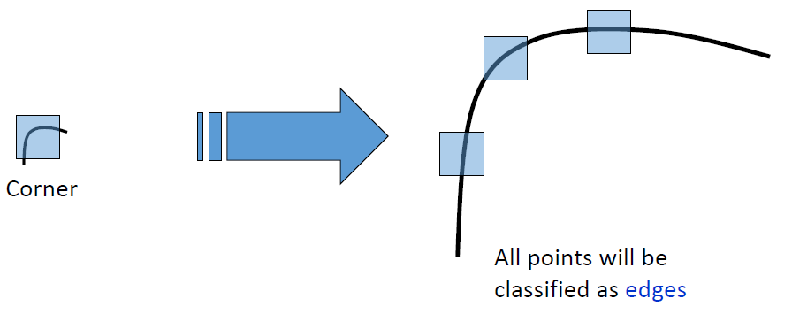
Harris Detector: Invariance Properties
Scaling
Not invariant to scaling

Slide 53
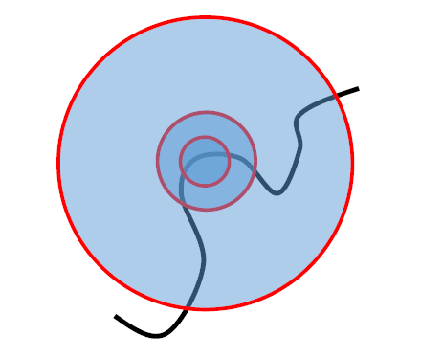
Scale Invariant Detection
Suppose you’re looking for corners
Key idea: find scale that gives local maximum of f
  in both position and scale
  One definition of f : the Harris operator

Slide 54
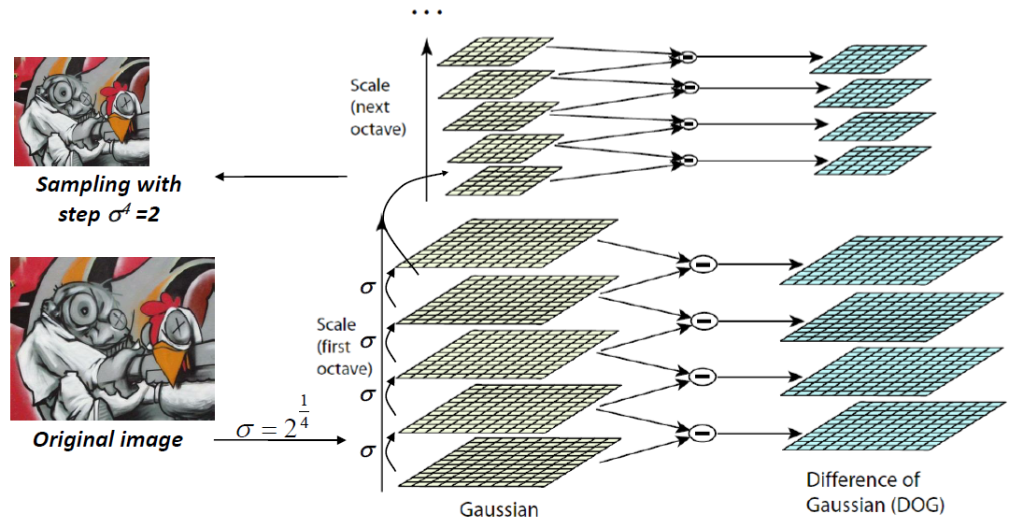
DoG – Efficient Computation
Computation in Gaussian scale pyramid
4
3
2

Slide 55
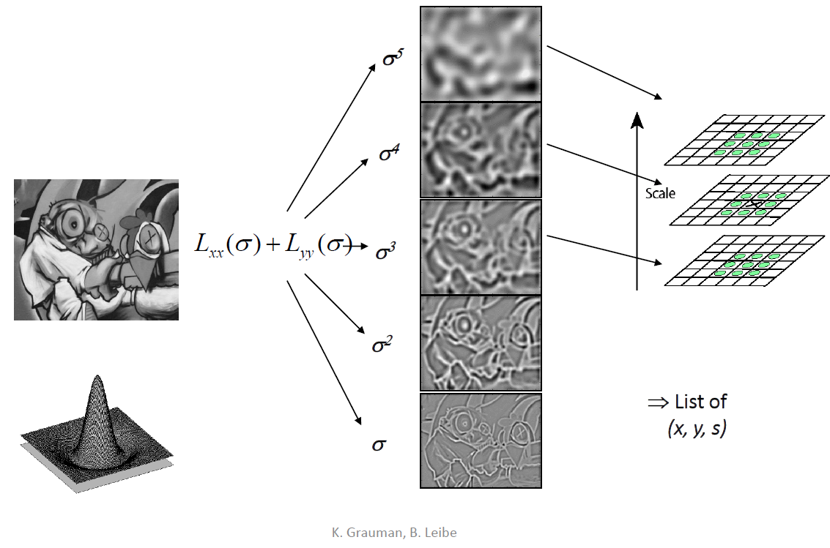
Find Local Maxima in Position-Scale Space of DOG

Slide 56
Results: Difference of Gaussian

Slide 57
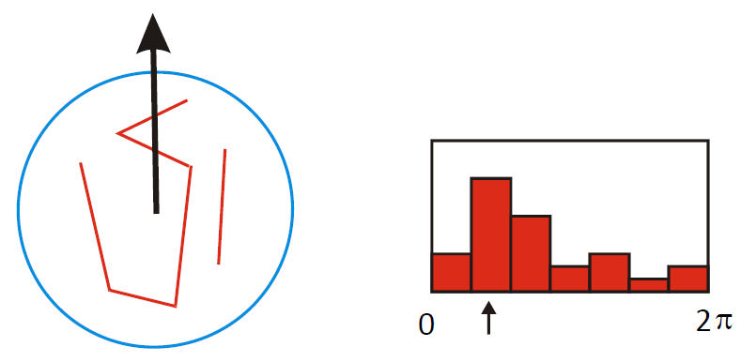
Orientation Normalization
Compute orientation histogram
Select dominant orientation
Normalize: rotate to fixed orientation

Slide 58
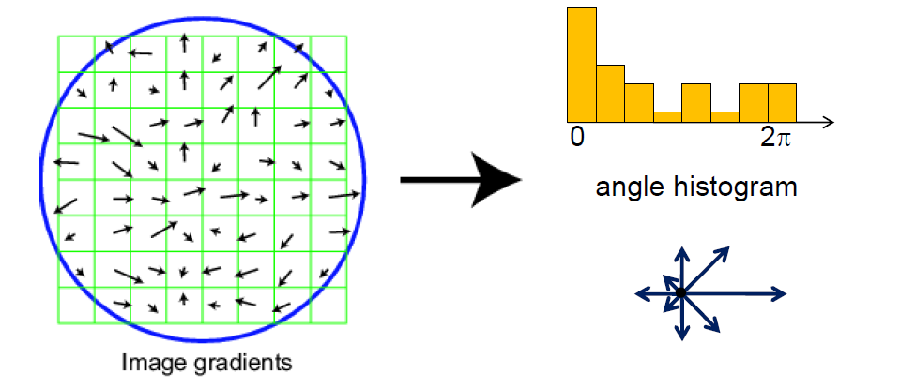
Scale Invariant Feature Transform
Basic idea:
  Take 16x16 square window around detected feature
  Compute edge orientation (angle of the gradient 90°) for each pixel
  Throw out weak edges (threshold gradient magnitude)
  Create histogram of surviving edge orientations

Slide 59
SIFT descriptor
Full version:
  Divide the 16x16 window into a 4x4 grid of cells
  (2x2 case shown below)
  Compute an orientation histogram for each cell
  16 cells * 8 orientations = 128 dimensional descriptor

Slide 60
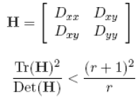
Details of Lowe’s SIFT algorithm
Run DoG detector
  - Find maxima in location/scale space
  - Remove edge points
Find all major orientations
  - Bin orientations into 36 bin histogram
    Weight by gradient magnitude
    Weight by distance to center (Gaussian weighted mean)
  - Return orientations within 0.8 of peak
    Use parabola for better orientation fit
For each (x, y, scale, orientation), create descriptor:
  - Sample 16 x 16 gradient mag. and rel. orientation
  - Bin 4 x 4 samples into 4 x 4 histograms
  - Threshold values to max of 0.2 , divide by L2 norm
  - Final descriptor: 4 x 4 x 8 normalized histograms

